Slide 1
Reading from files
Shiva K

Slide 2
How to read from a file?
read,readline,reader

Slide 3
Writing something down to remember it is only helpful,if you can read it later when you need.
Reading a shopping list at grocery store so you know what to buy.
Checking number of guests in a guest list to check if you enough food for all.
Looking up a phone number so you can call someone.

Slide 4
In programs we often have to read information that is saved in files.
If you open your e-book reader, it looks up what page you were on, when you shut down.
When you start up your game, it looks for what treasures you already collected so you can pick up where you left off.
There are also thousands of interesting open data files out there to find cool information you can use in your programs.For example.what fauna is available at the museaum in Tasmania .(You will be amazed at the information available over the Internet)

Slide 5
Text files.

Slide 6
How do we read a file with code?
Use the open function.
- myFile = open(fileName,accessMode)
Looks familiar! yes, we use the same method that we used to write to a file.
So how does the program know whether to read or write?
The access mode

Slide 7
Access Modes
Access mode | Action
r | Read the file
w | Write to the file
a | Append to the file content
b | Open a binary file

Slide 8
How do you read the file content?
Use the read function.
- fileContent = myFile.read()
The read method will read the entire file contents into a specified string variable.

Slide 9
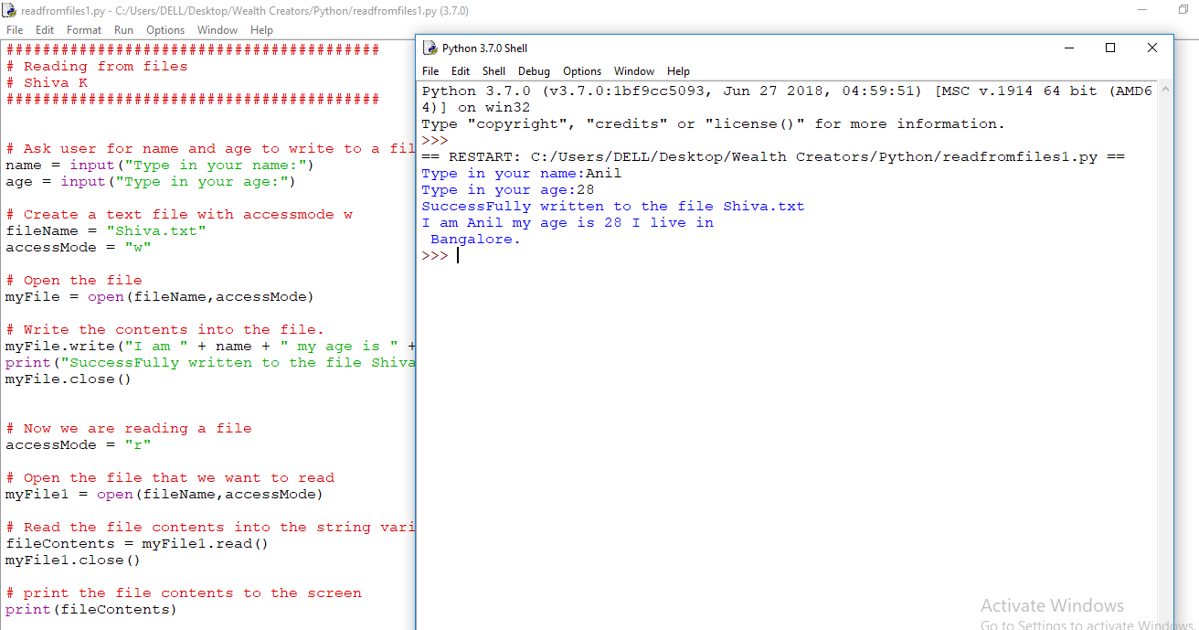

Slide 10
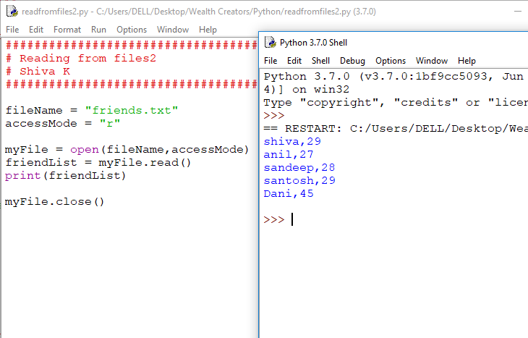

Slide 11
CSV files

Slide 12
If you are reading a CSV file,there is a csv library that will help you do this.
To access the features in csv library,you must import it
import csv

Slide 13
Now, you can use the reader function to return all the records in a csv file to a list.
The reader function will take an open csv file and return each row into a list.
- dataFromFile = csv.reader(mycsvfile)
If your file is not using comma to separate the values, you can tell the reader function as to what character is used as delimeter. dataFromFile = csv.reader(mycsvfile,delimiter = “,”)

Slide 14
Now,we can open and read a csv file.
fileName = “guests.txt”
accessMode = “r”
with open(fileName,accessMode) as myCSVFile:
dataFromFile = csv.reader(myCSVFile)

Slide 15
Why do we have ‘with’ and ‘:’?
Programs should always open a file and close it when they are finished reading.
If they don’t sometimes, the code crashes when you try to reopen a file that is not closed.
The ‘with’ and ‘:’ is used for certain methods to make sure to clean up your code and close file runs even if there is an error

Slide 16
Once we have all the rows from CSV files,how we do we access individual rows?
Use for loop to loop through the values in the list.
Each row will be one value
with open(fileName,accessMode) as myCSVFile:
dataFromFile = csv.reader(myCSVFile)
for row in dataFromFile:
print(row)

Slide 17
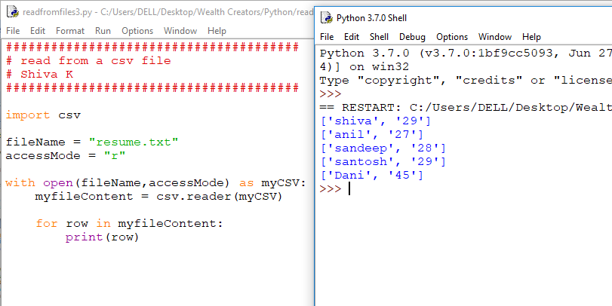

Slide 18
What if I want to access individual value from list not just row?
The row returned in the loop was the list of values .
So you create a nested loop to loop through list of values.
for row in dataFromFile:
for value in row:
print(value)

Slide 19
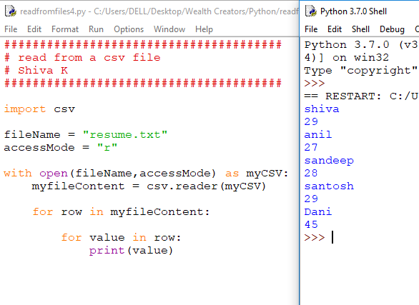

Slide 20
But,I don’t like those square brackets and quotes for the rows?
You can use the join function to format the output.
for row in dataFromFile:
print(‘,’.join(row))

Slide 21
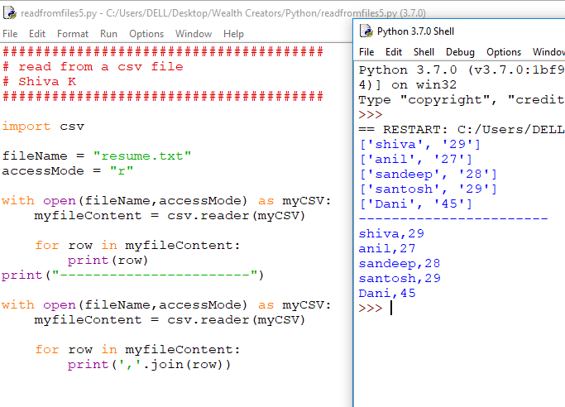

Slide 22
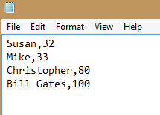
Your challenge!
Write a program that will print the names and ages of the guests file you created in last module.
If you didn’t do it,you can write a program to write to text file as below.

Slide 23
Congratulations!
You can write a program that can receive or retrieve information from a file.

