Slide 1
Remembering lists.
Shiva K

Slide 2
Sometimes you have to remember list of values.
I have to remember names of all the members who are coming to a party.
I want to remember the scores of all my subjects.
I want to remember the directions to get to the docter.

Slide 3
Multiple values

Slide 4
Lists allow you to store multiple values
guests = [‘Shiva’,’Pavan’,’Shubham’,’Depanshu’]
Scores = [93,94,78,65,79]

Slide 5
You can create an empty list and add values later.
guests = []
Scores = []

Slide 6
You can reference any value in the list by just specifying its position.
guests = [‘Shiva’,’Pavan’,’Shubham’,’Depanshu’]
# prints the third value in the list
print(guests[2])
Scores = [93,94,78,65,79]
# access the first value in the list
print(Scores[0])

Slide 7
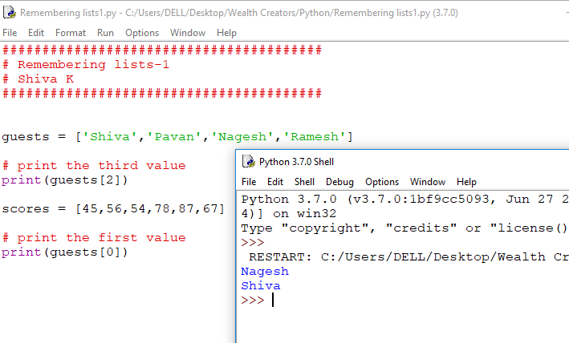

Slide 8
Geek tip!
We call the position of the item in list ‘index’.

Slide 9
You can even count backwards!
guests = [‘Shiva’,’Pavan’,’Shubham’,’Depanshu’]
# print last entry in the list
print(guests[-1])
#print second last entry in the list
print(guests[-2])

Slide 10
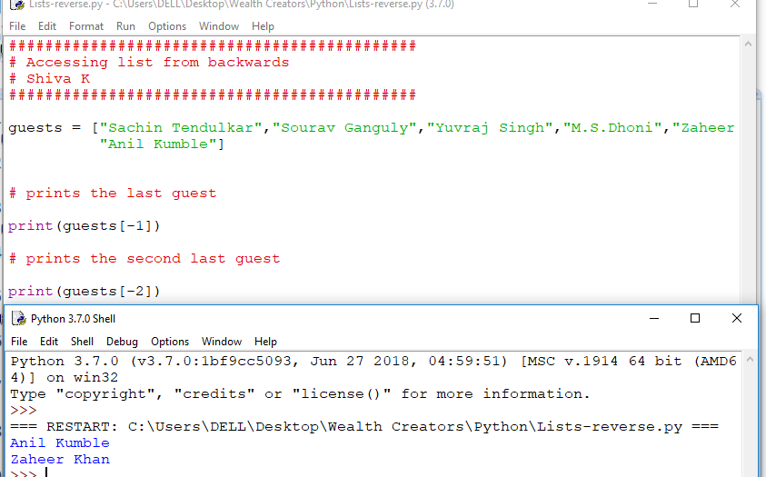

Slide 11
Updating a list!

Slide 12
You can change a value in a list!
guests = [‘Shiva’,’Pavan’,’Shubham’,’Depanshu’]
# print first element in the list
print(guests[0])
guests[0] =“Ramesh”
#prints the new entry in the list
print(guests[0])

Slide 13
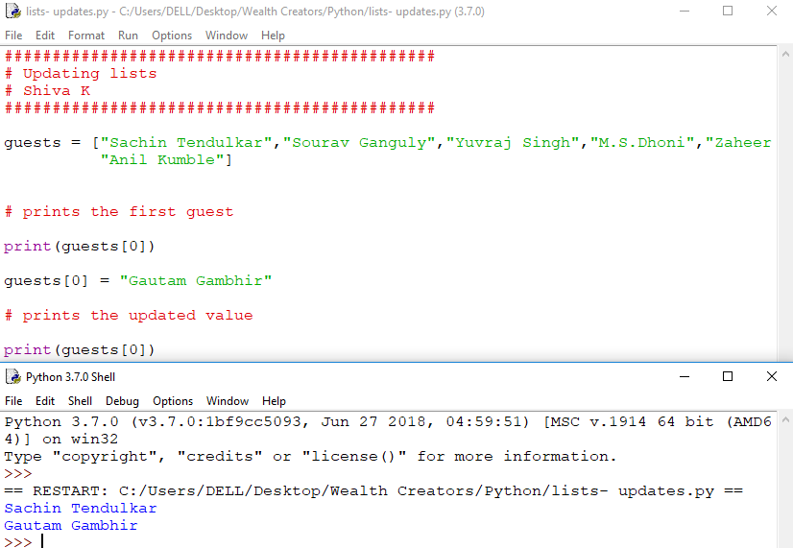

Slide 14
You can add value to a list using an append()
guests = [‘Shiva’,’Pavan’,’Shubham’,’Depanshu’]
# update the list with a new value at the end
guests.append(“Ramesh”)
for guest in guests:
print(guest)

Slide 15
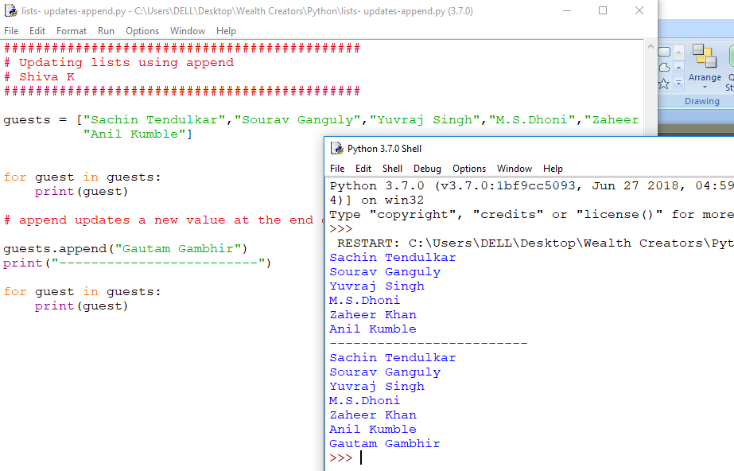

Slide 16
You can delete a value using a remove function.
guests = [‘Shiva’,’Pavan’,’Shubham’,’Depanshu’]
# update the list with a new value at the end
guests.remove(’Shubham’)
for guest in guests:
print(guest)

Slide 17
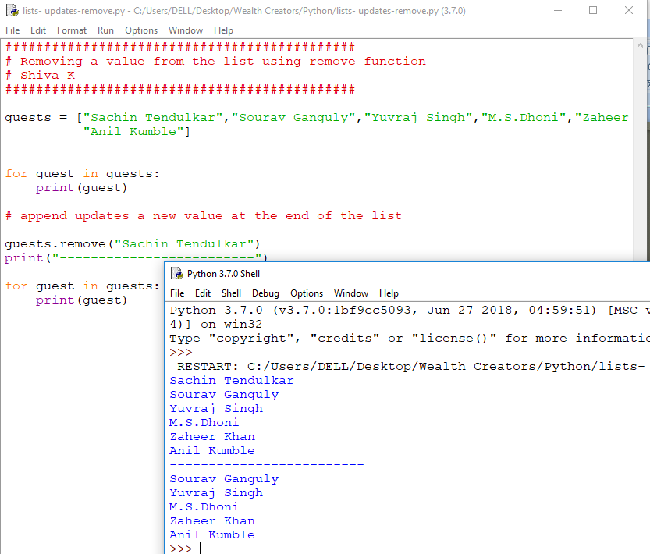

Slide 18
You can use del command to delete an entry from list.
guests = [‘Shiva’,’Pavan’,’Shubham’,’Depanshu’]
# update the list with a new value at the end
del guests[1]
for guest in guests:
print(guest)

Slide 19
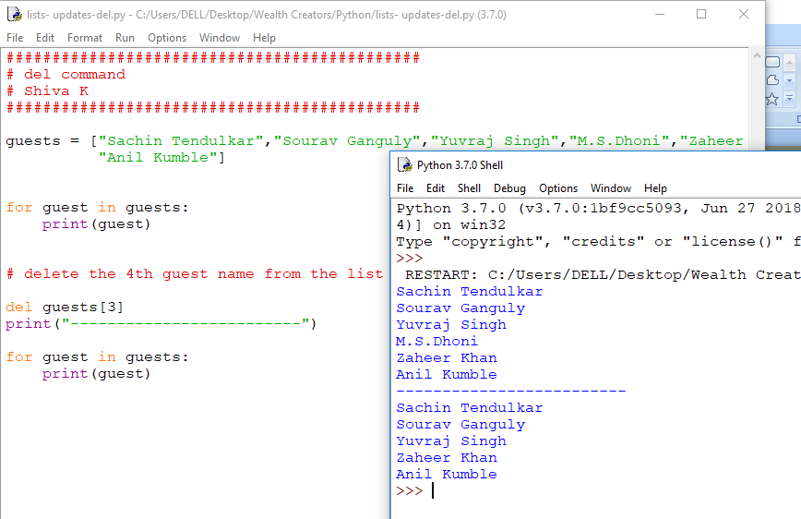

Slide 20
Finding Values

Slide 21
The index() function will search the list and return the index of the position where the value was found.
guests = [‘Shiva’,’Pavan’,’Shubham’,’Depanshu’]
# returns the index of the position of the value ‘Shubham’
print(guests.index(‘Shubham’))
This will return the index of the position of the value ‘Shubham’ in the list.

Slide 22
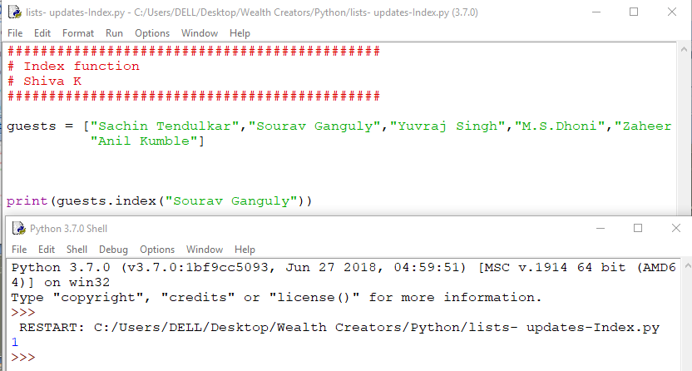

Slide 23
What do you think will happen if we search for a value that does not exist in the list.
guests = [‘Shiva’,’Pavan’,’Shubham’,’Depanshu’]
# returns the index of the position of the value ‘Shubham’
print(guests.index(‘Steve’))
The code crashes,
We need to add error handling or find another way to go through the index to find the value.

Slide 24
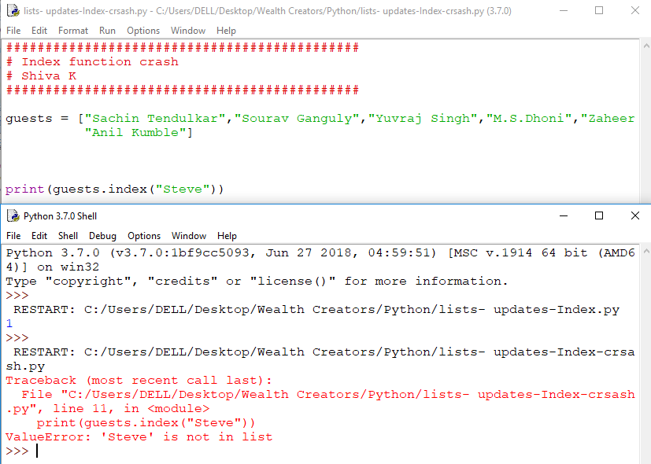

Slide 25
Displaying values

Slide 26
Use a loop
employees = [ ‘Steve’, ‘Ramsey’, ‘Ozil’, ‘Xzaka’]
for steps in range(4):
print(employees[steps])

Slide 27
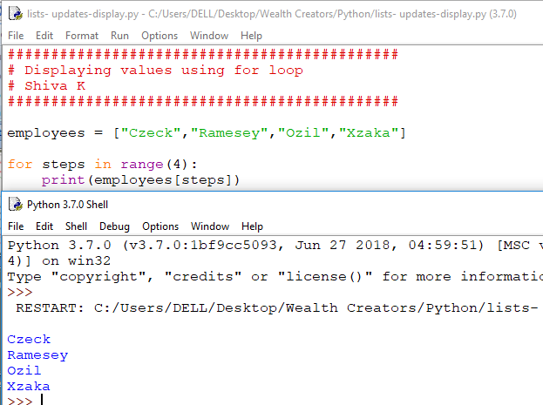

Slide 28
What if I do not know how many values are there in the list?
Use len() function to get the length(size) of the list.
employees = [ ‘Steve’, ‘Ramsey’, ‘Ozil’, ‘Xzaka’]
numberOfemployees = len(guests)
for steps in range(numberOfemployees): print(employees[steps])

Slide 29
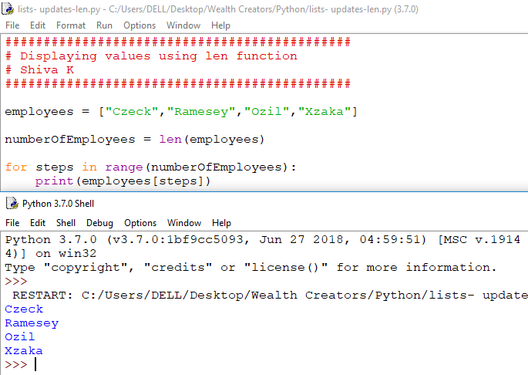

Slide 30
There is even an easier way to go through the all the values of a list.
employees = [ ‘Steve’, ‘Ramsey’, ‘Ozil’, ‘Xzaka’]
for employee in employees:
print(employee)

Slide 31
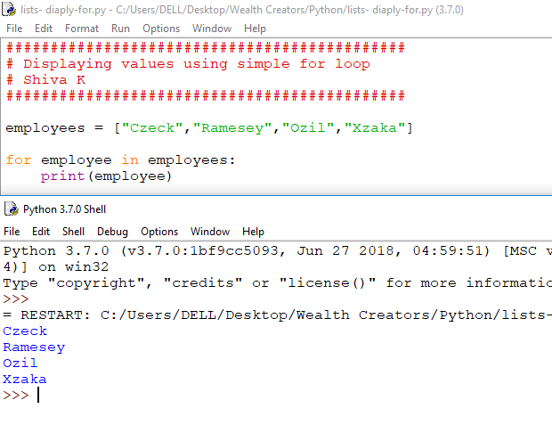

Slide 32
Want to sort your list?

Slide 33
You can sort your list with the sort function
myFbFrnds = [ ‘Steve’, ‘Ramsey’, ‘Ozil’, ‘Xzaka’]
# sorts the list in Alphabetical order
myFbFrnds.sort()
for frnd in myFbFrnds:
print(frnd)

Slide 34
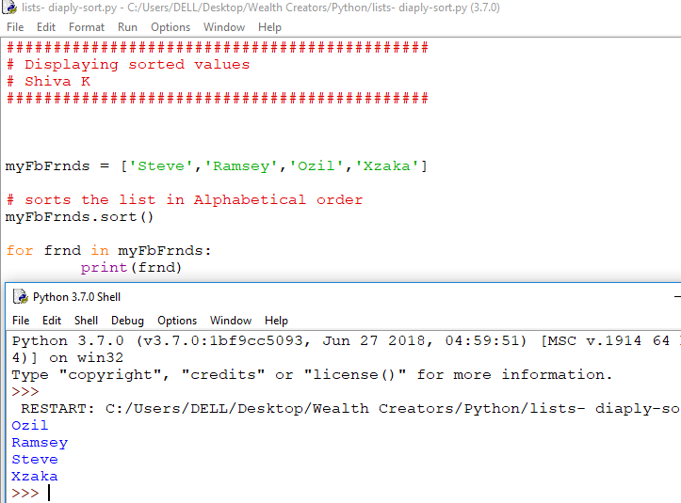

Slide 35
Your challenge, starting to get harder.
Ask the user to enter the names of everyone attending the party.
Then return the list of party guests in alphabetical order
This will require pulling through everything we learned so far. So, let’s walk through the thought process of idea to code.

Slide 36
Break the problem into steps
Ask the user to enter the names of the guests.
Put those values in a list.
Sort the list.
Print the sorted list.

Slide 37
Ask the user to enter the names of the guests.
What command do we use to ask the user for input.
- Input function
What kind of variable will we need to store the user names?
- list
How can I ask the user for more than one name?
- use loop

Slide 38
Should we use for loop or while loop?
Do you know how many times the user will enter?
- No,that means we do not know how many times the loop will execute, so we need to use while loop.
How will the loop know when to stop executing?
- We will have user enter a special keyword when they are done.
.

Slide 39
2.Put those values in a list.
Declare an empty list
Each time a new name is entered add it to the list.
.
Notes:
D

Slide 40
3. Sort the list
Once the values are entered, then use the function on the list to sort them in alphabetical order.
.
Notes:
D

Slide 41
4.Print the sorted list.
Use a loop to go through the values in the list.
For each value, print the name.
.
Notes:
D

Slide 42
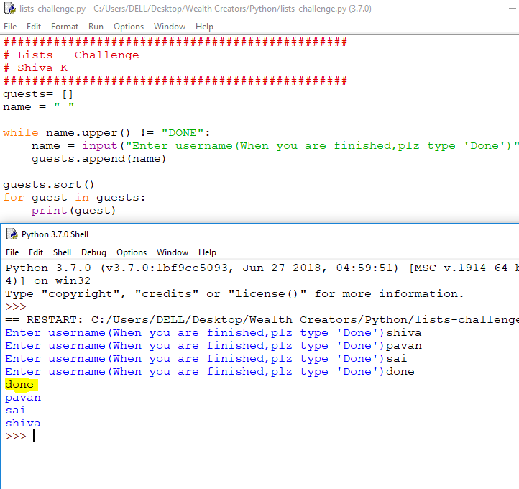

Slide 43
Done is also appended to the list which we indicated as an End Of String.
How to avoid that?
Notes:
D

Slide 44
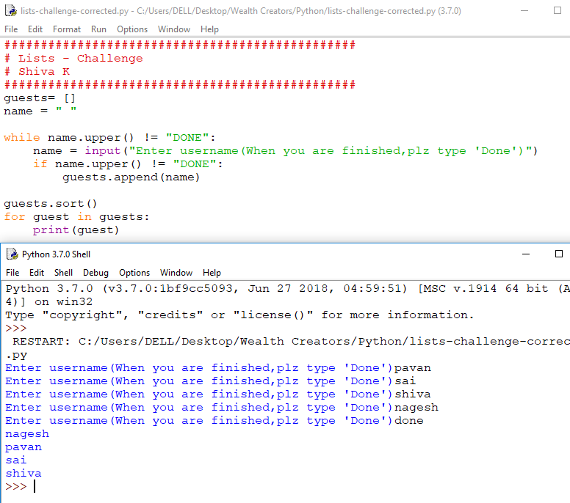

Slide 45
Congratulations!
You can now remember a list of different values.
You can search the list for specific value
You can sort the list.
You can read through all the values in the list.
Notes:
D

