Slide 1
Repeating Events Until Done: While loops..
Shiva K

Slide 2
Sometimes, we need to repeat a task more than once.
Pour a cup of coffee for each guest.
Wash the dishes until they are clean.
Make a name card for each guest attending a party.

Slide 3
Loop an unknown number of times

Slide 4
For loops allow us to execute the code fixed number of times.
So,if we know there are twenty guests, we can print twenty invitation cards
for steps in range(20) :
...................

Slide 5
What if we don’t know exactly how many times the code need to be repeated?
Keep guessing until you get the right answer.
Wash the dishes until they are clean.
Read all the values in a file or a database.

Slide 6
While loops allow you to execute until a particular condition is true.
answer = “0”
while answer != “4”:
answer = input(“What is 2 + 2?”)
print(“Yes!,2 + 2 is 4”)

Slide 7
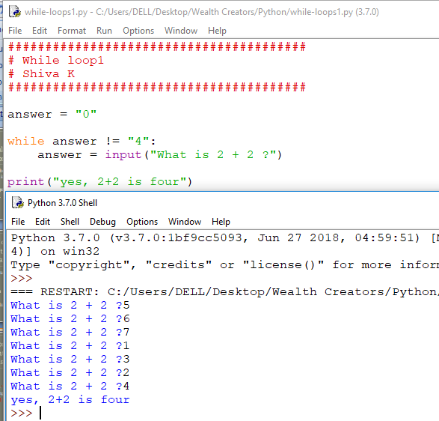

Slide 8
Can you figure out what this code will do?
import turtle
count = 0
while count < 4:
turtle.forward(100)
turte.right(90)
count = count + 1

Slide 9
Yes, it will draw a square.

Slide 10
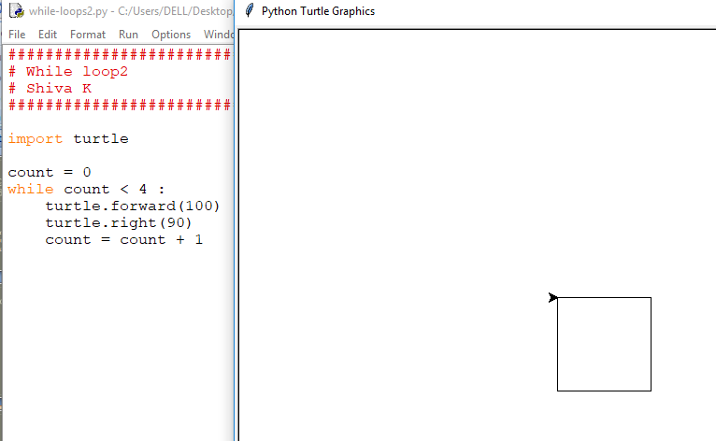

Slide 11
While loops can be used instead of for loops!
for steps in range(4):
turtle.forward(100)
turtle.right(90)
Count = 0
while count < 4:
turtle.forward(100)
turtle.right(90)
count = count + 1
Both will have the same result!

Slide 12
How many lines the following code draws?
count = 0
while count <= 4:
turtle.forward(100)
turtle.right(90)
count = count + 1
It will actually draw five lines, not four.

Slide 13
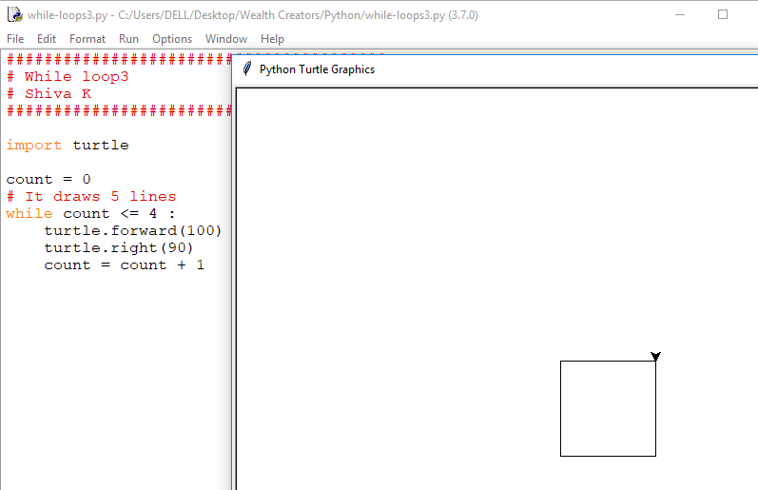

Slide 14
How many lines the following code draws?
count = 1
while count < 4:
turtle.forward(100)
turtle.right(90)
count = count + 1
It will actually draw three lines, not four.

Slide 15
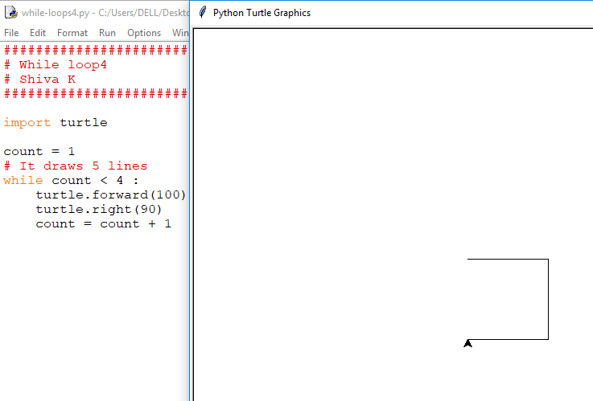

Slide 16
Looping issues

Slide 17
How many lines the following loop draws?
count = 1
while count < 4:
turtle.forward(100)
turtle.right(90)

Slide 18
Trick question! It will execute forever.How can value of count get updated? It will remain one and keep on rotating.
count = 1
while count < 4:
turtle.forward(100)
turtle.right(90)
This is called an endless loop.

Slide 19
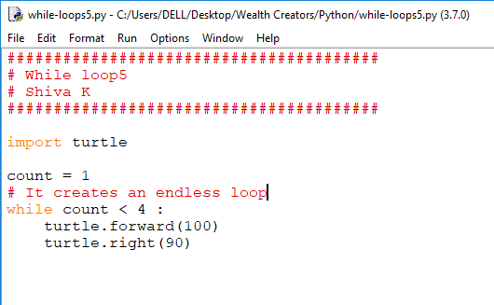

Slide 20
How to get out of an endless loop?

Slide 21
How to get out of an endless loop?
It is easier to commit mistake with while loop compared with for loop.
Use for loops wherever possible.

Slide 22
Do not fear the while loop!
You will encounter the problem where while loop is the only solution.
They are often used in reading data(read until no more data).

Slide 23
Your challenge
Create an etch sketch program
Have the user enter pencUsolor,line length and an angle.
Use turtle to draw a line based on the specifications.
Let the user specify new lines over and over till enter line length of zero.
When the user specifies line length of zero, stop drawing!

Slide 24
Congratulations!
You can manage problems which require repeating the same task and end when specific condition occurs.

