Slide 1
Repeating Events: for loops...
Shiva K

Slide 2
Some times, we need to perform an action more than once.
Pour a cup of coffee for each guest
Wash the dishes until they are all clean
Make a name card for each guest a attending a party

Slide 3
In code, we use loops to repeat a task.
We are going to have some fun in this module by drawing objects.
We will loops to draw these objects.

Slide 4
Hello,turtle

Slide 5
Did you know Python can draw?
import turtle
turtle.forward(100)

Slide 6
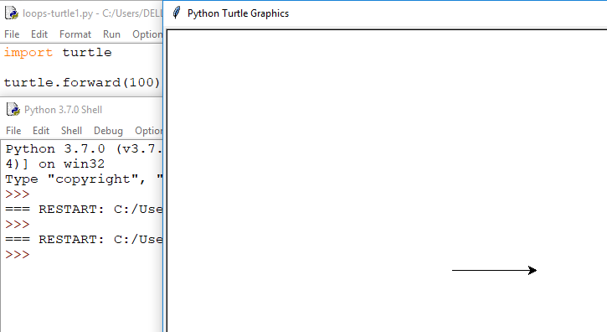

Slide 7
turtle is a library that lets you draw
import turtle
turtle.color(‘Green’)
turtle.forward(100)
turtle.right(45)
turtle.color(‘blue’)
turtle.forward(50)
turtle.right(45)
turtle.color(‘pink’)
turtle.forward(100)

Slide 8
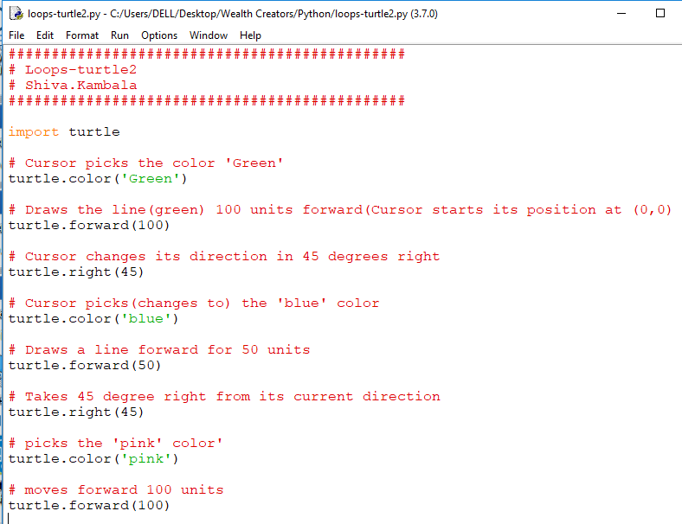

Slide 9
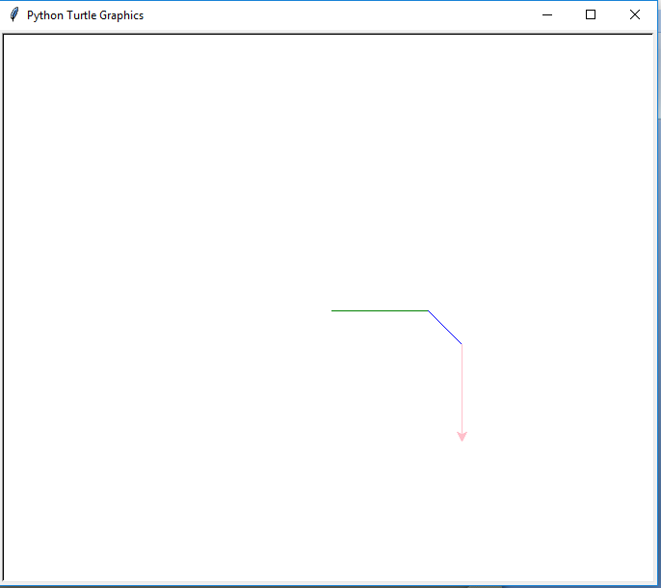

Slide 10
You can probably guess,what turtle commands do!
Command | Action
right(x) | Rotate right x degrees
left(x) | Rotate left x degrees
color(‘x’) | Change pen color to x
forward(x) | Move forward x
backward(x) | Move backward x

Slide 11
for loops

Slide 12
How would we get turtle do draw a square?
import turtle
# we repeat the two lines using loops
turtle.color(‘Green’)
turtle.forward(100)

Slide 13
Loops allow us to repeat the same line of code as often as we want..
import turtle
for steps in range(4):
turtle.forward(100)
turtle.right(90)

Slide 14
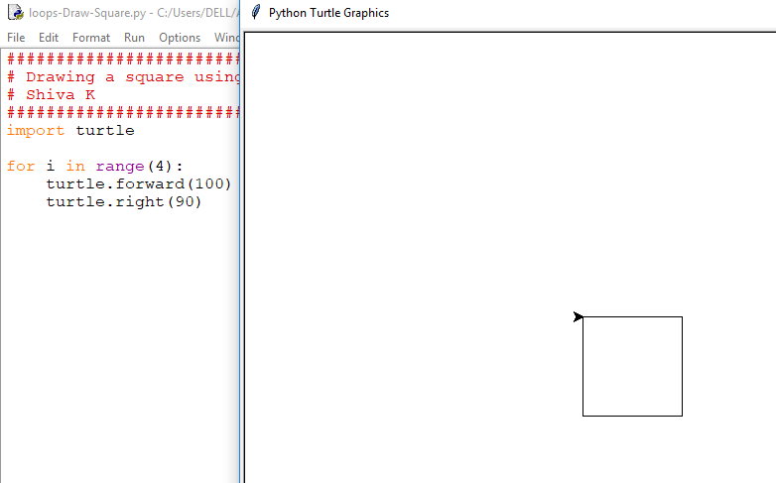

Slide 15
Only the intended code is repeated
import turtle
for steps in range(4):
turtle.forward(100)
turtle.right(90)
turtle.color(‘red’)
Turtle.forward(200)

Slide 16
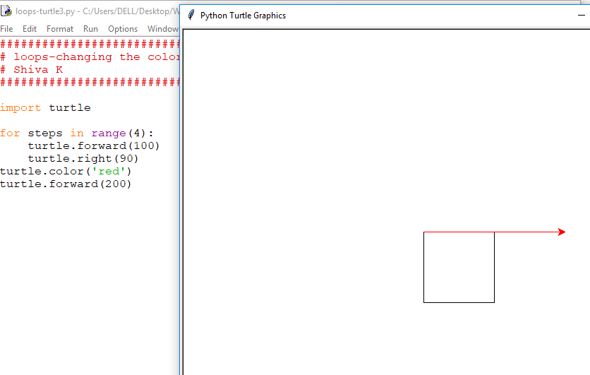

Slide 17
Nested loops

Slide 18
You can have lots of fun when loop is placed inside another loop!
import turtle
for steps in range(4):
turtle.forward(100)
turtle.right(90)
for moreSteps in range(4):
turtle.forward(50)
turtle.right(90)

Slide 19
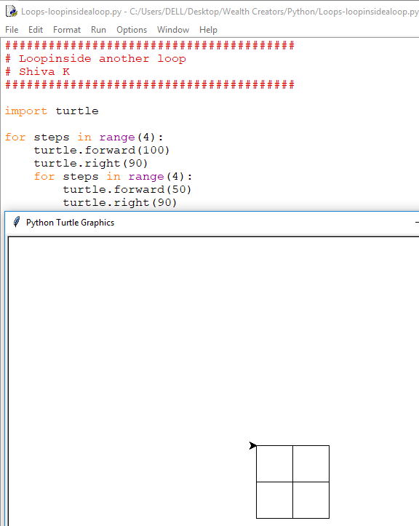

Slide 20
Just for fun
import turtle
for steps in range(5)
turtle.forward(100)
turtle.right(360/5)
for moreSteps in range(5):
turtle.forward(50)
turtle.right(360/5)

Slide 21
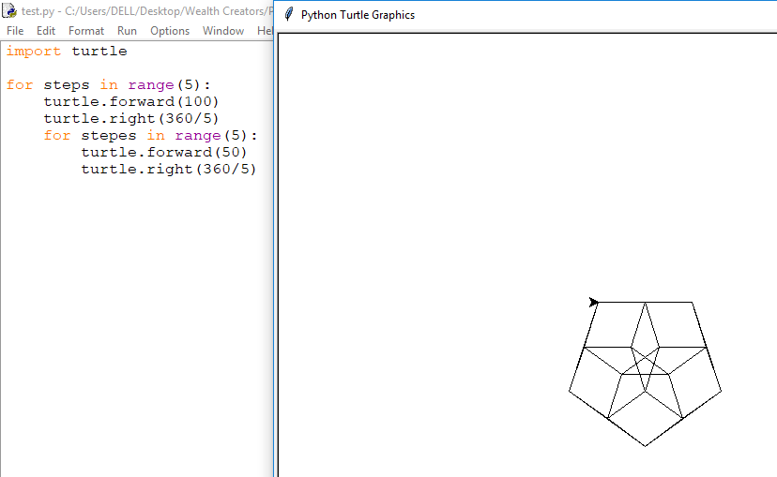

Slide 22
Variables in loops

Slide 23
We could use a varible to decide the number of sides our object will have.
import turtle
numberOfSides = int(input(“Enter number of sides of the Object:”))
for steps in range(numberOfSides):
turtle.forward(100)
turtle.right(360 / numberOfSides)
for steps in range(numberOfSides):
turtle.forward(50)
turtle.right(360 / numberOfSides)

Slide 24
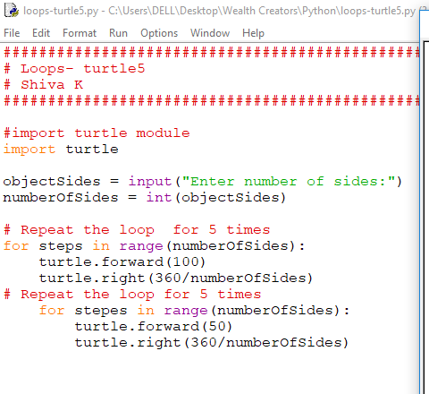

Slide 25
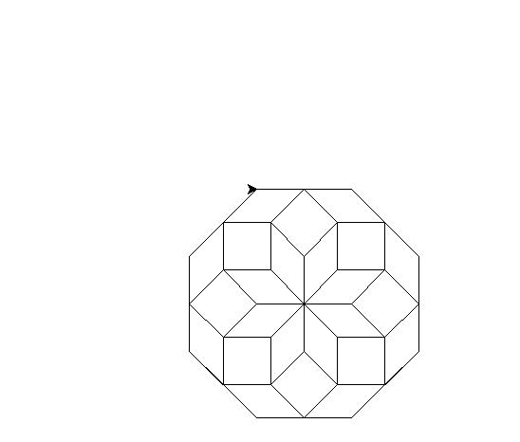

Slide 26
What is the advantage in using a variable instead of just typing in a number?
import turtle
numberOfSides = 7
for steps in range(numberOfSides):
turtle.forward(100)
turtle.right(360 / numberOfSides)
for steps in range(numberOfSides):
turtle.forward(50)
turtle.right(360 / numberOfSides)

Slide 27
When we use a variable,if we want to change a variable that is in different places, we just have to update one line of code.
So, There is no scope for missing an update for our code in many different places.

Slide 28
Accessing the loop value!

Slide 29
You can look at the loop values with in the loop
for steps in range(4):
print(steps)
Yes,the count starts from zero and that is very common in programming.

Slide 30
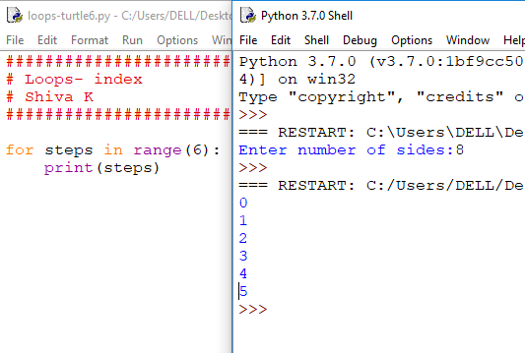

Slide 31
If you need to start counting from 1,you can specify your numbers to count to and from..
for steps in range(1,4):
print(steps)

Slide 32
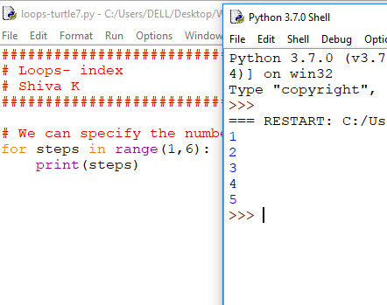

Slide 33
You can also tell the loop to skip a number by specifying it
for steps in range(1,14,2):
print(steps)

Slide 34
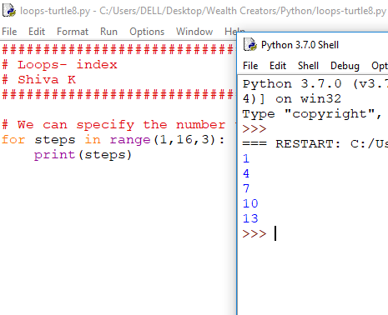

Slide 35
One of the cool things about python loops is,you can tell what you want to print..
for steps in [1,3,5,7,9,11,13,17]:
print(steps)
You just need to use different braces[] for this and not this() and no mention of range.

Slide 36
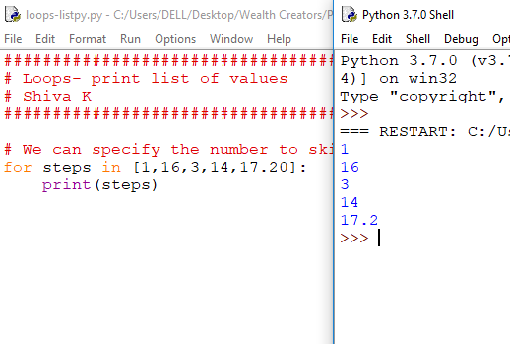

Slide 37
You don’t have to use numbers...
for steps in [‘red’,’green’,’blue’,’yellow’]:
turtle.color(steps)
turtle.forward(100)
turtle.right(90)

Slide 38
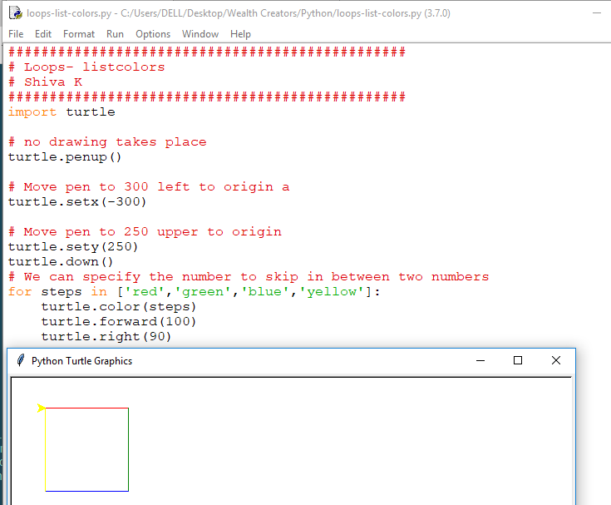

Slide 39
You can mix up different data types too..
for steps in [‘red’,’green’,’blue’,’yellow’,10,11.5]:
print(steps)

Slide 40
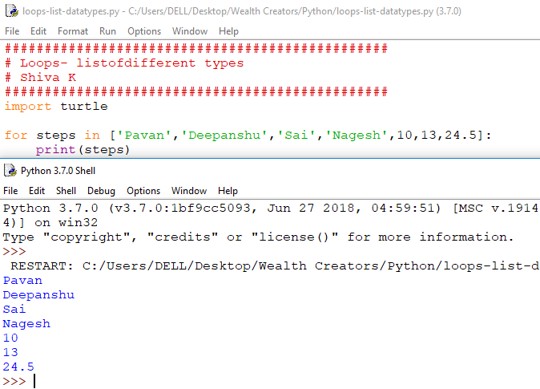

Slide 41
Your Challenge
Get turtle to draw an octagon
Hint: To calculate the angle,take 360 and divide it by the number of sides.
Extra Challenge : Let the user specify the number of sides he needs.
Double bonus challenge: Try nested loop to draw a smaller of object inside.

Slide 42
Congratulations !
You can manage repeating a task over and over fixed number of times.

