Slide 1
GENSUM
Adaptive Generalizated Text Summarization using optimized transformers
FINAL YEAR PROJECT
10th April 2023
University of Westminster | Informatics Institute of Technology School of Computing
SUPERVISOR INFO
Mr. Torin Wirasingha
School of Computing
STUDENT INFO
Mohammed Nazhim Kalam
2019281 | W1761265
Computer Science

Slide 2
OUTLINE
Problem Background & Domain
Research Gap & Solution Approaches
Existing Solutions
Concept Map
Proposed System Architecture
Models
Contributions
Demo

Slide 3
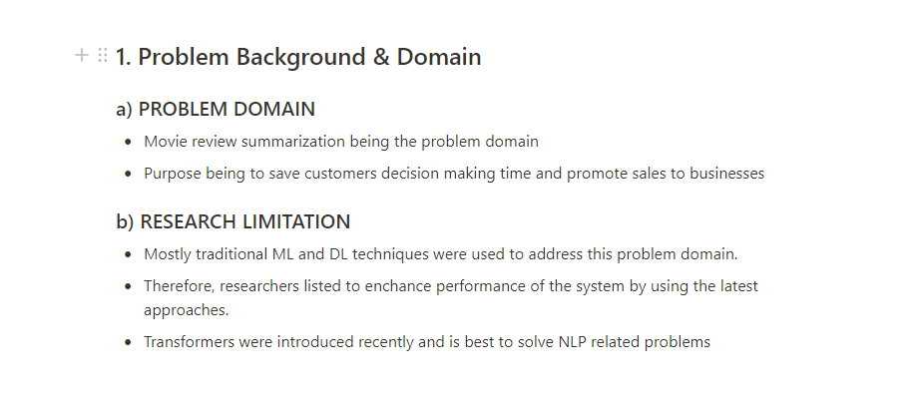

Slide 4
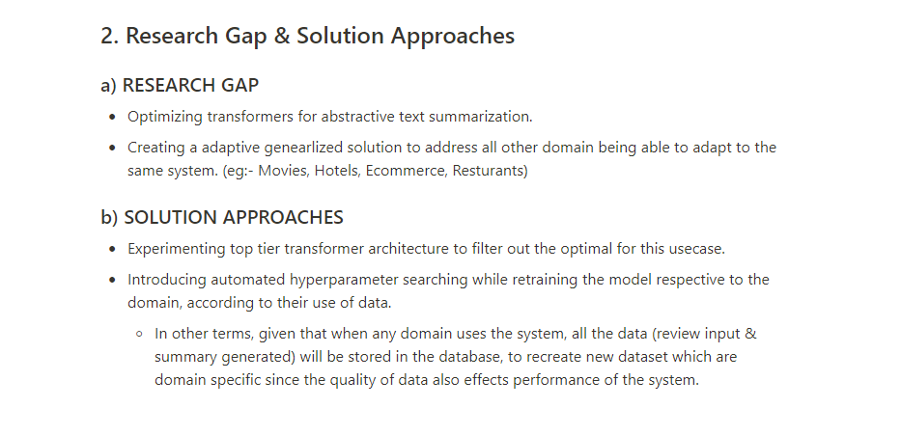

Slide 5
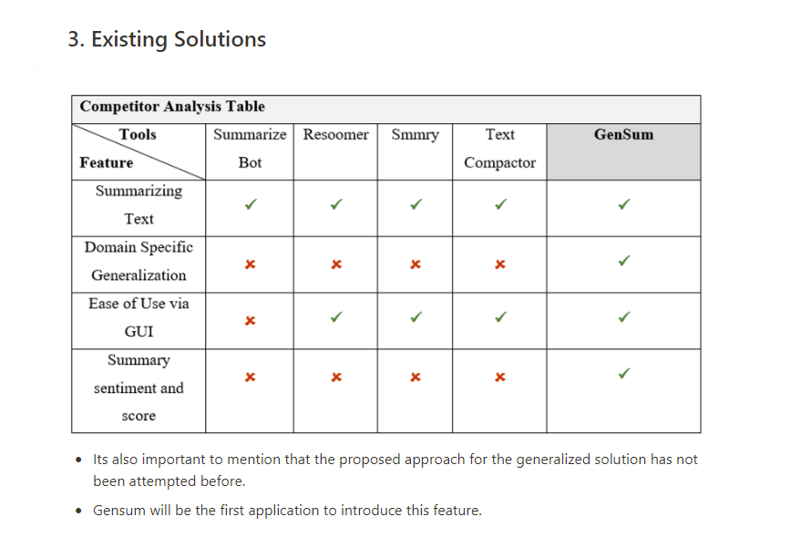

Slide 6
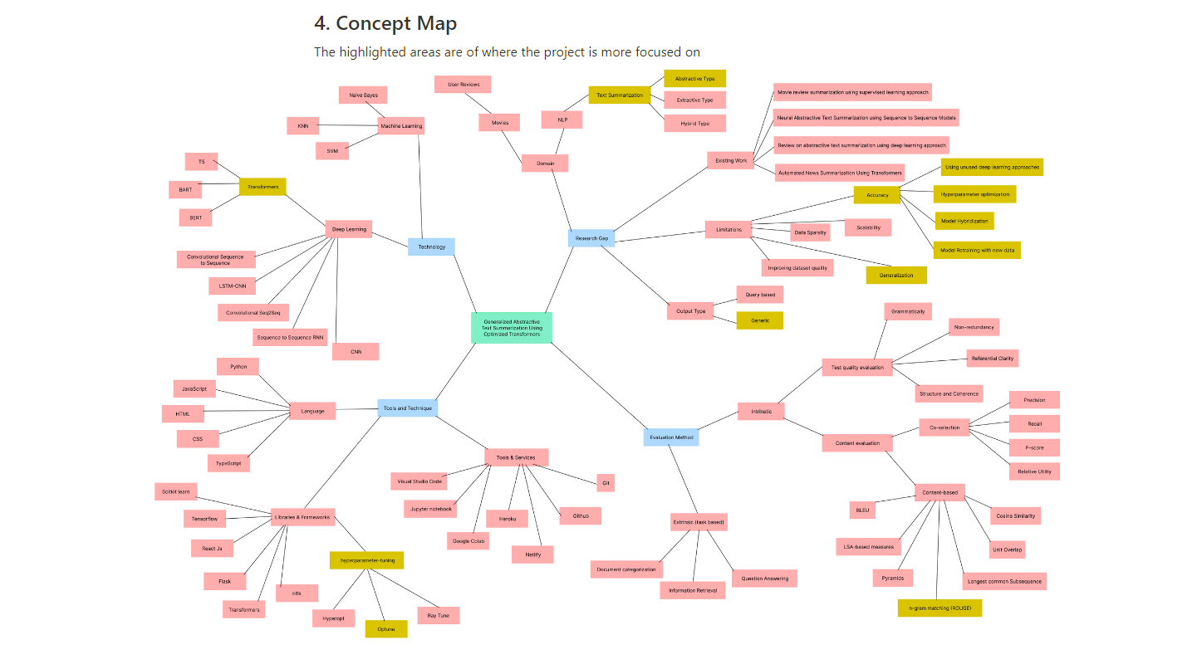

Slide 7
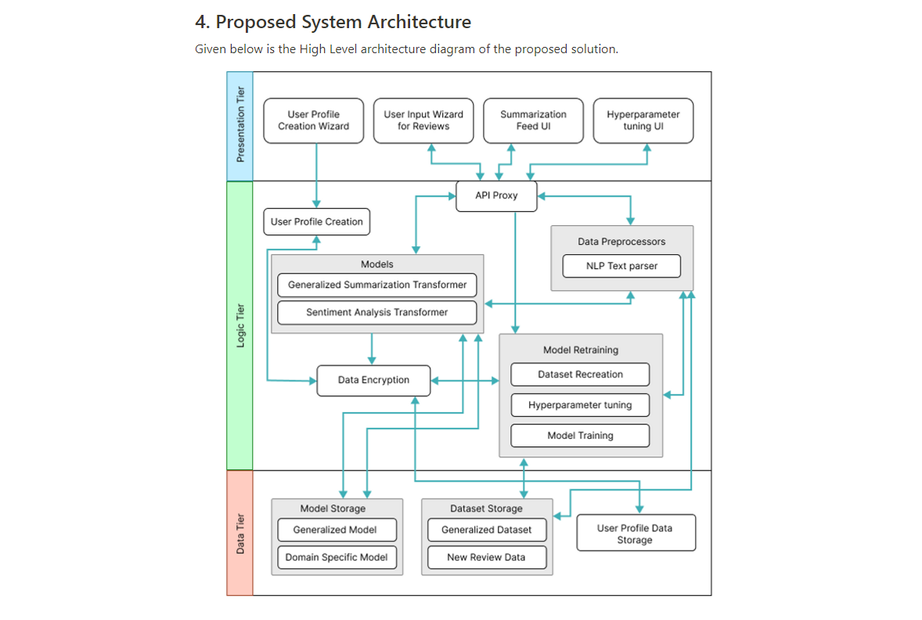

Slide 8
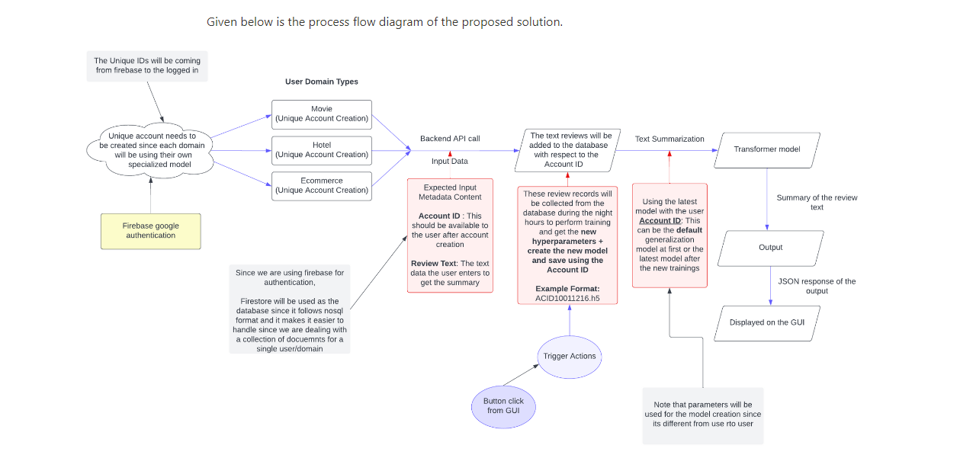

Slide 9
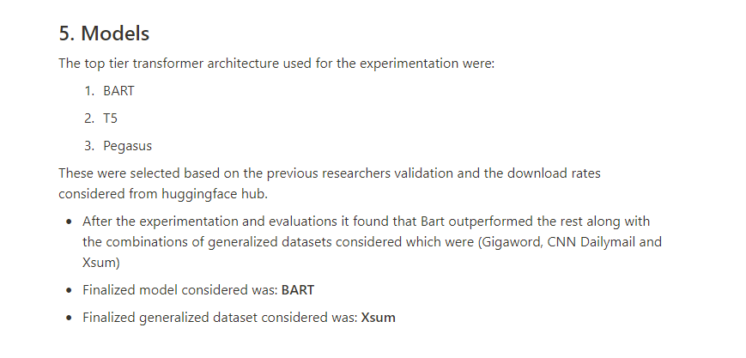

Slide 10
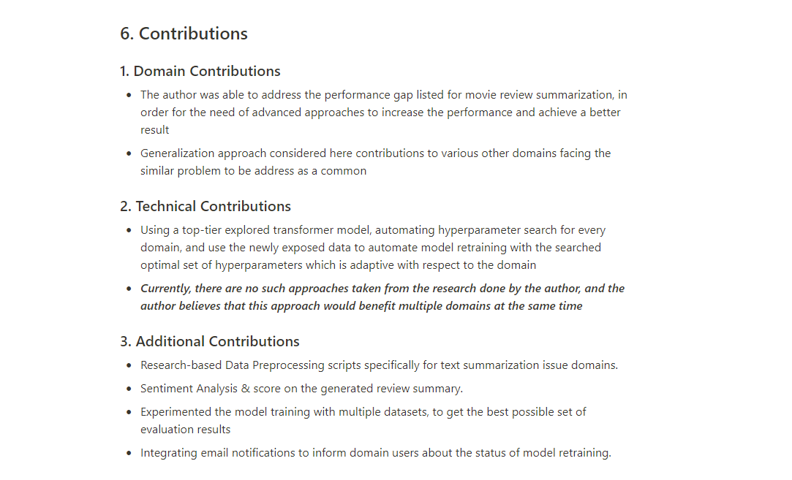

Slide 11
Project Demo

