Slide 1
GENSUM
An automated approach for improving abstractive text summarization using an adaptive generalized optimal transformer
FINAL YEAR PROJECT | PSPD
6th February 2023
University of Westminster | Informatics Institute of Technology School of Computing
SUPERVISOR INFO
Mr. Torin Wirasingha
School of Computing
STUDENT INFO
Mohammed Nazhim Kalam
2019281 | W1761265
Computer Science

Slide 2
OUTLINE
Problem Background & Domain
Research Gap & Solution Approaches
Existing Solutions
Proposed System Architecture
Prototype Demo
Additional Research improvements

Slide 3
1. Problem Background & Domain
Problem Domain:
movie review summarization, to save customers time.
Research limitation to be addressed:
performance increase, since mostly traditional ML and DL are used but yet the need for performance enhanced using latest approaches (such as Transformers).

Slide 4
2. Research Gap & Solution Approaches
Research Gap
Optimize transformers for abstractive text summarization & creating a generalized model/solution which can be able to be adapted to any domain and increase performance as the domain uses it with time.
This can be movie domain, hotel domain, tourism etc….
Solution Approaches
Automating hyperparameter searching and model retraining
Experimenting top tier transformer architecture to filter out the optimal for this use-case

Slide 5
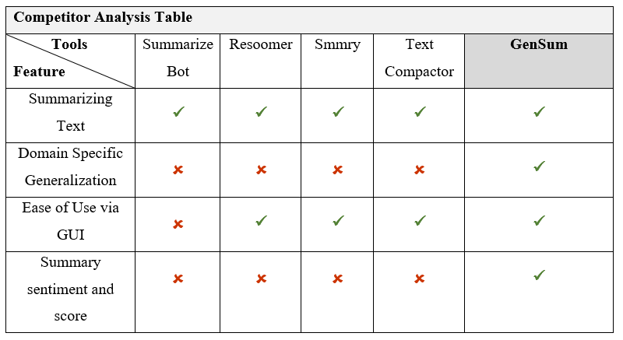
3. Existing Solutions

Slide 6
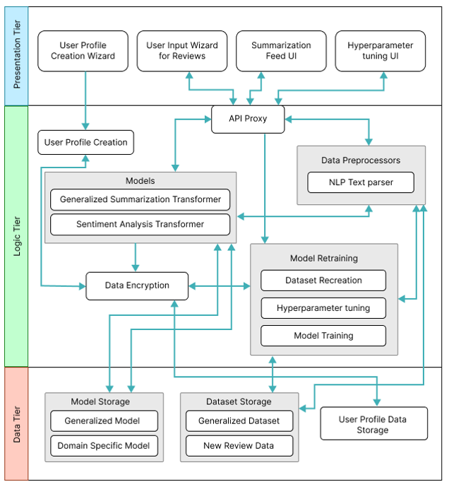
4. Proposed System Architecture
High Level System Architecture

Slide 7
5. Prototype Demo

Slide 8
6 . Additional Research improvements
Experimenting the usage of hybrid model combination using ensemble techniques.
Customize the existing transformer architecture layers to increase the performance.

