Slide 1

Fire Simulation and Modelling for Data Centers
Submission 3 – Group Presentation
Group 2
Course | Petri Net Theory And Modeling Of Systems (CSE718)
Faculty | Annajiat Alim Rasel [AAR]
Name | ID
Sushana Islam Mim | 22273001
Mirza Ahmad Shayer | 22273008
Salman Sadat Nur | 22273011
Nazia Parvin | 23166034

Slide 2
In our modern society, data is the ultimate currency. To manage, store and use them in any case is a very complex process. That is why data management, storage and usage have become popular fields of study. Data storage is often most important for if data is lost, it is very difficult or almost impossible to recover.
Large amounts of data is stored in large data centers containing thousands of servers. Usually those servers are built to ensure they can handle a lot of heat, however due to any or many factors data centers can often catch on fire very easily.
In our world data centers are everywhere, every second they do huge amounts of various different work. They must run continuously 24/7. As such, they are now a common source of many fires. Now, fire simulation and modelling in data centers have become a huge topic and many researchers are trying to ensure they can solve the problem and save lives.

Slide 3
We can divide our work into 4 spaces to have a much clearer understanding:
We first look into the servers in the data centers and understand how they behave, how much power they use and how much heat they generate.
Then we try to use active methods to reduce heat generation in the servers of the data center such as heatsinks, thermal lattices etc.
We look into other models and methods of data center cooling and find details, pros and cons of each system.
We look into the latest systems that utilize liquid nitrogen as a coolant.
By dividing our work this way we can cover more ground in less time and simultaneously understand and present more clearly all findings.

Slide 4
According to Levy, data center systems must adopt end-to-end resource management, covering both cyber and physical components. The methodology is aimed to facilitate the estimation of quality of service, airflow and power requirements, and key indicators to assess data centers, and to then compare them to one another, or compare different scenarios under which data centers operate.
ITE requires power. It consumes energy and generates heat, both of which vary depending on the workload required to be processed. The cooling system cools the facility and extracts the heat. IT resource management systems actively manage the
workloads. ITE, power, and cooling systems interact and are controlled by dynamic management of ITE resources.
The approach is comprised of three easy-to-follow steps:
Modeling the cyber components
Modeling the physical components
Identifying data center key indicators.

Slide 5
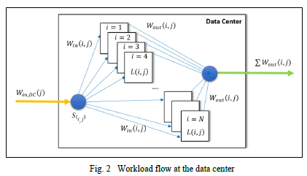
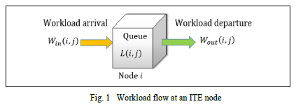
The first step consists of identifying and modeling the components responsible for processing the workloads. Workload processed affects energy consumption, which directly impacts the physical environment. A data center that is not processing workload will still consume a fixed amount of energy to maintain the availability of all the resources. As workload increases, energy consumption increases, reaching a maximum where processing time may also rise. Diagrams below show workload flow of ITE node and data center.

Slide 6
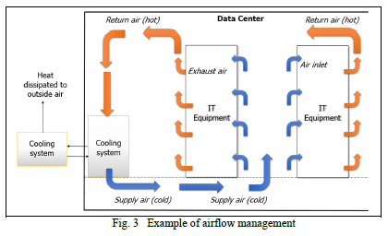
Figures show airflow management of data center. Air circulates and cools servers down.

Slide 7
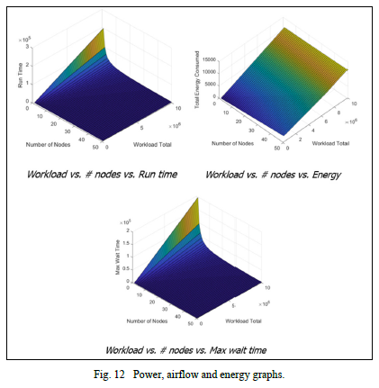
Figure shows 3D visualization of power, airflow and energy graphs. High workloads with high number of ITE, result in good values for quality of service (e.g., low values for run time and maximum waiting time) but at higher costs (e.g., more ITE, as well as greater power and airflow requirements). High workloads and low number of ITE result in worse values for the quality of service parameters (e.g., high values for run time and maximum waiting time), at around the same operational costs (e.g., energy consumption) but with fewer ITE (lower capital expenditures).

Slide 8
According to Biswas et al, recent advances in active cooling techniques have shown on-chip thermoelectric coolers (TECs) to be very efficient at selectively eliminating small hot-spots, where applying current to a superlattice film deposited between silicon and the heat spreader results in a Peltier effect that spreads the heat and lowers the temperature of the hot-spot significantly to improve chip reliability.
The running costs of data centers are dominated by the need to dissipate heat generated by thousands of server machines. Higher temperatures are undesirable as they lead to premature silicon wear-out; in fact, mean time to failure has been shown to decrease exponentially with temperature. Even as processor complexity and technology scaling has increased the average energy density inside a processor to maximally tolerable levels, modern microprocessors make extensive use of hardware structures such as the load-store queue and other CAM-based units, and the peak temperatures on chip can be much worse than even the average temperature of the chip.

Slide 9
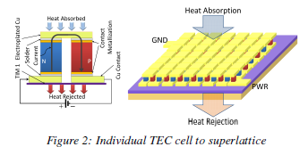
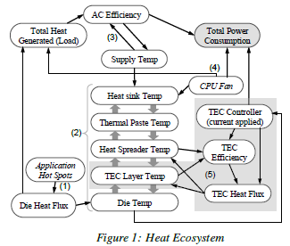
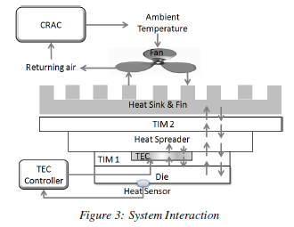
Heat ecosystem, individual TEC cell to superlattice and system interaction

Slide 10
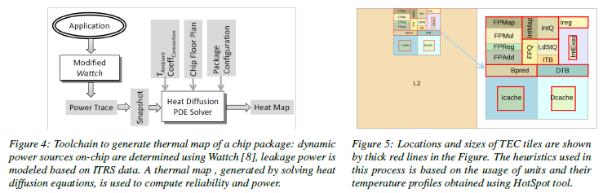
In a data center with thousands of servers, the cooling system plays a major role in reliability of the servers, and also in the cost of running a data center, which is typically in the order of millions of dollars per year. In a typical data center, the cooling power is nearly equal to the total power of running the IT equipment. Cooling units show higher efficiency with the increase in the target supply air temperature. However, the cooling units are provisioned for the worst case, i.e. the hot-spots inside the processors.

Slide 11
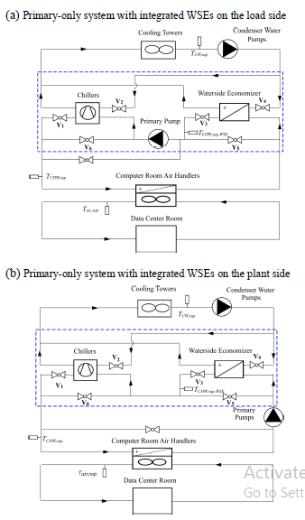
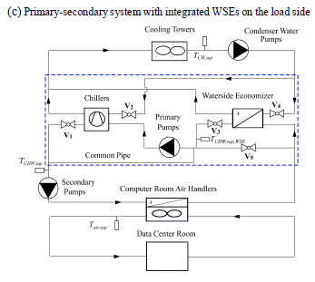
According to Fu et al, Simulation can be an effective way to assist the design and operation of data centers. Many tools have been developed in academia and industry to perform computer simulation of cooling systems in data centers.
Figure 1(a) shows an integrated WSE in a primary only chilled water system, where the WSE is in series with the chillers on the chilled water return side and in parallel with the chillers on the condenser water side.

Slide 12
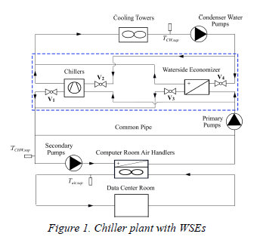
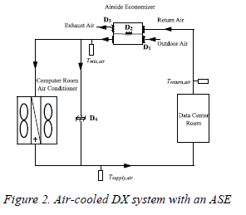
A typical configuration of a DX system with an air-cooled Computer Room Air Conditioner (CRAC) and an ASE is shown in Figure 2. The data center room can be cooled by the ASE, or the air-cooled CRAC or both of them.

Slide 13
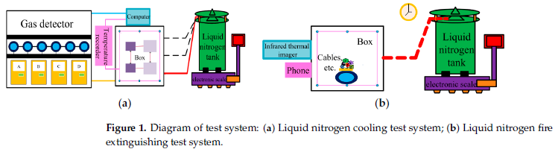
According to Meng et al, with the rapid development of worldwide computer data center construction, the reliability requirements of the fire-fighting system for data center rooms are also increasing. By using the self-designed simulation platform of liquid nitrogen spray, this paper studies the liquid nitrogen cooling process in the initial heating stage of a computer data center room fire and the liquid nitrogen extinguishing effects for common combustible materials, revealing the feasibility of applying liquid nitrogen to the fire extinguishing system for data center room.

Slide 14
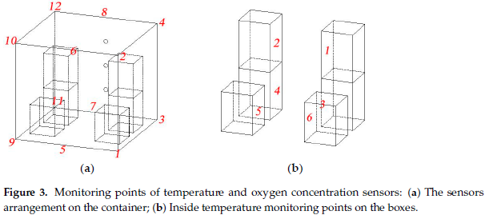
Monitoring sensor point locations in a data center with variable ranges

Slide 15
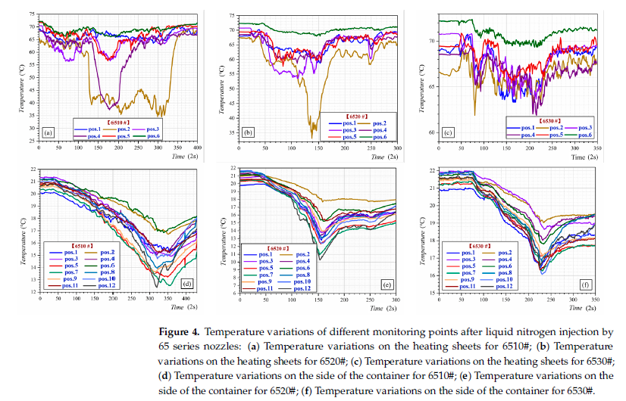
Data graphs of the nitrogen system.

Slide 16
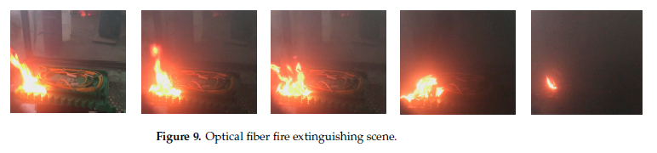
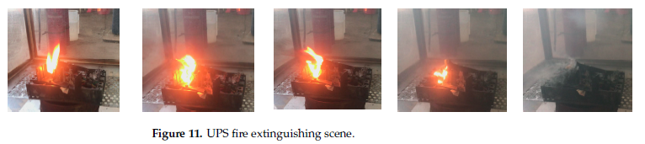
System putting out fires on different objects.

Slide 17
References:-
M. Levy, “Modeling and Simulation of Data Centers to Predict Behavior,” American Journal of Science and Engineering., vol. 1, no. 1, pp. 11-20, 2019. URL - https://ajse.us/wp-content/uploads/2019/12/Modeling-and-Simulation-of-Data-Centers.pdf
S. Biswas, M. Tiwari, T. Sherwood, L. Theogarajan and F. T. Chong, “Fighting Fire With Fire: Modeling the Datacenter-Scale Effects of Targeted Superlattice Thermal Management,” 38th International Symposium on Computer Architecture (ISCA 2011), 2011. DOI - https://doi.org/10.1145/2000064.2000104
Y. Fu1, M. Wetter, and W. Zuo, Modelica Models for Data Center Cooling Systems, 2018 Building Performance Analysis Conference and SimBuild, 2018. URL – https://simulationresearch.lbl.gov/wetter/download/2018-simBuild-dataCenter.pdf
J. Meng, T. Wang, G. Li and J. Kang, “Simulation Test on Cooling and Fire Suppression with Liquid Nitrogen in Computer Room of Data Center,” Fire, vol. 6, no. 3, pp. 116, 2023. DOI - https://doi.org/10.3390/fire6030116

Slide 18
Thank you
Any Questions?

