Slide 1
01
LECTURE 1
AI-Based Software Systems
and the MLOps Lifecycle
AI Implementation Technologies
Senior Lecturer • AI & Computer Vision
4th-year university course | Production AI systems engineering
From trained models to reliable software systems.

Slide 2
SCOPE
What This Course Is About
The course starts after two things are already familiar:
Software foundations
repositories, APIs, containers, tests, CI/CD
Model foundations
training, metrics, datasets, CNNs, detection models
This course
contracts, evidence, serving, monitoring, release decisions
We use these foundations; we do not reteach them. The target is production evidence.
AI Implementation Technologies
Lecture 1 | 02

Slide 3
CORE IDEA
The Main Shift
The engineering question changes because part of the behavior is learned.
Deterministic software
Did the code implement the expected behavior?
Production AI system
Is learned behavior still acceptable under changing data, users, models, and environments?
The question changes because part of the behavior is learned.
AI Implementation Technologies
Lecture 1 | 03

Slide 4
PRODUCTION RISK
A Green Service Can Hide a Bad Decision
FireWatch can return HTTP 200 while missed smoke alerts are already increasing.
VISIBLE SERVICE EVIDENCE
HIDDEN PRODUCT EVIDENCE
HTTP STATUS
200
≠
OPERATOR RECEIVES
NORMAL
FEWER TRUE ALERTS
P95 LATENCY
NOT THE SAME SIGNAL
DASHBOARD
GREEN
NO SIGNAL EXPLAINS THE DROP
PREDICTION LOGS + EXPECTED OUTCOMES → BEHAVIOR COMPARISON
The missing evidence links each alert to the expected outcome and the operator's decision.
The most dangerous AI failure is often a working service with worse decisions.
AI Implementation Technologies
Lecture 1 | 04

Slide 5
SYSTEM BOUNDARY
A Model Is Not The System
PRODUCTION AI SYSTEM
COURSE INTERPRETATION
The model is not the product, the service, or the production responsibility.
INPUT
VALIDATE
MODEL
POLICY
USER
data
contract
learned behavior
fallback
decision
AI COMPONENT
learned behavior used inside the system
SURROUNDING SOFTWARE RESPONSIBILITY
OTHER COMPONENTS
data, code, interface, runtime, logs, owners
TESTS
LOGS
MONITORING
OWNER
assumptions
evidence
signals
next action
SYSTEM CLAIM
behavior must be justified across the boundary
A production AI system includes the model and the surrounding software responsibility.
AI Implementation Technologies
Lecture 1 | 05

Slide 6
RECURRING MODEL
FireWatch: One System Boundary
PRODUCTION PATH
CAMERA
FRAME CHECK
PREPROCESS
MODEL
ALERT POLICY
EVENT LOG
OUTCOME CHECK
CONTROLS AROUND THE PATH
TESTS
VERSIONING
ROLLBACK
OWNER
reject invalid frames before alerting
link camera, code, model, and policy versions
restore the last trusted package
decide when to investigate, pause, or update
FireWatch is the full decision path—not only the classifier.
AI Implementation Technologies
Lecture 1 | 06

Slide 7
FAILURE PATHWAYS
How FireWatch Can Fail
A failure can enter before the classifier and appear later as an unsafe alert decision.
enters as
system state
appears as
Camera shift
new angle, glare, darkness
Model update
trusted scenes now behave differently
FireWatch
frames + model + policy + operator
Label gap
steam-like scenes were never labeled
Late alert
the operator receives it too late
Policy error
a weak score becomes an urgent alert
Silent drift
no comparison exposes the loss
Production work makes each failure path observable and actionable.
AI Implementation Technologies
Lecture 1 | 07

Slide 8
CLASS ACTIVITY
Boundary Check: What Must Be Included?
System boundary
Which components belong inside FireWatch?
Input
What enters before the classifier?
Decision
Who receives the alert, and what action follows?
Failure
What if the alert is wrong, late, or missing?
Evidence
What would reveal that failure?
If the decision, owner, failure, and evidence are unclear, the boundary is incomplete.
AI Implementation Technologies
Lecture 1 | 08

Slide 9
REFERENCE CONNECTION
Software Engineering Still Matters
Requirements
Design
Validation / Testing
elicit
specify
validate
architecture
components
interfaces
component
system
customer
users, constraints, acceptance criteria
structure, behavior, dependencies
unit, integration, acceptance evidence
Requirements, design, and testing remain essential; learned behavior adds new evidence needs.
AI Implementation Technologies
Lecture 1 | 09

Slide 10
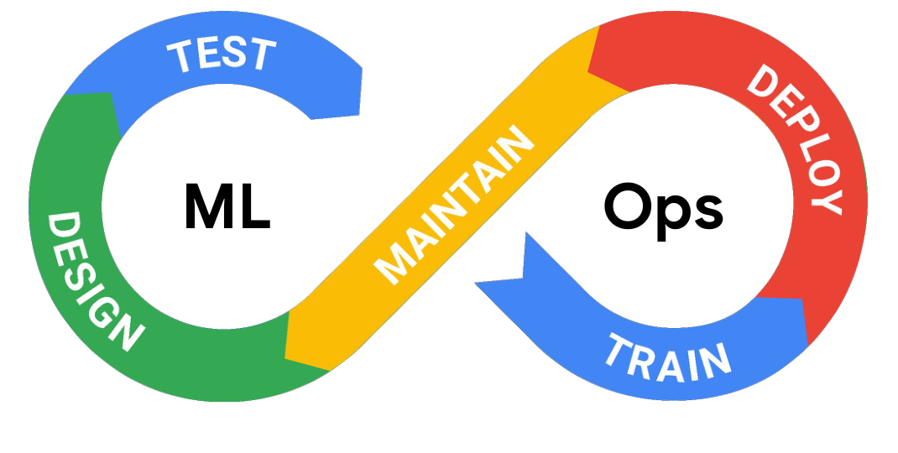
MLOPS
MLOps In One Sentence
COURSE INTERPRETATION
Repeatable
same inputs and versions can be rerun
Testable
assumptions become checks
Observable
runtime behavior leaves evidence
Maintainable
owners can respond when signals change
ML + Ops loop
MLOps is not a tool list. It is a way to structure production ML work.
AI Implementation Technologies
Lecture 1 | 10

Slide 11
LIFECYCLE
Workflow: From Data to Inference
REFERENCE WORKFLOW / NATIVE REDRAW
Collect Data
Preprocess Data
Design a Model
Train a Model
Evaluate Optimize
Convert Model
Deploy Model
Make Inferences
DATA
DEVELOPMENT
VALIDATE + PACKAGE
PRODUCTION
A workflow describes one pass through technical stages.
It is not yet the system's operating lifecycle.
Every stage must leave evidence the next stage can trust.
AI Implementation Technologies
Lecture 1 | 11

Slide 12
LIFECYCLE
Lifecycle: Keeping the System Useful
MLOPS PROCESS / NATIVE REDRAW
ML Development
DATA + MODEL MANAGEMENT
CODE + CONFIG
ML Training
TRAINING PIPELINE
Continuous Training
REGISTERED MODEL
Model Deployment
SERVING PACKAGE
Prediction Serving
SERVING LOGS
Continuous Monitoring
MLOps process reference
The lifecycle continues after deployment through serving, monitoring, and response.
AI Implementation Technologies
Lecture 1 | 12

Slide 13
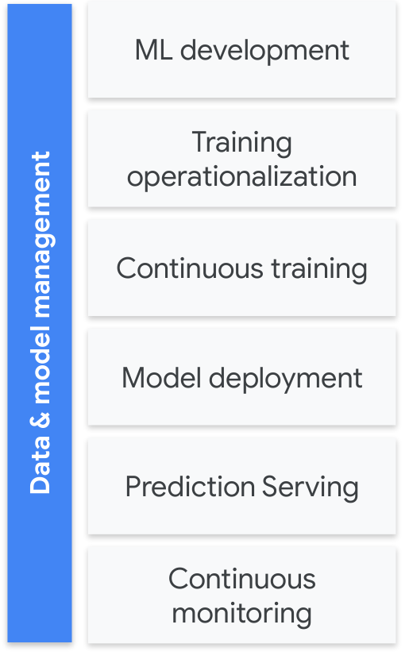
COURSE MAP
Nine Lectures, One Evidence Chain
OUR COURSE ORDER
1.
AI systems
2.
ML lifecycle
3.
requirements
4.
architecture
5.
data validation
6.
experiments
7.
testing
8.
serving
9.
monitoring
Each lecture owns one decision and adds evidence to the same system.
AI Implementation Technologies
Lecture 1 | 13

Slide 14
PROJECT EVIDENCE
The Project Builds an Evidence Trail
FireWatch becomes credible one engineering decision at a time—not in one final demo.
boundary
metrics
data checks
experiment
tests
serving
monitoring
report
Frame the system
define the user decision, boundary, and first risks
Build evidence
connect data, experiment, and test choices
Operate and defend
connect serving, monitoring, limits, and ownership
Every lab should make one system claim easier to trust.
AI Implementation Technologies
Lecture 1 | 14

Slide 15
COURSE PREVIEW
Question 1: What System Are We Building?
DEFINE THE DECISION
User and decision
who receives the alert, and what do they do?
Who acts on what output?
Acceptable behavior
what counts as useful, late, or wrong?
Runtime path
where does inference run, and what surrounds it?
Before tools, make the boundary explicit.
Fallback
what happens when evidence is weak?
Today we frame the questions; Lectures 3–4 will answer them.
AI Implementation Technologies
Lecture 1 | 15

Slide 16
COURSE PREVIEW
Question 2: What Evidence Can We Trust?
MAKE CLAIMS CHECKABLE
Data
are inputs valid for the decision?
Data, experiments, and tests must leave evidence.
Experiment
why this model and this result?
Tests
what must pass before release?
Trust comes from linked checks—not one score.
Version trail
which data, code, model, and policy?
Today we see the chain; Lectures 5–7 will build it.
AI Implementation Technologies
Lecture 1 | 16

Slide 17
COURSE PREVIEW
Question 3: How Will We Respond?
Operating the system means comparing signals with a baseline and assigning an action.
Area
Evidence
Decision
Service
latency, errors, availability
fallback, restore, or investigate?
Inputs
frame validity and profile
accept, reject, or inspect?
Decisions
alerts and later outcomes
continue, retrain, or pause?
Ownership
gate and incident evidence
ship, revert, or escalate?
Today we name the loop; Lectures 8–9 will implement it.
AI Implementation Technologies
Lecture 1 | 17

Slide 18
SEMESTER MAP
Course Timeline
Weeks 1-7: core lectures and foundations
1
2
3
4
5
6
7
8
9
10
11
12
13
14
15
Weeks 8-15: guided implementation, reviews, demos
The lecture sequence is short; the lab evidence trail continues all semester.
AI Implementation Technologies
Lecture 1 | 18

Slide 19
PROJECT STANDARD
Project Direction: Model or System?
The difference is whether the team can explain the complete decision path.
Weak direction
We trained a fire/smoke classifier.
Strong direction
We built FireWatch: validated input, alert policy, logs, fallback, and an owner.
A strong project explains behavior, evidence, operations, and limits.
AI Implementation Technologies
Lecture 1 | 19

Slide 20
LAB 1
Lab 1: Frame the System
Team setup
repository and working collaboration
Candidate system
user, decision, model output, and system boundary
AI justification
why learned behavior is needed
Feasibility + risk
real data; wrong, late, or missing outcome; initial risks
Frame the system before choosing the model.
AI Implementation Technologies
Lecture 1 | 20

Slide 21
CLOSING
Course Mantra
SE4AI QUALITY GOALS / NATIVE REDRAW
safety
74
COURSE MANTRA
functional correctness
40
Model quality
robustness
40
reliability
25
is not system quality.
security
19
accuracy
16
testability
12
The chart reports frequency in reviewed papers—not an importance ranking.
explainability
11
maintainability
11
performance
9
papers mentioning goal
Accuracy is one system-quality concern, not the whole quality argument.
AI Implementation Technologies
Lecture 1 | 21

Slide 22
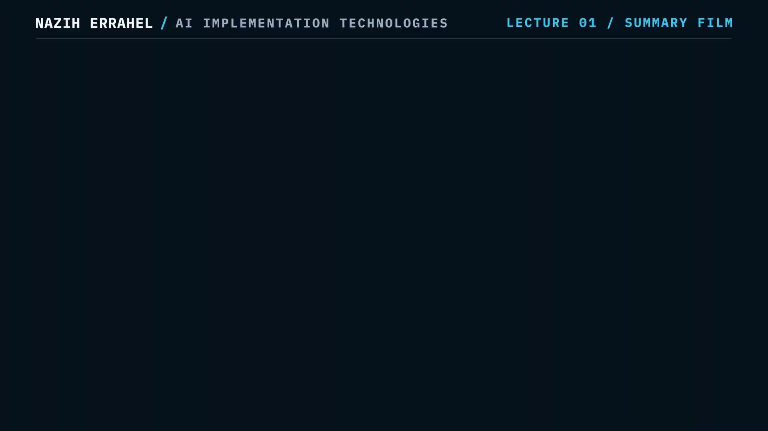
22
SUMMARY

Slide 23
BRIDGE
Next Lecture
Next: ML Lifecycle and Pipeline Artifacts
system view
explicit pipeline
artifacts
reproducible run
We move from notebook experiments to reproducible, testable AI pipelines.
AI Implementation Technologies
Lecture 1 | 23

