Slide 1

Closer look at the Pandemics
TEAM MEMBERS:
FARIHA SIDDIQUI
NAZILA ENTEZARI
YING FENG

Slide 2
Project Outline
Our project conducts a comparative analysis between the impacts of Covid-19 versus H1N1. We will examine and compare the various trends between the two pandemics and explore the potential impact of Covid-19.
Questions we will be exploring:
What is the rate of increase in total cases for the pandemics?
What is the death rate and how does it compare to the total cases?
How many countries are impacted?
Are there any geographical similarities between the two pandemics?

Slide 3
Data Exploration
Found clean csv in Kaggle for H1N1 and Covid-19
Issues that arose:
Covid-19 ’date’ column was not consistent
Resolution:
Used API to retrieve another set of data for Covid-19

Slide 4
Data Cleanup
Changed column names to match the two datasets
Removed unnecessary columns and NaN values
Changed date column type from object to dateframe
Changed the timestamp format to datetime
Covid-19 dataset from the api has over 600,000 rows with inconsistent data
Cleaned the inconsistency in the dataset by deleting multiple rows for one date and keeping the max value for each date

Slide 5
Data Analysis

Slide 6
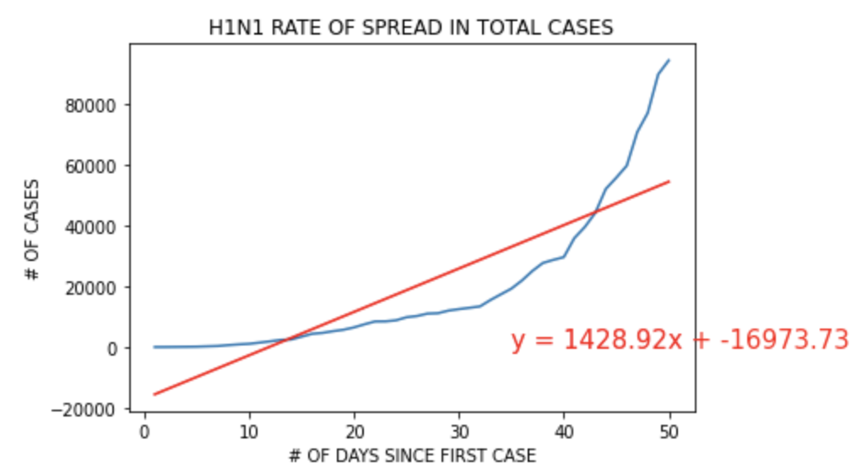
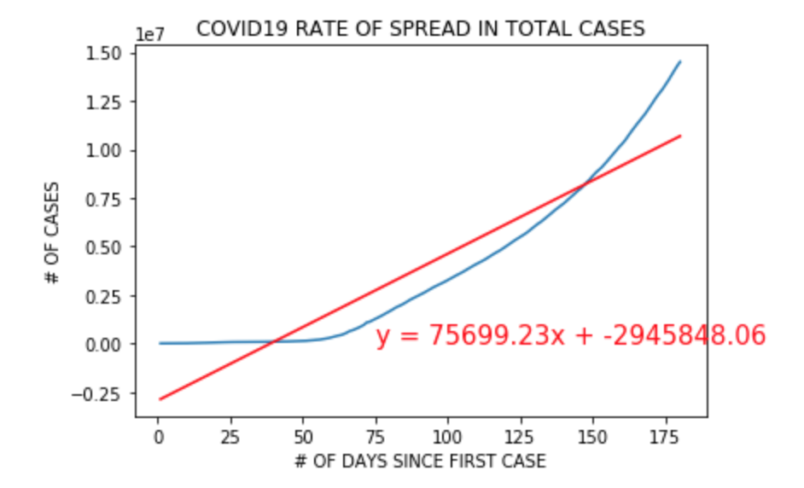
Rate of Spread of H1N1 & Covid-19
Visual Comparison:
There is a slow rate of increase at the beginning for both H1N1 and Covid-19 as seen by the flatter part of the curve in the graphs.
By comparing the graphs it appears that Covid-19 has a steeper slope once it passes the initial stage.
Mathematical Comparison:
By looking at the slopes, the rate of increase of Covid-19 (75,699) is much greater than H1NI (1,429)

Slide 7
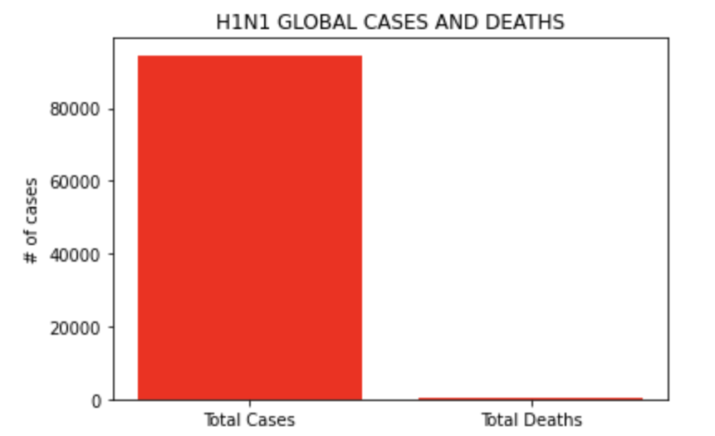
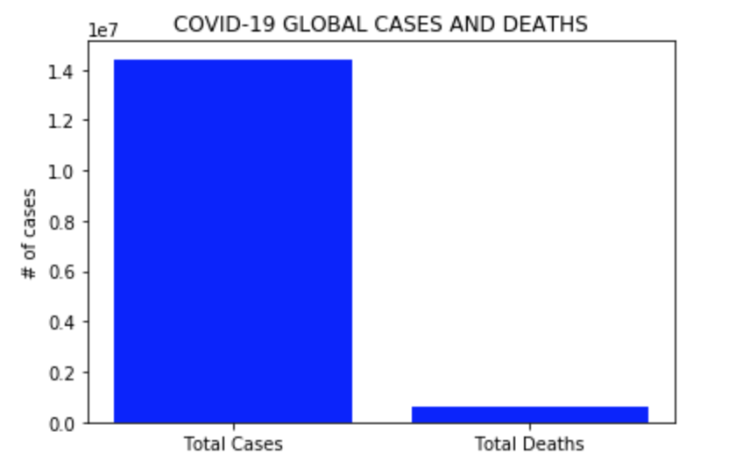
Death Rate of H1N1 & Covid-19
Pandemics | Total Global Cases | Total Deaths | Death Rate
H1N1 | 94,577 | 429 | 0.45 %
Covid-19 | 14,416,267 | 602,837 | 4.18 %

Slide 8
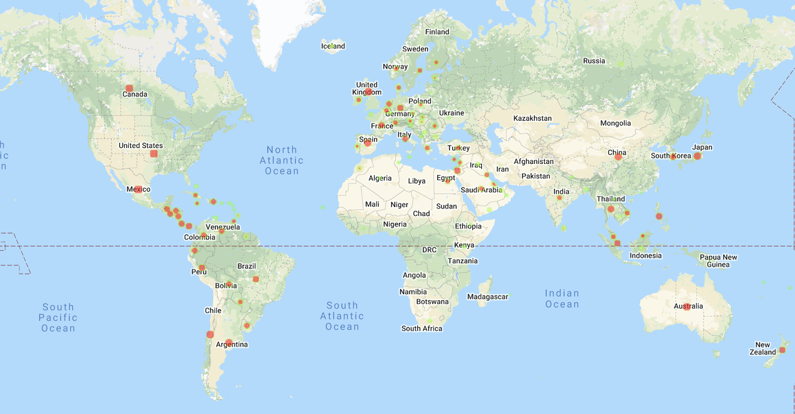
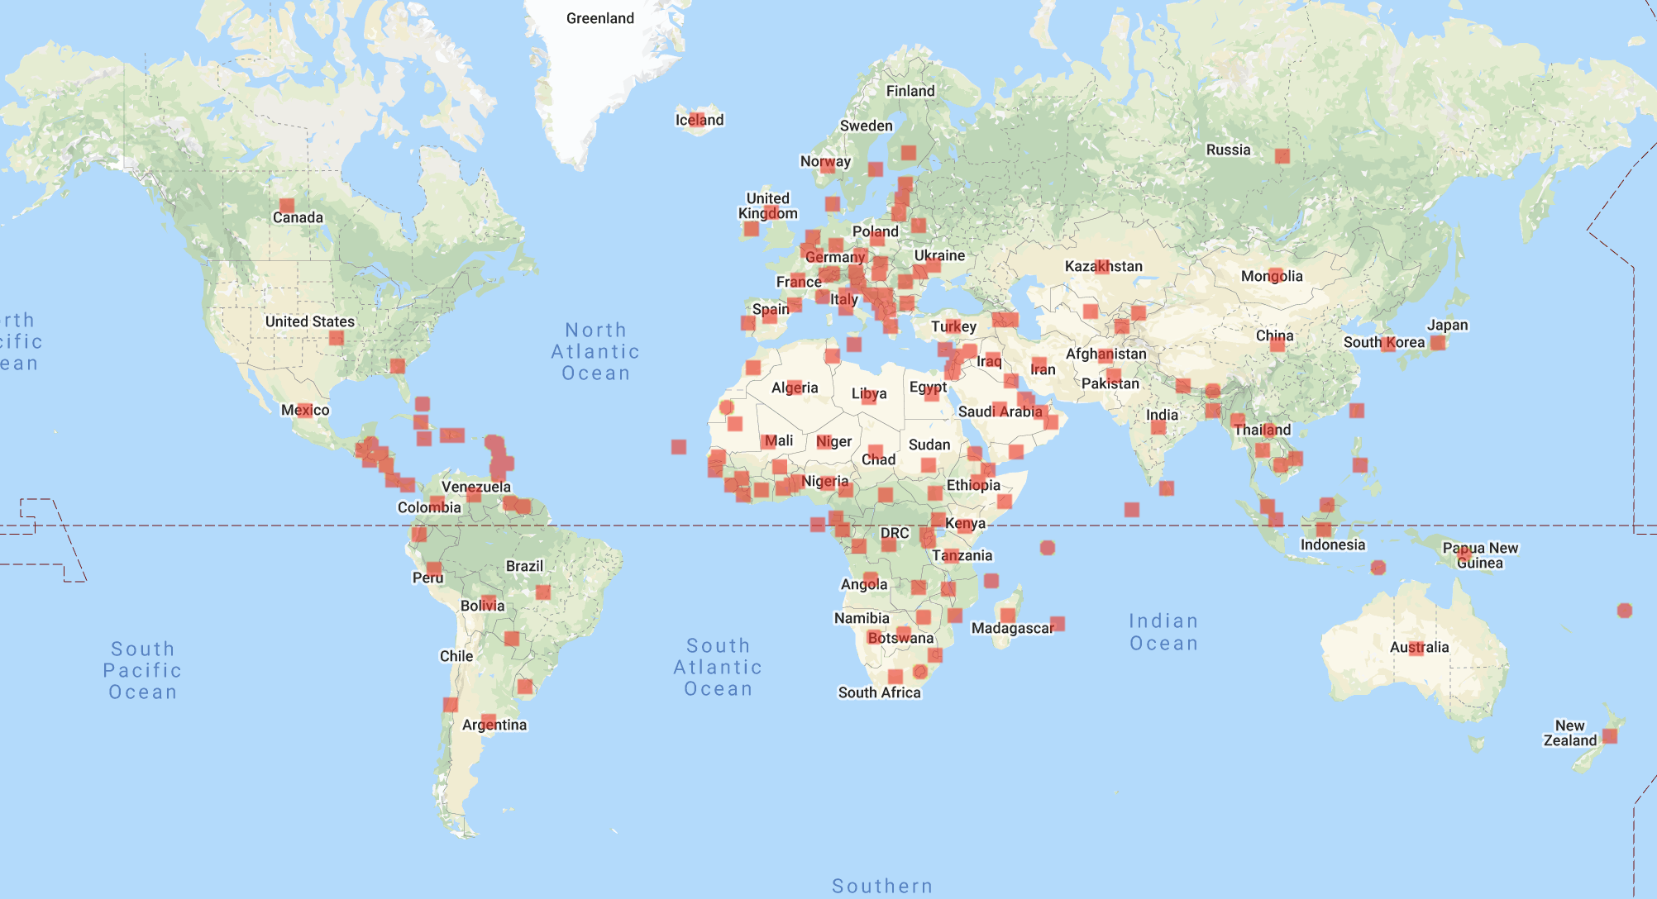
Global Impact of H1N1 vs. Covid-19
Impact of H1N1
Pandemic | % of world impacted
H1N1 | 75%
COVID-19 | 95%
Impact of Covid-19

Slide 9
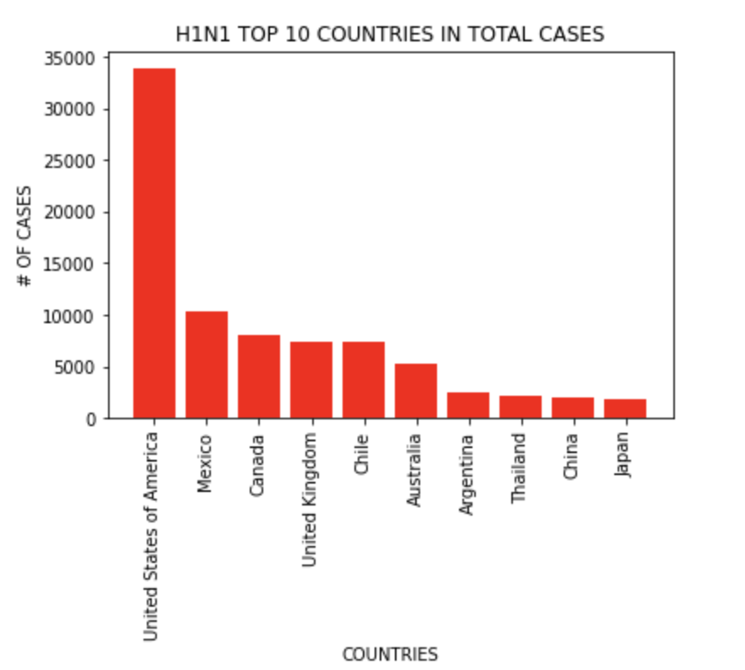
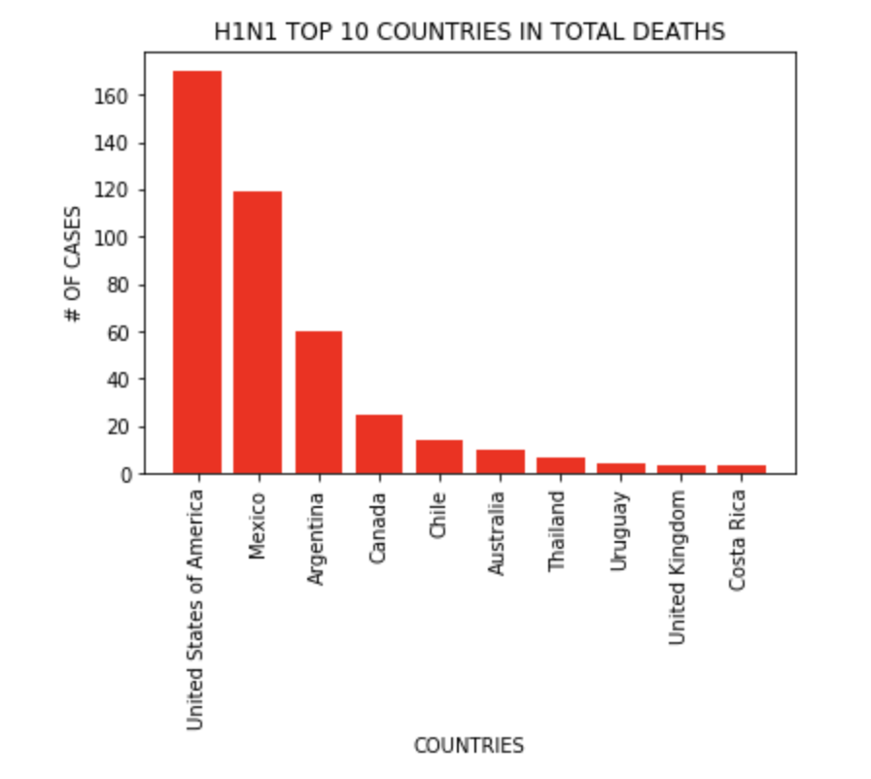
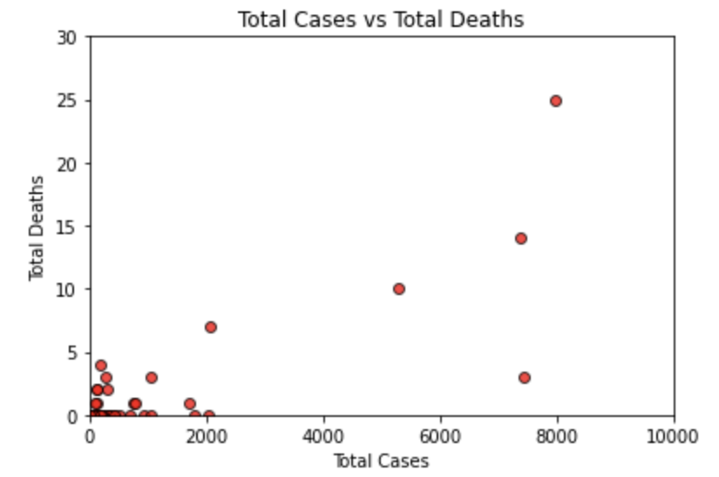
Analysis of Total Cases vs. Total Deaths: H1N1
Most of the countries in top 10 total cases and total deaths are the same
The correlation coefficient of total cases vs. total deaths is 0.893.
The total deaths is positively and significantly correlated to the total cases

Slide 10
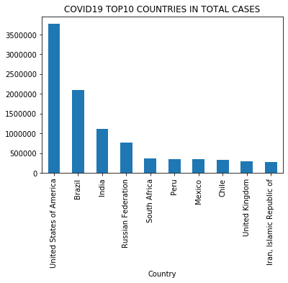
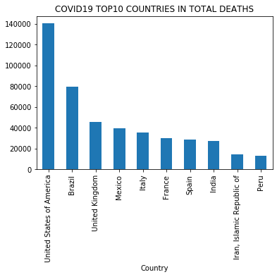
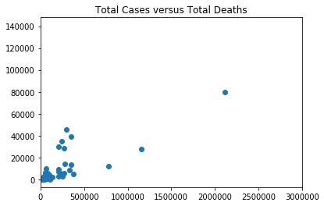
Analysis of Total Cases vs. Total Deaths: Covid-19
Most of the countries in top 10 total cases and total deaths are the same
The correlation coefficient of total cases vs total deaths is 0.93.
The total deaths is positively and significantly correlated to the total cases

Slide 11
A closer look at Covid-19

Slide 12
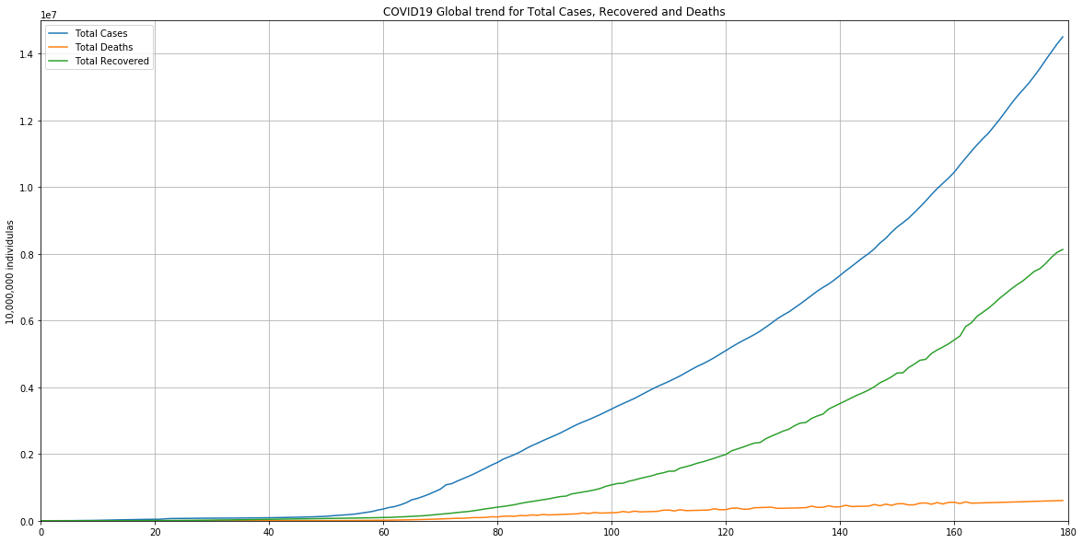

Slide 13
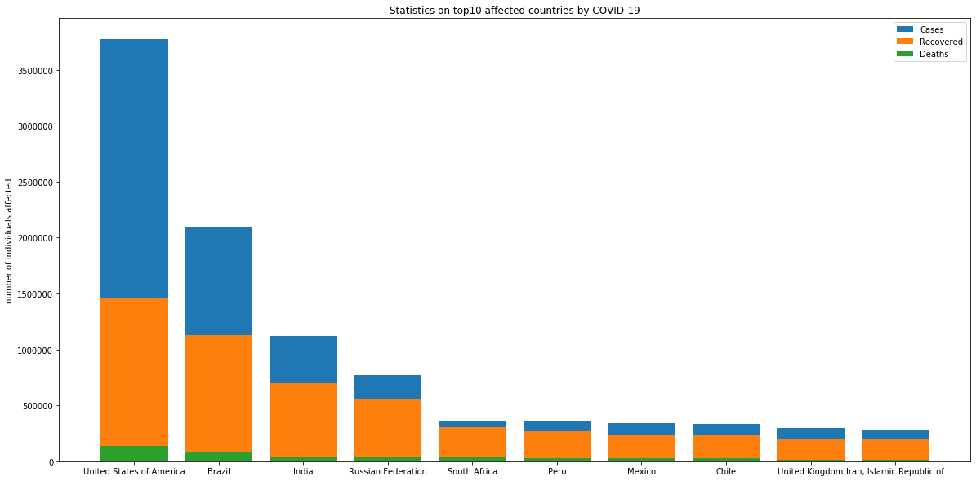
DEATH RATE FOR EACH COUNTRY
%3.72
%3.79
%4.05
%5.09
%9.62
%8.5
%8.35
%8.31
%4.81
%4.82

Slide 14
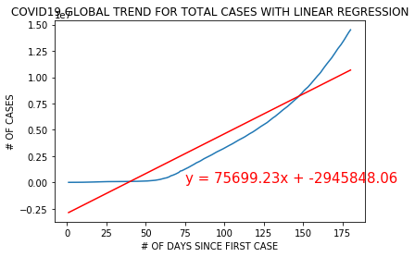
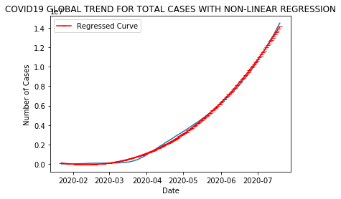
Covid-19 number of cases predictions by Regression
Regression Value = 75699.2x - 2945848.06
The predicted number of deaths globally by the end of year 2020 based on our 2nd degree nonlinear regression will be 24,684,370
Regression Value = 0.86x³ + 372.05x² -16816.07x +114054.0
The predicted number of deaths globally by the end of year 2020 based on our 3rd degree nonlinear regression will be 85,137,099 following the current trend.

Slide 15
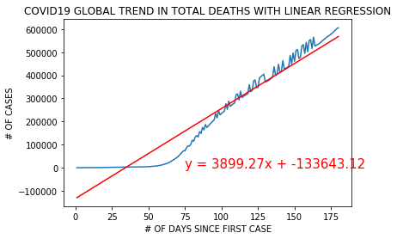
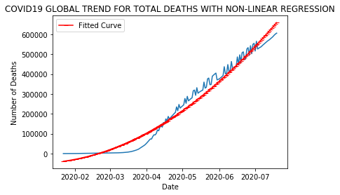
Covid-19 number of deaths predictions by Regression
Regression Value = 3899.27x-133643.12
The predicted number of deaths globally by the end of year 2020 based on our linear regression will be 1,289,590
Regression Value = 17.12 x² + 800.48x - 39646.33
The predicted number of deaths globally by the end of year 2020 based on our 2nd degree nonlinear regression will be 2,533,394 if the current trend persists.
Our predictions show a death rate of around 3% relatively close to our current death rate.

Slide 16
Conclusion
Covid-19 cases increase at a higher rate than H1N1
Covid-19 death rate is higher than H1N1
Covid-19 affected more countries and at a greater severity than H1N1 and for both pandemics USA was the most impacted
Therefore: After comparing the two pandemics, it is clear that Covid-19 is more severe in rate of increase in cases, death rate, and has a greater impact in the world than H1N1. Based on the further analysis on Covid-19, it appears that by the end of the year both total cases and death cases will increase.

Slide 17
Post Mortem
Further analysis can be done on the following:
Statistical analysis
Exploring age group trends for both pandemics
Explore data that has been tracking Government response measures to find correlation between the different measures to the number of cases and deaths to then evaluate the effectiveness of these measures

Slide 18
Q&A

