Slide 1
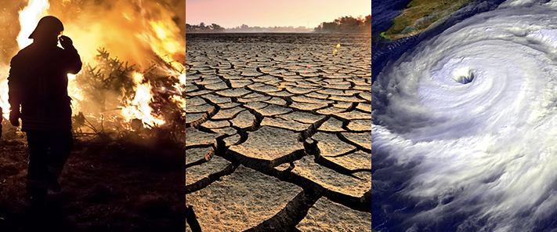
Climate change on Twitter
Notes:
Many people get their news nowdays from Twitter. However, due to high informatin circulation within friendhsip groups and similar people. People can often suffer from what is called an echo chamber and might not be exposed to information outside of their network.
The purpose of my project is create a product which can help users find news and reading resources related to particular topics of interest based on information from the whole of Twitter. In this case I am using an example topic of Climate change.
To do this, I will scrape tweets from twitter on climate change, cluster them into sub-topics and then present the user with relevant resources to learn more about each sub-topic.

Slide 2




The Data
20,000 tweets
Keyword Filter:
Climate change
Climate
Global Warming
etc...
Notes:
Firstly I scrape all tweets within the last week.
The data is scraped using a fixed number human curated key words relevent to each topic.
In total 3200,000 tweets were.
These tweets were then stored in MongoDB database so it can easily accesed during modeling.

Slide 3
Text Preprocessing and Modeling
“Wildfires caused by climate change”
LDA model
Topic 1
[wildfire, caused]
Topic 2
[wildfire, caused, wildfire caused]
Topic 3
Notes:
Before modeling, the text was pre-processed with tokenization, lematization, removing stopwords and creating bigrams and trigrams.

Slide 4
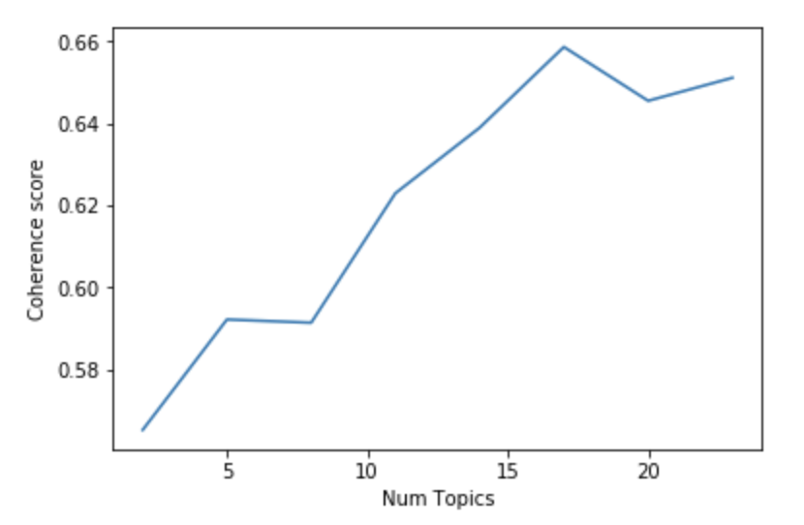
Optimizing cluster number: 1. Maximize coherence
17
Notes:
The chosen model used was Latent Dirichelt Allocation. To find the optimal number of clusters for each topic, the coherence of each topic was found. Each generated topic consists of words, and the topic coherence is applied to the top N words from the topic. It is defined as the average / median of the pairwise word-similarity scores of the words in the topic (e.g. PMI).

Slide 5
Optimizing cluster number: 2. Removing similar topics
Jensen-Shannon divergence:Measures distances between topics.
Rank topics according to total distance with other topics.
Remove lowest 10% of the topics.
No. of Topics:
17
15
Notes:
However, with a large amount of topics, there are many topics with overlapping themes. The next step was to trim it down by removing topics which were too similar on a whole to the other topics. I did this using the Jensen-Shannon divergence which measure the distances between topics.
I then ranked all the topics based on total distance to other topics.
The I removed the topics with the lowest score, these were the most similar to other topics.
Doing this, I moved from 17 topics down to 15.

Slide 6
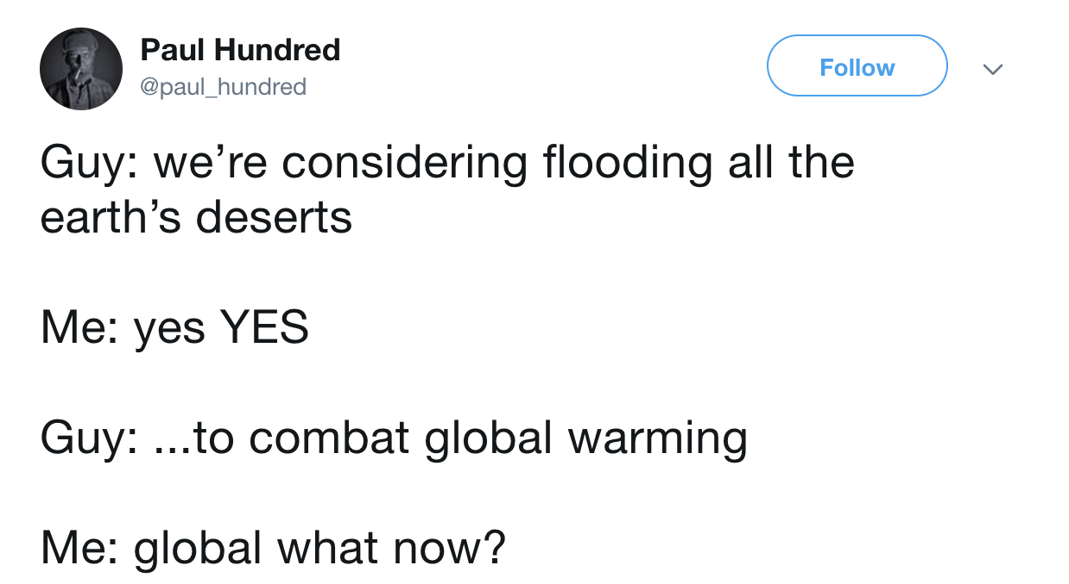
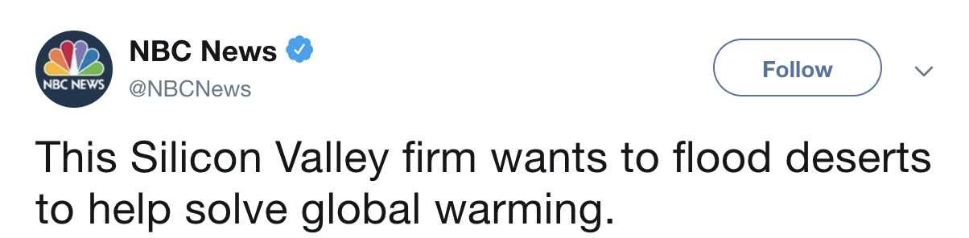
LDA Modeling
Topic 1:
Word | Probability
help | 0.003
stop | 0.003
flooding | 0.002
deserts | 0.002
flooding deserts | 0.002
Notes:
After modeling, each topic has a probability distribution for words within that topic. Here you can see the top key words in Topic 1.
Here are some tweets that are classified in topic 1. We can see that many of the top words are inlcuded here. Overall it seems like people are talking about flooding the desert to help stop global warming. Seems quite interesting.

Slide 7

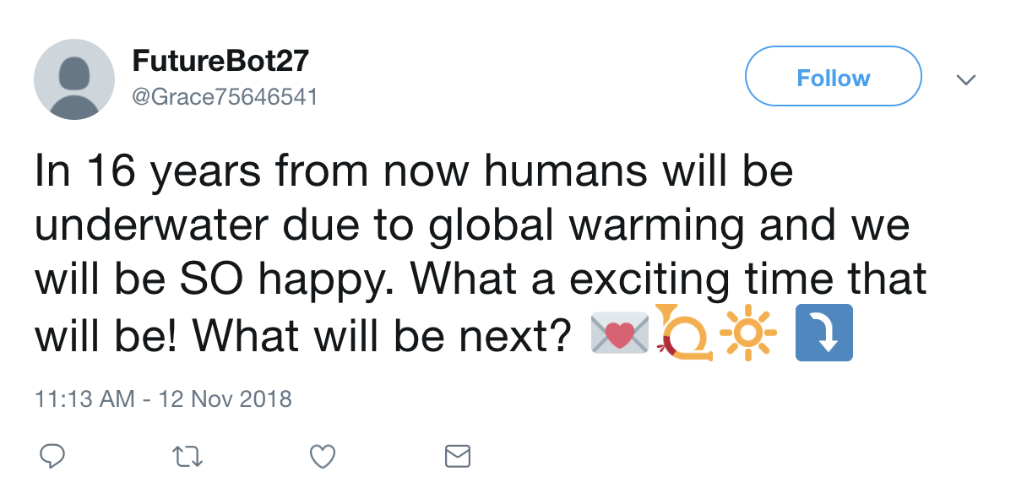
Sentiment analysis: Positive
+0.88
+0.90
Notes:
Another feature that may be useful for a user is to give sentiments on certain topics. This was done using VADER sentiment analysis on each tweet in a topic and then averaged out to give a topic sentiment.
Here you can see two sentiments which were rated postively by VADER. On your left you can see a genuinely positive tweet.
However, VADER has problems picking up on sarcasm as can be seen by the tweet on the right.

Slide 8
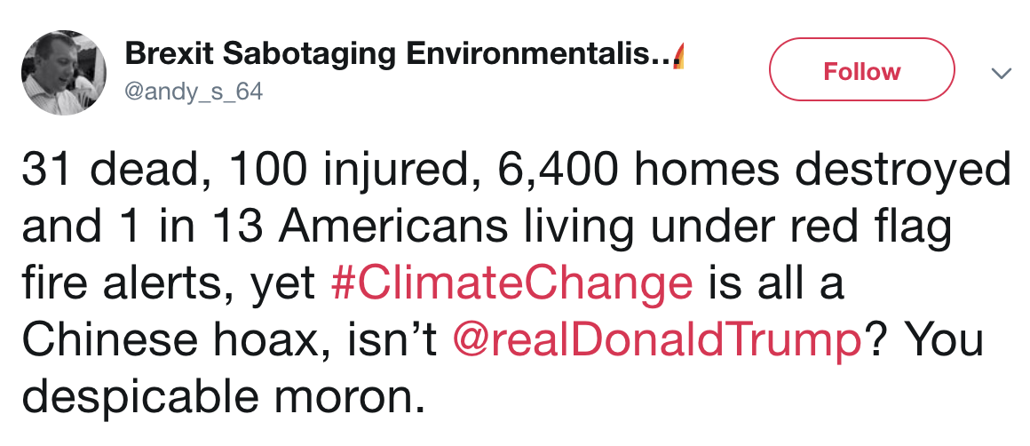
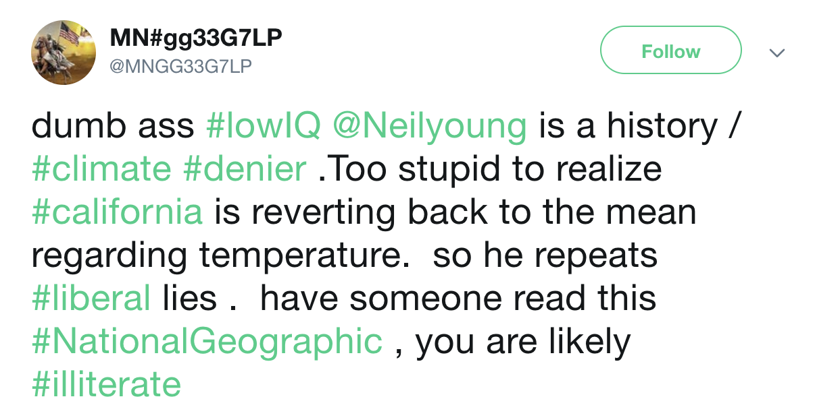
Sentiment analysis: Negative
-0.88
-0.80
Notes:
Here are some examples of tweets with negative sentiment.
On the left the tweet involves death and injury so the sentiment is bad.
On the right we have some guy hating on Neil Young.

Slide 9
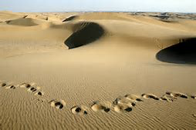


Generating resource links and images
would
flooding deserts
help
deserts
stop
flooding
Notes:
So these key words can then be used to automatically generate resources for a user to learn more about a sub-topic.
I used the key words to generate a link using Google’s I’m feeling lucky to a relevant article on the topic.
I also use the key words to scrape relevant images from Bing to give a better context of the topic.
These resources are used to automatically update a webpage whixh showcases the results.
So putting this together, here is a flask app.

