Slide 1
Impact of Covid-19 Vaccine on world-(Emphasis on stock market,economy and covid-related deaths)
By Muskan, Ahmad,Jasleen and Nazim

Slide 2
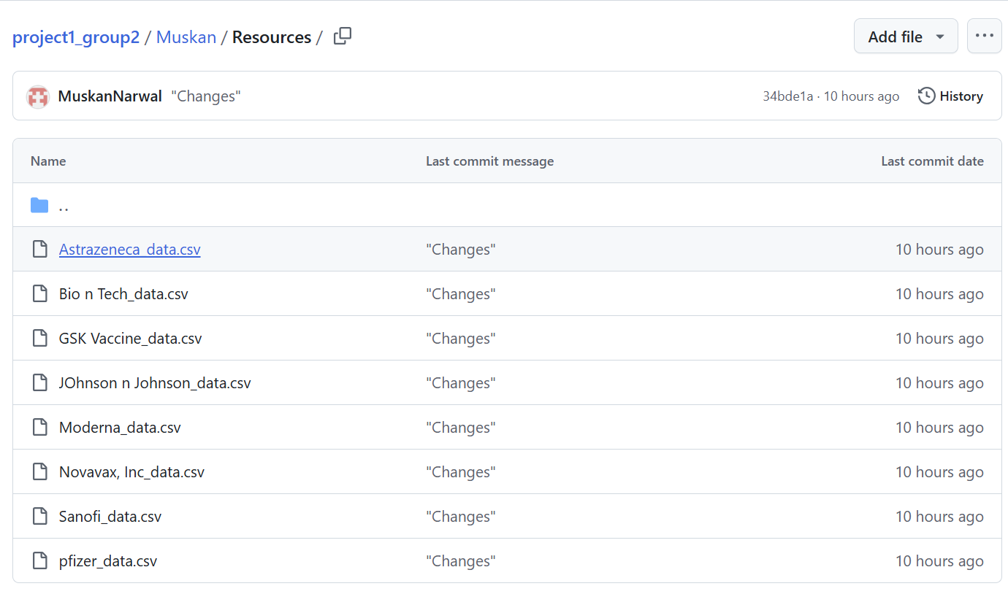

Resources Question 1 - Which Pharmaceutical Company Stock Performed the most during Covid-19?
Data Collection :
Data Source - (Python Libraries)
pip install yfinance - Download market data from Yahoo! Finance API
import yfinance as yf- (yfinance is an open-source library that allows you to access market data from Yahoo! Finance's API.)
The csv. files contains stock information for each vaccine listed -later merged to one csv - to compare the performance .

Slide 3
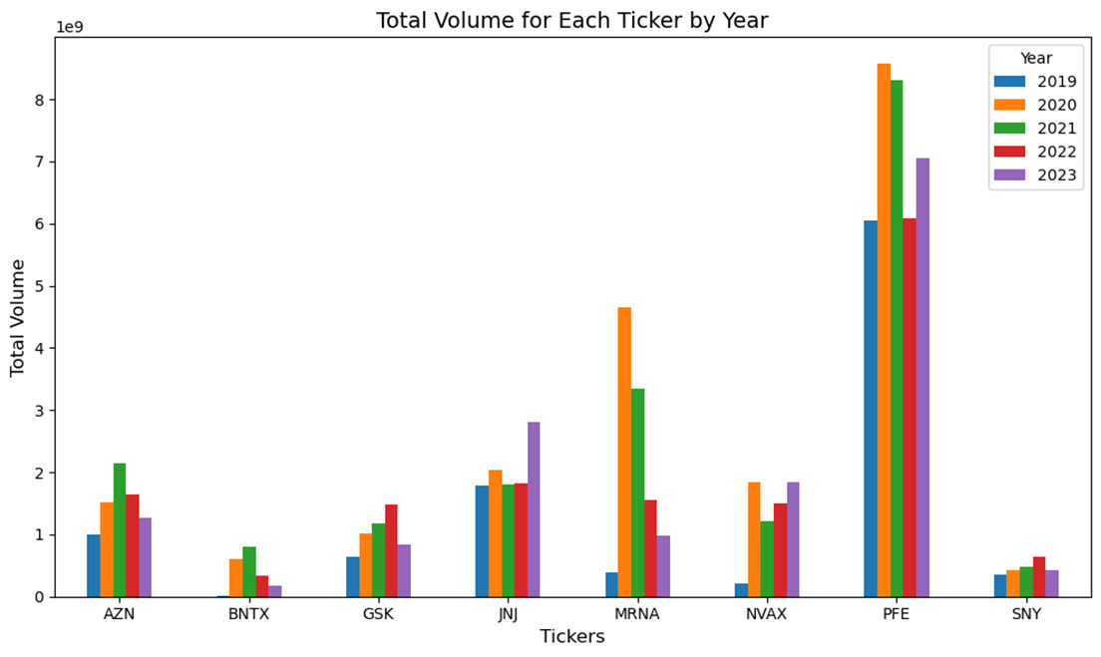
Research Question 1 - Which Pharmaceutical Company Stock Performed the most during Covid-19?
MRNA saw significant increases in volume starting in 2020, correlating with the development.
Pfizer (PFE):Consistently had the highest trading volume across 2019–2023.
BioNTech (BNTX)volume, although not as high as Pfizer or Moderna, did see increases in 2020 and 2021- likely due to its collaboration with Pfizer on the COVID-19 vaccine.
Novavax(NVAX) saw a sharp spike in trading volume in 2020, which coincides with high expectations for its vaccine development.
Figure:Trading Volume and Stock performance (for each Ticker)

Slide 4
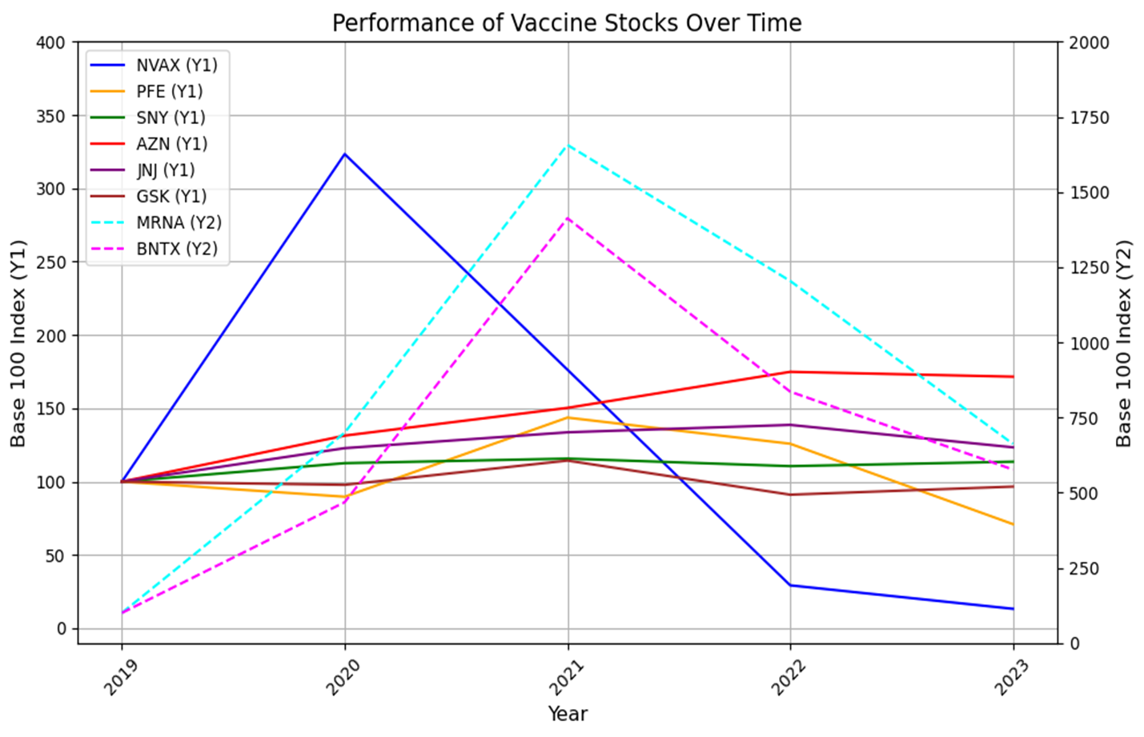
Research Question 1 - Which Pharmaceutical company Performed the most during Covid-19?
MRNA and BNTX (plotted on the secondary Y2 axis) far outperformed the other stocks in terms of stock price growth.
MRNA reached a peak index of over 1750 in 2021, meaning it grew more than 17 times its 2019 value, while BNTX hit an index of 1250. This shows these stocks benefited the most from COVID-19 vaccine success.
Figure:Price Growth and Stock performance (2019-2023)

Slide 5
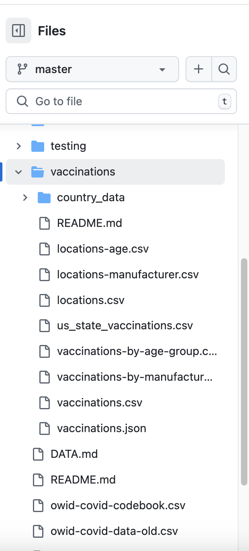
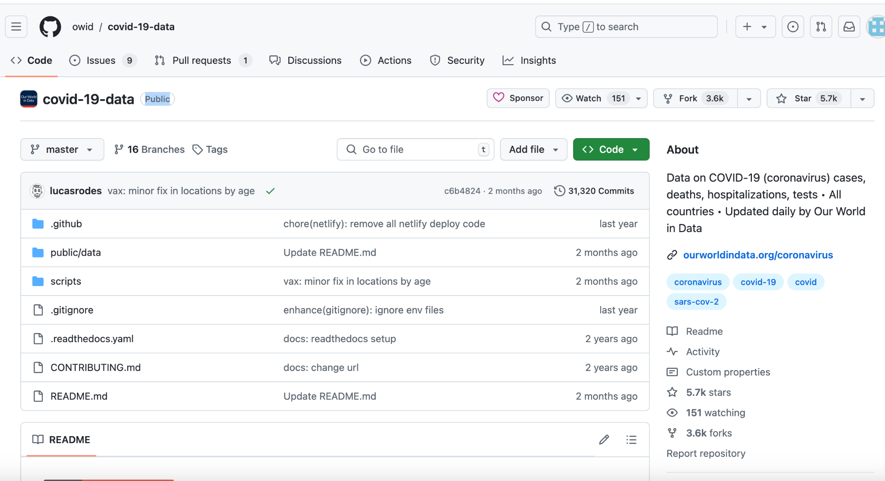
Research Question 2 - analyzing correlation between amount of vaccines administered for a manufacturer and stock volume of the company
-Data was collected from Our World in Data (owid) covid-19-data Github repository, more specifically the vaccinations-by-manufacturer.csv file from the vaccinations folder inside the public/data folder
https://github.com/owid/covid-19-data.git

Slide 6
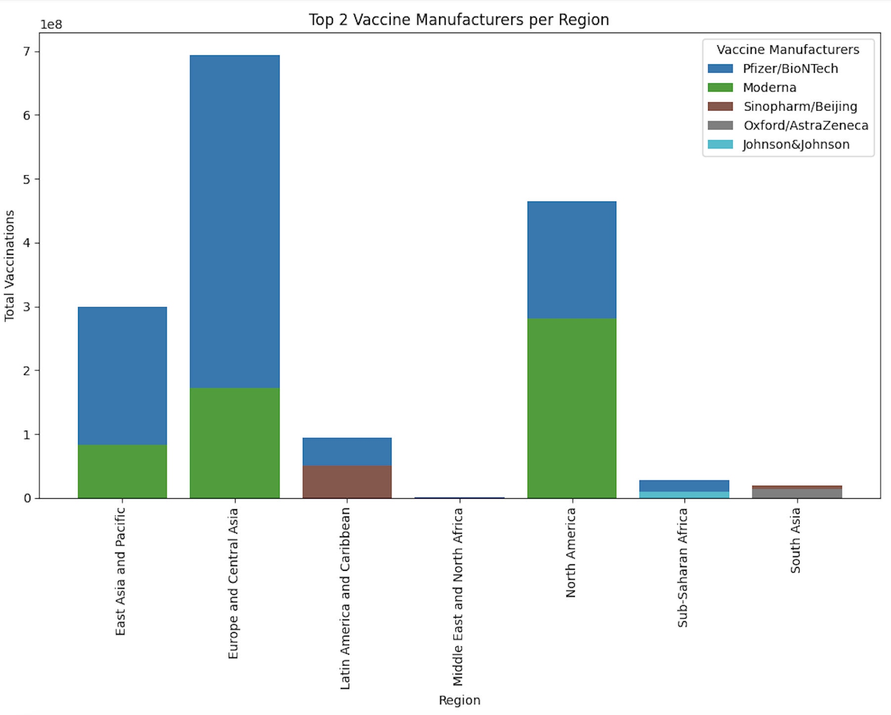
Research Question 2 - analyzing correlation between amount of vaccines administered for a manufacturer and the stock volume of the company
-Bar Graph showing top 2 manufacturers per region
-Pfizer, Sinopharm and Moderna appear to dominate the market
-These manufacturers are collected to perform the linear regression on the next slide

Slide 7
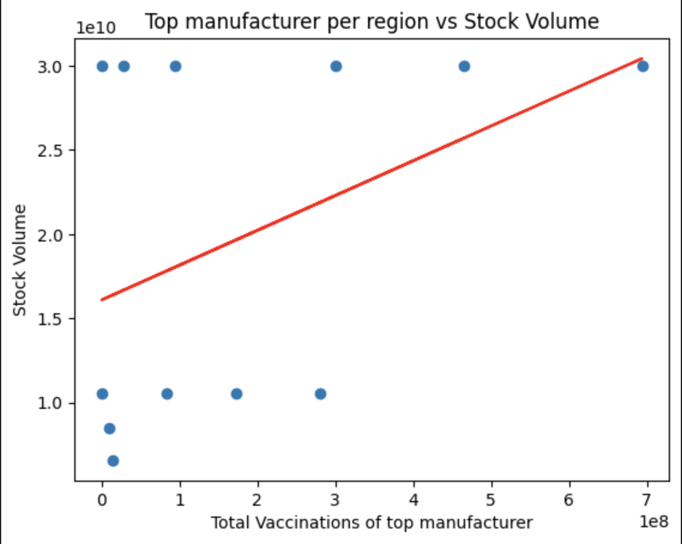
Research Question 2 - analyzing correlation between amount of vaccines administered for a manufacturer and the stock volume of the company
-R-value is 0.42 - not high enough to say that there is a strong correlation
-Conclusion: it cannot be said said by means of statistical measures that as the amount of vaccines administered for one manufacturer increases then so does the stock volume of the company

Slide 8
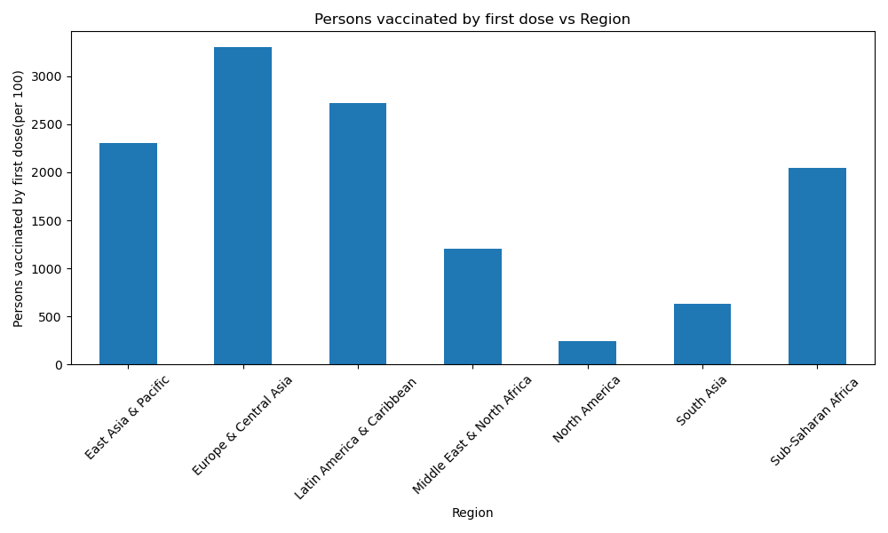
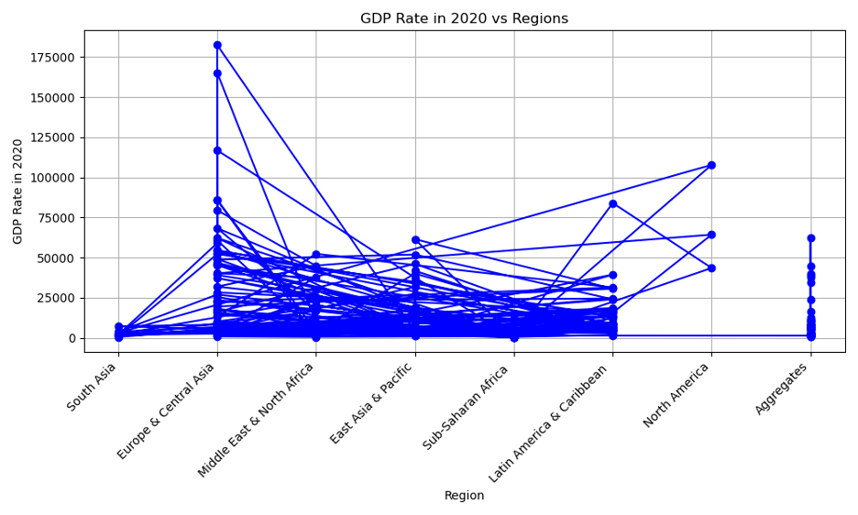
Research Question 3: Is there a correlation between the vaccine rollout and the change in economy of different countries throughout this timeframe
Individuals vaccinated per region(first dose):
GDP (after the first dose):

Slide 9
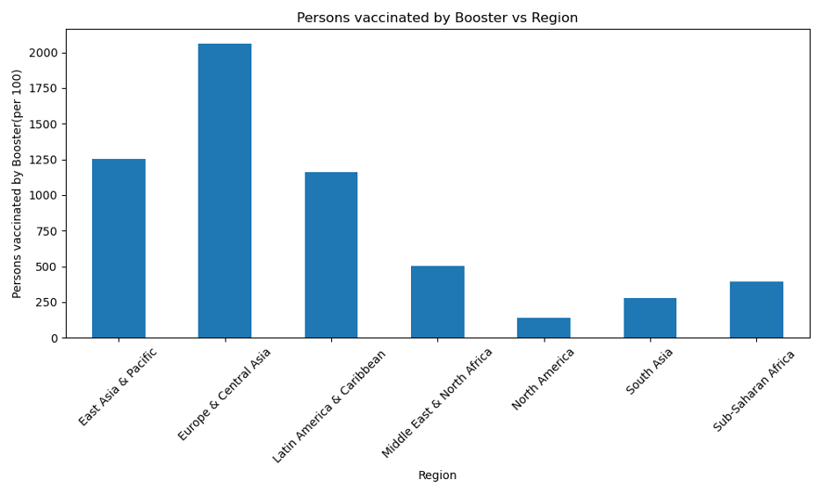
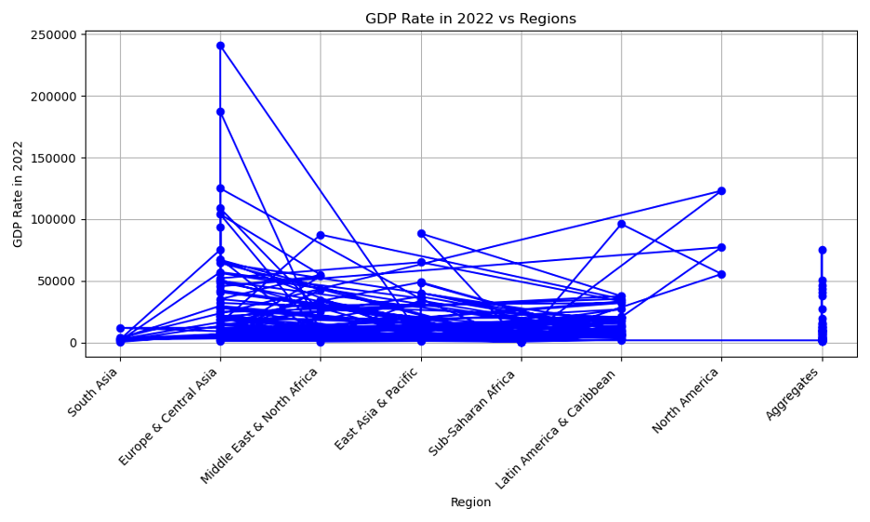
Question 3:
Individuals vaccinated per region(booster):
GDP (after the booster):

Slide 10
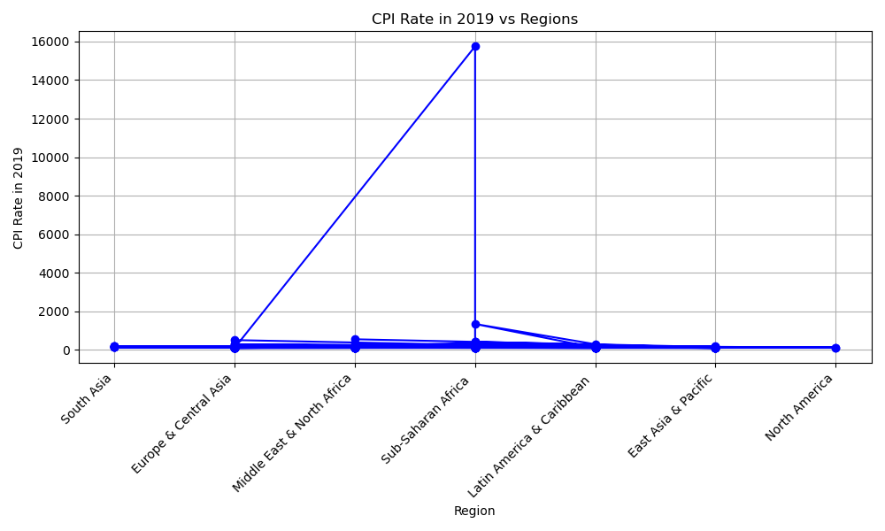
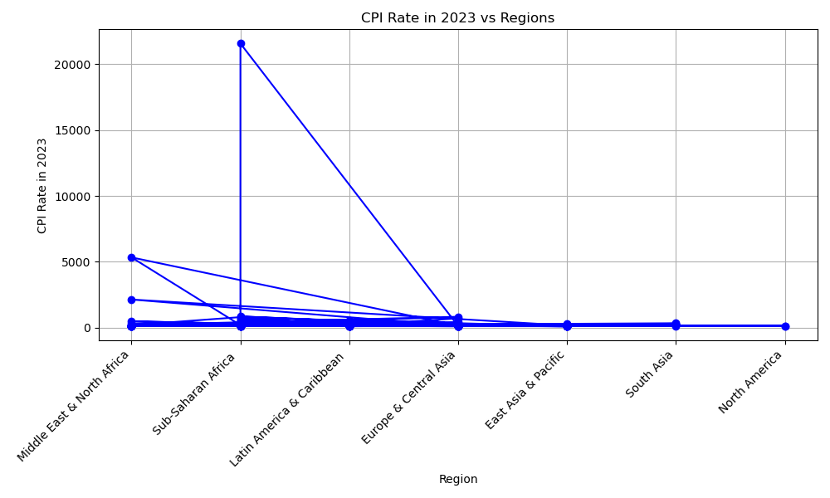
Question 3:
CPI(consumer spending before the pandemic):
CPI(consumer spending post pandemic):

Slide 11
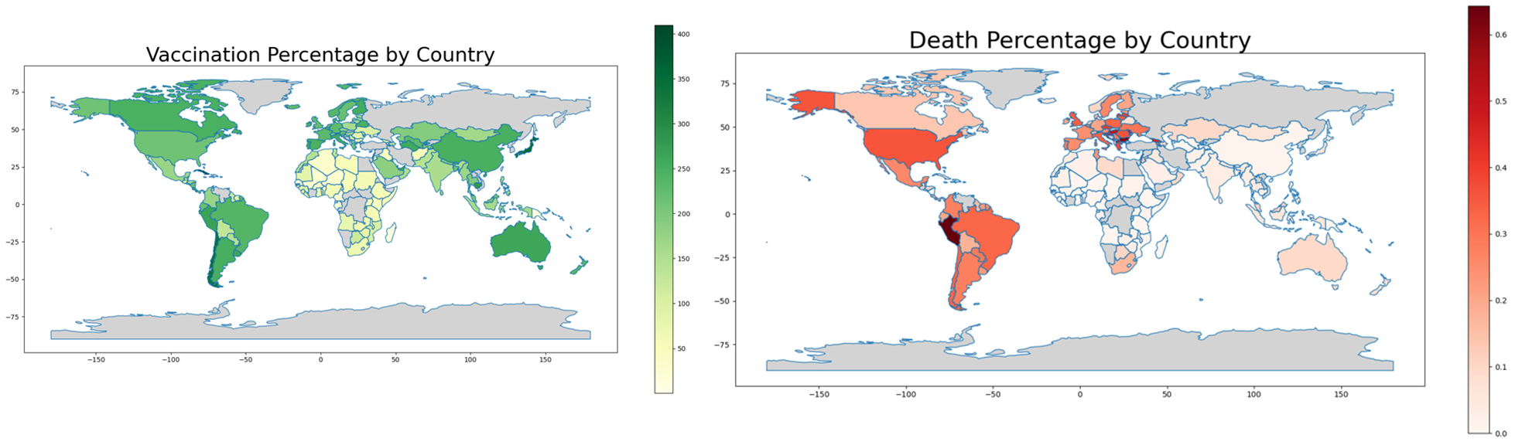
Resources Question 4-Is there a Correlation between Covid vaccination campaign and deaths?

Slide 12
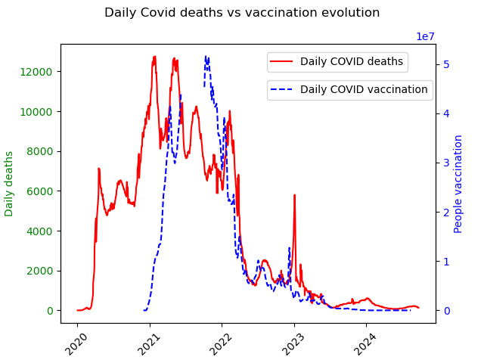
Resources Question 4-Is there a Correlation between Covid vaccination campaign and deaths?
This chart shows how the daily decreases due to COVID evolved between the beginning of the pandemic till today,
There was several pics corresponding to the different waves
Since the launch of the vaccines late 2020, the number of deaths starts decreasing which would suggest a correlation between the vaccination campaign and the effect of the pandemic,

Slide 13
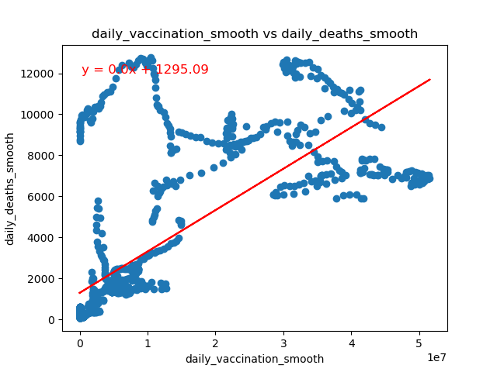
Resources Question 4-Is there a Correlation between Covid vaccination campaign and deaths?
When we compare the evolution of the vaccines with the daily deaths number, we do not observe a correlation between the two indicators.
The data is skewed and does not follow an obvious pattern.

Slide 14
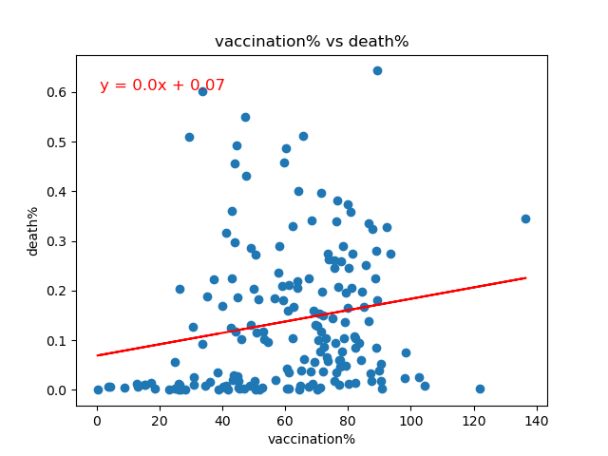
Resources Question 4-Is there a Correlation between Covid vaccination campaign and deaths?
This observation is confirmed when we compare the vaccination% (compared to the total population) and the deaths%, country by country
In this case we also does not observe a correlation between the 2 sets of data collected for 200 countries.

Slide 15
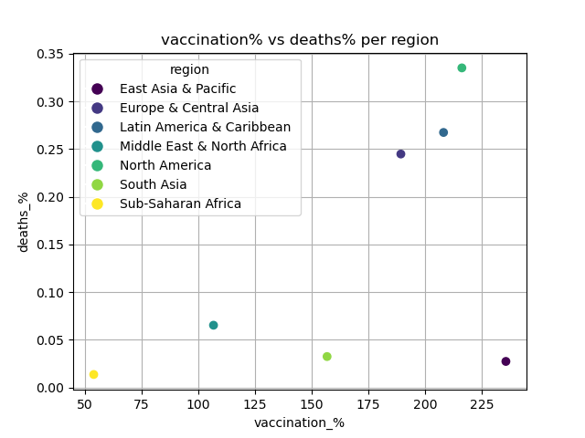
Resources Question 4-Is there a Correlation between Covid vaccination campaign and deaths?
If we aggregate the countries by region,
this observation is confirmed
- no correlation between both indicators
However, we recognize some specifics that can explain the impact of the pandemic in the world
Sub-Saharan Africa : the impact was limited and observed from the beginning (no explanation till now). The most probable is a natural immunization of the population to the severe consequences.
Asia : the contingent policies that last longer could explain the limitation of deaths in these areas : longer and more strict lockdowns, population control.
There are 3 regions highly impacted with severe consequences

