Slide 1

FedEx-project
Logistics Optimization for Delivery Routes – FedEx
Summitted By
Name – Nazim khan
Course Name – Data Science

Slide 2
Project Overview
Analyze shipment performance, delays, routes, warehouses, and agents.
Improve delivery efficiency
Evaluate warehouse efficiency and utilization
Measure delivery agent performance
Track shipments status and operational bottlenecks

Slide 3
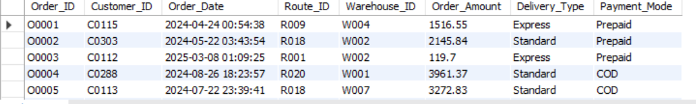
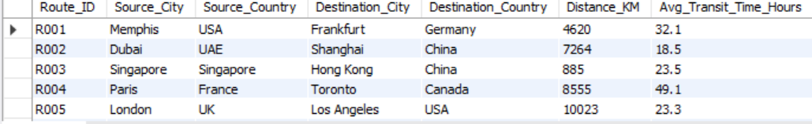
Dataset Description
Orders, Routes, Warehouses, Delivery Agents, Shipments

Slide 4
Task 1: Data Cleaning
Duplicates, NULL handling, date formatting, integrity checks
Find the Null Delay_Hours
select * from Shipments where Delay_Hours is null;
-- Format the order date –
SELECT DATE_FORMAT(Order_Date,'%Y-%m-%d %H:%I:%s') FROM Orders;
-- Check the missing Routs IDs –
select * from Orders where Route_id not in ( select Route_id from Routes );

Slide 5
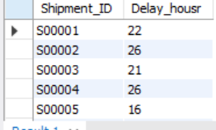
Task 2: Delivery Delay Analysis
Delay calculation, delayed routes, rankings
Calculate Delivery Delay (Hours) for each Shipment
select Shipment_ID, TIMESTAMPDIFF(Hour, Pickup_date, Delivery_Date) as Delay_housr from Shipments;

Slide 6
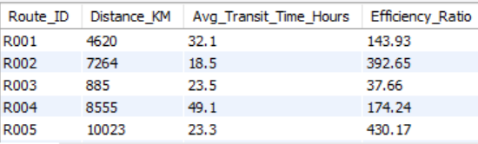
Task 3: Route Optimization
Transit time, efficiency ratio, optimization insights
Distance-to-Time Efficiency Ratio
SELECT Route_ID, Distance_KM, Avg_Transit_Time_Hours, ROUND(Distance_KM / Avg_Transit_Time_Hours, 2) AS Efficiency_RatioFROM Routes;
Lowest efficiency routes
Optimization opportunities

Slide 7
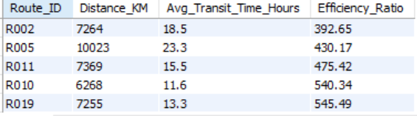
Task 4: Warehouse Performance
Warehouse delays, shipment counts, rankings
Find the Top 3 Warehouses with Highest Average Delay
select Warehouse_id, Avg(Delay_Hours) as Avg_Delay from Shipments group by Warehouse_id order by Avg_Delay desc Limit 3;

Slide 8
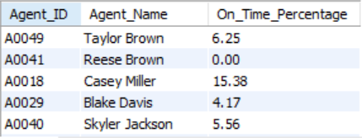
Task 5: Agent Performance
On-time %, ratings, experience comparison
Find the Agents whose on-time % is bleow 85% --
SELECT s.Agent_ID, a.Agent_Name, ROUND( SUM(CASE WHEN s.Delay_Hours <= 0 THEN 1 ELSE 0 END) * 100.0 / COUNT(*), 2 ) AS On_Time_PercentageFROM Shipments s JOIN Delivery_Agents a ON s.Agent_ID = a.Agent_IDGROUP BY s.Agent_ID, a.Agent_NameHAVING On_Time_Percentage < 85;

Slide 9
Task 6: Shipment Tracking
Latest status, transit routes, high-delay shipments
Find the Display the latest status and latest Delivery_Date of r each shipment
select Shipment_id, delivery_status, delivery_date from Shipments;
Find the Routes where the majority of shipments are "In Tansit" or "Retuned"
select route_id, delivery_status, count(*) as total_shipments from shipments where delivery_status in ('In Transit','Returned') group by route_id, delivery_status order by total_shipments desc;
Find the Order with exceptionly high delay (.120 hours)
select shipment_id, order_id, route_id, warehouse_id, agent_id, delay_hours from shipments where delay_hours > 120 order by delay_hours desc;

Slide 10
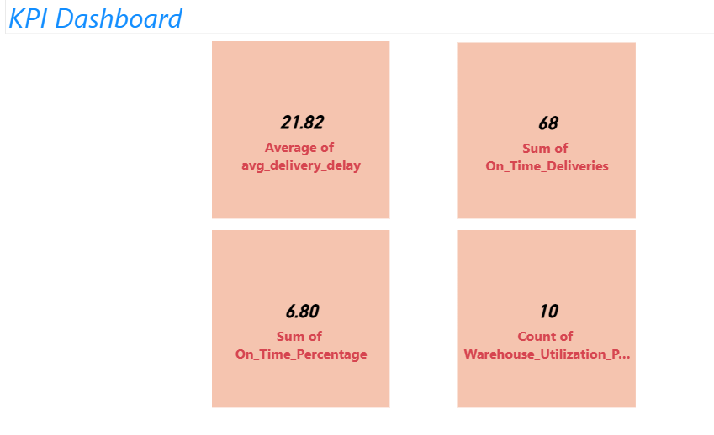
Task 7: KPI Dashboard
Delay by country, on-time %, route delay, utilization
3 routes caused maximum delay.
2 warehouses exceeded average dalay.
Top agents achieved 95% + on-time delivery.
Warehouse utilization below capacity in some locations.

Slide 11
Key Findings
1.Delevery Delay
Several shipments experience significant delay due to routes congestion and operational bottlenecks.
A few routes consistently showed higher average delay hours than others.
2. Routes Performance
Then worst-performing routes had low distance-to-time efficiency ratios.
More than 20% of shipments on some routes exceeded expected transit times.
3. Warehouse Performance
Certain warehouses handled a large number of delayed shipments.
Some warehouses had average delays higher than the overall network average.
On-time delivery percentages varied significantly across warehouses.
4. Delivery Agent Performance
Top-performing agents achieved very high on-time delivery rates.
Agents with lower experience and ratings generally showed lower on-time performance.
Some agents had on-time delivery percentages below 85%, indicating a need for improvement.
5. Shipments Tracking
Most shipments were delivered successfully.
A few shipments experienced exceptionally high delays (>120 hours), requiring investigation.

Slide 12
Recommendations
Route optimization, capacity planning, agent training.
Optimize high-delay routes.
Improve coordination between warehouses and transport hubs.
Provide training and mentoring for low-performing agents.
Balance delivery workloads agents.
Monitor high-delay shipments proactively.
Use KPI dashboard for continuous performance tracking and decision-making.

Slide 13
Conclusion
SQL-driven insights improve logistics efficiency.
The analysis successfully identified major delay patterns, inefficient delivery routes, warehouse bottlenecks, and delivery agent performance gaps within the FedEx logistics network.
By optimizing routes, improving warehouse operations, enhancing shipment tracking, and providing targeted training for delivery agents, FedEx can significantly improve on-time delivery performance.
These improvements will help reduce operational costs, increase customer satisfaction, and strengthen overall logistics efficiency and service reliability across the global network.

Slide 14
Video Link
https://drive.google.com/file/d/1MsWWH14PYamUCuGKbiJOaIn3a_K-BWkQ/view?usp=drivesdk

