Slide 1
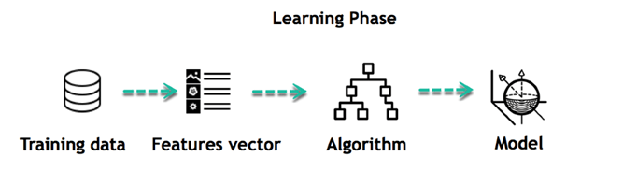
Machine Learning Project
Nazim Zerrouki
Jing Tian
Charchita Kuppa

Slide 2
Pre-Process the Data
Using the nltk library:
Convert the review to all lowercase letters
Remove the numbers
Remove the punctuation, including:
!"#$%&'()*+,-./:;<=>?@[\]^_`{|}~
Remove all the stop words to filter out common words and improve performance, such as:
you, he, she, who, do, is, above, that, in, will, can, and so on
Lemmatization
Word-embedding: map words to vectors of real numbers from 0 to 1, so it can be processed by an ML model.
TF-IDF: Another popular method of mapping words to vectors based on their relative importance in a collection of files. This can be fed into supervised learning models such as SVM

Slide 3
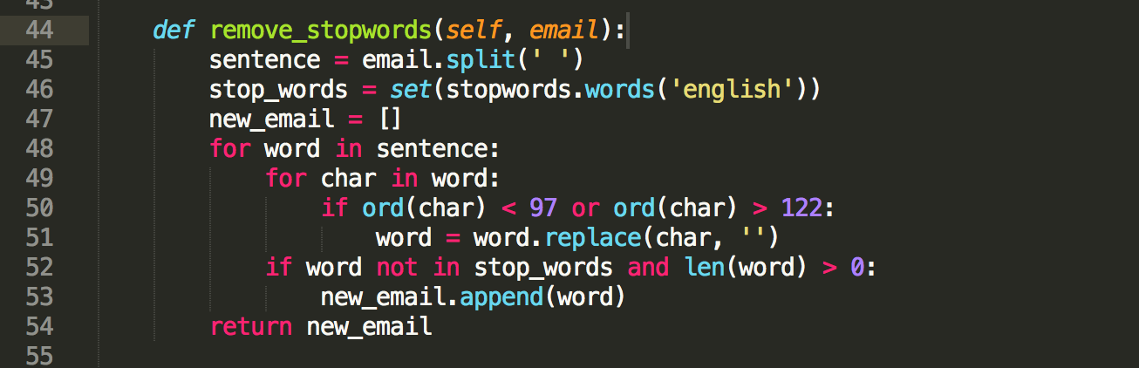
Code of removing stop words

Slide 4
Lemmatization
Lemmatization is the process of removing suffixes of words to return them to their base form, so different variations of the same word can be grouped together to get relevant results.
Stemming algorithms are also tools that can accomplish the same task, but they lead to less accurate results because they do not take into consideration of the context of the word.
Lemmatization aims to rectify this using algorithms that take into consideration of a pos tag. A pos tag gives meaning to the context of a word i.e noun, verb, adverb, adjective, etc.
It is slower, but leads to more precise results.

Slide 5
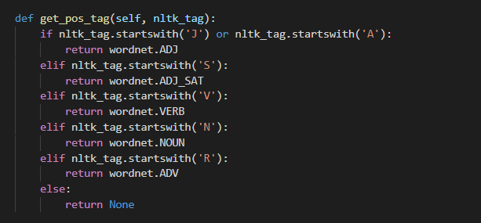
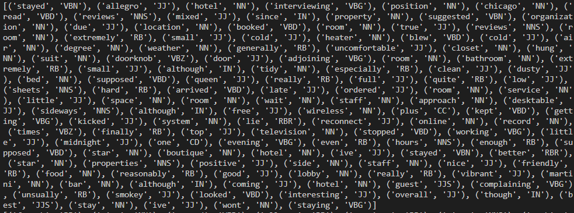
Context

Slide 6
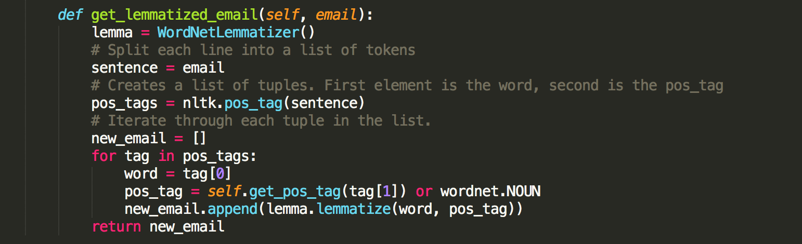
Extraction

Slide 7
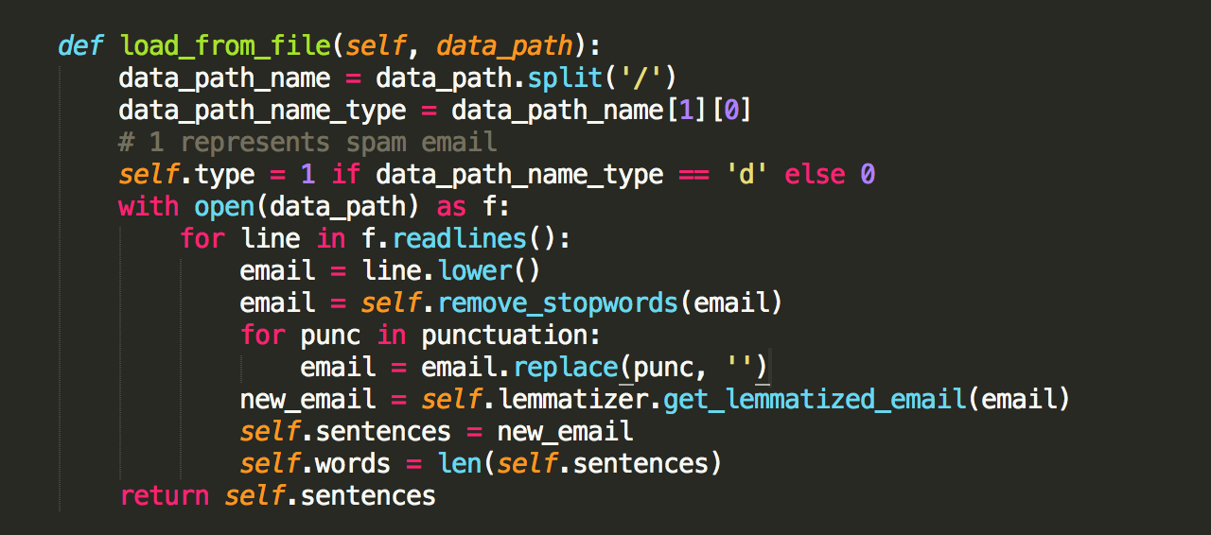
Entire Process

Slide 8
Example
Path name: positive_polarity/deceptive_from_MTurk/fold2/d_talbott_9.txt
Review:
excellent staff and customer service, very clean and spotless. elegant and luxurious with a beautiful ocean view. the bed is very comfortable and relaxing. i give it a five star.
Cleaned-review:
['excellent', 'staff', 'customer', 'service', 'clean', 'spotless', 'elegant', 'luxurious', 'beautiful', 'ocean', 'view', 'bed', 'comfortable', 'relax', 'give', 'five', 'star’]

Slide 9
Example
Path name: positive_polarity/deceptive_from_MTurk/fold2/d_hardrock_19.txt
Review:
My husband and I recently stayed at the Hard Rock Hotel Chicago and we can't wait to go back! The hotel is located in downtown Chicago and seems to be at the heart of the city, we were close to everything. The Hard Rock Hotel is forty stories high and the view from our room was simply breathtaking. The room itself was spotless and featured modern luxurious decor and furnishings. The bed was heavenly. The hotel staff was friendly, upbeat and extremely helpful, we asked for directions and restaurant recommendations and they were spot on with both. I highly recommend the Hard Rock Hotel in Chicago and I would stay there again in a heartbeat.
Cleaned-review:
['husband', 'recently', 'stay', 'hard', 'rock', 'hotel', 'chicago', 'cant', 'wait', 'go', 'back', 'hotel', 'locate', 'downtown', 'chicago', 'seem', 'heart', 'city', 'close', 'everything', 'hard', 'rock', 'hotel', 'forty', 'story', 'high', 'view', 'room', 'simply', 'breathtaking', 'room', 'spotless', 'feature', 'modern', 'luxurious', 'decor', 'furnishing', 'bed', 'heavenly', 'hotel', 'staff', 'friendly', 'upbeat', 'extremely', 'helpful', 'ask', 'direction', 'restaurant', 'recommendation', 'spot', 'highly', 'recommend', 'hard', 'rock', 'hotel', 'chicago', 'would', 'stay', 'heartbeat']

Slide 10
Data visualizations

Slide 11
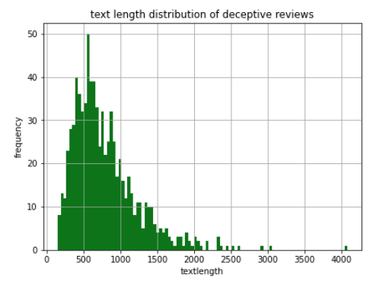
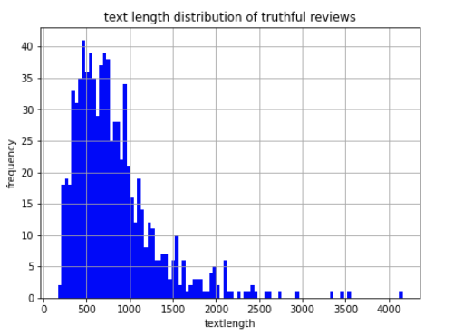
Review text length of deceptive and truthful reviews
The text lengths of truthful reviews are more distributed than the text length of deceptive reviews.

Slide 12
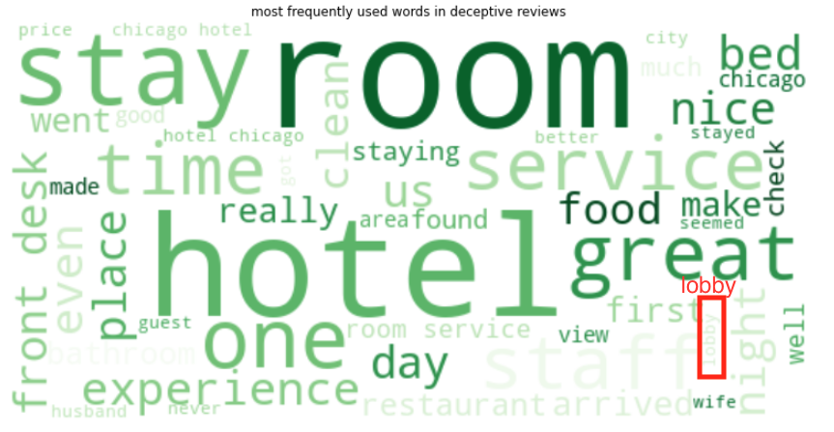
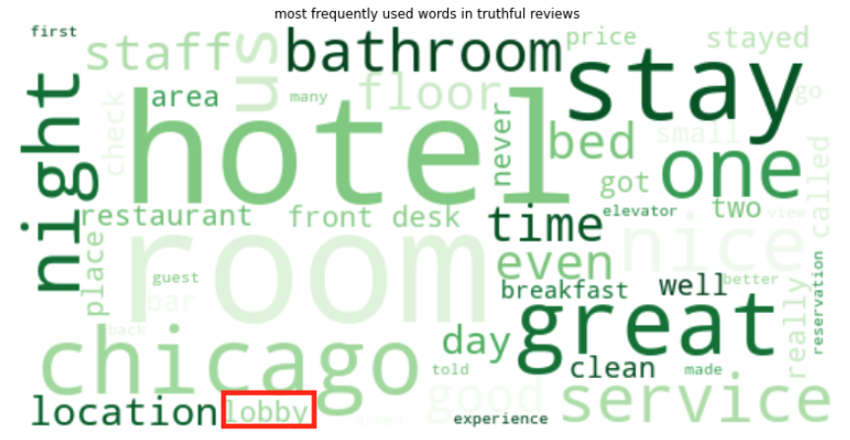
Word clouds for deceptive and truthful reviews for 50 most used words
The word cloud images shows most frequently used words with bigger font size
The word 'lobby’ is more frequently used in truthful reviews than in deceptive reviews.

Slide 13
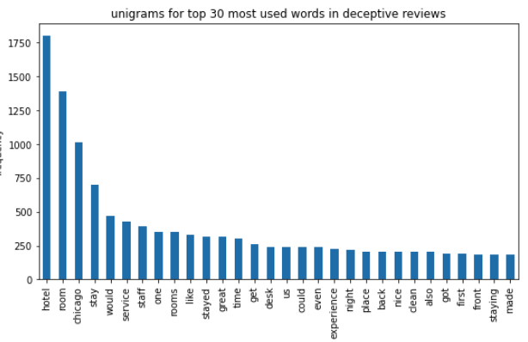
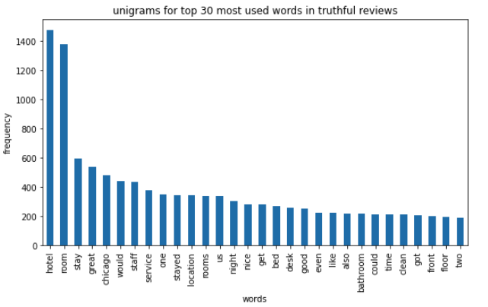
Top 30 most used Unigrams for Deceptive and Truthful reviews
The word ‘Chicago’ is used 1000 times in deceptive reviews , while it was used 400 to 600 times approximately in truthful reviews.

Slide 14
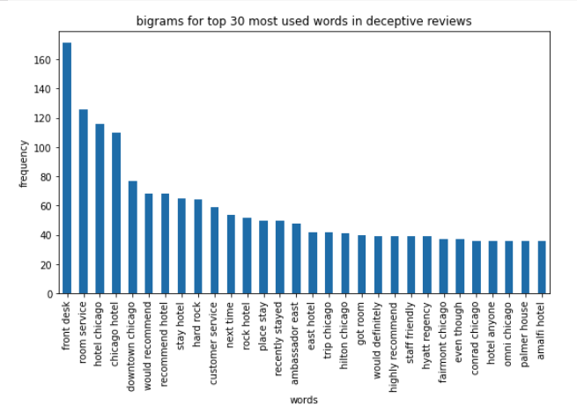
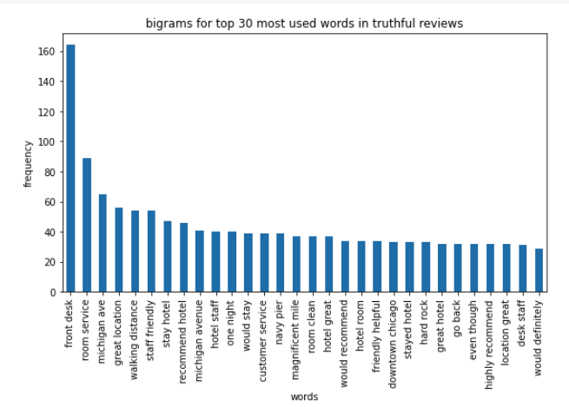
Top 30 most used bigrams in truthful and deceptive reviews
The bigrams for deceptive reviews mostly contains hotel names like 'faimount chicago', ‘conrad chicago’
the bigrams for truthful reviews contains information about street names like 'michigan avenue', about location like 'location great’.

Slide 15
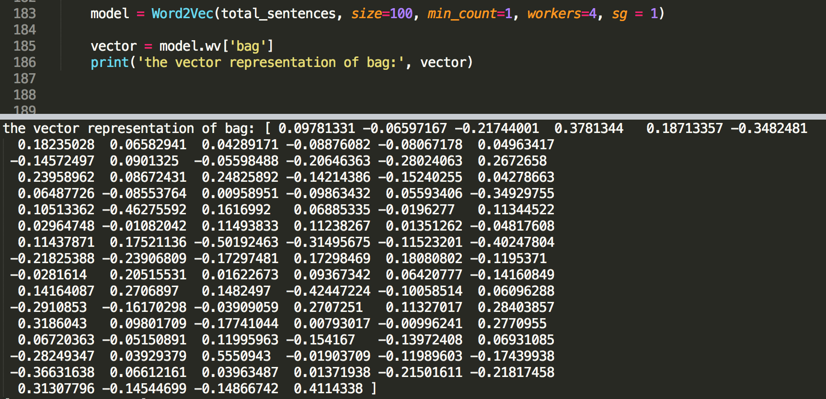
Code of word-embedding
model = Word2Vec(total_sentences, size=100, min_count=1, workers=4, sg = 1)
The total_sentences is a list of all the cleaned-review, so its length is 1600.
Each cleaned-review is a list of all the word.
This code can map each word in the cleaned-review to a vector which length is 100.

Slide 16

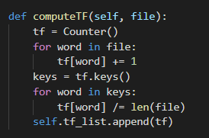
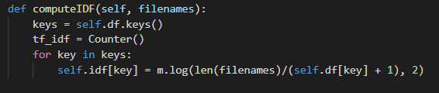
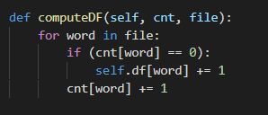
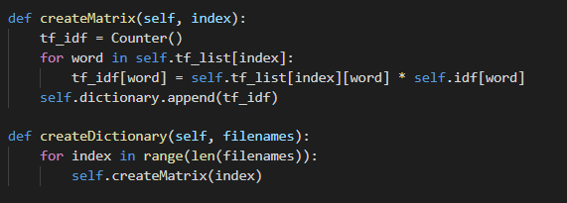
TF-IDF Matrix
Term Frequency: Relative frequency of a word in a file.
Document Frequency: The number of occurrences a word appears in every document.
Inverse Document Frequency:
Final Result: The product of the term frequency and inverse document frequency.

Slide 17
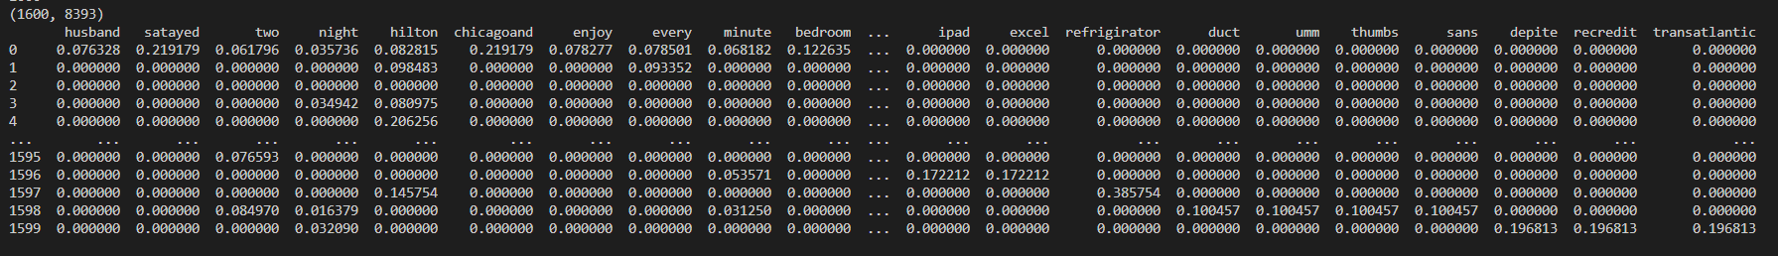
TF-IDF Result
1600 files with shared TF-IDF values among 8393 words

Slide 18
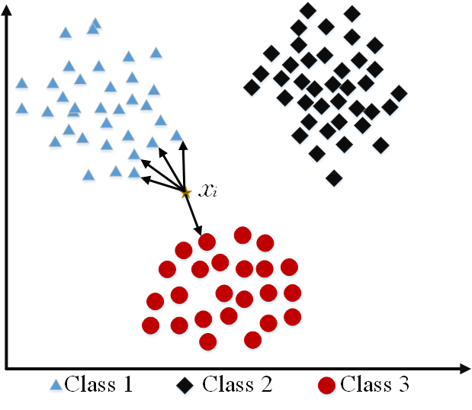
Model Survey For Opinion spam Detection
Since the dataset is labelled supervised machine learning model could be used for opinion spam detection. Here are some popular supervised machine learning models.
KNN(K Nearest Neighbours):
It is an instance based machine learning model.
Given a sample of data it finds the k nearest neighbours of this sample and assigns label to the sample data based on the class of K neighbours.

Slide 19
Advantages:
No training step is needed in KNN algorithm and easy to implement
Limitations:
As the data set becomes large efficiency and speed of KNN algorithm declines.
KNN is sensitive to noise, outliers and missing values in the dataset
Decision Trees:
This model build trees by splitting data points, at each level different split points are tried and tested using a cost function like Information gain and Gini index.
The split with the best cost (or lowest cost) is selected. This is done until a pure leaf node is reached

Slide 20
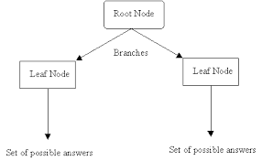
Advantages:
Decision trees has in built feature selection, It is insensitive to missing data and irrelevant features.
Limitations:
They are very unstable, a small change in the data could result in the large change in the structure of tree.
They are extremely sensitive to noise in data and tend to overfit easily.

Slide 21
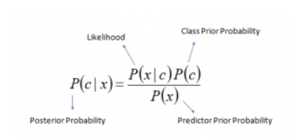
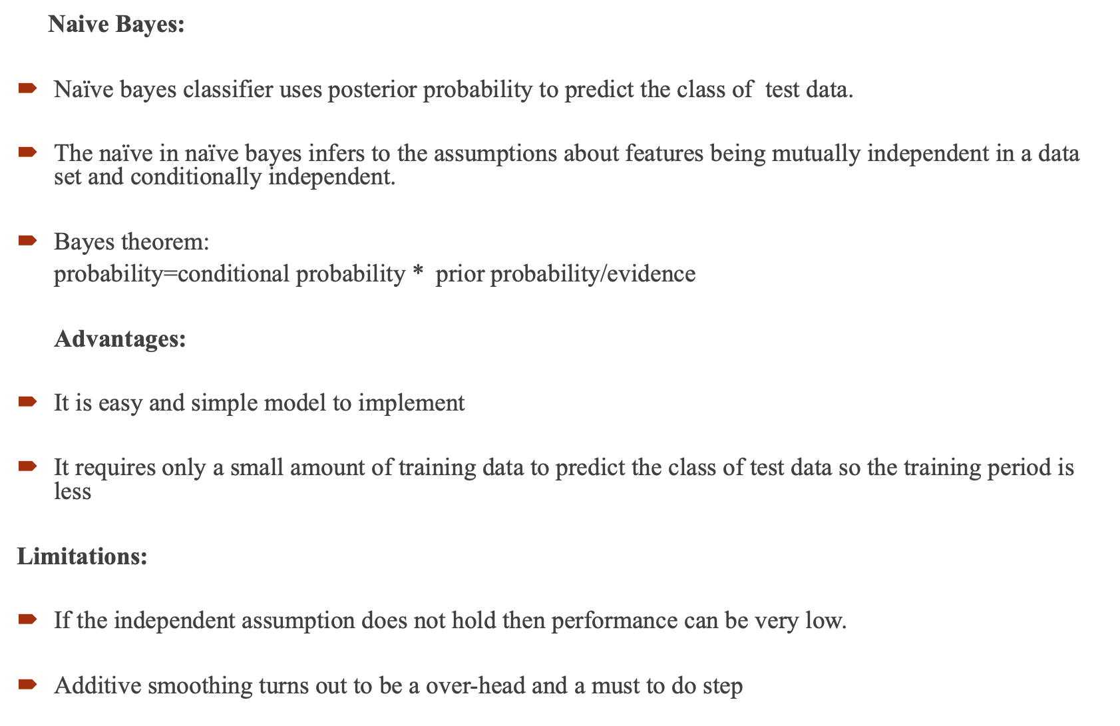
Naive Bayes:
Naïve bayes classifier uses posterior probability to predict the class of test data.
The naïve in naïve bayes infers to the assumptions about features being mutually independent in a data set and conditionally independent.
Bayes theorem:
probability=conditional probability * prior probability/evidence
Advantages:
It is easy and simple model to implement
It requires only a small amount of training data to predict the class of test data so the training period is less
Limitations:
If the independent assumption does not hold then performance can be very low.
Additive smoothing turns out to be a over-head and a must to do step

Slide 22
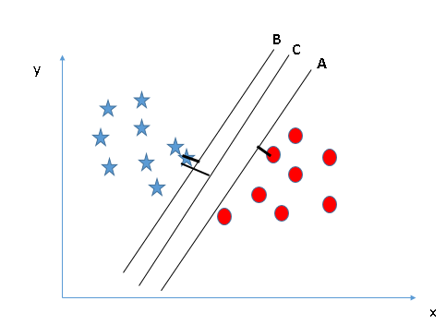
Support Vector Machine Algorithm:
SVM algorithm plots values of each feature as points in n-dimensional space(where n is the number of features) and then performs classification by finding a hyper plane that segregates classes perfectly.
It finds the hyperplane with maximum distance from nearest point and uses it as a classifier for two classes.
SVM uses a technique called kernel to deal with data points from classes that are not linearly separable.

Slide 23
Advantages:
It works well when there is a clear margin of separation between classes.
It scales well to high dimensional spaces
SVM generalizes well to test data, risk of over fitting is less.
Limitations:
Takes longer training time for large data sets.
Does not perform very well when the data set has more noise i.e. overlapping target classes.
Choosing proper kernel function is biggest challenge.

Slide 24
Recurrent Neural Networks
Recurrent Neural Networks are designed to recognize sequential characteristics of data.
Instead of assuming that all inputs and outputs are independent of each other, we assume there is a relationship between them that we can predict.
It uses a class of neural networks to remember the output from the previous steps and is fed into the input of the current state.
Advantages:
RNN can model sequence of data so each sample can be assumed to dependent on previous one.
Can take an input of any size.
Disadvantages:
It is computationally slow.

Slide 25
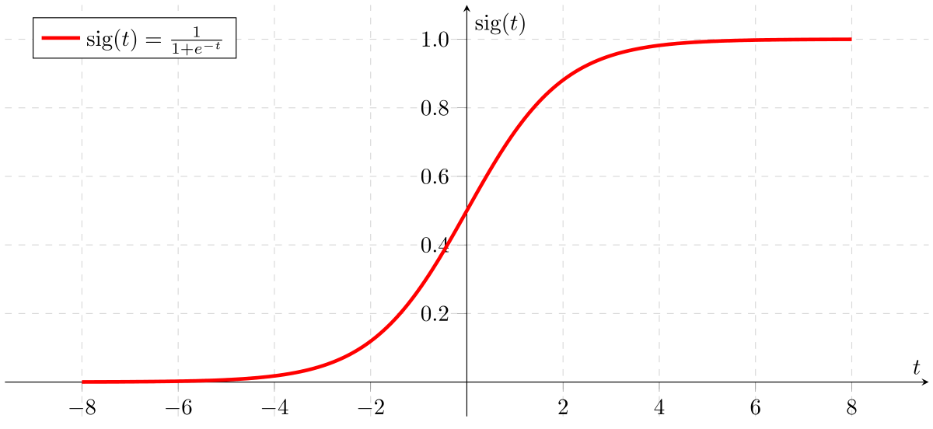
Logistic regression
The model uses probabilities for classification problems with two possible outcomes. It uses sigmoid function on linear equation to get probabilities between 0 and 1.
Probabilities > threshold value 0.5 belong to one class and probabilities < threshold value belong to another.

Slide 26
Advantages:
Logistic Regression proves to be very efficient when the dataset has features that are linearly separable.
In a low dimensional dataset having a sufficient number of training examples, logistic regression is less prone to over-fitting.
Limitations:
Logistic regression tend to overfit if number of features are greater that number of data points.
Logistic regression can suffer from complete separation i.e., if there is a feature that would perfectly separate the two classes, the logistic regression model can no longer be trained because the weight for that feature would be infinite so it would not converge.

Slide 27
Model Selection
Out of all the models we have researched, we have selected the Support Vector Machine, Naïve Bayes, and Recurrent Neural Networks. The main reason for this is because we feel these models best represents our problem and bode well with our current work. For instance, with a simple implementation, we can apply both Word2Vec and TF-IDF vectors to SVM and Naïve Bayes. We have also found out that these models work very well for the selected problem.

Slide 28
Naïve Bayes
Train test split: 20% of data for testing and 80% of data for training
Evaluation metrics: accuracy scores
Features Used: TFIDF vectors with max_features =4000(for both unigrams and bigrams) and Review Text length
Model: Naïve bayes
Features Used | Accuracy for Train Data(%) | Accuracy for Test Data(%) | Training Time in seconds
Unigrams | 95.9375 | 87.1875 | 0.119976
Unigrams + Text length | 95.9375 | 85.9375 | 0.120047
Bigrams | 98.046875 | 80.625 | 0.333666
Bigrams + Text length | 96.40625 | 87.8125 | 0.450027
Unigrams + Bigrams | 96.796875 | 90.3125 | 0.426835
Unigrams + Bigrams + Text length | 96.40625 | 87.8125 | 0.422098

Slide 29
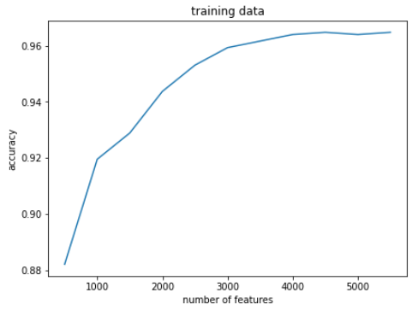
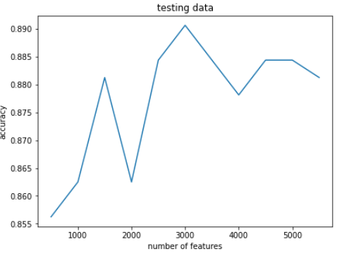
Fine tuning the model:
Changing the max_features from 500 to 6000
Graphs for train and test data (features used : TFIDF vectors for unigrams and bigrams, text length)

Slide 30
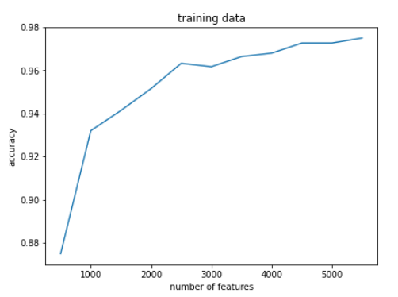
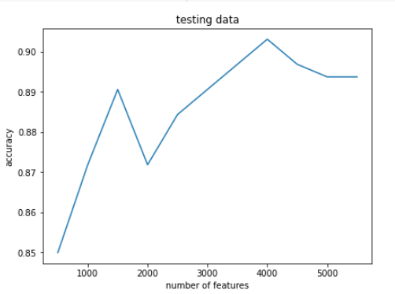
Graphs for train and test data (features used : TFIDF vectors for unigrams and bigrams)

Slide 31
Support Vector Machine
Train Test Split: 20% of the data was used for testing and 80% was used for training. A random seed of 42 was used and the data was shuffled for more relevant results.
Evaluation Metric: Training time and accuracy scores
Features: TFIDF vectors using CountVectorizer and TfidfTransformer with max_features=1000 for both unigrams and bigrams. The number of features are crucial for setting the regularization parameter and can skew training time as well.
Parameters:
C is the regularization parameter that dictates the number of points used for the support vector. Lower values allow for more misclassifications because less data points are being used and lead to underfitting(low variance/high bias). Higher values allow for more precise classifications and overfitting(high variance/ low bias) because more data points are being used. The number of features was adjusted so that the strength of regularization would not be too large or too small.
Kernel function describes the orientation of the hyperplane that distinctly classifies each group of reviews. A polynomial kernel function was found to be the best suited for classification.
Gamma determines which points carry more weight in our decision boundary. Farther points carry more weight when gamma is lower and vice versa for large values of gamma.
Ultimately, selecting the correct kernel function as well as choosing the best values for C and Gamma is crucial to prevent underfitting and overfitting which will produce reliable results.

Slide 32
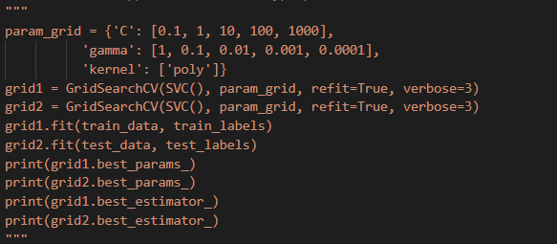
Results
Features | C | Kernel | Gamma | Training Time | Accuracy (Train) | Accuracy(Test)
1000 | 1.0 | Polynomial | 1.0 | 0.61897s | 100% | 52.292%
Used GridSearchCV in order to find approximations for selecting hyperparameters that produce greatest results.
However, these approximations provided fairly low results, so finetuning helped in improving evaluation metrics.

Slide 33
Model Training: lstm
Split the data for 80% training and 20% evaluation
evaluation metrics: accuracy
Train time: each epoch takes about 3-4 minute to run
Codes:
run on python
use the lstm structure on Pytorch
use wordembedding to process the data
use Binary CrossEntropyLoss as the loss function
use Adam algorithm as the optimizer with batch size 256, lr = 0.01

Slide 34
Model Training: lstm
Fine tune the model:
Change the value of learning rate
Change the structure: rnn or lstm
Change the optimizer: SGD or Adam
Change the batch size: 5 or 10 or 128 or 256
Change the parameters in lstm: dropout and bidirectional
Results on 150 epoch:
accuracy rate for training set: 99.7%
accuracy rate for test set: 64.1%

Slide 35
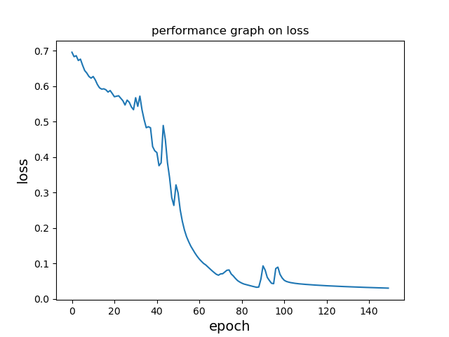
Result: lstm

Slide 36
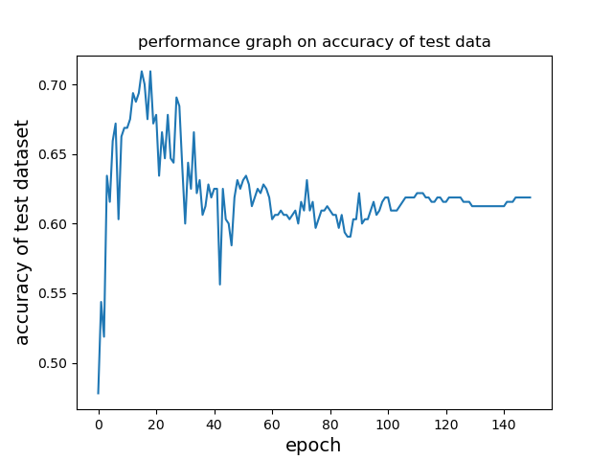
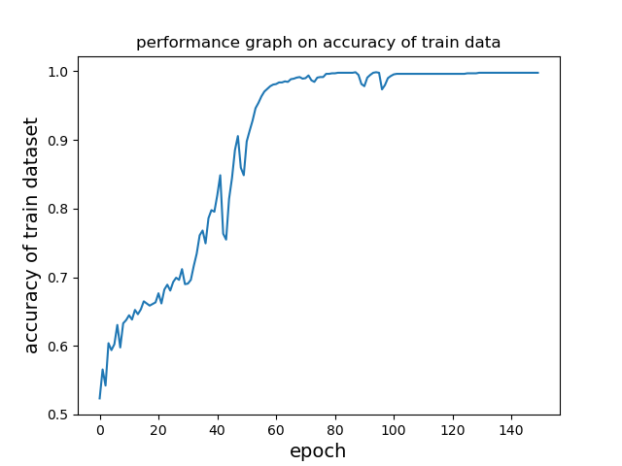
Result: lstm

Slide 37
Model Training: neural network
Split the data for 80% training and 20% evaluation
evaluation metrics: accuracy
Train time: each epoch takes about 3-4 second to run
Codes:
run on python
only use fully connected layer and activation function on Pytorch
don’t use any special structure like CNN or RNN
use TFIDF to process the data
use Binary CrossEntropyLoss as the loss function
use SGD algorithm as the optimizer with batch size 256 , lr = 0.01

Slide 38
Model Training: neural network
Fine tune the model:
Change the value of learning rate
Change the optimizer
Change the batch size
Results on 30 epoch:
accuracy rate for training set: 100%
accuracy rate for test set: 90.6%

Slide 39
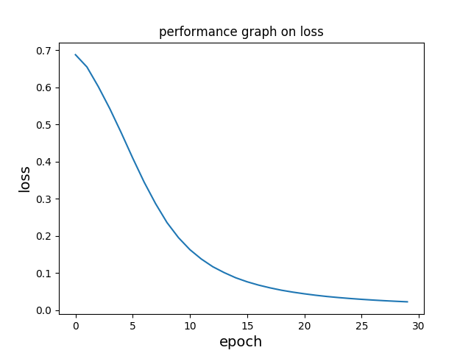
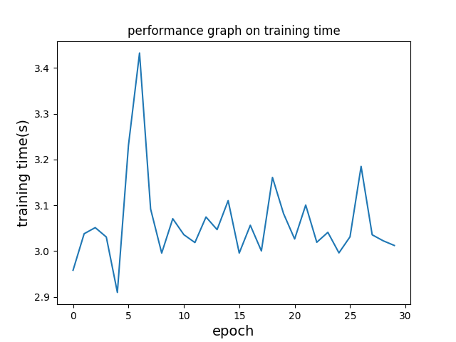
Result: neural network

Slide 40
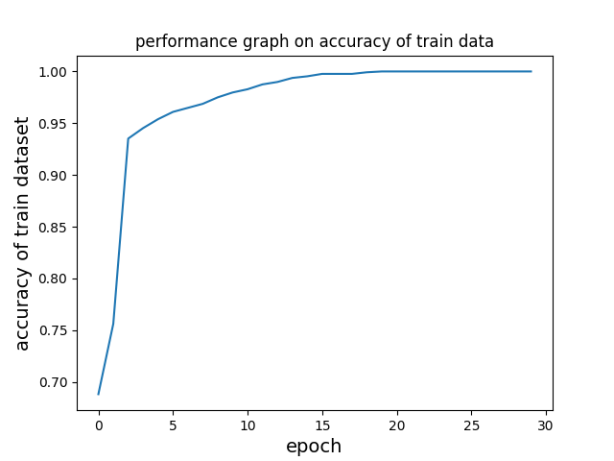
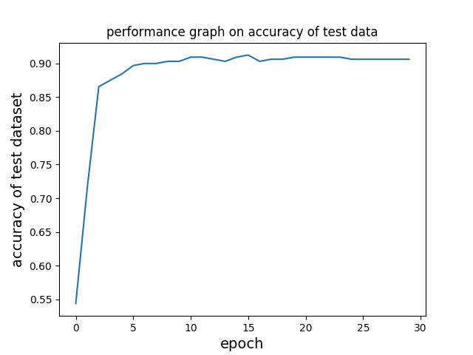
Result: neural network

Slide 41
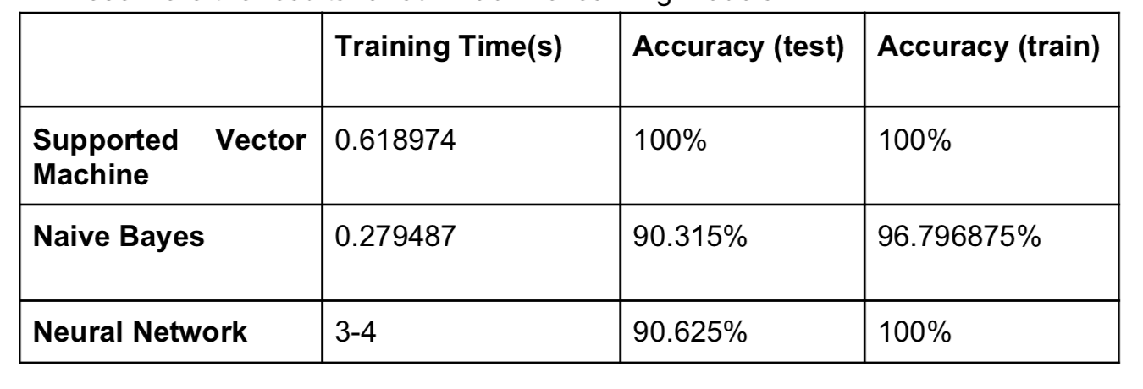
Comparison of the results
Correction: After thorough testing, the accuracy results for the test data using the Support Vector Machine came up at 52.292% meaning that it performed significantly worse than other models with the test data. Training accuracy remained the same after reevaluation.

Slide 42
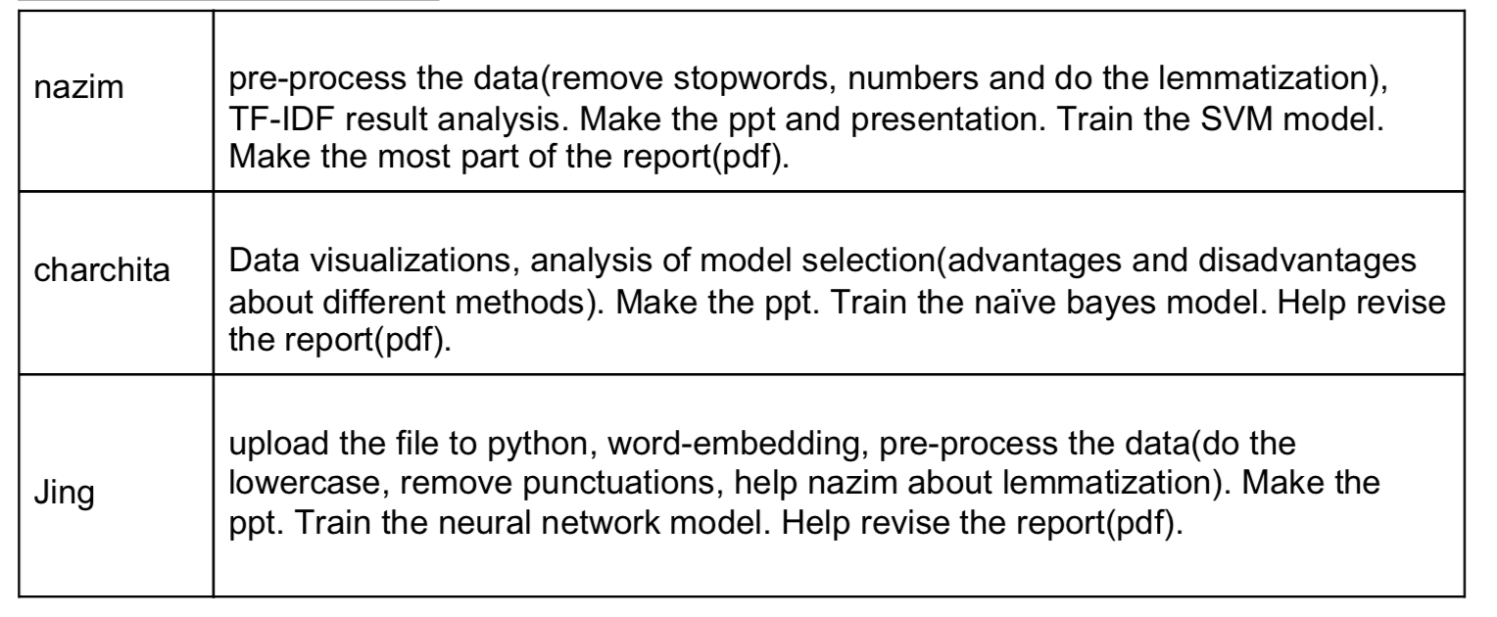
Personal Contribution

