Slide 1
FUSIONVI
When RNA and protein
disagree
A gated totalVI encoder for donor-generalized pharmacodynamic response profiling
10 donors
16,382 cells
RNA + 39 proteins
Negative results included
Multimodal AI for therapeutic discovery
Notes:
Opening question: Can a model recognize an activation surface phenotype when RNA points in a different direction? This project changes only the totalVI inference network and evaluates new donors. Presentation timing: about 35 seconds.

Slide 2
THERAPEUTIC DISCOVERY QUESTION
02
The biological problem
A perturbation can move RNA and surface protein on different clocks
Question
Can multimodal AI preserve this biologically meaningful disagreement and recover activation markers in a new donor?
RNA
Surface protein
≠
fast transcriptional
response
translation, trafficking,
internalization
24 h perturbation
pharmacodynamic phenotype
Why it matters
Biomarker selection fails if the model averages away the modality that carries the response.
Notes:
Lawlor et al. showed that CITE-seq can capture transcript and surface-protein activation responses after LPS or anti-CD3/CD28 stimulation. totalVI assumes a shared latent cell state while retaining modality-specific likelihoods. Sources: https://www.frontiersin.org/journals/immunology/articles/10.3389/fimmu.2021.636720/full ; https://pmc.ncbi.nlm.nih.gov/articles/PMC7954949/ . Timing: 50 seconds.

Slide 3
DATASET AND STUDY DESIGN
03
Paired immune perturbation study
10 healthy donors
Each donor contributes all three conditions
CITE-seq
Baseline
LPS
anti-CD3/CD28
→
4,000 genes
39 surface proteins
16,382 cells
unstimulated
monocyte response
T-cell response
Validation
Leave one donor out
Train on 9 donors
→
Test the unseen donor
× 10 folds per model
Notes:
The original study profiled 10 donors at baseline and after 24 hours of LPS or anti-CD3/CD28. It used 39 antibodies and recovered 16,382 cells after filtering. The project uses a strict leave-one-donor-out design and sequencing lane as the batch covariate. Source: Lawlor et al., Frontiers in Immunology 2021, DOI 10.3389/fimmu.2021.636720. Timing: 50 seconds.

Slide 4
FUSIONVI ARCHITECTURE
04
One controlled change to totalVI
Standard totalVI
RNA + protein
→
joint encoder
→
latent z
→
totalVI
decoders
FusionVI
RNA
→
RNA encoder
↘
per-cell
scalar gate
→
latent z
→
same
decoders
protein
protein encoder
↗
→
Same ELBO
Same likelihoods
15-D latent
20.5% fewer parameters
Notes:
totalVI maps joint RNA and protein counts to a latent state and decodes both modalities with modality-specific likelihoods. FusionVI replaces only the encoder: equal-width RNA and protein branches feed a learned scalar sigmoid gate for each cell. The original totalVI decoder and ELBO remain. FusionVI has fewer parameters, so capacity is reported as a limitation. Source: Gayoso et al., Nature Methods 2021, DOI 10.1038/s41592-020-01050-x. Timing: 65 seconds.

Slide 5
EVALUATION PLAN
05
The test targets biology that the encoder cannot copy
1
Hide activation proteins
2
Stress RNA-protein disagreement
CD25, CD69 and HLA-DR are zeroed at encoder input, then reconstructed by the decoder.
Challenge cells differ by at least 50 percentile points between RNA proxy and measured surface protein.
Biological readouts
T cells: anti-CD3/CD28
Monocytes: LPS
NK + B indirect response
Held-out markers
Baselines
RNA PCA • protein PCA • equal late-fusion PCA • standard totalVI
Statistics
one value per donor | paired Wilcoxon | bootstrap CI | BH correction
Notes:
This evaluation addresses circularity. The three activation proteins are hidden from encoder inputs. Performance is computed independently in each held-out donor. The harder subset contains cells where transcript and protein ranks strongly disagree. Cells are never treated as biological replicates. Timing: 55 seconds.

Slide 6
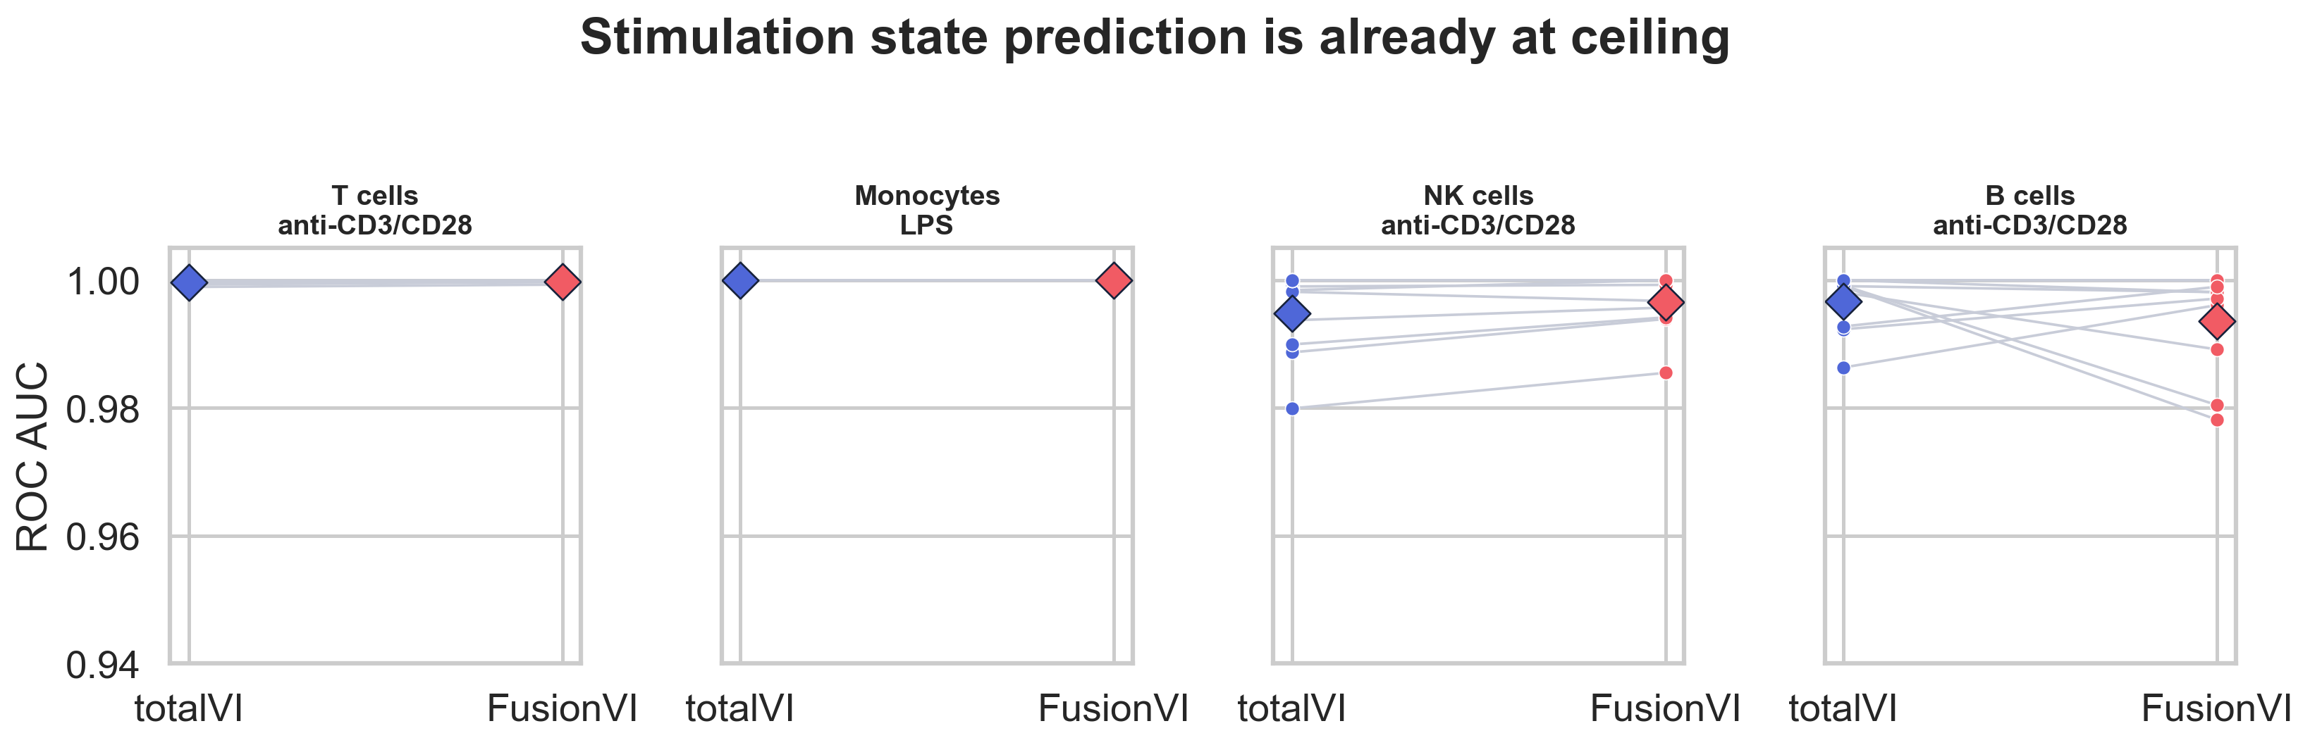
RESULT 1
06
Broad stimulation labels were already solved
0.995–1.000
mean totalVI AUC
RNA PCA also reached
0.989–1.000
Interpretation
Condition classification cannot reveal a better fusion strategy here.
Notes:
The direct T-cell and monocyte contrasts are perfect for both models. NK and B responses are also close to perfect. Even RNA PCA performs at ceiling. This endpoint confirms that the models learned biology, but it cannot discriminate FusionVI from totalVI. Results generated by this project. Timing: 45 seconds.

Slide 7
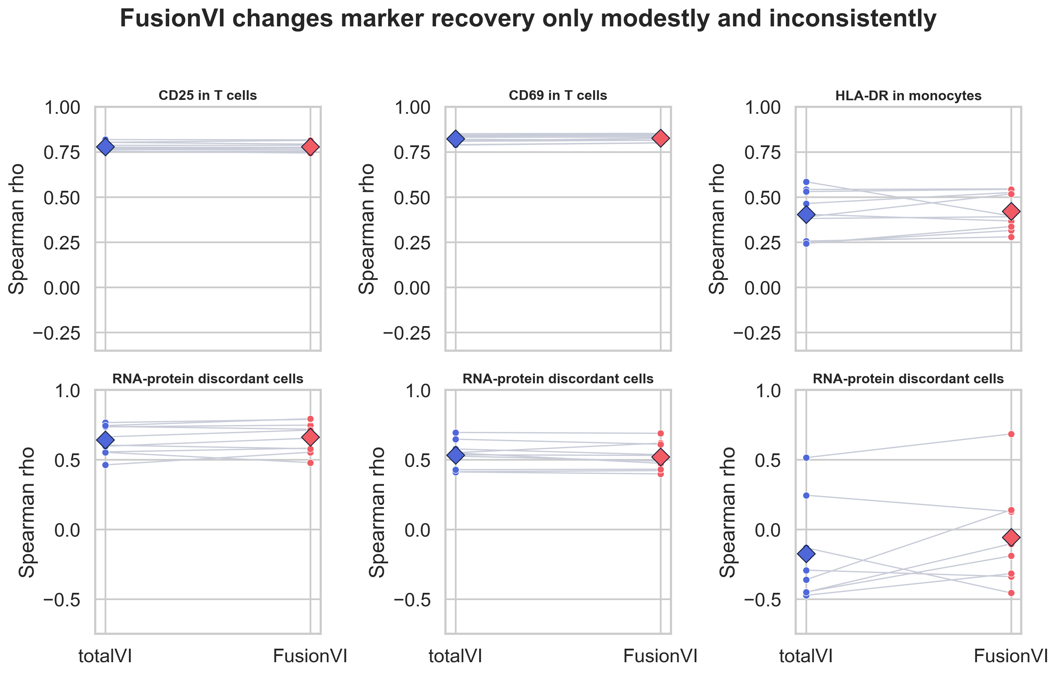
RESULT 2
07
Held-out marker recovery changed only modestly
Global Spearman ρ
CD25
0.779 → 0.779
q = 1.000
CD69
0.822 → 0.826
q = 0.165
HLA-DR
0.404 → 0.421
q = 0.382
Discordant cells
Small gains for CD25 and HLA-DR; a small loss for CD69. None survived correction.
Notes:
CD25 reconstruction is unchanged. CD69 rises by 0.0045 and HLA-DR by 0.017, but neither is significant after correction. In RNA-protein discordant cells, FusionVI improves CD25 and HLA-DR modestly and worsens CD69. HLA-DR is highly variable across donors. Timing: 55 seconds.

Slide 8
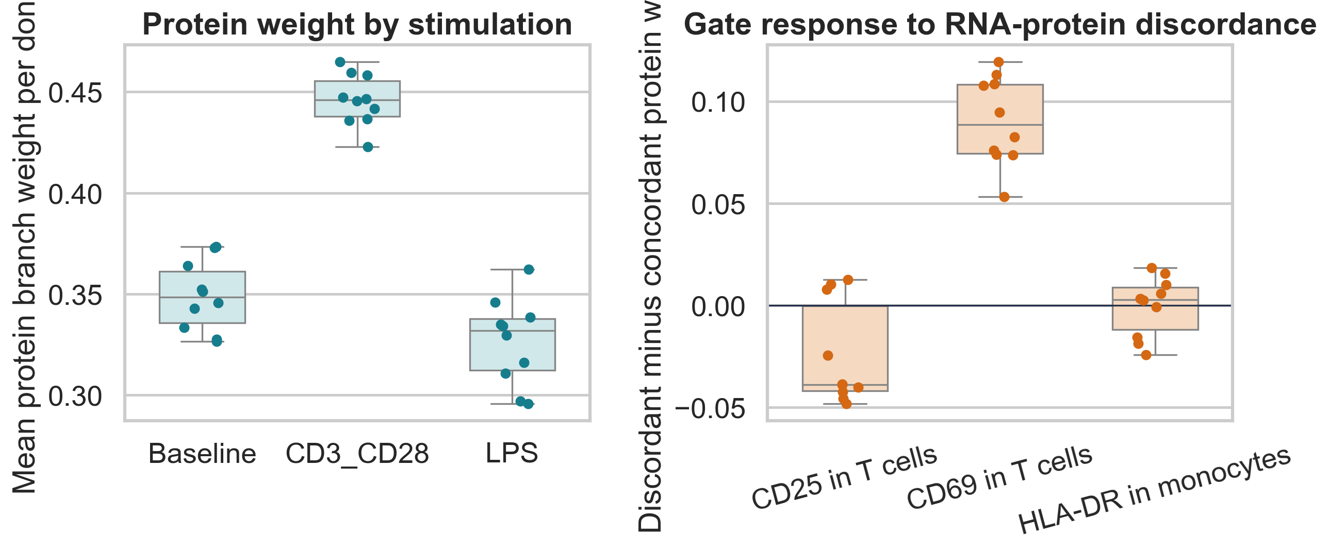
MECHANISTIC RESULT
08
The gate learned context without improving recovery
+0.096
protein weight after
anti-CD3/CD28 vs baseline
+0.090
protein weight in
CD69-discordant cells
Recognition ≠ recovery
The gate moved, but prediction did not improve.
Notes:
The gate did not collapse. It used more protein under anti-CD3/CD28 and strongly increased protein weight in cells with CD69 RNA-protein disagreement. Yet CD69 reconstruction on those cells did not improve. The architecture recognizes context, but the unsupervised ELBO does not force the gate to use that context for the biomarker endpoint. Timing: 55 seconds.

Slide 9
CONCLUSION
A useful negative result
What worked
Best next experiment
FusionVI learned cell-specific, stimulation-sensitive modality weights.
Train a constrained or supervised gate on cross-modal prediction, then test a larger perturbation dataset with multiple doses and timepoints.
What did not
Adaptive fusion alone did not improve donor-generalized marker recovery.
Controls
capacity-matched encoder • multiple seeds • external pharmacodynamic readout
Code, folds, metrics and report are reproducible from one pipeline.
Notes:
The conclusion should be stated directly: the gate is biologically responsive, but that responsiveness does not improve the targeted recovery task. This is acceptable under the course criteria because the project is rigorous, reproducible and interpretable. The next method should constrain the gate using a cross-modal objective and use a dataset with more doses and timepoints. Timing: 45 seconds, leaving about three minutes for questions.

