Slide 1
FUSIONVI
Can multimodal context
recover a missing
surface marker?
0.673
FusionVI mean Spearman
vs 0.578 for totalVI
Paper totalVI versus our final FusionVI pipeline on the original totalVI dataset
16,813
4
2
cells
hidden proteins
held-out mice
Multimodal AI for therapeutic discovery
Notes:
We compare only two final systems: the paper totalVI baseline and our model, FusionVI. The task is to recover four missing immune surface markers in a mouse never seen during training. Timing: 35 seconds.

Slide 2
BIOLOGICAL QUESTION
02
A missing protein can erase drug-relevant cell identity
Can RNA and the remaining surface panel recover a missing immune marker in a new biological replicate?
CD20
CD28
CD4
CD8a
B-cell identity
T-cell costimulation
helper T cells
cytotoxic T cells
therapeutic target
activation state
lineage marker
lineage marker
measurement hidden
measurement hidden
measurement hidden
measurement hidden
Therapeutic relevance: reconstructing missing markers can support biomarker panels and immune-target profiling when an antibody measurement is absent or unreliable.
Notes:
The biological question is about immune-cell identity. CD20 is an established therapeutic target. CD28 reflects costimulation, while CD4 and CD8a distinguish major T-cell lineages. We hide all four and ask whether multimodal context can reconstruct them in another mouse. Timing: 50 seconds.

Slide 3
STUDY DESIGN
03
The original totalVI dataset provides a direct transfer test
16,813
4,000
110
2
2
cells
genes
proteins
mice
tissues
Mouse 0
Mouse 1
TEST in fold 0
TRAIN in fold 1
TRAIN in fold 0
TEST in fold 1
9,251 cells
7,562 cells
Spleen + lymph node
Spleen + lymph node
Every cell from one mouse stays entirely in training or test data
Source: Gayoso et al., Nature Methods 2021; official totalVI reproducibility object
Notes:
We use the exact SLN111 object released with totalVI. Each fold holds out an entire mouse, including both tissues. This prevents leakage between cells from the same animal. The source has only two biological replicates, so this is a technical transfer study. Timing: 50 seconds.

Slide 4
METHODS
04
Two complete prediction pipelines
totalVI
Paper baseline
FusionVI
Our final model
RNA + 106 visible proteins
RNA branch
protein branch
↓
joint encoder
cell-specific gate
↓ 15-dimensional latent state ↓
↓ 15-dimensional latent state ↓
fixed Ridge readout
native protein decoder
latent + 106 proteins + marker RNA
hidden protein estimate
hidden protein estimate
The target protein is absent from both model inputs
Notes:
totalVI uses its native decoder. FusionVI separates RNA and protein branches, combines them with a cell-specific gate, then uses a fixed Ridge readout with the latent state, other proteins and one prespecified transcript. We compare the complete pipelines, and we state that clearly. Timing: 65 seconds.

Slide 5
VALIDATION
05
Each mouse is evaluated exactly once
Fold 0
Fold 1
Mouse 1
→
Mouse 0
Mouse 0
→
Mouse 1
TRAIN
TEST
TRAIN
TEST
9,251 held-out cells
7,562 held-out cells
25
4
ρ
epochs per model and fold
proteins hidden together
Spearman rank correlation
Notes:
There are four neural runs: two models in two leave-one-mouse-out folds, each for 25 epochs. We hide all four markers at once. The metric is Spearman correlation between measured and predicted protein abundance. With only two animals, we show fold values and do not calculate cell-based p-values. Timing: 50 seconds.

Slide 6
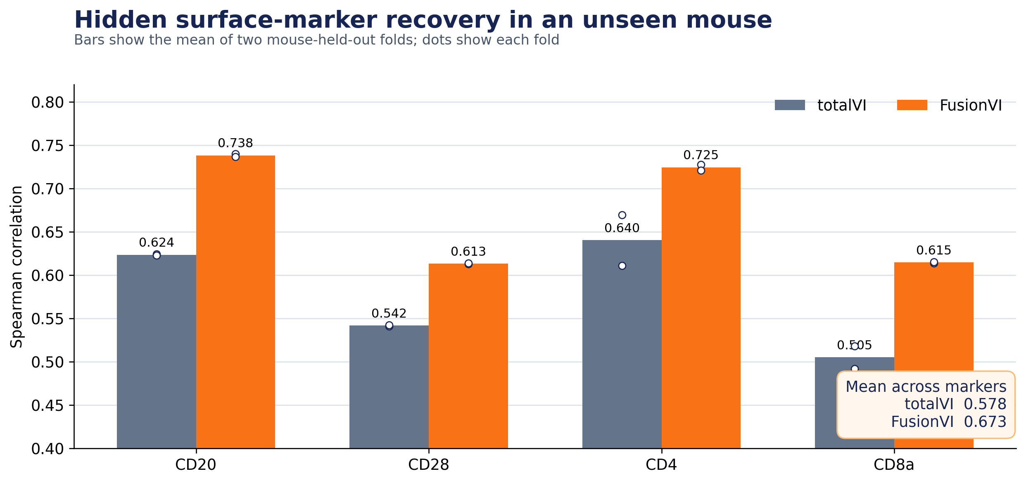
RESULTS
06
FusionVI improves every hidden marker
+0.095
mean Spearman gain
0.578 → 0.673
Gain by marker
CD20 +0.115
CD28 +0.072
CD4 +0.084
CD8a +0.110
Both held-out directions improved
Notes:
FusionVI increases the mean correlation from 0.578 to 0.673. It improves all four proteins, and the result holds in both transfer directions. CD20 and CD8a show the largest gains. Timing: 60 seconds.

Slide 7
INTERPRETATION
07
Lineage context drives the largest gains
CD20 and CD8a
CD28
The remaining protein panel strongly encodes B-cell and cytotoxic-T-cell identity. FusionVI can use that context when the target marker is missing.
The smaller gain fits a costimulatory state marker that is less tightly determined by lineage alone.
What the result supports
What remains uncertain
Cross-modal context helps reconstruct missing immune surface measurements in an unseen mouse.
Two mice cannot establish population-level or clinical generalization. FusionVI includes a supervised readout, so the full gain cannot be assigned to the encoder alone.
Notes:
The biological interpretation is strongest for lineage markers. Other ADTs preserve B-cell and cytotoxic-T-cell identity, which helps reconstruct CD20 and CD8a. CD28 depends more on activation state. The main limitation is two mice, and this comparison evaluates full pipelines rather than isolating the encoder contribution. Timing: 60 seconds.

Slide 8
CONCLUSION
FusionVI recovers missing immune markers better than totalVI
0.578
0.673
→
totalVI
FusionVI
The useful contribution
The boundary
A dual-branch representation plus targeted cross-modal readout preserves cell identity when a surface marker is absent.
The evidence supports technical transfer across two mice. Larger biological cohorts are the next test.
Questions?
Notes:
The final statement is that FusionVI improves missing-marker recovery on the original totalVI dataset. The result is consistent across four proteins and both transfer directions. It is a technical cross-mouse result, and the next experiment needs more biological replicates. Timing: 35 seconds, leaving three minutes for questions.

