Slide 1
FUSIONVI-X
When RNA and protein
disagree
Cross-modal recovery of surface biomarkers in unseen donors and unseen perturbations
2 datasets
37,111 cells
10 donors + 25 targets
Two external tests
Multimodal AI for therapeutic discovery
Notes:
Opening question: Can a model recover a surface biomarker when marker RNA points in a different direction? We test unseen donors in primary PBMCs and unseen CRISPR targets in a separate PD-L1 screen. Timing: 30 seconds.

Slide 2
THERAPEUTIC DISCOVERY QUESTION
02
The biological problem
A perturbation can move RNA and surface protein on different clocks
Question
Can multimodal AI preserve this biologically meaningful disagreement and recover surface biomarkers in a new donor or after a new perturbation?
RNA
Surface protein
≠
fast transcriptional
response
translation, trafficking,
internalization
24 h perturbation
pharmacodynamic phenotype
Why it matters
Biomarker selection fails if the model averages away the modality that carries the response.
Notes:
Lawlor et al. showed that CITE-seq can capture transcript and surface-protein activation responses after LPS or anti-CD3/CD28 stimulation. totalVI assumes a shared latent cell state while retaining modality-specific likelihoods. Sources: https://www.frontiersin.org/journals/immunology/articles/10.3389/fimmu.2021.636720/full ; https://pmc.ncbi.nlm.nih.gov/articles/PMC7954949/ . Timing: 50 seconds.

Slide 3
DATASET AND STUDY DESIGN
03
Paired immune perturbation study
10 healthy donors
Each donor contributes all three conditions
CITE-seq
Baseline
LPS
anti-CD3/CD28
→
4,000 genes
39 surface proteins
16,382 cells
unstimulated
monocyte response
T-cell response
Validation
Leave one donor out
Train on 9 donors
→
Test the unseen donor
× 10 folds per model
Notes:
The original study profiled 10 donors at baseline and after 24 hours of LPS or anti-CD3/CD28. It used 39 antibodies and recovered 16,382 cells after filtering. The project uses a strict leave-one-donor-out design and sequencing lane as the batch covariate. Source: Lawlor et al., Frontiers in Immunology 2021, DOI 10.3389/fimmu.2021.636720. Timing: 50 seconds.

Slide 4
FUSIONVI-X ARCHITECTURE
04
From an unsupervised gate to a targeted readout
Standard totalVI
RNA + protein
→
joint encoder
→
latent z
→
totalVI
decoders
FusionVI
RNA
→
RNA encoder
↘
per-cell
scalar gate
→
latent z
→
same
decoders
protein
protein encoder
↗
→
FusionVI-X readout: latent z + remaining proteins + marker RNA proxy → hidden surface marker
Notes:
totalVI maps joint RNA and protein counts to a latent state and decodes both modalities. FusionVI replaces only the encoder with two branches and a scalar gate. FusionVI-X then adds a target-specific readout using the latent state, the other 36 proteins and a prespecified RNA proxy. The hidden target marker is never an input. Source: Gayoso et al., Nature Methods 2021, DOI 10.1038/s41592-020-01050-x. Timing: 65 seconds.

Slide 5
EVALUATION PLAN
05
The test targets biology that the encoder cannot copy
1
Hide activation proteins
2
Select the readout inside training groups
CD25, CD69, HLA-DR or PD-L1 is zeroed at encoder input, then reconstructed without copying the target.
Inner grouped validation chooses the head; the outer donor or CRISPR target is never used.
Biological readouts
T cells: anti-CD3/CD28
Monocytes: LPS
Unseen CRISPR targets
Discordant RNA/protein
Baselines
RNA proxy • other ADTs • RNA + ADTs • totalVI-X • FusionVI-X
Statistics
donor-level inference | target-by-replicate effects | paired tests
Notes:
This evaluation prevents target leakage. The surface marker is hidden from all inputs. Readout selection happens only within training donors or training CRISPR targets. Experiment 1 reports one value per donor. Experiment 2 reports perturbation effects relative to held-out non-targeting cells in each replicate. Timing: 45 seconds.

Slide 6
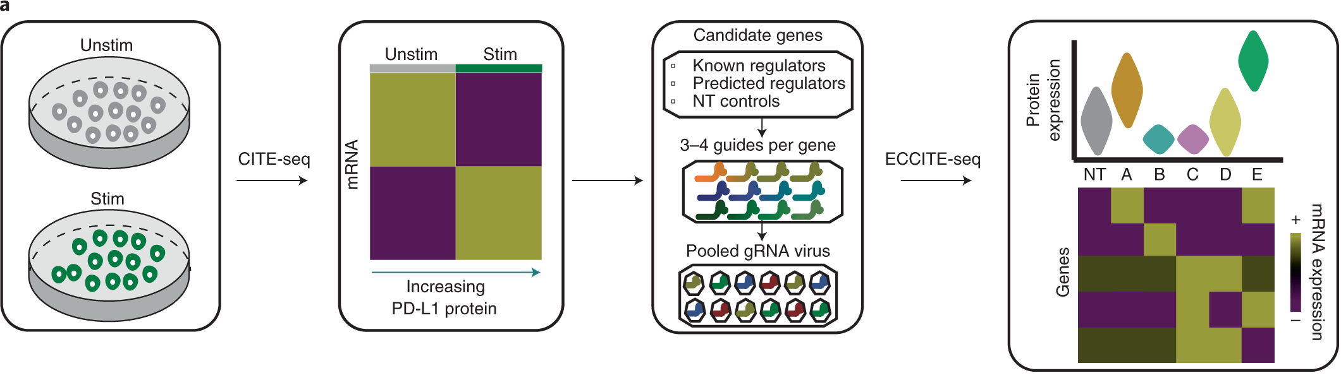
EXPERIMENT 2 DESIGN
06
A second dataset tests unseen PD-L1 regulators
20,729 cells
25 CRISPR targets
3 replicates
PD-L1 hidden
Five target-held-out folds
Train on 20 targets
Test 5 unseen targets
75 target × replicate effects
Source: Papalexi et al., Nature Genetics 2021, Fig. 1a
Notes:
Experiment 2 uses the Papalexi ECCITE-seq screen. PD-L1 is hidden from model input. Five folds each hold out all cells from five CRISPR targets, while non-targeting controls are partitioned within replicate. This tests mechanism-level transfer in an immune-checkpoint setting. Timing: 45 seconds.

Slide 7
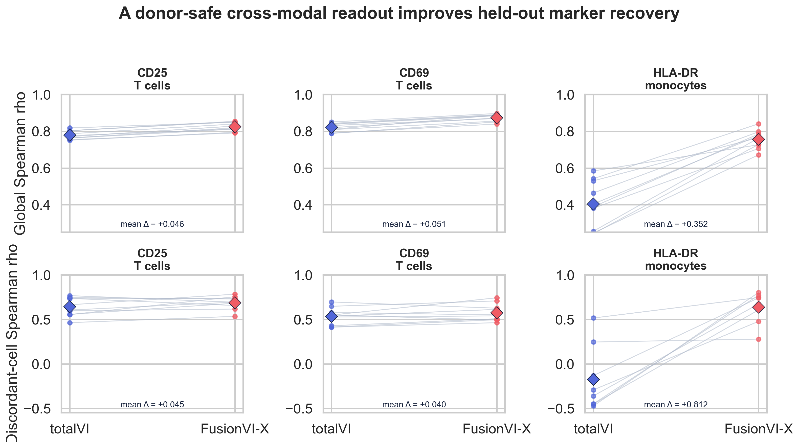
RESULT 2
07
Targeted cross-modal readout improves every global marker
Global Spearman ρ
CD25
0.779 → 0.825
q = 0.0039
CD69
0.822 → 0.873
q = 0.0039
HLA-DR
0.404 → 0.756
q = 0.0039
Hardest subset
HLA-DR discordant cells:
−0.175 → 0.637
q = 0.0117
Notes:
The donor-nested cross-modal head improves all three global marker correlations with adjusted q values of 0.0039. The largest gain is HLA-DR. In the prespecified HLA-DR discordance subset, correlation changes from negative 0.175 to positive 0.637, with q equal to 0.0117. Timing: 60 seconds.

Slide 8
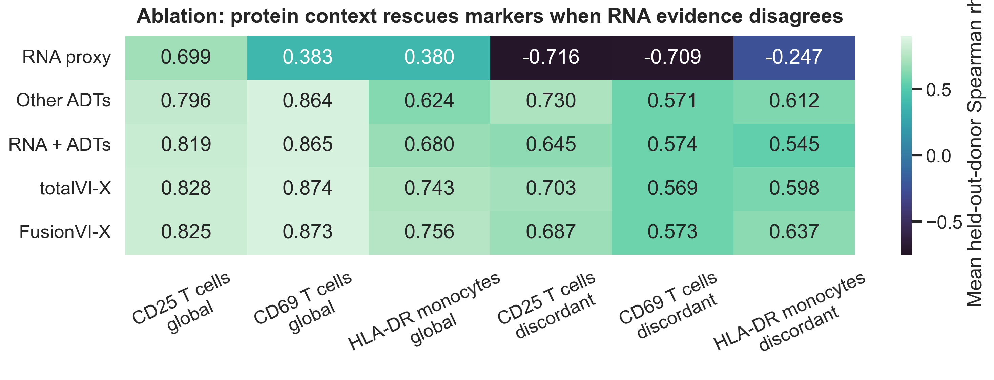
WHY IT WORKS
08
Protein context rescues markers when RNA is misleading
RNA proxy alone fails in discordant cells → the other surface proteins preserve activation-state information
Notes:
The ablation gives the biological explanation. RNA proxy alone becomes anticorrelated with measured surface protein in every discordant subset. Other ADTs restore positive correlations without access to the target marker. Adding the learned latent state gives the best global HLA-DR result. Similar totalVI-X and FusionVI-X results show that targeted supervision is the main improvement. Timing: 55 seconds.

Slide 9
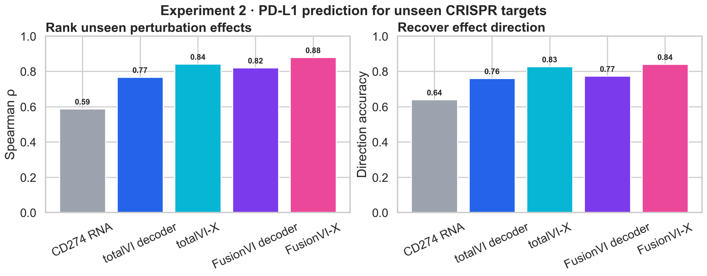
EXPERIMENT 2 RESULT
09
The result transfers to unseen PD-L1 perturbations
ρ = 0.879
FusionVI-X effect ranking
84%
effect direction correct
Useful failure
CMTM6 lowers surface PD-L1, but RNA and the model miss it.
FusionVI-X vs totalVI-X: median target error reduction 0.0042; p = 0.042
Notes:
External validation is positive. FusionVI-X ranks 75 unseen target-by-replicate PD-L1 effects with Spearman 0.879 and gets 84 percent of directions correct. CD274 RNA alone reaches 0.587 and 64 percent. The model recovers JAK-STAT and CUL3-BRD4 biology but fails on CMTM6, a known post-transcriptional stabilizer. Timing: 55 seconds.

Slide 10
CONCLUSION
Cross-modal context generalizes across two tests
What worked
Methodological lesson
FusionVI-X improved CD25, CD69 and HLA-DR in unseen donors, then recovered PD-L1 effects from unseen CRISPR targets.
Targeted supervision converts cross-modal context into better biomarker recovery. The scalar gate alone contributes less.
What the ablation says
Neighbouring surface proteins retain response information that marker RNA can miss.
Boundary
CMTM6 shows that post-transcriptional stability mechanisms can remain invisible without direct protein evidence.
Two outer validation schemes, all ablations and all statistics are reproducible.
Notes:
The same principle now holds in two datasets: unseen donors and unseen perturbations. Targeted cross-modal context improves surface biomarker recovery, while CMTM6 defines a biologically important failure. This is the conclusion. Timing: 40 seconds, leaving about three minutes for questions.

