Slide 1
FUSIONVI
Can RNA recover an
entire missing
protein panel?
+0.0085
calibrated FusionVI − totalVI
95% CI crosses zero
Published totalVI versus FusionVI after scale matching
Paper Figure 3 task on the official SLN111 CITE-seq object
16,828
110
16
cells
proteins hidden
paired seeds
Multimodal AI for therapeutic discovery
Notes:
We compare the published totalVI architecture with FusionVI on the paper's missing-protein benchmark. Every protein in SLN111-D2 is hidden during training, and the model predicts all 110 from RNA plus the multimodal structure learned in SLN111-D1. Across 16 paired seeds, FusionVI's original RMSLE lead disappears after a D1-only affine calibration: the calibrated difference is +0.0085 and its 95 percent interval crosses zero. Timing: 40 seconds. Source: Gayoso et al., Nature Methods 2021, doi:10.1038/s41592-020-01050-x.

Slide 2
BIOLOGICAL QUESTION
02
A missing protein panel weakens immune phenotyping
Can RNA in a new batch recover all 110 proteins after their measurements are removed?
CD20
CD28
CD4
CD8a
B-cell identity
T-cell costimulation
helper T cells
cytotoxic T cells
therapeutic target
activation state
lineage marker
lineage marker
example target
example target
example target
example target
Therapeutic relevance: recovering surface proteins can rescue immune biomarker profiling when an antibody panel fails or differs between studies.
Notes:
The biological question concerns panel completion. Surface proteins define immune populations and include therapeutic targets such as CD20. If a whole antibody panel is missing in a new batch, can transcript measurements recover those protein abundances? CD20, CD28, CD4 and CD8a are examples among the 110 targets. Timing: 50 seconds.

Slide 3
STUDY DESIGN
03
The paper's two-batch design creates a direct transfer test
16,828
4,005
110
2
1
cells
genes
proteins
batches
transfer task
SLN111-D1
SLN111-D2
REFERENCE
BATCH
ALL PROTEINS
HIDDEN
9,264 cells
7,564 cells
RNA + 110 proteins
RNA only for training
D2 proteins never enter training and are revealed only for scoring
Source: Gayoso et al., Nature Methods 2021; GSE150599; official reproducibility object
Notes:
SLN111-D1 supplies RNA and the complete protein panel. We set every D2 protein input to zero and let totalVI treat that batch as missing protein measurements. The untouched D2 counts remain separate as test truth. Both models receive the same 4,005 genes, 110 target proteins, batches and validation split. Timing: 55 seconds.

Slide 4
METHODS
04
One controlled architectural change
totalVI
Paper baseline
FusionVI
Our final model
RNA + available proteins
RNA branch
protein branch
↓
joint RNA-protein encoder
availability-aware gate
↓ 20-dimensional latent state ↓
↓ 20-dimensional latent state ↓
native totalVI decoder
native protein decoder
same RNA and protein likelihoods
110 protein estimates
110 protein estimates
Only the encoder changes; missing panel routes to RNA only
Notes:
totalVI concatenates RNA and protein measurements in one encoder. FusionVI uses separate RNA and protein branches, then combines their hidden states with a learned gate for each cell. Both models estimate a 20-dimensional latent state and use the same native totalVI decoders and likelihoods. This isolates the encoder as the experimental variable. Timing: 65 seconds.

Slide 5
VALIDATION
05
Paired training controls the comparison
totalVI
FusionVI
D1 complete
→
D2 RNA
D1 complete
→
D2 RNA
TRAIN
PREDICT
TRAIN
PREDICT
110 D2 proteins scored
same 110 proteins scored
500
25
RMSLE
maximum epochs + early stopping
posterior samples averaged
primary metric • lower is better
Notes:
For each of 16 seeds, we train one totalVI model and one FusionVI model with identical settings: at most 500 epochs, learning rate 0.004, batch size 256, 90/10 training-validation split and early stopping patience 45. Prediction averages 25 posterior samples. The primary metric is mean per-protein root mean squared log error across 7,564 D2 cells. The paper ran 30 initializations; our course benchmark runs 16 paired seeds. Timing: 60 seconds.

Slide 6
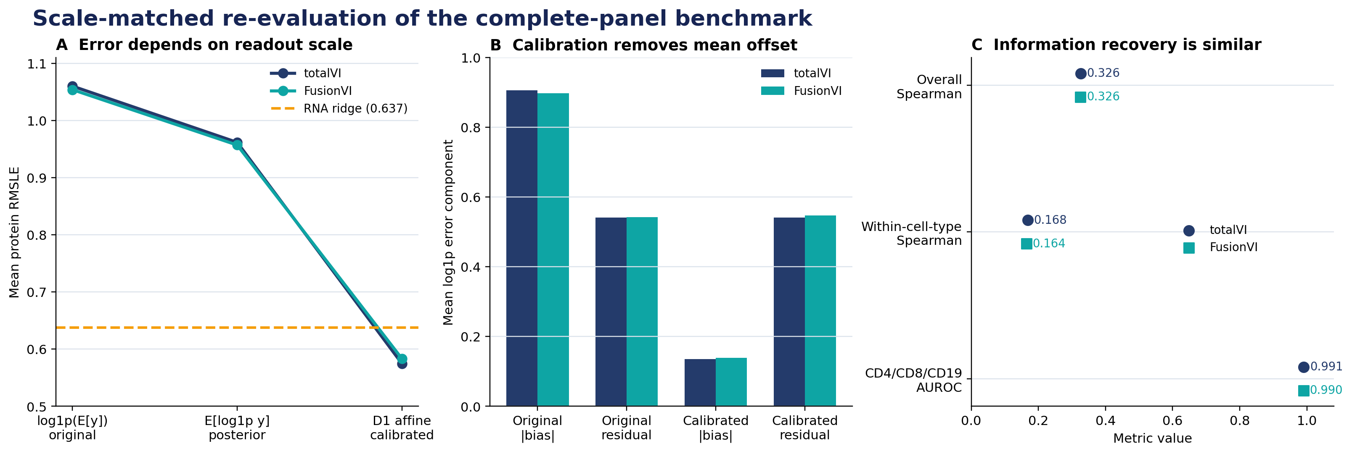
RESULTS
06
Scale matching changes the conclusion
+0.0085
calibrated RMSLE difference
0.5745 | 0.5831
FusionVI − totalVI
Residual SD +0.0065
Within-cell -0.0041
Marker AUROC -0.0006
16 paired seeds • all checkpoints re-scored
Notes:
The original log-of-mean readout favours FusionVI, but both posterior E[log1p y] and D1-only calibration reduce the difference. After calibration, totalVI is numerically better by 0.0085 RMSLE and the confidence interval crosses zero. Calibration removes mean bias without improving residual or within-cell-type recovery for FusionVI. Timing: 70 seconds.

Slide 7
INTERPRETATION
07
Calibration explains the apparent RMSLE gain
Original readout
After D1 calibration
FusionVI was lower by 0.0062 RMSLE when scoring log1p of expected counts.
FusionVI is +0.0085 versus totalVI; the 95% CI crosses zero and residual error is higher.
Biological information
Interpretation
Within-cell-type Spearman is 0.164 for FusionVI versus 0.168 for totalVI.
The encoder changes output scale, but this benchmark does not show stronger recovery of biological variation.
Notes:
Matched controls first showed that the raw RMSLE difference was reproducible. The scale-matched evaluation then changed its interpretation: calibration removes the advantage, residual error is higher, and within-cell-type rank recovery is slightly lower for FusionVI. Timing: 60 seconds.

Slide 8
CONCLUSION
FusionVI changes scale, not biological recovery
0.5745
0.5831
→
totalVI calibrated RMSLE
FusionVI calibrated RMSLE
What we learned
Practical benchmark result
Across 16 seeds, the raw FusionVI lead disappears after source-only calibration; residual and rank metrics do not improve.
D1 calibration reduces neural RMSLE below RNA ridge (0.6373), showing the earlier ridge gap was also mostly scale.
Questions?
Notes:
FusionVI's original-scale RMSLE advantage is reproducible, but it does not survive D1-only calibration and is not supported by residual or within-cell-type metrics. The useful contribution is the diagnostic: evaluation scale can reverse conclusions in missing-protein benchmarks. Timing: 35 seconds, leaving three minutes for questions.

