Slide 1
ProteoGuard
Reliable immune-marker predictions
for new participants
Can RNA plus a small measured protein panel support reliable calls of immune activation?
Course final project
Extension of the totalVI analysis pipeline
MBZUAI · October 2026 · 7-minute talk + 3-minute Q&A
1 / 9
Notes:
25 seconds. This project asks whether imputed surface proteins support reliable immune-marker calls in a new participant. The application is biomarker research and immune phenotyping, not clinical treatment selection. ProteoGuard is a framework around an existing imputer; we do not change totalVI architecture. The main talk ends at slide 9; slides 10–13 are backup.

Slide 2
Existing predictors leave a participant-level question
totalVI and sciPENN
Predict protein abundance and uncertainty from RNA.
Hierarchical conformal methods
Calibrate dependent observations grouped by participant.
ProteoGuard evaluation
Test calibration, measured panels, and selective marker calls together.
Biological readout: is the fraction of marker-positive cells high or low relative to the reference cohort?
Gayoso 2021; Lakkis 2022; Dunn et al.; Lee, Barber & Willett
2 / 9
Notes:
40 seconds. Prior work already predicts proteins and studies prediction uncertainty. Grouped conformal prediction also already exists. Our contribution is evaluating their combination with small measured protein panels and participant-level marker decisions. HLA-DR and CD38 motivate immune-state measurements relevant to biomarker research. High and low are defined relative to the design cohort, not a clinical threshold. Sources: https://www.nature.com/articles/s41592-020-01050-x ; https://doi.org/10.1038/s42256-022-00545-w ; https://arxiv.org/abs/2306.06342 .

Slide 3
Separate participants for every stage
Stephenson: 118 participants, 192 ADTs
59
20
15
20
TRAIN
DESIGN
CALIBRATE
TEST
RNA + full proteins
Fit base predictor
Full measurements
Select anchors and thresholds
Full target proteins
Set interval adjustment
RNA + anchors only
Hidden targets for scoring
35-person pool is repeatedly split 15 / 20; 4 additional Sanger participants lack local calibration.
COMBAT: 122 participants = 61 train + 20 design + 15 calibration + 26 test
Target proteins held out; totalVI fitting and RNA SVD use held-out RNA transductively
3 / 9
Notes:
55 seconds. Every role has separate participants within a split. In Stephenson, 59 train the base model and 20 held-out design participants select anchors, fit correction, and define thresholds. Another 35 are repeatedly divided into 15 calibration and 20 test participants. Four Sanger participants form an additional descriptive subgroup without Sanger calibration participants. The site was represented earlier, so this is not completely unseen-site transfer. COMBAT uses 61, 20, 15 and 26 participants. Full target proteins are measured in reference and calibration participants. Only RNA and permitted anchors enter test predictions. Two splits reuse cohort members and are not independent cohort replications. Static code inspection shows totalVI includes held-out RNA during fitting with proteins masked, and measured-input ridge fits RNA SVD on all RNA. This is transductive evaluation, not a fully inductive unseen-RNA test.

Slide 4
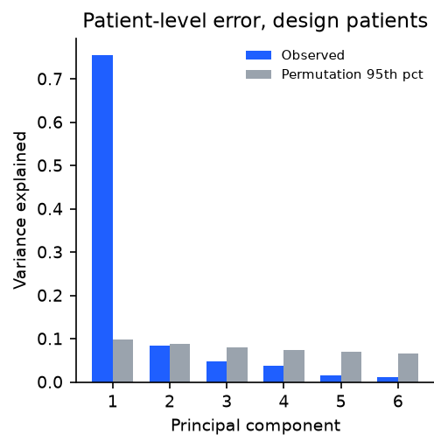
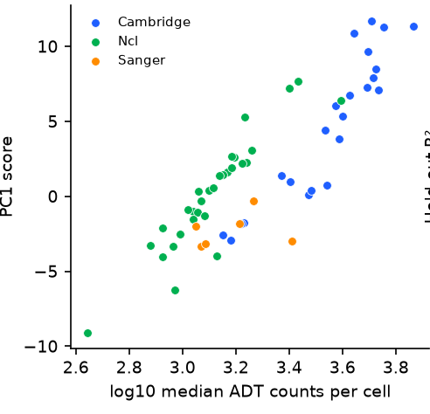
A shared residual factor tracks antibody depth
PC1 versus ADT depth
75.6%
of participant-offset variance in PC1
ρ = 0.83
association with ADT depth
Consistent with technical variation. Association does not establish a purely technical cause.
Stephenson: design set for PCA; 59 held-out participants for associations
4 / 9
Notes:
45 seconds. Average coverage can hide participant-specific errors. In Stephenson, a single component explained 75.6 percent of participant-offset variance, and 98.4 percent of protein loadings had the same sign. The association with antibody depth was strong. This is consistent with a shared technical contribution, but it is not proof of a purely technical mechanism: both summaries use the same measurements. No adjusted severity association was detected. PCA and association samples differ and are labelled. Figure reused from the supplied deck without altering plotted values.

Slide 5
Prediction, calibration, and decisions
1 PREDICT
2 CALIBRATE
3 CALL OR ABSTAIN
RNA + a few measured proteins
One score per participant
Compare a fraction interval
Use anchors as model inputs, or correct a fixed imputer using their residuals.
Set an interval adjustment from 15 reference participants after freezing design choices.
Above threshold: HIGH
Below threshold: LOW
Crosses threshold: ABSTAIN
For each protein: at least an 81.25% probability that a new exchangeable participant gets at least 90% empirical cell coverage.
Marginal over participants; not every person or every protein simultaneously
5 / 9
Notes:
55 seconds. The method has three separate outputs. First, predict protein abundance using RNA and a small measured panel, or correct a fixed imputer after prediction. Second, calibrate intervals using one score per participant. With 15 calibration participants our chosen levels give an 81.25 percent lower bound on the probability that a new exchangeable participant reaches 90 percent empirical cell coverage, for each protein separately. Third, separately calibrate the estimated fraction of marker-positive cells. Call high or low only when that fraction interval lies entirely on one side of the design threshold. Otherwise abstain. The cell-coverage proposition does not guarantee the selective error among biomarker calls.

Slide 6
Calibration changes coverage across participants
Share reaching at least 90% cell coverage, averaged across target proteins
Participant-block target: ≥81.25%. HCP achieved higher coverage with wider intervals and a different guarantee.
Ridge + the same five measured inputs; identical predictions within each cohort
6 / 9
Notes:
55 seconds. This comparison holds the predictor and measured inputs fixed: ridge with five sentinels. We change only the calibration rule. Cell-wise calibration gives 58 and 55 percent participant success. Participant-block gives approximately 82 percent in each cohort, consistent with its 81.25 percent lower-bound target. HCP gives 95 and 98 percent and wider intervals. That is a different operating trade-off, not HCP failing our lower bound. Values are averages across proteins and repeated participant splits; they do not establish success for each individual protein. Data: supplied full draft Tables 3 and 4 and course report. No new calculations of performance. The comparator also applies a design-mean offset in its none (design mean) row.

Slide 7
Measured inputs gave the most efficient intervals
Ridge variant | Below 85% | Interval score | Width
Design-mean offset only | 8.3% | 3.26 | 2.65
Common offset | 4.4% | 2.79 | 2.20
Isotype-driven map | 4.5% | 2.81 | 2.22
Learned shared map | 4.2% | 2.77 | 2.19
Measured inputs | 4.5% | 2.33 | 1.90
Simple corrections matched the learned map closely. Direct measured inputs reduced interval score and width at similar coverage.
Stephenson; same participant-block calibration. Lower interval score is better.
7 / 9
Notes:
45 seconds. These are correction controls under the same participant-block calibration. A common offset and the assay isotypes perform similarly to the learned map. This limits the contribution of a sophisticated correction. Directly providing measured proteins to ridge gives the lowest interval score and narrowest intervals among these completed comparisons, at similar coverage. All rows are Stephenson results. In the associated prediction comparison, RNA-only ridge RMSE was 0.72 and measured-input ridge was 0.54. That is a different contrast from the interval-score comparison between post-hoc correction and measured inputs. Suitable isotypes can help when already present; they are not free in every assay.

Slide 8
Useful biomarker calls remain selective
Stephenson: compare at the same 27% call rate
Procedure | Error among calls
Random abstention | 31.7–32.9%
Threshold distance | 20.1–20.6%
Anchor correction only | 4.7–6.6%
ProteoGuard | 2.1–2.2%
COMBAT
Only 5–9%
of decisions called
5–9% observed error
among those calls
High / low is relative to the design cohort. These are empirical selective errors, not clinical guarantees.
Matched-rate ranges span base predictors; they are not confidence intervals
8 / 9
Notes:
60 seconds. High and low mean above or below a design-cohort threshold for the fraction of marker-positive cells. To compare fairly, hold the call rate at 27 percent. The full draft reports about 32 percent error with random abstention, 20 percent with threshold distance, 5 to 7 percent after anchor correction alone, and about 2 percent with ProteoGuard. The ranges span base predictors, not confidence intervals. The supplied newer course summary reports 1.6 to 2.3 percent error at each pipeline’s own 27 to 33 percent call rate; those are not the matched-rate rows shown here. COMBAT is the important limitation: only 5 to 9 percent of decisions were called with 5 to 9 percent observed error. Low error did not mean broad recovery of biomarker decisions.

Slide 9
What replicated, and what remained limited
Replicated
Participant-block calibration and the interval-efficiency benefit of measured inputs in both cohorts.
Cohort-dependent
Post-hoc correction helped Stephenson, but provided little additional benefit in COMBAT.
Biological scope
Immune-marker calls remained selective. COMBAT supported substantially fewer usable calls.
Questions · Further comparisons and reproducibility details in backup slides
9 / 9
Notes:
40 seconds. Our strongest conclusion is that participant-level evaluation matters. Measured protein inputs and participant-block calibration worked across the two cohorts studied. The learned post-hoc correction did not generalize uniformly. The biological application remained selective, especially in COMBAT. The project supplies a controlled exploratory study, rather than proof that five proteins recover a complete biological profile or that a new totalVI architecture wins. Nine main slides are timed to seven minutes in total. Pause for three minutes of questions.

Slide 10
Backup: the participant-block guarantee
1. Within each participant, take the score needed to cover 90% of evaluated cells.
2. Across 15 calibration participants, take the 13th smallest participant score.
P(new-participant empirical coverage ≥ 90%) ≥ 13/16
Per protein; exchangeable participant blocks; design choices fixed before calibration. The bound is marginal and is not simultaneous across proteins.
Adaptation of the conformal rank argument; details and limitations in the report
Backup 1
Notes:
Backup only. Let a_icj=max(l+s-y,y-u-s). The participant score is the ceil(gamma*m_i)-th smallest cell score, gamma=0.9. Set k=ceil((n+1)(1-delta)), delta=0.2, and lambda to the kth participant score. For n=15, k=13. If k>n, define lambda=+infinity. Scores may be negative, allowing interval contraction; document the implementation convention. The guarantee concerns empirical coverage of the evaluated cell block, not the infinite-population coverage of a participant. It requires exchangeability of blocks and appropriate freezing or symmetry of the entire prediction procedure. Because held-out RNA participates in fitting, the complete transductive pipeline needs a symmetry justification; the fixed independent-predictor argument alone does not prove deployment coverage for an additional later arrival. HCP targets a different marginal quantity. Sources: https://arxiv.org/abs/1809.07441 ; https://arxiv.org/abs/2306.06342 .

Slide 11
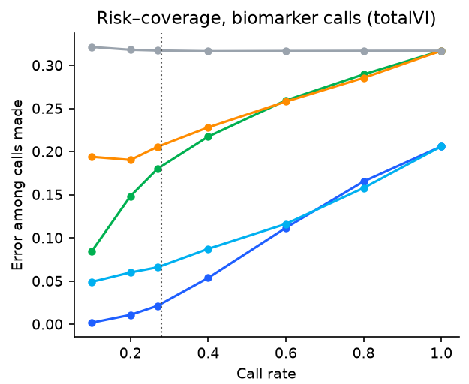
Backup: totalVI risk–coverage curve
Each method chooses which decisions to call.
Compare errors at a fixed horizontal position, so every method makes the same fraction of calls.
Blue: ProteoGuard Cyan: corrected point prediction
Green: block, no anchors Orange: threshold distance Grey: random
Original figure from supplied deck; no curve values digitized or regenerated
Backup 2
Notes:
Backup only. This enlarges the original totalVI risk–coverage panel. A lower curve means lower observed error among the calls made at the same call rate. The plot does not provide a conditional selective-error guarantee. The original blue and cyan lines are visually close at high call rates; emphasize the clinically unvalidated cohort-relative task. Source: supplied presentation slide 9.

Slide 12
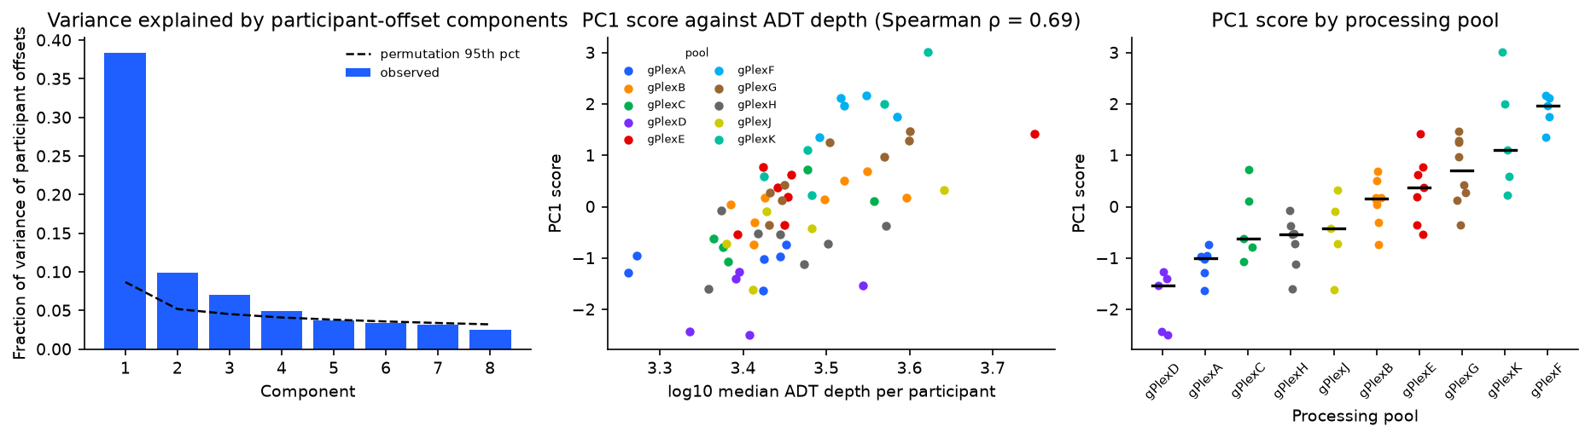
Backup: COMBAT processing-pool association
Processing-pool association supports a technical contribution. It does not exclude biology or demonstrate transfer to new pools.
COMBAT: 122 participants, 10 pools. Random participant splits represent existing environments.
Backup 3
Notes:
Backup only. COMBAT PC1 explains 38 to 40 percent of participant-offset variance and associates with processing pool and ADT depth. No clinical-group association was detected. The analysis is correlational. Some participants share processing pools, which matters for the scope of exchangeability and deployment. Pool-held-out evaluation remains a separate sensitivity analysis. Original figure from supplied slide 10.

Slide 13
Backup: unfinished comparisons and reproducibility
scVAEIT remains preliminary
Verify the same inputs, target scale, and convergence before comparing completed models. The supplied longer run has no final result here.
Repository fixes + eight CPU tests
Seeds, paths, pipeline ordering, and the budget plot are fixed. Exact source preparation, result manifests, and the server environment still need verification.
Code and documents: github.com/nazirad19/proteoguard​
No cohort training was rerun for this revision.
Readout: efficiency-corrected totalVI protein likelihood; see report for pending provenance
Backup 4
Notes:
Backup only. The source report lists preliminary scVAEIT results at 100 epochs. The supplied script defaults to 200 through SV_EPOCHS and skips existing prediction files. No live server log or completed longer run was supplied. Neither current training progress nor model superiority is established. Both ZIPs contain identical non-Git files and 33 scripts that pass syntax parsing; the archived commit is 4cd21a01fed12e6176061fdc78ebc2f49f6892d9. The repository revision fixes the hard-coded training seed and paths, adds an ordered runner that creates sentinel JSON before ridge_sentinels.py, and replaces the budget illustration with CSV loading. Eight CPU tests passed. A reconstructed count-data adapter is included but has not been exercised on the cohort sources. Numerical outputs, exact original preparation and environment manifests are still needed. No cohort training was rerun.

