Slide 1
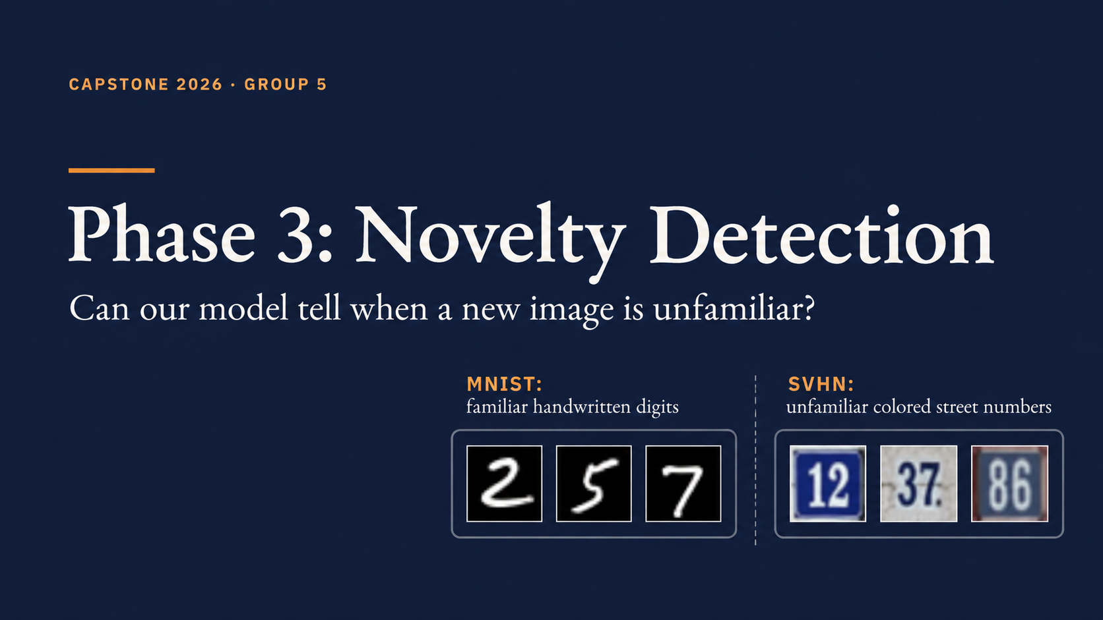

Slide 2
PHASE 3 · THE MAIN IDEA
What is a novel image?
Can we spot street-number photos that look different from MNIST handwriting?
FAMILIAR
UNFAMILIAR
3
8
5
12
45
7
MNIST handwritten digits
SVHN street-number photos
Our question: should the system flag the image for review?
GROUP 5 · PHASE 3
1 / 9

Slide 3
PHASE 3 · NOVELTY DETECTION
Our Phase 3 workflow
We reuse the trained CNN and the 15×15 SOM from earlier phases.
Image
CNN
SOM
Score
→
→
→
28×28 input
84 features
closest neuron
how unusual?
Trained CNN + trained SOM stay fixed
GROUP 5 · PHASE 3
2 / 9

Slide 4
PHASE 3 · NOVELTY DETECTION
SOM and BMU: a simple idea
The SOM is a map of 225 neurons (15 × 15).
BMU = Best Matching Unit
← BMU
The neuron most similar
to the image’s 84 features
A BMU is NOT a digit label.
GROUP 5 · PHASE 3
3 / 9

Slide 5
PHASE 3 · NOVELTY DETECTION
Quantization Error (QE)
QE measures the distance from an image to its closest neuron (BMU).
SMALL DISTANCE
LARGE DISTANCE
● ↔ ●
● ←────→ ●
Looks more familiar
May be unfamiliar
Higher QE = more unusual under this distance score
GROUP 5 · PHASE 3
4 / 9

Slide 6
PHASE 3 · NOVELTY DETECTION
How do we flag an image?
We choose the cutoff from MNIST training distances — not from the final test set.
Training QE scores
→
95th percentile
→
Fixed cutoff
Usually familiar
Flag for review
Historical threshold ≈ 1.569 · Rule: QE > cutoff
GROUP 5 · PHASE 3
5 / 9

Slide 7
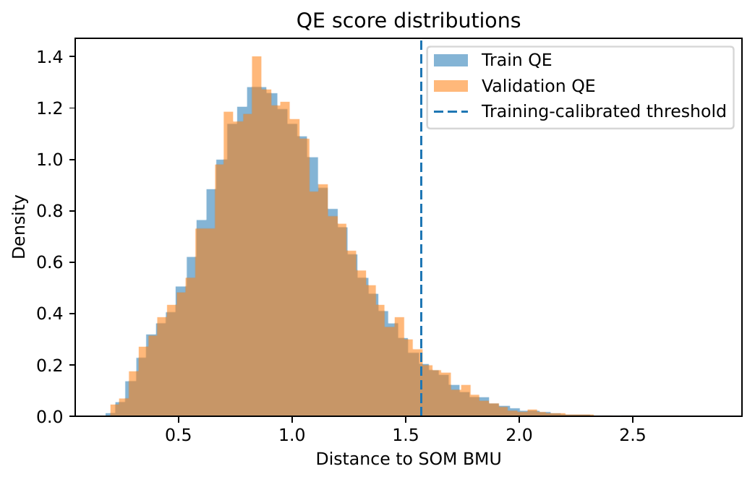
PHASE 3 • NOVELTY DETECTION
QE: Where do we flag unfamiliar images?
The dashed line is our MNIST-training cutoff (QE ≈ 1.569); images to its right are flagged as unfamiliar.
2

Slide 8
PHASE 3 · NOVELTY DETECTION
U-Matrix: look at neighboring neurons
QE compares an image with its BMU; U-Matrix compares neurons with their neighbors.
Small neighbor distance
→
Similar region of the map
Large neighbor distance
Boundary between patterns
Near neighbors
U-Matrix is not the same as QE.
GROUP 5 · PHASE 3
6 / 9

Slide 9
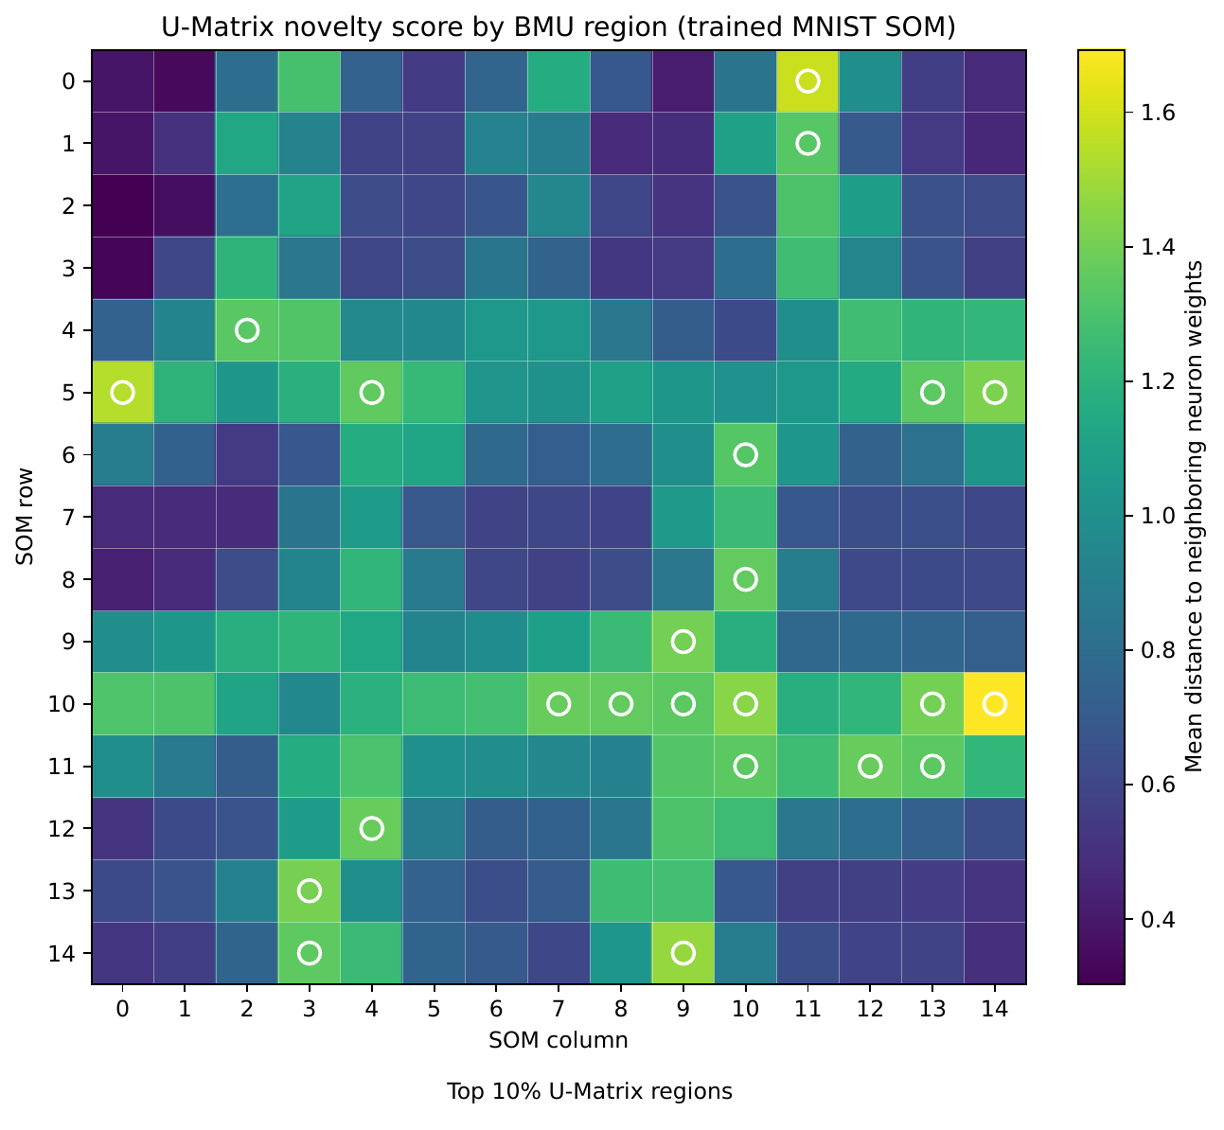
PHASE 3 • NOVELTY DETECTION
U-Matrix: Differences between SOM neighbors
🟣 Purple: A neuron is very similar to its neighboring neurons.
🟢 Green: A neuron is somewhat different from its neighboring neurons.
🟡 Yellow: A neuron is very different from its neighboring neurons.
⚪ White circle: This neuron belongs to the top 10% of neurons with the highest U-Matrix scores.
Purple = similar neighbors; green/yellow = larger differences; white circles = top 10% of high-scoring neurons.
1

Slide 10
PHASE 3 · NOVELTY DETECTION
Our historical SVHN results
SVHN contains house-number images that differ from MNIST handwriting.
96.17%
SVHN images flagged
5.13%
MNIST validation flagged
at frozen QE cutoff
MNIST images were flagged by mistake
0.9811
QE AUROC
0.9696
U-Matrix AUROC
SVHN vs MNIST
SVHN vs MNIST
AUROC shows ranking quality — not detection percentage.
GROUP 5 · PHASE 3
7 / 9

Slide 11
PHASE 3 · NOVELTY DETECTION
Which method best separates MNIST validation from SVHN test images?
Higher AUROC means better separation between familiar and unfamiliar images.
Energy
0.9998
Max-softmax
0.9985
SOM QE
0.9811
kNN (k=5)
0.9766
Mahalanobis
0.7764
MSP scores higher than QE: difference 0.0174 AUROC (paired 95% CI: 0.0154–0.0194).
GROUP 5 · PHASE 3
8 / 9

Slide 12
PHASE 3 · NOVELTY DETECTION
Conclusion: What did Phase 3 show?
Evaluation: familiar MNIST validation vs unfamiliar SVHN test images
1
We evaluated unfamiliar images
96.17% of SVHN images were flagged using the fixed QE cutoff.
2
We checked familiar images too
5.13% of MNIST validation images were flagged by mistake.
3
We measured score separation
QE AUROC = 0.9811 · U-Matrix AUROC = 0.9696
Takeaway: QE flagged most SVHN images in this MNIST–SVHN experiment.
GROUP 5 · PHASE 3
CONCLUSION

