Slide 1




Company 3
Company 4
Mediator
Company 1
Company 2

Slide 2
Company 3
Company 4
What clients you want to negotiate about?
Mediator
Company 1
Company 2

Slide 3
Company 3
Company 4
Current
assignment
Mediator
Company 1
Company 2

Slide 4
Company 3
Company 4
Exchange?
Current
assignment
Mediator
Proposed
assignment
Company 1
Company 2

Slide 5
Company 3
Company 4
No
No
Current
assignment
Mediator
Proposed
assignment
No
Yes
Company 1
Company 2

Slide 6
Company 3
Company 4
No
No
Current
assignment
Mediator
Proposed
assignment
No
Yes
Not accepted, but Company 2 prefers the 4th client to the 3rd. Similar things can be inferred when exchanges were 1 to 1.
Update preferences
Company 1
Company 2

Slide 7
Company 3
Company 4
Exchange?
Current
assignment
Mediator
Proposed
assignment
Company 1
Company 2

Slide 8
Company 3
Company 4
No
No
Current
assignment
Mediator
Proposed
assignment
Yes
Yes
Company 1
Company 2

Slide 9
Company 3
Company 4
No
No
Current
assignment
Mediator
Proposed
assignment
Company 1 and 2 have accepted, and their exchanges only involve them. I can partially update the current assignment. I can also update prefs.
Yes
Yes
Company 1
Company 2

Slide 10
Company 3
Company 4
No
Current
assignment
Mediator
Proposed
assignment
Company 1
Company 2

Slide 11
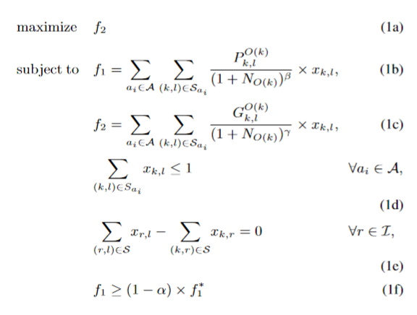
Bidding strategy?

Slide 12
Bidding strategy?
Represents an acceptance score

Slide 13
Bidding strategy?
Represents an information gain score

Slide 14
Bidding strategy?
For each agent, the new offer should only involve one swap at most

Slide 15
Bidding strategy?
If I give client r someone gets client r and vice versa

Slide 16
Bidding strategy?
I want a mínimum acceptability score in my offer

Slide 17
Bidding strategy?
With the new offer I aim to maximize what I know about the agents' preferences

Slide 18
Bidding strategy?
The acceptability of a swap can either be 1 or 0 if i know that you previously said yes/no to the swap. For unknown values, I can use some sort of weighted similarity considering how similar the clients' route and pick-up/drop-off times are to other requests I have said yes/no

Slide 19
Bidding strategy?
The information gain can be measured by how much I may infer from the preferences when the agent says yes/no. Ideally, I should have a complete ranking. In reality, only the ranking from what I currently have matters.

