Slide 1

Almost half of the children were killed when the ship sank. Analyzing the survival rates considering their age, sex, embarkation port, and family members on board can provide valuable insight.
In the disaster of the Titanic
https://titanicfacts.net/titanic-victims/#:~:text=How%20many%20children%20died%20on,from%20First%20Class%20who%20perished.

Slide 2
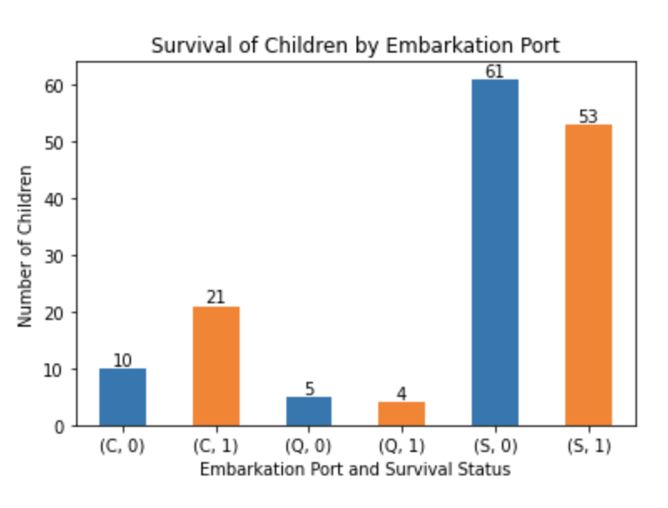
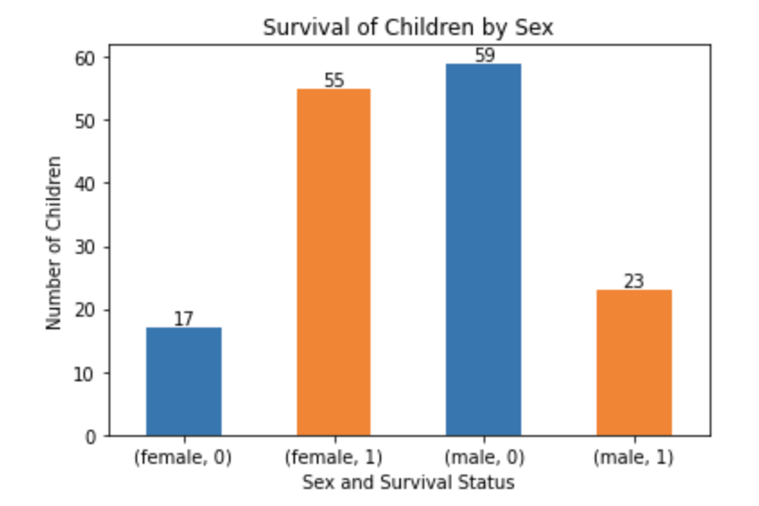
Most children embarked at Southampton port, of which 61 didn't survive. That is 4/5 of the child victims.
There were 3.5 times more male victims than females. That's while an almost equal number of girls and boys were on board, 72 female and 82 male.

Slide 3
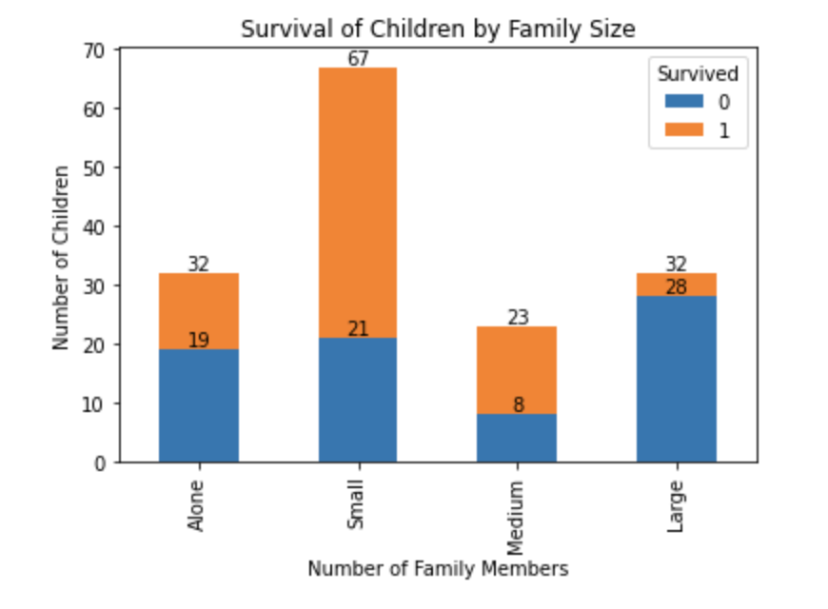
Children accompanied by 1 or 2 family members had better chance of survival (%68), while few children accompanied with more that 4 family members survived (%12).

Slide 4
The higher number of male child victims may suggest that males were more likely to be left behind during evacuation compared to females. This could be due to the societal norms of that time, which placed a higher value on the lives of women and children.
The higher survival rate of children accompanied by 1 or 2 family members may suggest that families with smaller size were able to evacuate more efficiently and effectively than those with larger size.
Overall, the findings highlight the complex and multifaceted nature of the factors that influenced the survival rates of children on the Titanic, including gender, family size, port of embarkation.
Southampton port was the main departure point for the Titanic, and most of the crew and passengers boarded here, which explainds why %80 of young passengers were boarded at this port.

