Slide 1
An Analysis of Informed Search Algorithms for Rush Hour Puzzle
By Nazli Ensafi, Haelang Park, Lauren Wu
Comp 472, Fall 2022

Slide 2
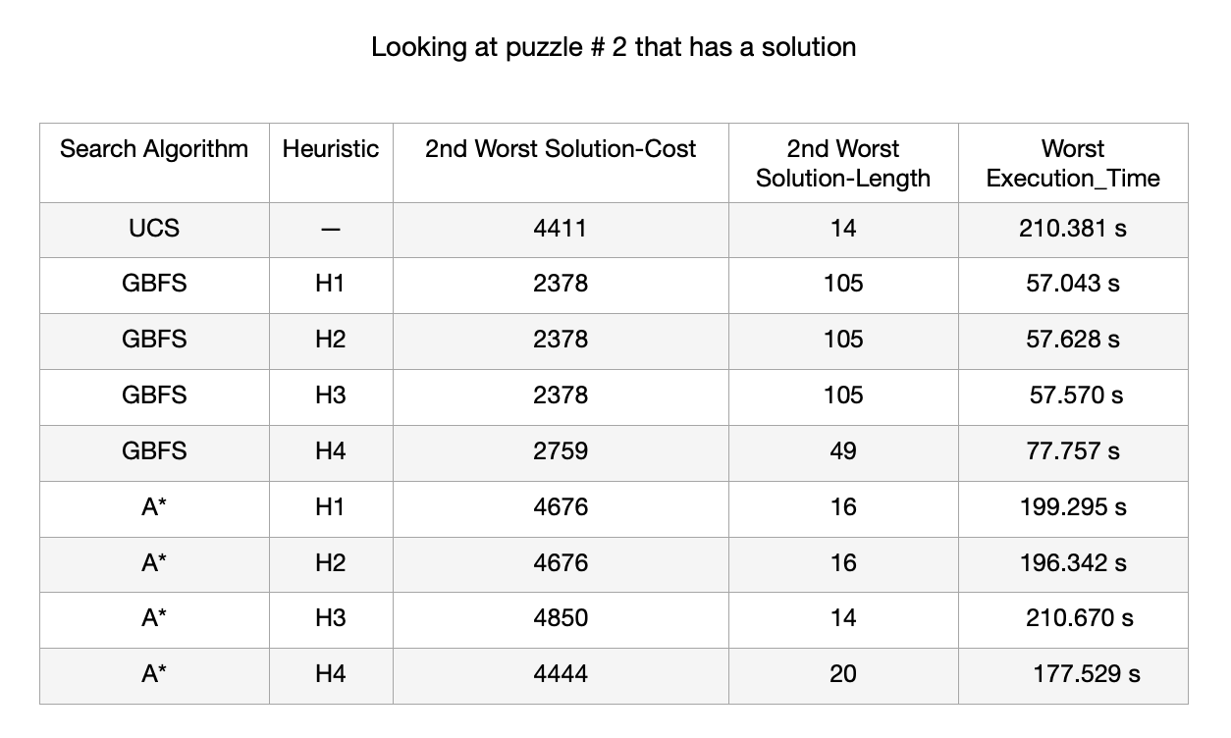
1. The length of the solutions across algorithms and heuristics

Slide 3
The length of the solutions across algorithms and heuristics
Worst solution length across all searches: GBFS(H1, H2, H3) = 105
Worst solution length across informed searches: GBFS(H1, H2, H3) = 105
Worst solution length across different heuristics of GBFS: (H1, H2, H3) = 105
Worst solution length across different heuristics of A*: H4 = 20
Worst solution length across different searches using H1: GBFS(H1) = 105
Worst solution length across different searches using H2: GBFS(H2) = 105
Worst solution length across different searches using H3: GBFS(H3) = 105
Worst solution length across different searches using H4: GBFS(H4) = 49

Slide 4
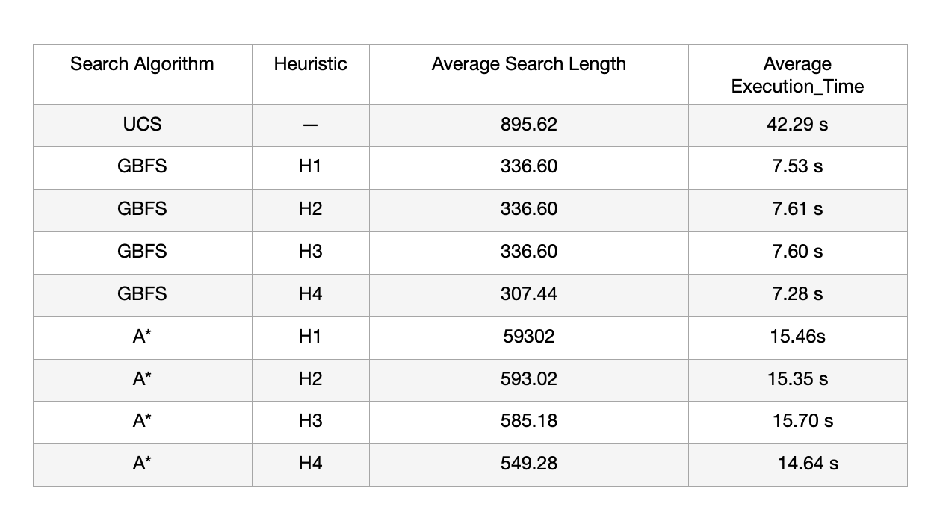
2. The lowest-cost solutions across all searches are:

Slide 5
3. The admissibility of each heuristic and its influence on the optimally of the solution.
H1: The number of blocking vehicles
inadmissible, is closer to the optimal solution when used in A* over Greedy Search.
The number of blocking vehicles will overestimate the optimal solution cost as there can be an unlimited number of blocking vehicles that don’t correspond to having to move and add them to the solution cost.
H2: The number of blocked positions
inadmissible, possess the same results to h1, also performs better when used in A* instead of Greedy.
H1 and H2 generally perform the worst, furthest away from optimal solution
H3: Value of h1 * constant
Inadmissible, but occasionally achieves the optimal solution when used in A*, better comparatively out of H1 and H2. However generally performs poorly and inadmissible similarly to H1 and H2 when used in greedy.
Performs slightly more accurately and achieves closer to the optimal solution compared to H1 and H2, even when not admissible.
H4: The number of cars blocking the cars blocking A
Generally the best accuracy, and achieves/achieves closest to the optimal solution out of the three heuristics, particularly when used in A* Search.
Admissible in the most amount of examples, however not consistently.
All cars blocking the blocked cars must be removed first, before removing the blocked cars. Therefore should be an admissible heuristic.

Slide 6
Is an informed search always faster?
Informed searches are not always faster. If we take our most challenging puzzle, puzzle #2, UCS finds a solution in 210.381 s whereas A*(H3) finds one in 210.670 s. Choice of the heuristic plays an important role in how fast a solution is found.

Slide 7
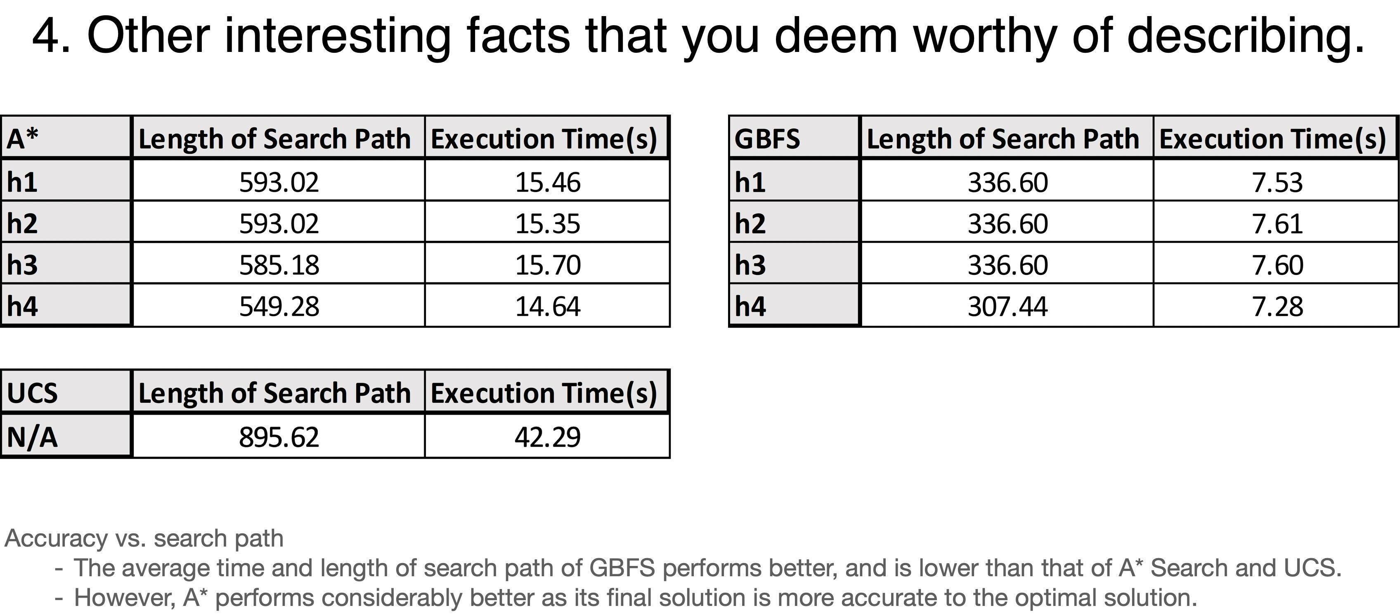

Slide 8
Thank you

