Slide 1
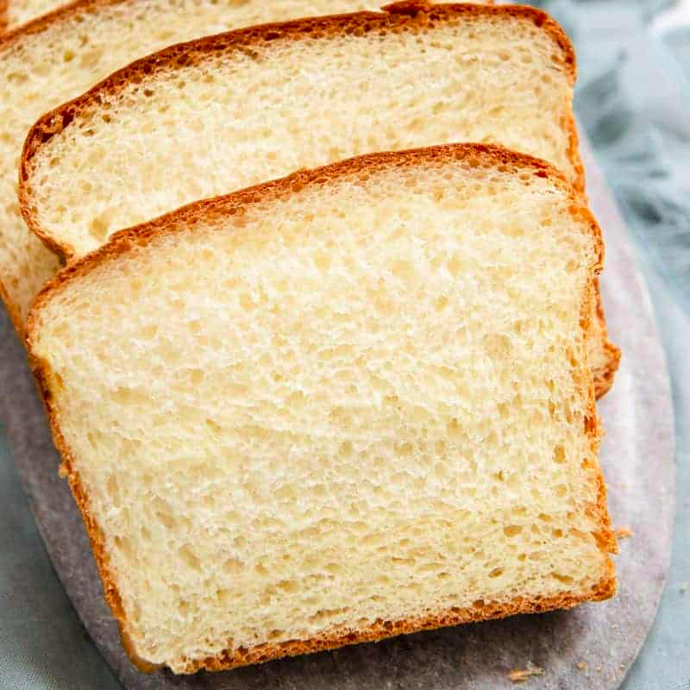
INSIDE OUT
of
A BREADBOARD
Presented by Fariha Akter Promi & Nazma Sarker

Slide 2
Objective
The purpose of this project is to help newbies in circuit laboratory to get acquainted with breadboard and its usage.
Hence we made a 3D animation video on breadboard in Bengali as we felt that it would be much more easier for the students to grasp the concepts easily.

Slide 3
Roles of Individual
Nazma Sarker
3D Animator
3D Model Designer
Art director
Audio Editing
Graphics Designer
Video Editing
Fariha Akter Promi
Script Writer
Storyboarding
Sound Designer
Video Editing
Audio Editing
3D Model Designer

Slide 4
Tools used
Blender
GIMP
Kdenlive
Audacity
Git & Github

Slide 5
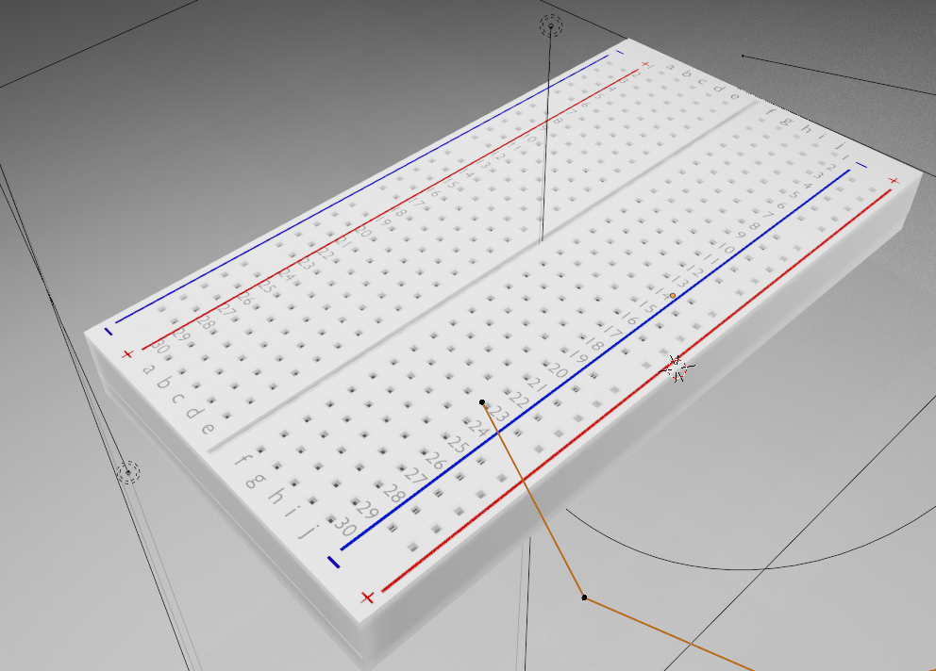
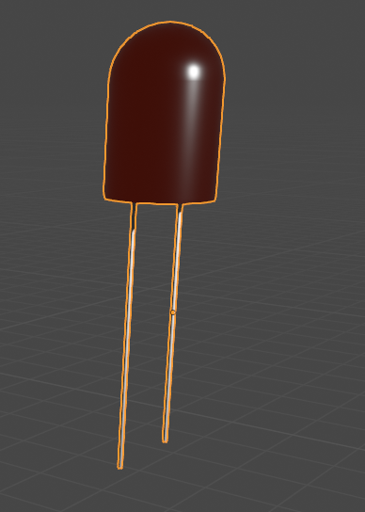
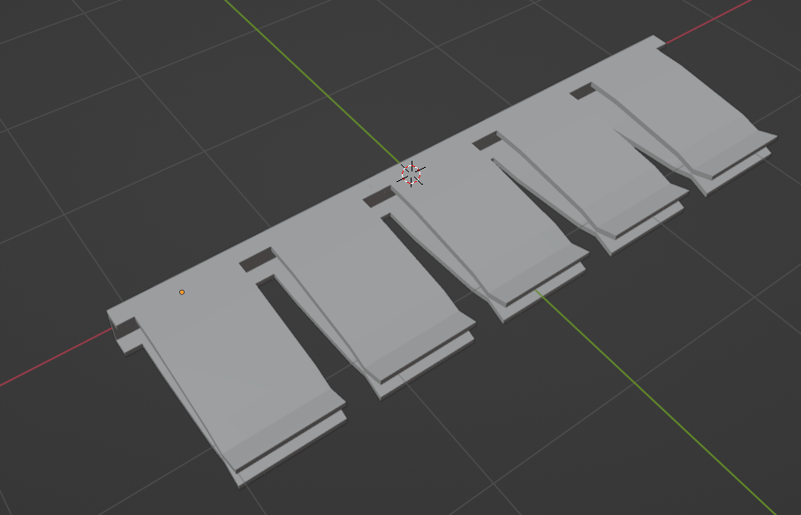
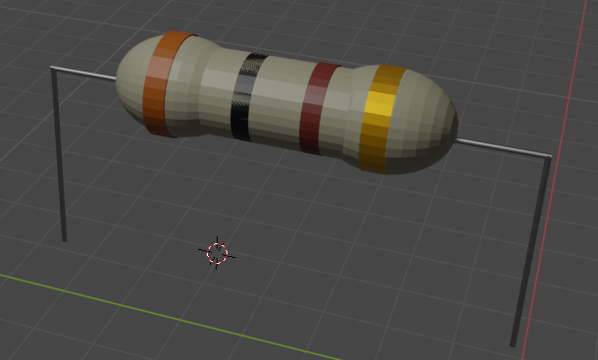
3D Models
Breadboard
LED
Metal Strip
Resistor

Slide 6
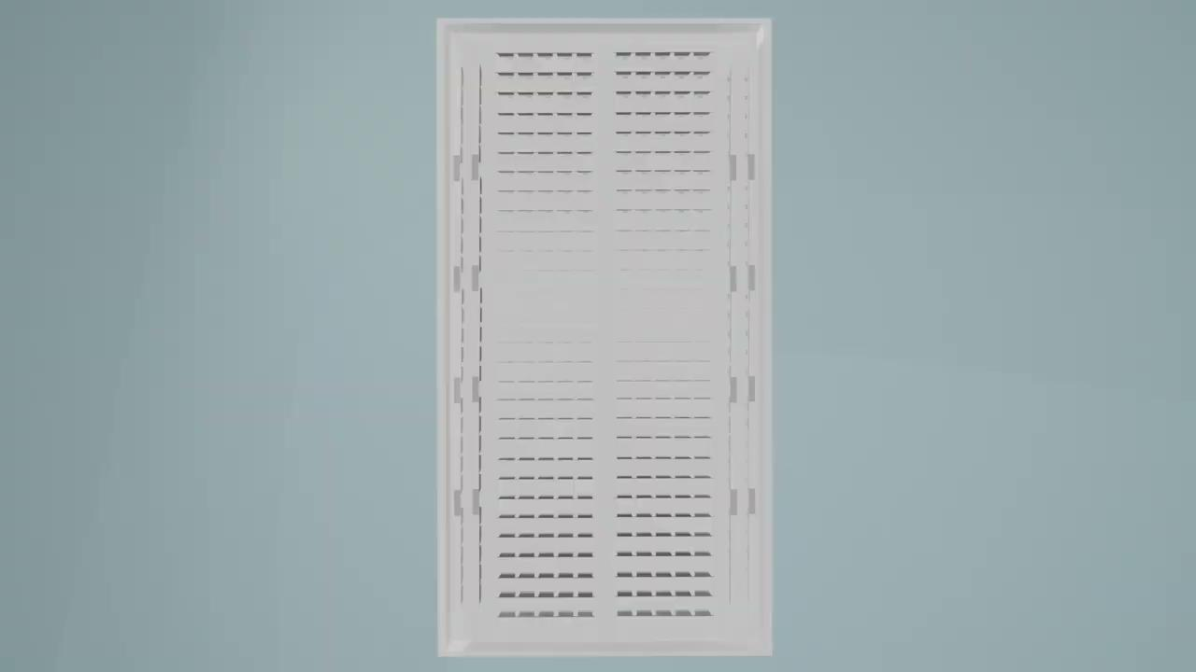
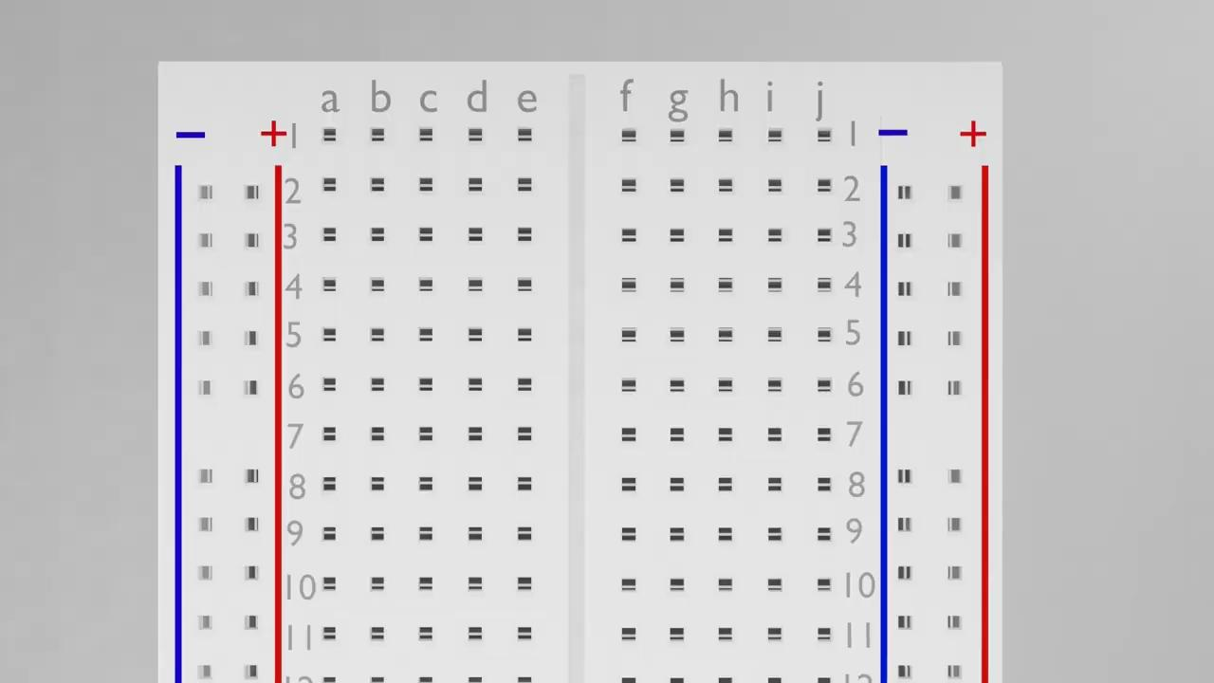
Animation Clips

Slide 7
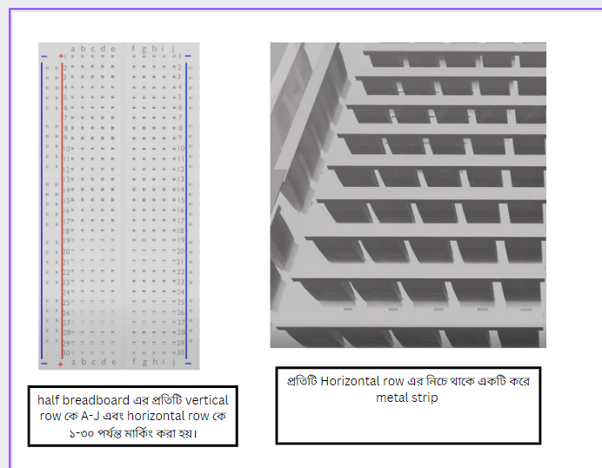
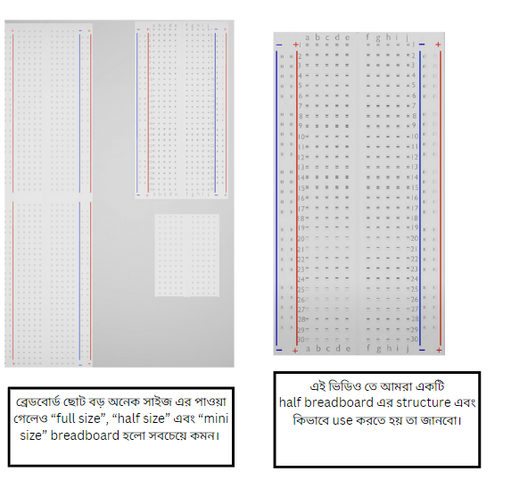
Storyboard

Slide 8
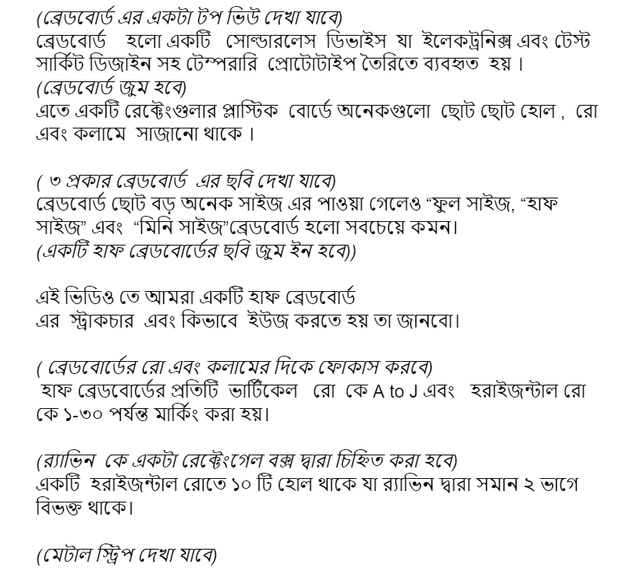
Script

Slide 9
Time Duration
1 Minute 51 Seconds

Slide 10
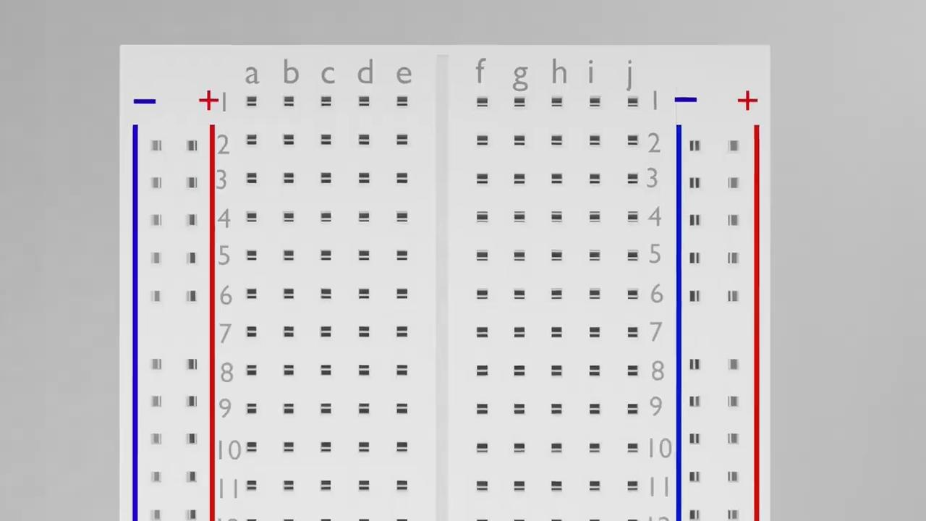
Product

Slide 11
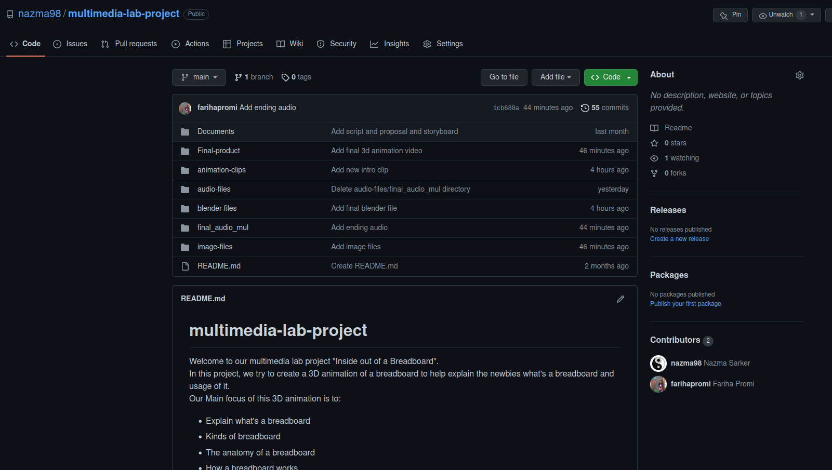
Github Repository
Link : Inside-Out-of-A-Breadboard

Slide 12
Hindrances
Graphics card
High configuration pc’s
Resources
High Quality Headset
Internet Connection

Slide 13
Time Frame
28th DECEMBER, 2022 to 22nd March, 2023

Slide 14
Thank You

