Slide 1
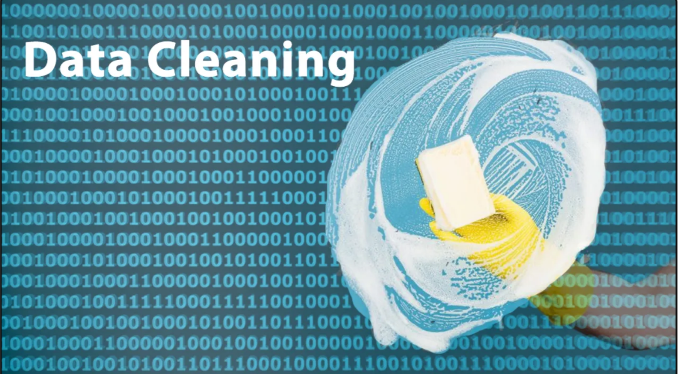


With PANDAS

Slide 2



