Slide 1
Doctor on demand A medical apps for better health

Slide 2
Presented by : nazia zerin 2013-2-60-059 nazmoon nahar 2013-2-60-043
Welcome

Slide 3

What is doctor on demand ??
To whom this app is useful??
What is the requirement of this app??
How it works ??
Necessity of this app ??

Slide 4

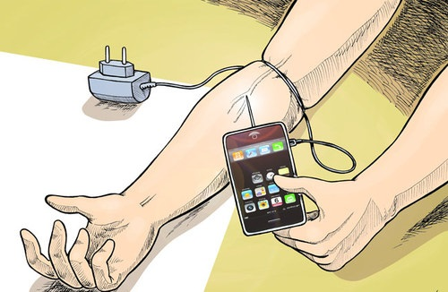


Doctor on demand is a type of application which can be easily use by the busy working people. It is one type of diary which has options to maintain his health records. Patient can take primary treatment using this application.
It is useful for people who forget to carry prescription when he or she need to visit to doctor. It is helpful for people who always forget about his or her medicine’s name. It is an application which carry about the patient’s history, prescribed medicines, name of the patient’s doctor/doctors, name and information about the different types of doctors
User can create an account.
Primary Disease detection.
Prescribe primary treatment according to the disease.
User can consult doctors.
Help to make appointments
Keep track of patient previous medical details.
Keep detail of current medicine
Can pay the appointed doctor’s bill through this app
Can call ambulance

Slide 5
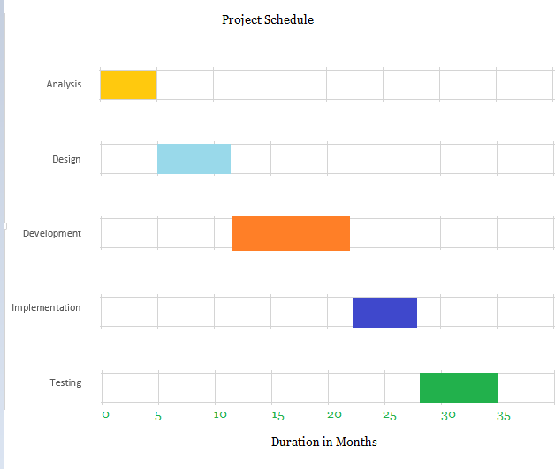
Project schedule

Slide 6
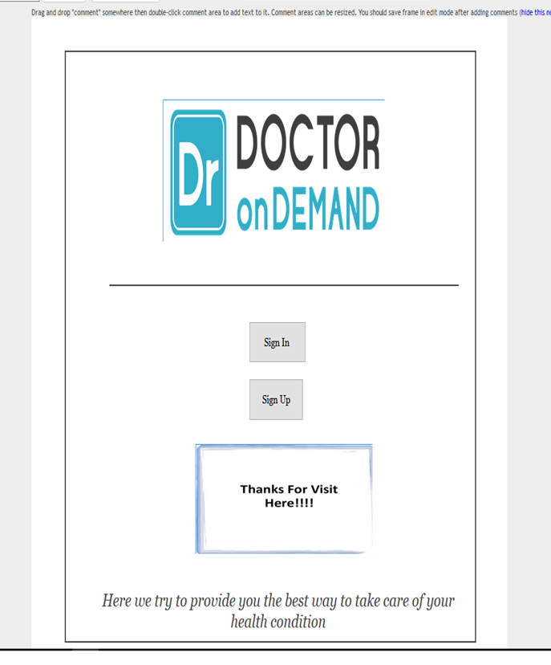
ui design of the app

Slide 7
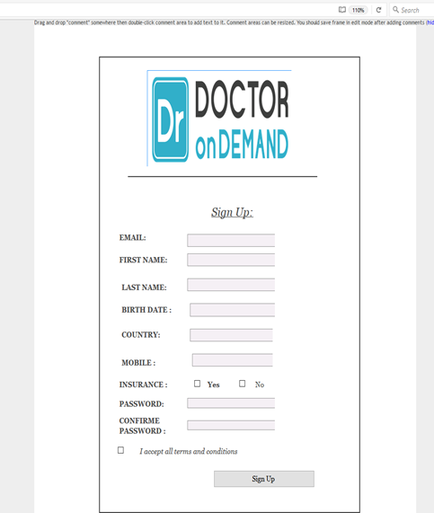
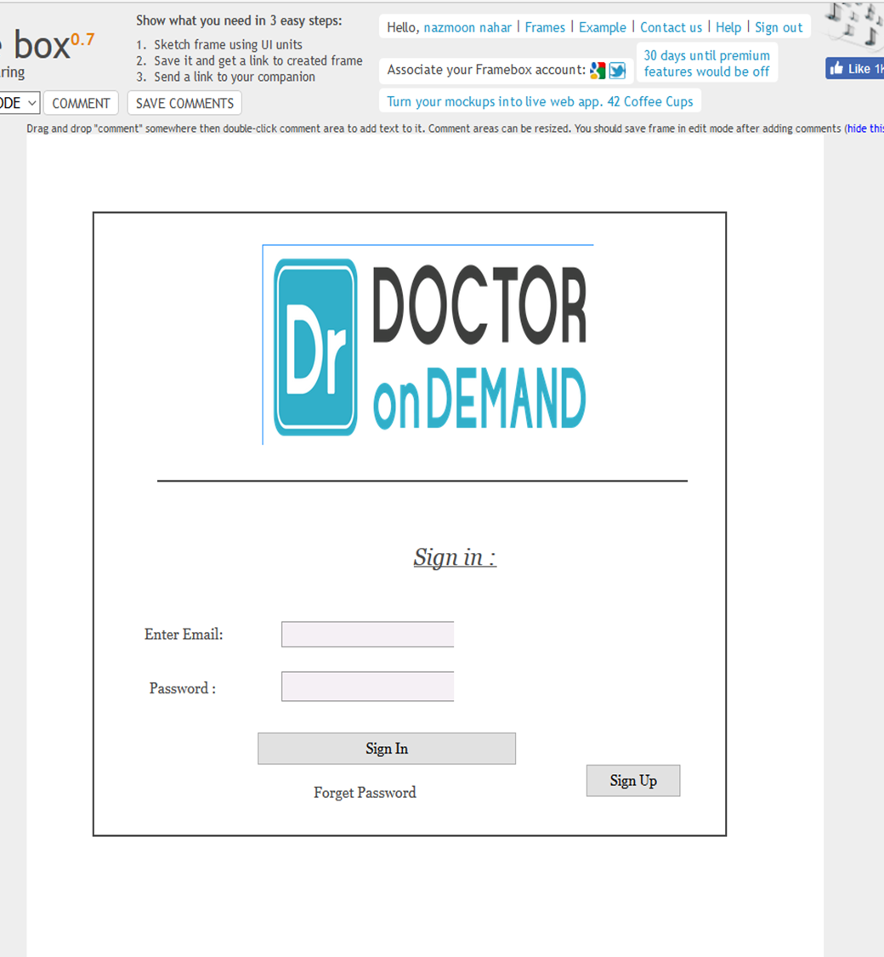

Slide 8
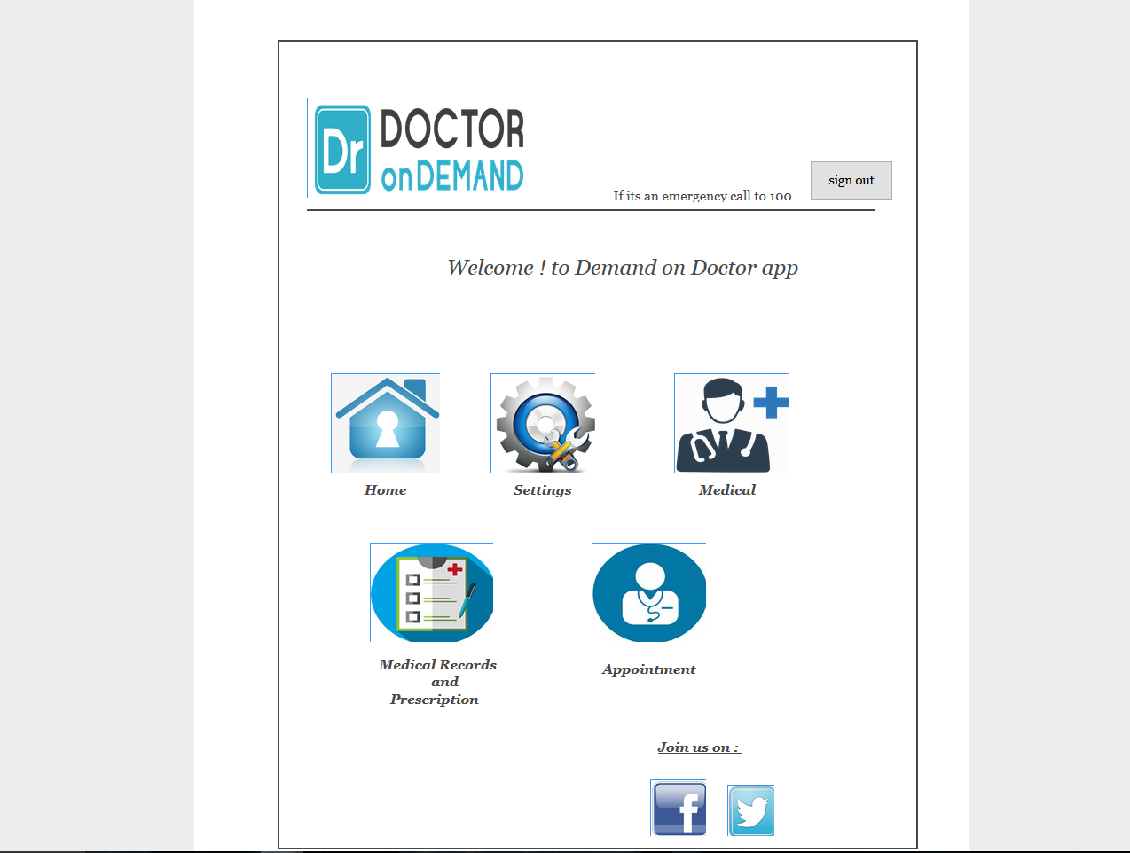
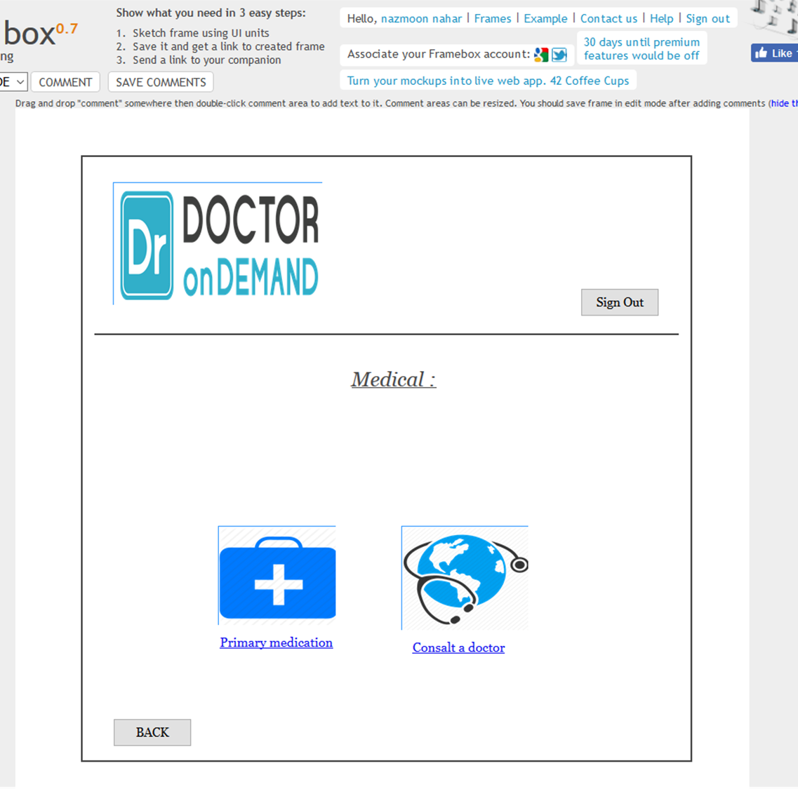

Slide 9
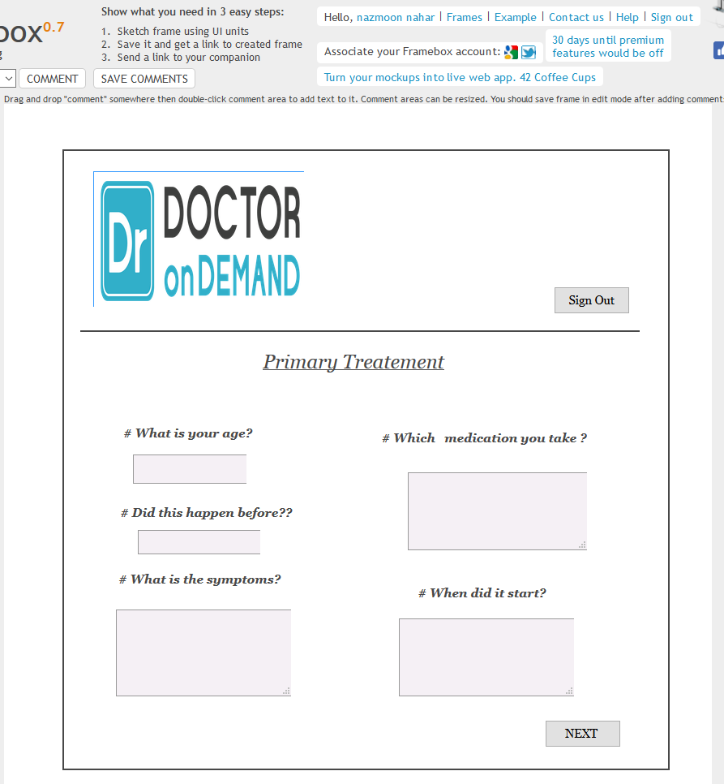
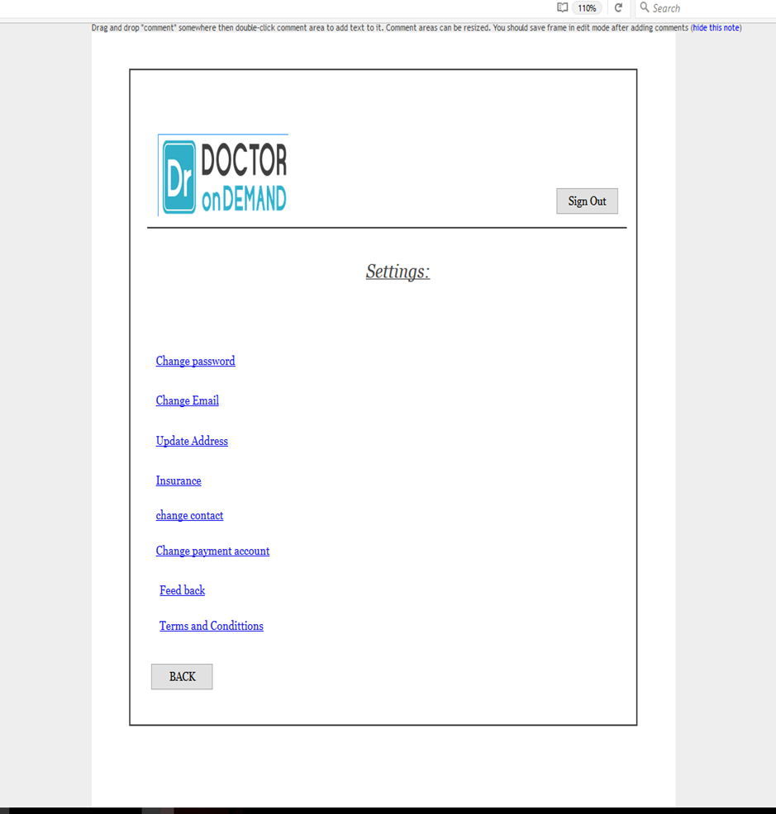

Slide 10
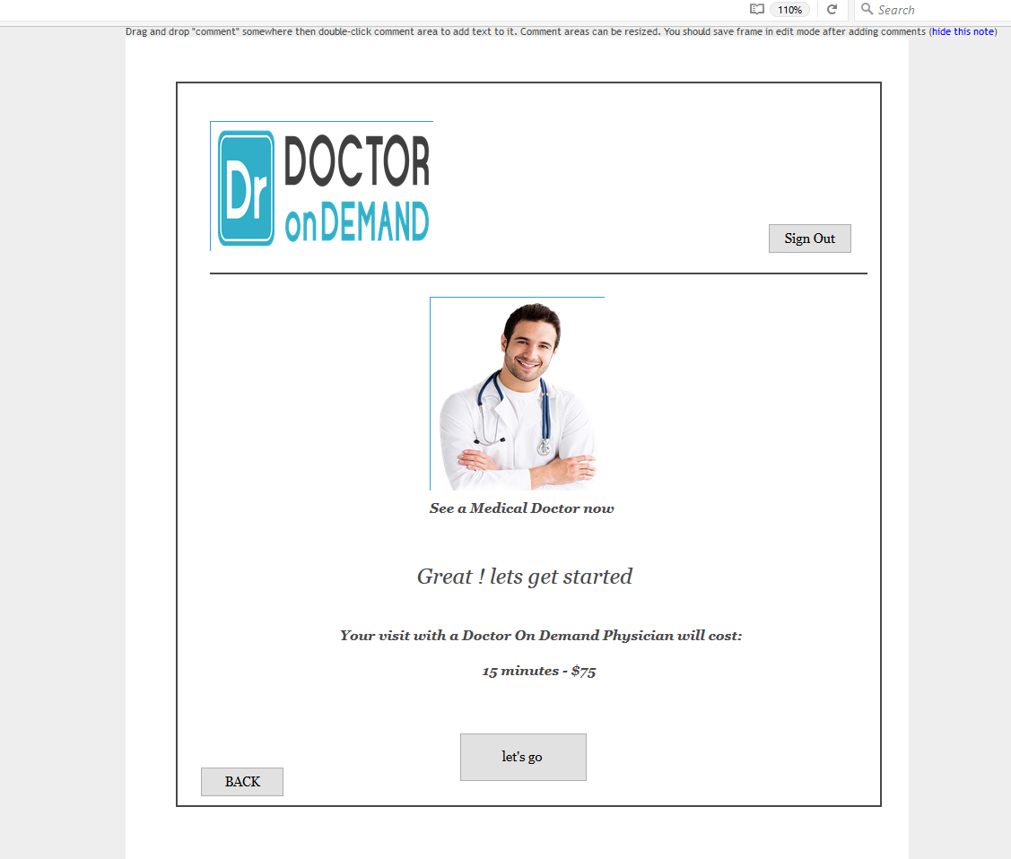
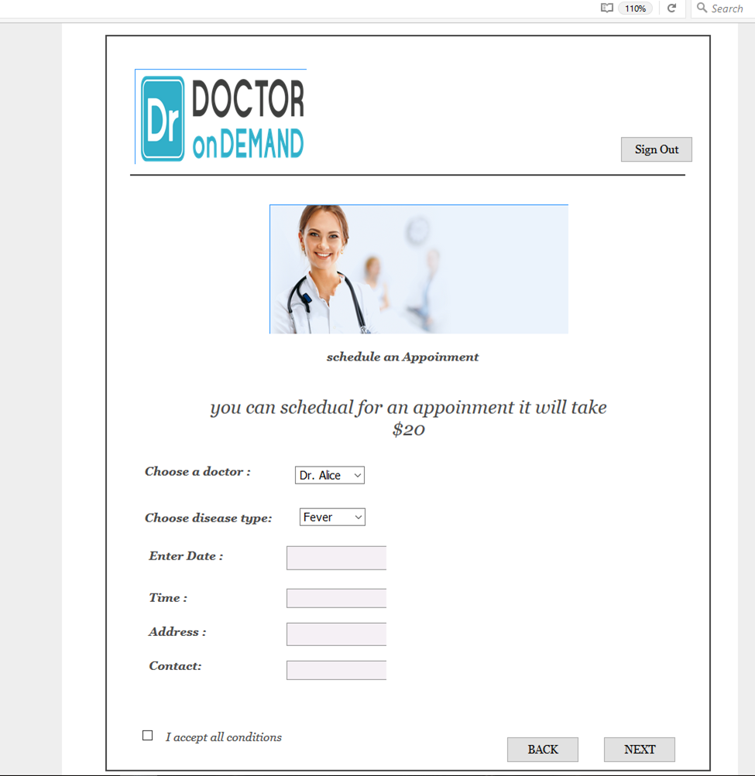

Slide 11
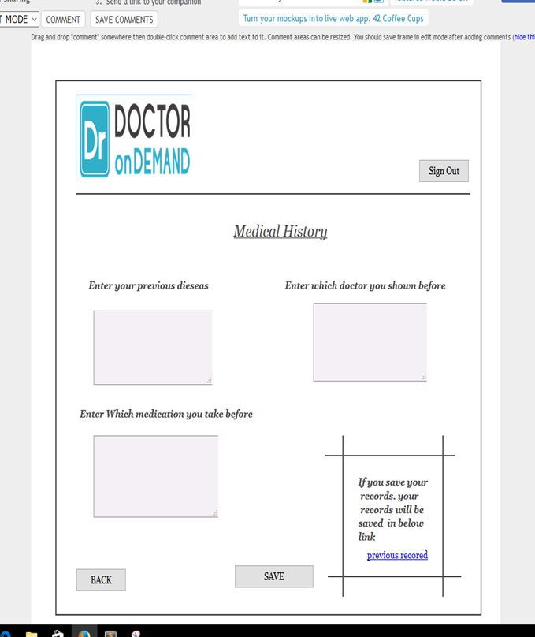
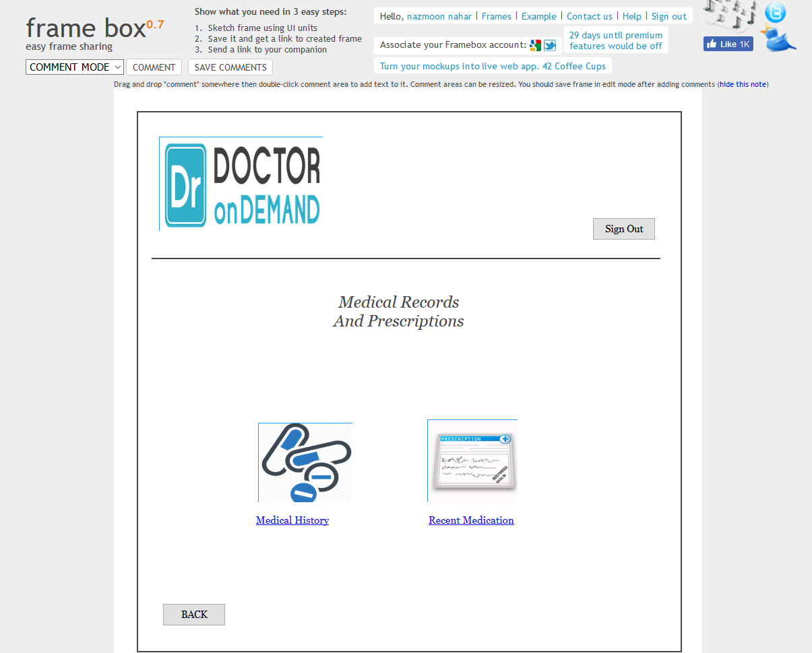

Slide 12
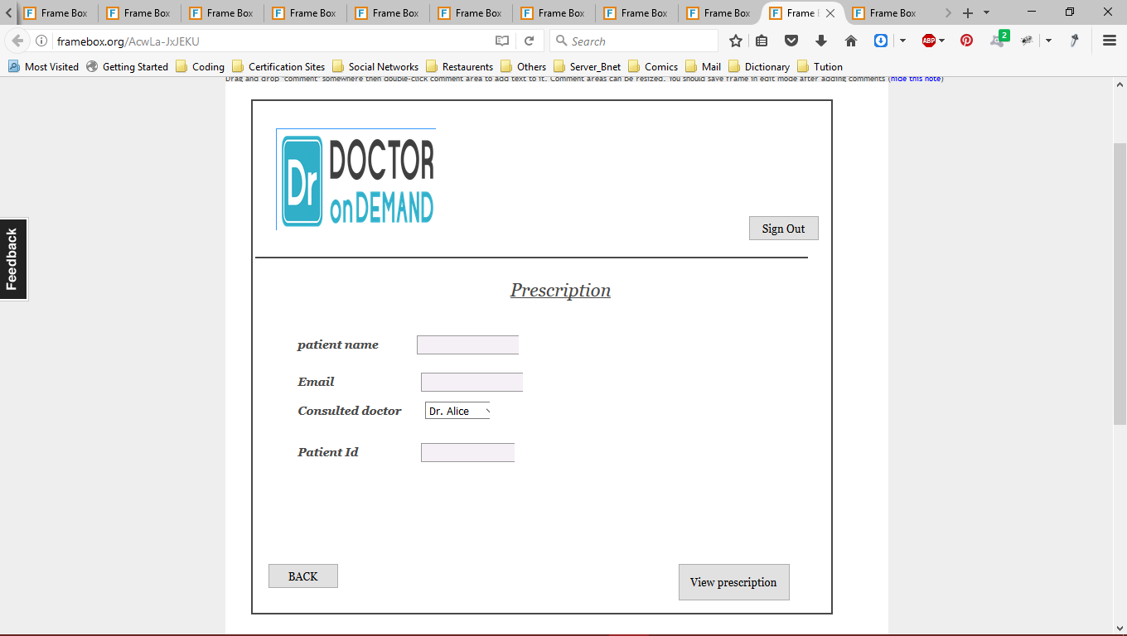
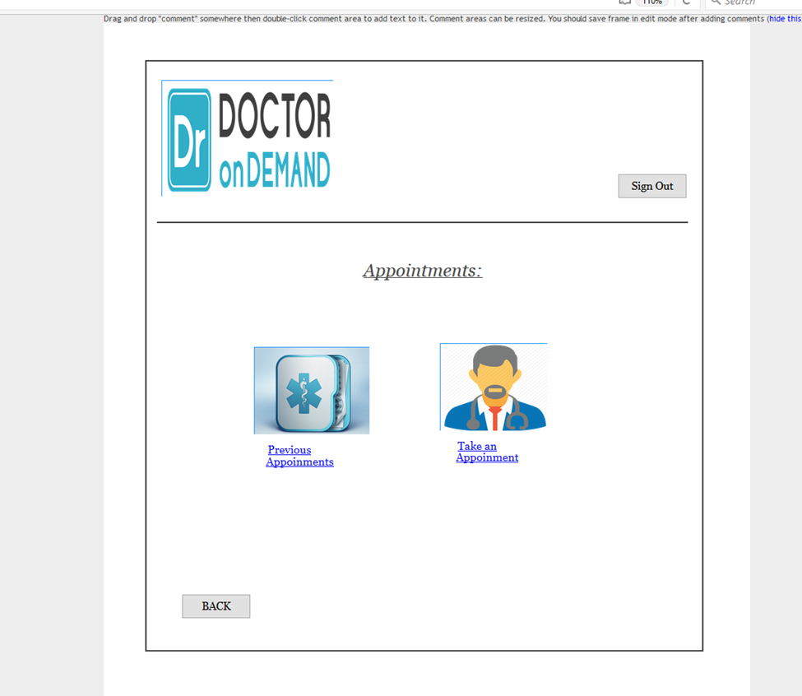

Slide 13
Test cases
Test Scenario | Test case ID | Test steps | Test data | Expected result
User sign-in |  | Pre-conditions: |  | Make sure that site under test is available and testable
 |  |  |  | Make sure user sign in test data is available
 | SN 01 | Step 1:OPEN URL
 |  | Step 2:provide valid user name and password | Username : alice Password : 123
 |  | Step 3:click sign in |  | Successfully sign in
 | SN 02 | Step 1:OPEN URL
 |  | Step 2:provide invalid user name and password | Username : alice Password : abc | Wrong username or password
 |  | Step 3:click sign in |  | Not signed in
 |  | Post-conditions: |  | User is validated with database and successfully login to account. The account session details are logged in database

Slide 14
Test Scenario | Test case ID | Test steps | Test data | Expected result
User sign-up |  | Pre-conditions: |  | Make sure that site under test is available and testable
 |  |  |  | Make sure user sign up test data is available
 | SU 01 | Step 1:OPEN URL
 |  | Step 2:provide valid email , name, country, birthdate, mobile ,insurance and password | alice@gmail.com Alice Rahman 2-2-1971 Bangladesh 01755765872 Yes 123 123
 |  | Step 3:click sign up |  | Successfully sign up
 | SU 02 | Step 1:OPEN URL
 |  | Step 2:provide valid email , name, country, birthdate, mobile, Insurance and password | Username : Alice Password : abc | Invalid data
 |  | Step 3:click sign up |  | Not signed up
 |  | Post-conditions: |  | User should provide email and internet connection should be available

Slide 15
Test Scenario | Test case ID | Test steps | Test data | Expected result
Primary treatment |  | Pre-conditions: |  | Make sure that site under test is available and testable
 |  |  |  | Make sure all field’s test data is available
 | PT 01 | Step 1:OPEN URL
 |  | Step 2:provide valid answer to all question field | Age : 46 Yes Fever, cough Nothing Last day
 |  | Step 3:click next |  | Show some prescription and refer some doctor’s name
 | PT 02 | Step 1:OPEN URL
 |  | Step 2:provide valid answer to all question field | Age : 46 | All fields are empty
 |  | Step 3:click next |  | All question must be answered to get a valid prescription
 |  | Post-conditions: |  | User should provide all answer correctly

Slide 16
Test Scenario | Test case ID | Test steps | Test data | Expected result
Medical history |  | Pre-conditions: |  | Make sure that site under test is available and testable
 |  |  |  | Make sure all field’s test data is available
 | MH 01 | Step 1:OPEN URL
 |  | Step 2:provide valid answer to all question field | Age : 46 cancer therapy Dr. bob Dr. Catherin Dr. Nahar
 |  | Step 3:click save |  | Save all information
 | MH 02 | Step 1:OPEN URL
 |  | Step 2:provide valid answer to all question field | Age : 46 | All fields are empty
 |  | Step 3:click save |  | All question must be answered to save previous medical history
 |  | Post-conditions: |  | User should provide all answer correctly to save his previous record correctly

Slide 17
Test Scenario | Test case ID | Test steps | Test data | Expected result
Prescription |  | Pre-conditions: |  | Make sure that site under test is available and testable
 |  |  |  | Make sure all field’s test data is available
 | PR 01 | Step 1:OPEN URL
 |  | Step 2:provide valid name, email, consulted doctor name, patient id | Alice alice@gmail.com Dr. Nahar p-10
 |  | Step 3:click view prescription |  | Show previously consulted doctor’s prescription
 | PR 02 | Step 1:OPEN URL
 |  | Step 2: :provide valid name, email, consulted doctor name, patient id | Alice alice@gmail.com p-6 | Invalid doctor name
 |  | Step 3:click view prescription |  | Invalid doctor name and could not load prescription
 |  | Post-conditions: |  | User should provide all data correctly to get previous prescription

Slide 18
Test Scenario | Test case ID | Test steps | Test data | Expected result
Schedule appointment |  | Pre-conditions: |  | Make sure that site under test is available and testable
 |  |  |  | Make sure all field’s test data is available
 | SA 01 | Step 1:OPEN URL
 |  | Step 2:provide valid doctor name, disease type, date, time, address, contact | Dr. Rich fever 01-11-2017 7.00pm 51/2 , malibagh , Dhaka-1217
 |  | Step 3:click next |  | Fixed a schedule to required doctor
 | SA 02 | Step 1:OPEN URL
 |  | Step 2: :provide valid name, email, consulted doctor name, patient id | Dr. Rich fever let field empty | Required field data
 |  | Step 3:click next |  | Invalid data . all field should be fulfill
 |  | Post-conditions: |  | User should provide all data correctly to get previous prescription

Slide 19
Project traceability matrix
Test case requirement | SN1 | SN2 | SU1 | SU2 | PT1 | PT2 | MH1 | MH2 | PR1 | PR2 | SA 1 | SA2
Sign in
Sign up
Primary treatment
Medical history
Prescription
Schedule appointment

Slide 20



