Slide 1
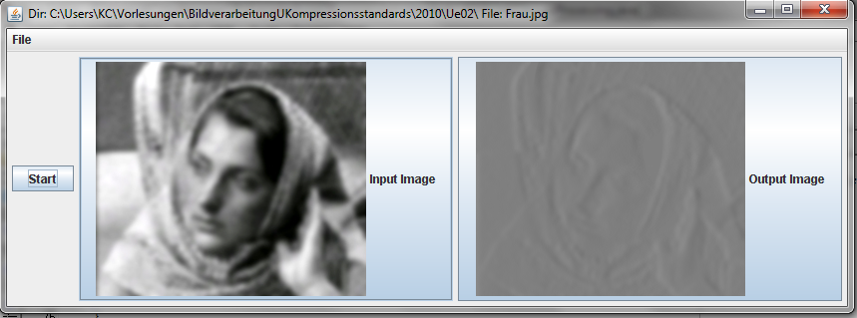
Exercise 1
a) Compute the difference data
R(n+1)= x(n+1) - x(n)_{prediction}
with the simplest predicition („good for piecewise constant signals“)
x_{prediction}= x(n)
and display the result.
b)Compute for the original and the difference image the shortest possible code length
in bits/pixel, which is given by the Entropie H.
(H_{orig} = H_{diff} = )
Notes:
<Nummer>

Slide 2
public double entropie(double[] p){
double H=0.0;
for(int i=0;i<p.length;i++){
if ( p[i]> 0.0) H=H - ((p[i]* Math.log(p[i]))/Math.log(2));
}
return H;
}
Notes:
<Nummer>

Slide 3
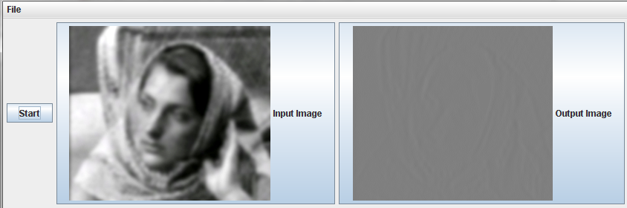
Exercise 2
Do the same as in Exercise 1 with a better predition („good for piecewise linear signals“)
x_{prediction}= 2*x(n) – x(n-1).
The simple predictor from Exercise 1 gives H_{diff}=4,5.
Enhenced predictor from Exercise 2 H_{pred}=3,13502
Notes:
<Nummer>

