Slide 1
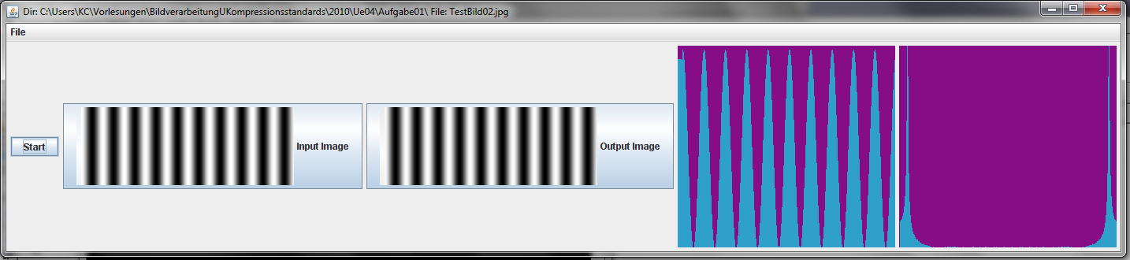
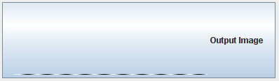
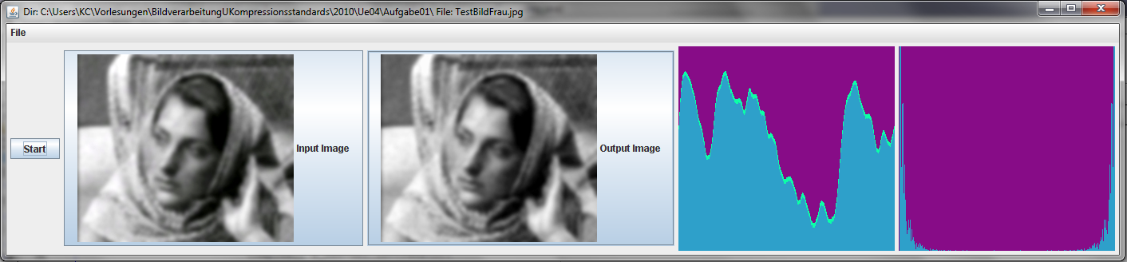
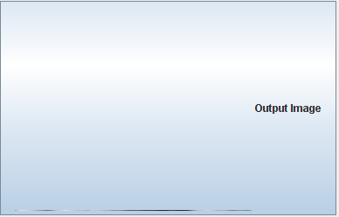
Exercise 1:
Compute the Fouriertransformation of one row of an image and display it.
Exercise 2:
Compute the inverse transformation and display it as well.

Slide 2

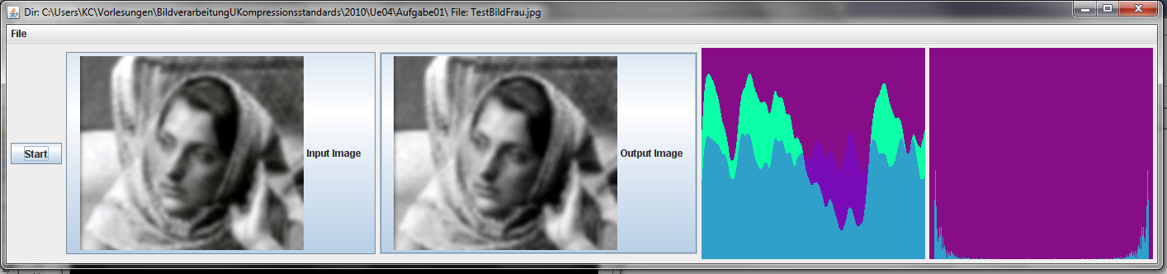
Exercise 3:
Set higher coefficiants to zero (d.h. z.B. für 128>i>5) and display the deep frequencies (that means the backtransformation of the remaining coefficiants).
Exercise 4: Set lower coefficiants to zero (d.h. z.B. für i<5) and display the higher frequencies (that means the backtransformation of the remaining coefficiants). Shift the signal into the positiv range.

