Slide 1


BASIC SQL COMMANDS
Mohshi Masnad Lecturer

Slide 2

What we have done so far……..
LOGICAL TESTS
AGGREGATE FUNCTIONS (BASIC)
JOINING OPERATIONS
SIMPLE SUB QUERY
SET OPERATIONS
GROUP BY
HAVING

Slide 3


What we are going to learn.…
ALIASES
SET COMPARISONS
CHECKING EMPTY RELATION
VIEW
INTEGRITY CONSTRAINTS
CHECK
Primary Key
Foreign Key

Slide 4

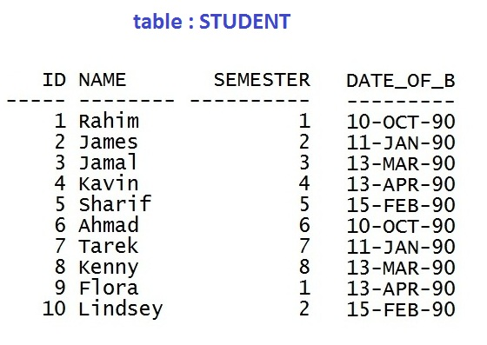
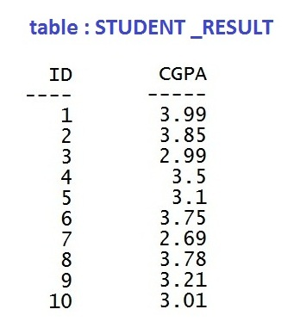
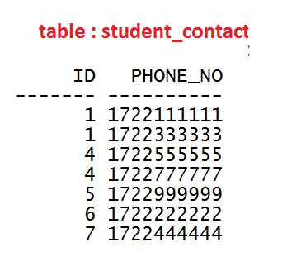
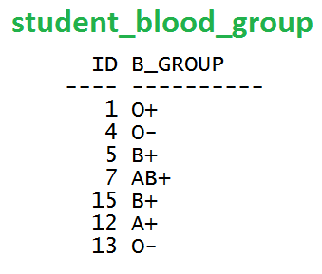
Our Tables

Slide 5
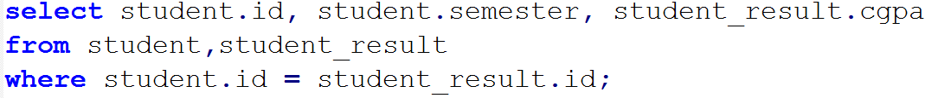
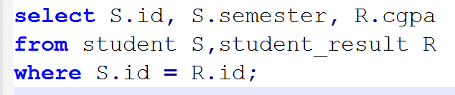
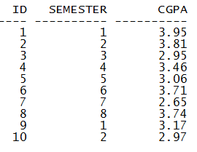
12
ALIASES

Slide 6
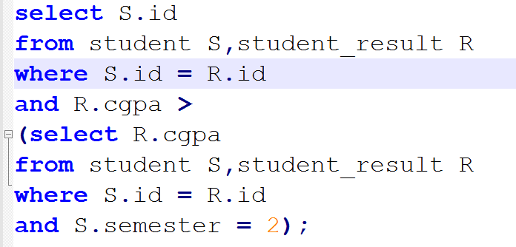
13
SET
comparisons

Slide 7
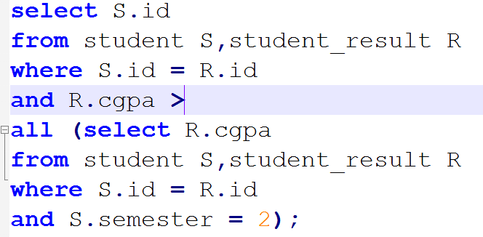

13
SET
comparisons

Slide 8
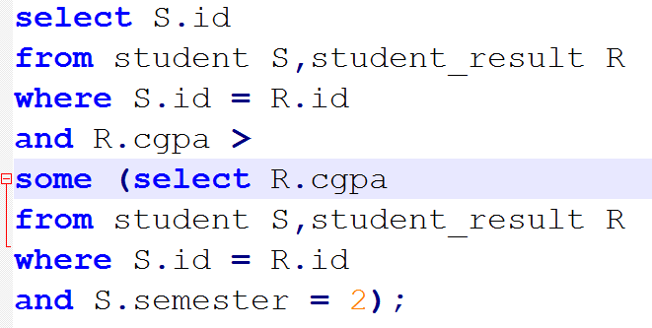

13
SET
comparisons

Slide 9
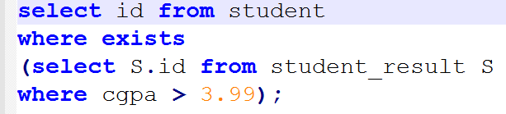

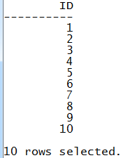
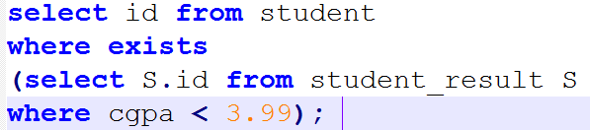
13
check for EMPTY
Similarly NOT EXISTS can be used if necessary

Slide 10




Scenario 1
Select ID , Name from Orginal_Table
User 1
ID | Name | Address | Age
Boss of
Orginal_Table
Select Name, Address, Age from Orginal_Table
User 2

Slide 11
VIEW of the Desired portion of Original_Table
User 1
ID | Name | Address | Age
Boss of
Orginal_Table
VIEW of the Desired portion of Original_Table
User 2

Slide 12

Scenario 2
A1 | A2 | A3 | A4 | A5
B1 | B2 | B3
C1 | C2

Slide 13
Scenario 2
A1 | A2 | A3 | A4 | A5
B1 | B2 | B3
Intermediate Table
(VIEW)
C1 | C2
Result

Slide 14
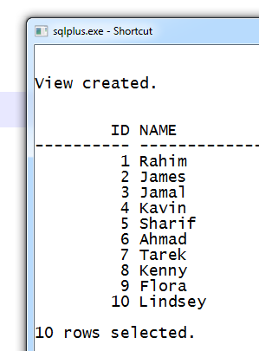
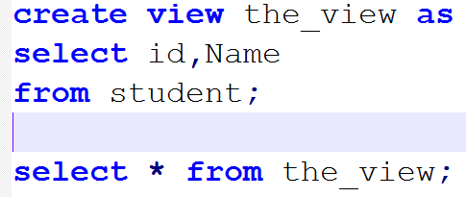
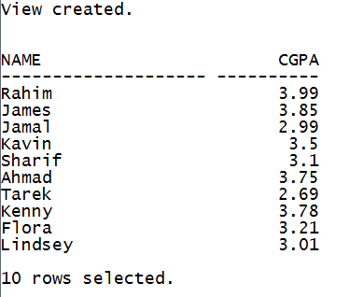
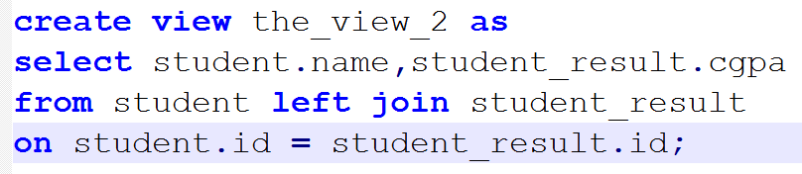
14
The
VIEW

Slide 15
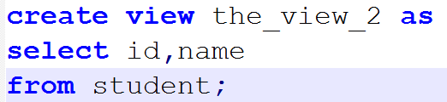
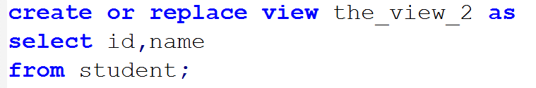
14
The
VIEW

Slide 16
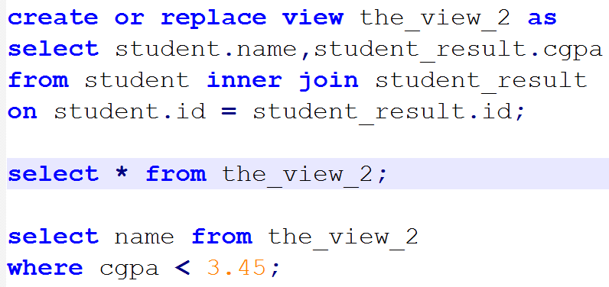
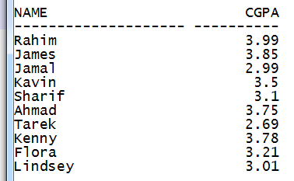
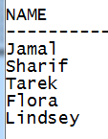
14
The
VIEW

Slide 17
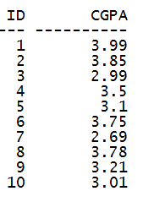
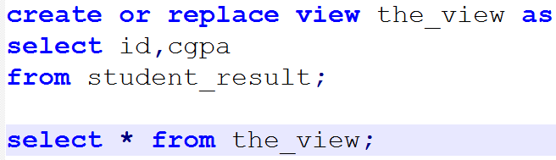
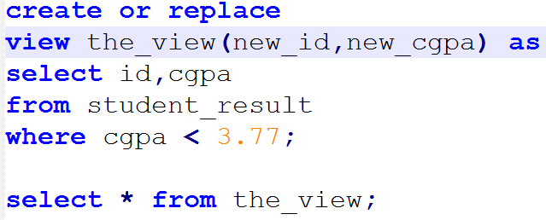
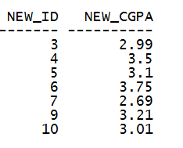
14
The
VIEW

Slide 18
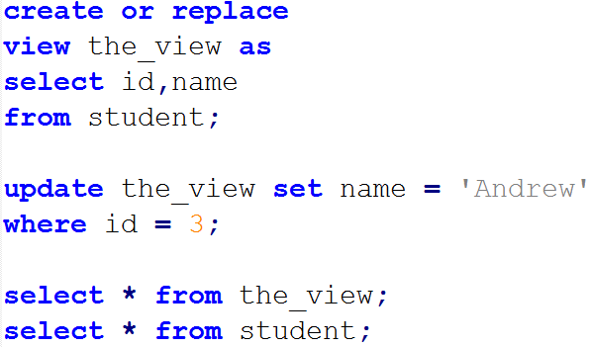
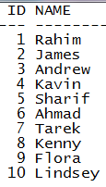
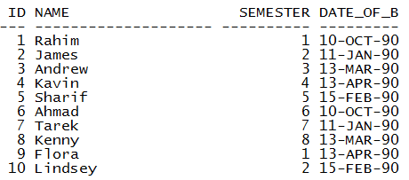
14
The
VIEW

Slide 19

16
CONSTRAINT
On a single relation
NOT NULL
UNIQUE
CHECK

Slide 20
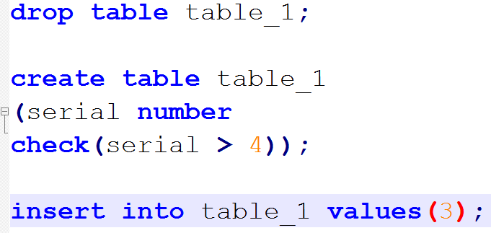
16
CHECK

Slide 21
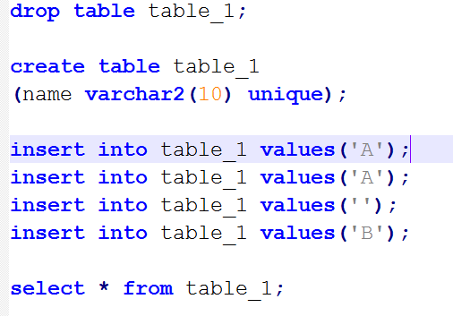
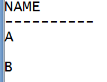
16
PRIMARY KEY

Slide 22
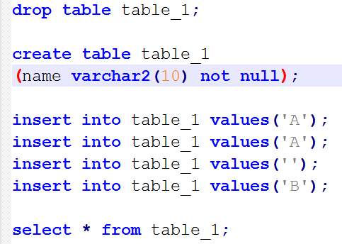
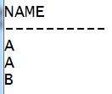
16
PRIMARY KEY

Slide 23
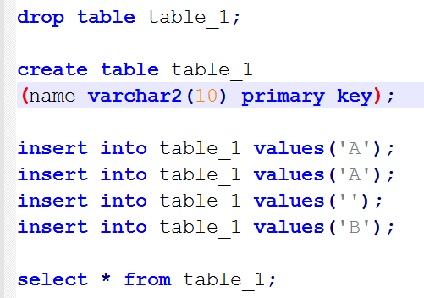
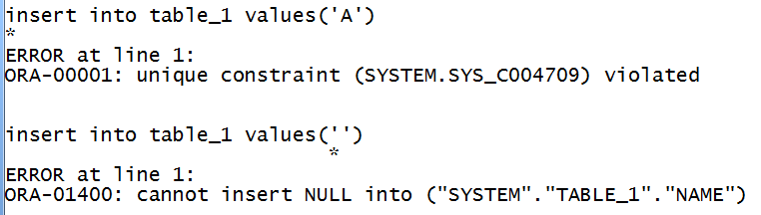
16
PRIMARY KEY

Slide 24

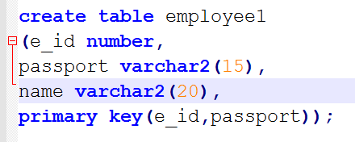
16
PRIMARY KEY

Slide 25
17
Referential Integrity
THE FOREIGN KEY
Table_1 (CHILD)
 |  | Attribute 3
 |  | 10
 |  | 11
 |  | 11
 |  | 12
 |  | 12
Table_2 (PARENT)
references
Attribute 1
10
11
12
references
FOREIGN KEY

Slide 26
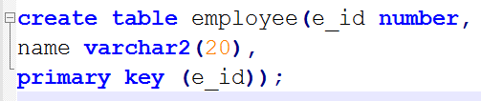
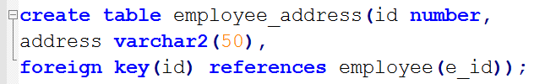
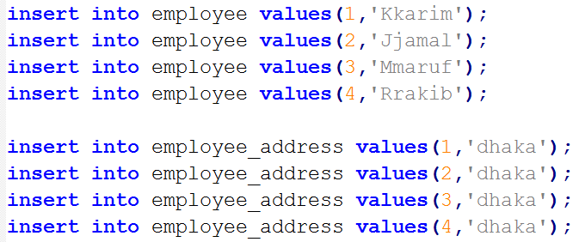
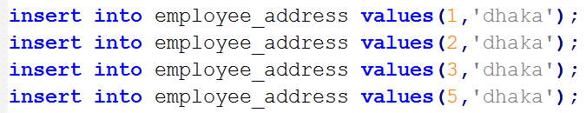
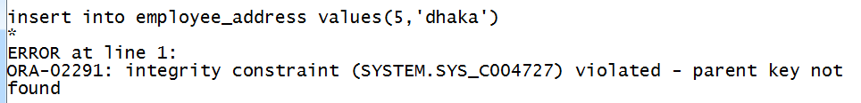
17
Referential Integrity
THE FOREIGN KEY

Slide 27
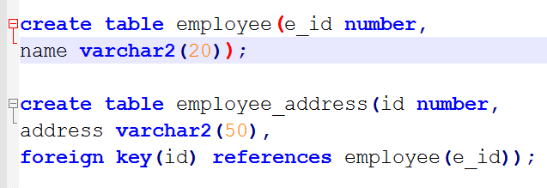
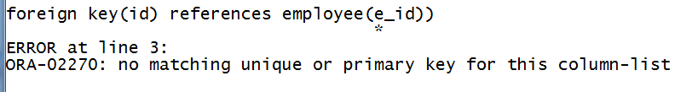
17
Referential Integrity
THE FOREIGN KEY

Slide 28
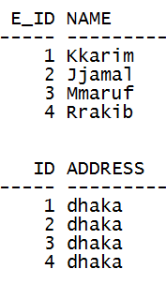
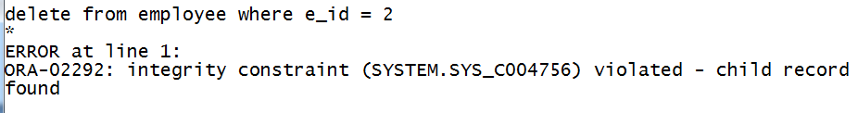
17
Referential Integrity
THE FOREIGN KEY

Slide 29
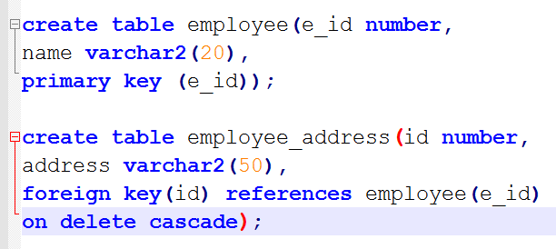
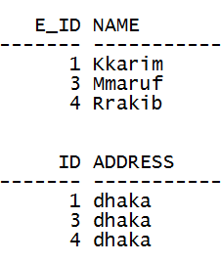
17
Referential Integrity
THE FOREIGN KEY

Slide 30
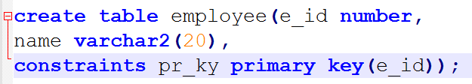
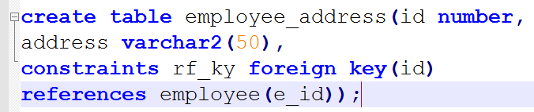
18
NAMING CONSTRAINTS

Slide 31


20
DROPPING A TABLE with constraints

Slide 32

20
DROPPING A TABLE with constraints

Slide 33


21
ALTER :
changing the table structure

Slide 34



21
ALTER :
changing the table structure

Slide 35

21
ALTER :
changing the table structure
The clause cascade automatically disables foreign key constraints that depend
on the (disabled) primary key

Slide 36
→ STUDENT (ID, NAME, SEMESTER, DATE_OF_BIRTH)
→ STUDENT _RESULT (ID, CGPA)
→ STUDENT _CONTACT (ID, PHONE_NO)
→ STUDENT _BLOOD_GROUP (ID, B_GROUP)
→ DEPARTMENT (DEPT_ID, DEPT_NAME)
→ EMPLOYEE (EMP_ID, EMP_NAME, EMP_DEPT)
CLASS TASK
Create a view showing the students’ ID and their corresponding number of phone no. entries.
Write any SQL example using NOT EXIST.
Find out the ID of the students whose semesters are above all the semesters of the students who have informed their blood group and contact information.
From (3), If at least 1 result is found, then show their CGPA’s .
Create DEPARTMENT and EMPLOYEE tables according to given schema and design with appropriate constraints (unique, not null, check and primary key)
Now put referential integrity where necessary.
Add a new column EMP_AGE in EMPLOYEE table.
Impose ON DELETE CASCADE and check deletion.

