Slide 1






Particle Swarm Optimization (PSO)
DEPT. OF CSE, KUET
Modified by S.M. Taslim Uddin Raju

Slide 2
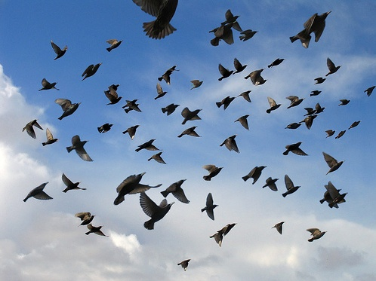

Introduction : Swarm Intelligence
Study of collective behavior in decentralized, self-organized systems.
Originated from the study of colonies, or swarms of social organisms.
Collective intelligence arises from interactions.

Slide 3
Examples of Swarms in Nature:
Classic Example: Swarm of Bees
Can be extended to other similar systems:
Ant colony
Agents: ants
Flock of birds
Agents: birds
Traffic
Agents: cars
Crowd
Agents: humans

Slide 4
SI system properties:
It is composed of many individuals.
The individuals are relatively homogeneous .
The interactions among individuals are based on simple behavioral rules.
The overall behavior of the system results from the interactions of individuals with each other and with their environment.

Slide 5


Particle Swarm Optimization
1) Particle swarm optimization (PSO) is a population (swarm intelligence) based on stochastic optimization algorithms to find a solution and then solve an optimization problem in a search space.
2) It has been developed by Eberhart and Kennedy in 1995, inspired by social behavior of bird flocking or fish schooling.
How can birds or fish exhibit such a coordinated collective behavior?

Slide 6
Particle Swarm Optimization
Particle Swarm Optimization:
Introduced by Kennedy & Eberhart 1995
Inspired by social behavior of birds and shoals of fish
Swarm intelligence-based optimization
Nondeterministic
Population-based optimization
Performance comparable to Genetic algorithms

Slide 7
Particle Swarm Optimization
Particle Swarm Optimization:
A swarm of n particles (individuals) communicate directly or indirectly with one another using search directions (gradients)
The algorithm adopted uses a set of particles flying over a search space to locate a global optimum
During an iteration of PSO, each particle updates its position according to its previous experience and the experience of its neighbors.

Slide 8
Particle Swarm Optimization
A particle composed of three vectors
The x-vector records the current position (location) of the particle in the search space.
The p-vector (pbest) records the location of the best solution found so far by the particle and
The v-vector contains a gradient (direction) for which particle will travel in if undisturbed.

Slide 9




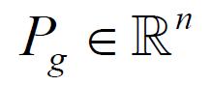

Particle Swarm Optimization
Swarm : a set of particles (S)
Particle: a potential solution
Position,
Velocity ,
Each particle maintains
Individual best position:
Swarm maintains its global best:

Slide 10
Personal best (Cognitive behavior)
Personal best position of a particle expresses the cognitive behavior of particle.
It is defined as the best position found by the particle.
It will be updated whenever the particle reaches a position with better fitness value than the fitness value of the previous personal best(pbest).

Slide 11
Global best (Social behavior)
Global best position expresses the social behavior.
It is defined as the best position found by all the particles in the swarm.
It will be updated whenever a particle reaches a position with better fitness value than the fitness value of the previous global best (gbest).

Slide 12
PSO Algorithm
Basic algorithm of PSO:
Initialize the swarm from the solution space
Evaluate fitness of each particle
Update individual and global bests
Update velocity and position of each particle
Go to step 2, and repeat until termination condition

Slide 13
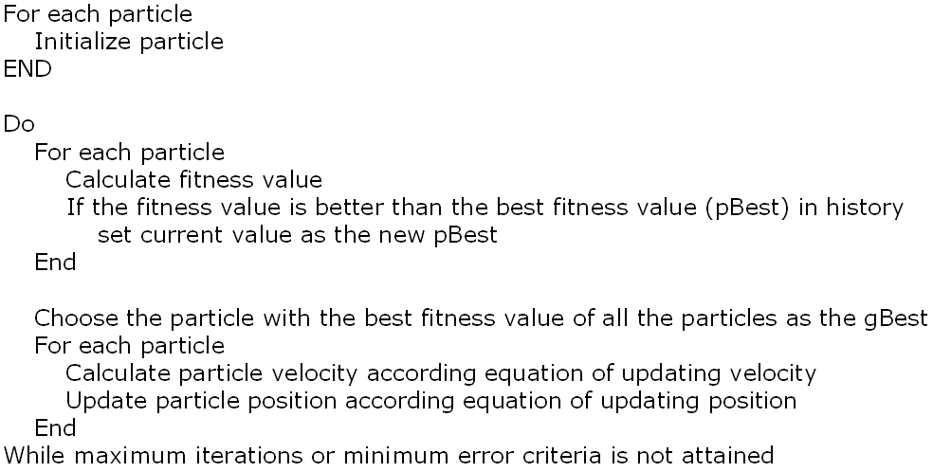
Pseudo-code for PSO

Slide 14
The Flowchart of PSO
Generate and initialize particles with random position (X) and velocity (V)
Particle m
…..
Particle 1
Evaluate position (Fitness)
If fitness(X) >fitness(Pbest)
Pbest=X
Update Position
If fitness(X) >fitness(Gbest)
Gbest=X
Update velocity
Termination criterion is met? (e.g., Gbest=sufficient good fitness or maximum generations)
Yes
No
Return the best solution

Slide 15
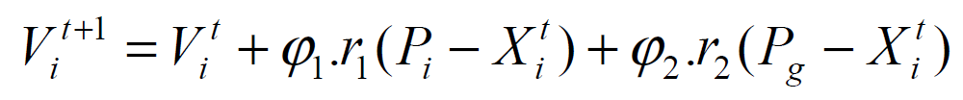
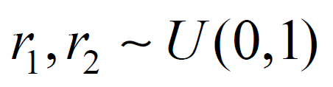
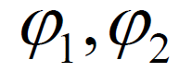
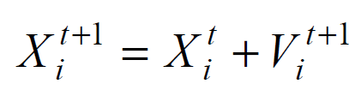
PSO Algorithm (cont.)
Original velocity update equation:
with :
: acceleration constant
Inertia
Cognitive Component
Social Component
Position Update:

Slide 16
Particle Swarm Optimization (PSO)
C₁ and C₂ = acceleration coefficients. (Typically (C₁ + C₂)<=4.
rand(.) and rand(.) = random number between (0,1).
P_{i} –X_{i}(t)=“cognitive” component represents the personal thinking of each particle which encourages the particles to move their best positions found so far
P_{g} -X_{g}(t)=“social” component which helps to find the global best position found so far.

Slide 17
Particle Swarm Optimization (PSO)
The basic concept of PSO lies in accelerating each particle toward the best position found by it so far (pbest) and global best position (gbest) found so far by any particle, with a random weighted acceleration at each time step.
This is done by simply adding the v-vector to the x-vector to get another x-vector
Once the particle compute the new X_{i,}then it evaluates its new location. It x-fitness is better than p-fitness , then pbest = X_{i} and p-fitness = x-fitness.

Slide 18
Particle Swarm Optimization (PSO)
Eq.(3)
My best perf.
PBest
p_{i}
Here I am!
x
The best perf. of team
p_{g}
v
gBest

Slide 19
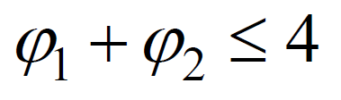
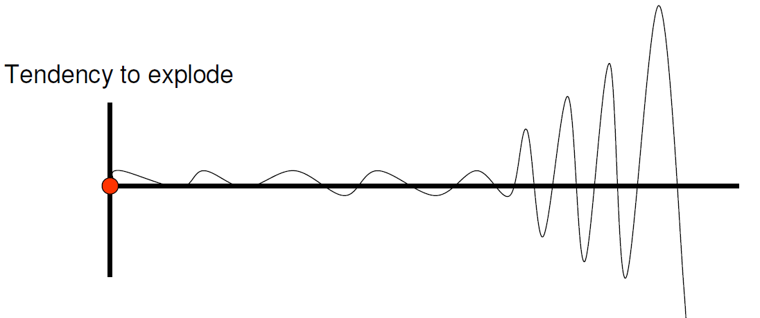
PSO Algorithm - Parameters
Acceleration constant
Small values limit the movement of the particles
Large values : tendency to explode toward infinity
In general

Slide 20

Cooperation example
Notes:
To illustrate what “cooperation” means in PSO, here is a simplistic example.
As usually, the big fish is difficult to catch, hidden in the deepest part of the pond. At each time step, each fisherman tells to the other how deep the pond is at his place. At the very begininng, as the depths are quite similar, they both follow their own ways. Now, Fisherman 2 seems to be on a better place, so Fisherman 1 tends to go towards him quite rapidly. Now, the decision is a bit more difficult to make. On the one hand Fisherman 2 is still on a better place, but on the other hand, Fisherman 1’s position is worse than before. So Fisherman 1 comes to a compromise: he still goes towards Fisherman 2, but more slowly than before. As we can see, doing that, he escapes from the local minimum.
Of course, this example is a caricatural one, but it presents the main features of a particle in basic PSO: a position, a velocity (or, more precisely an operator which can be applied to a position in order to modify it), the ability to exchange information with its neighbours, the ability to memorize a previous position, and the ability to use information to make a decision. Remember, though, all that as to remain simple.
Let’s now see more precisely these points.

Slide 21
Simple 1D Example
Initialize swarm and evaluate fitness (t=0)
gbest

Slide 22
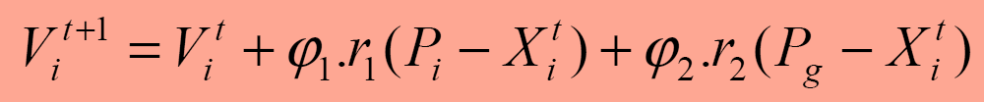
Simple 1D Example
Update velocity and position (t=1)
gbest

Slide 23
Simple 1D Example
Evaluate fitness
Update personal and global best (t=2)
gbest

Slide 24
Simple 1D Example
Evaluate fitness
Update personal and global best (t=2)
gbest

Slide 25
Simple 1D Example
Update velocity and position (t=2)
gbest
Inertia
Personal
Social
Total

Slide 26
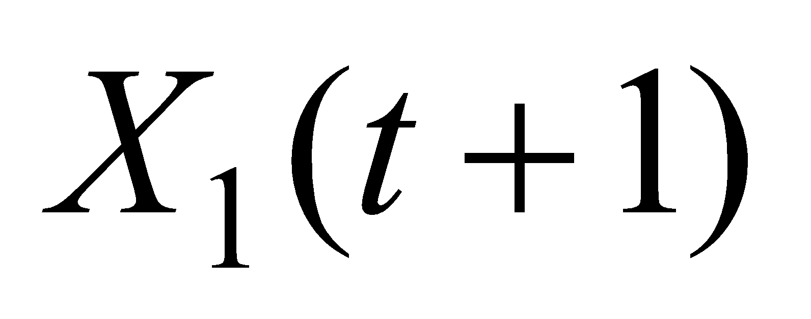
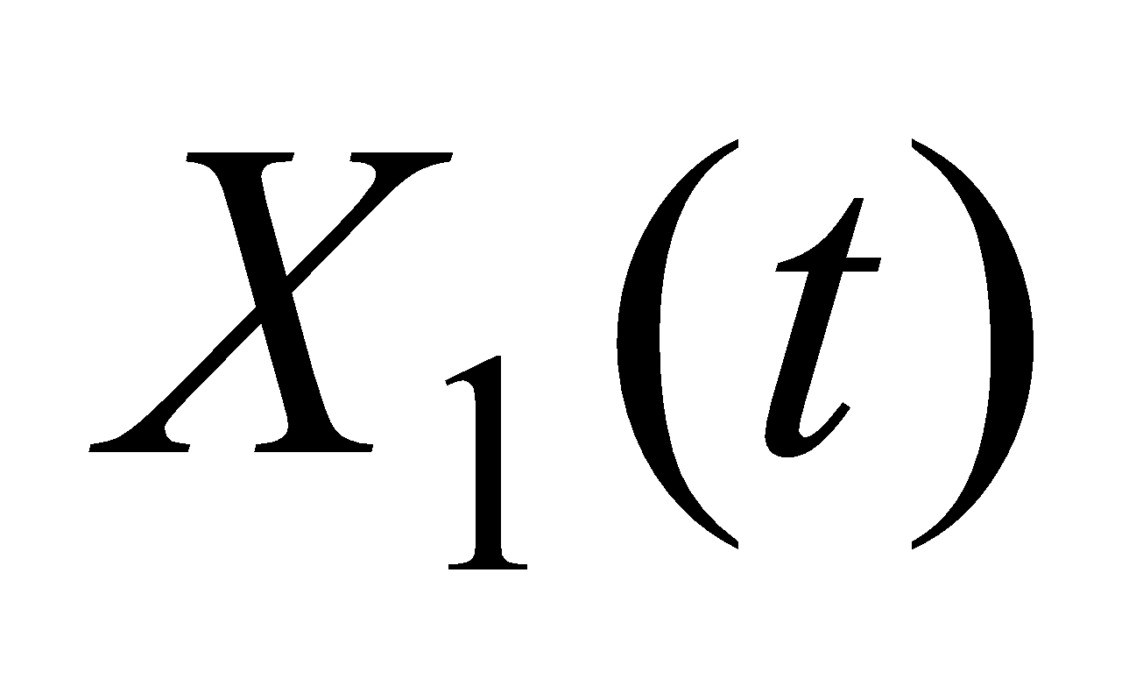
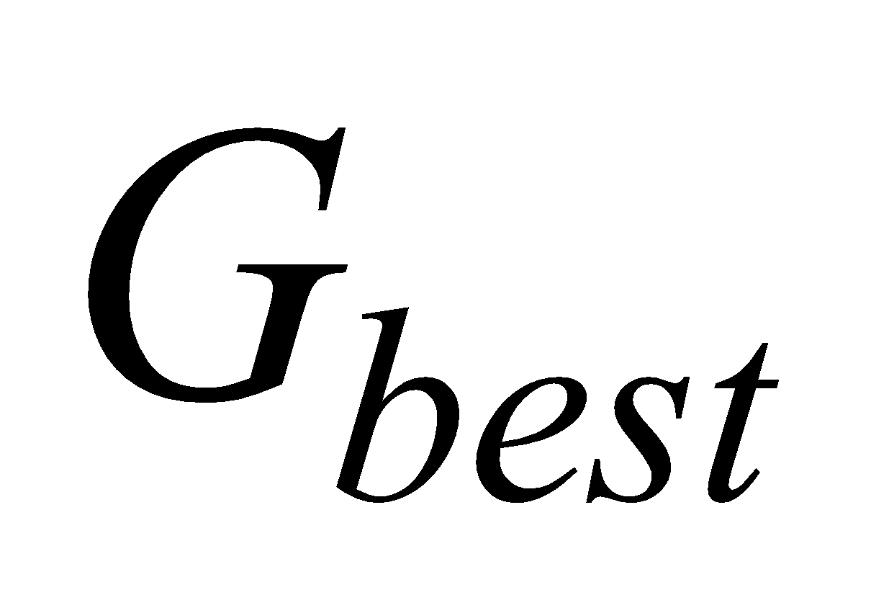
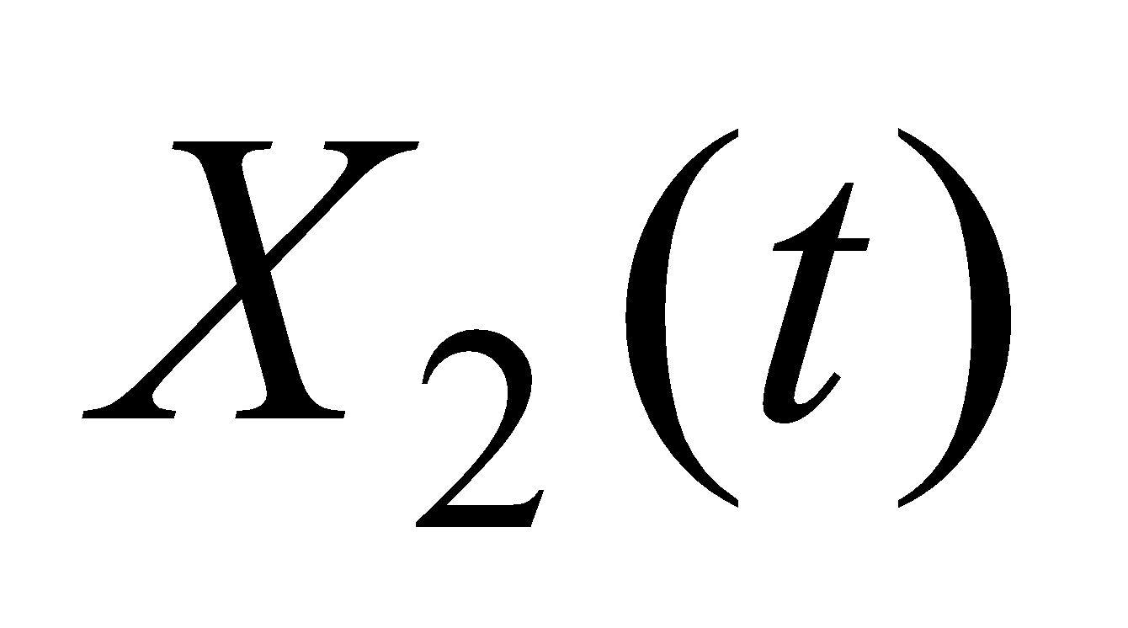
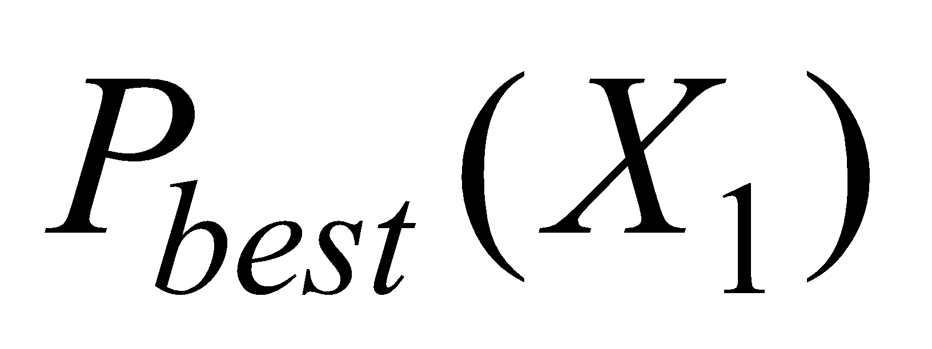
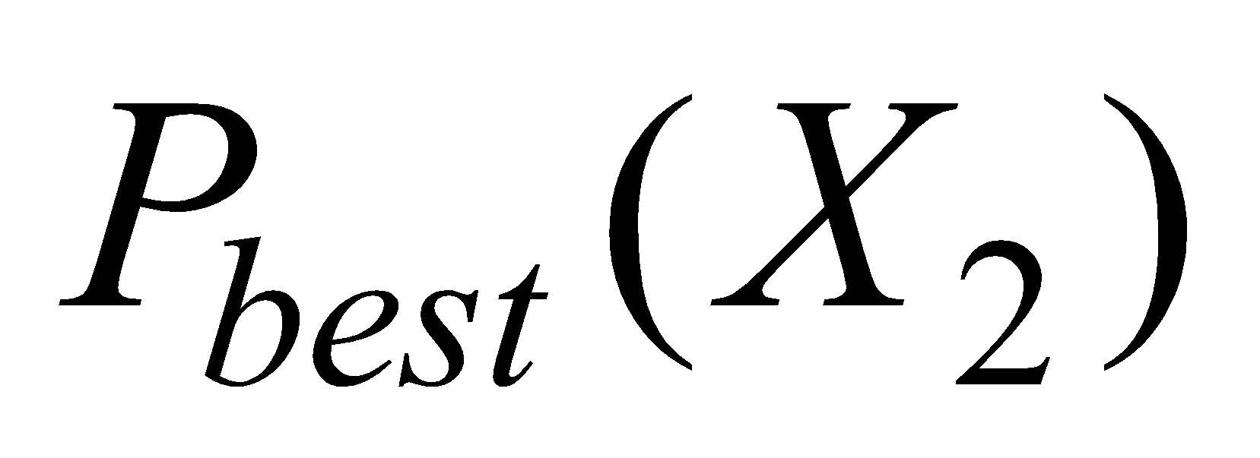
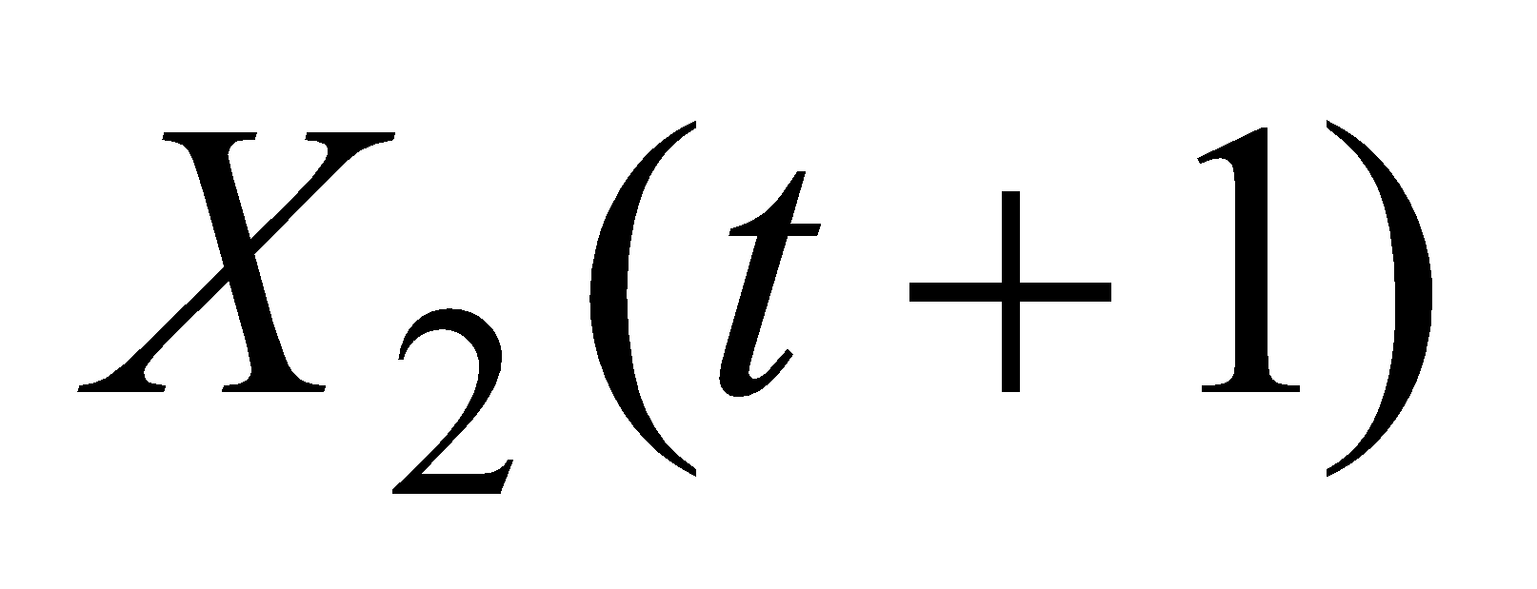
Aspects of Basic PSO (movement of particles
n
Original velocity
Velocity toward Gbest
Velocity toward Pbest
Resultant velocity
Particle 1
Particle 2
Global best
Personal best
1
Individual particles (1 and 2) are accelerated toward the location of the global best solution (Gbest) and the location of their own personal best (Pbest) in the n-dimensional space.

Slide 27
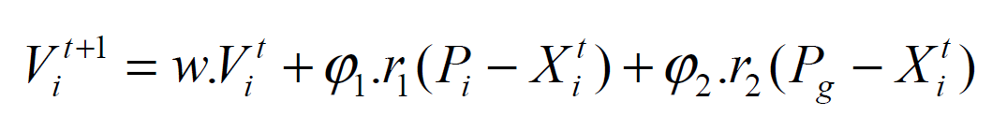
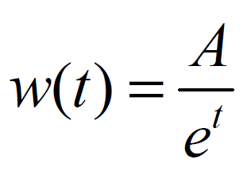
Rate of Convergence Improvement
Inertia weight: Scaling the previous velocity
Keeps the particle moving in the n the same direction it was originally heading
Control search behavior: Lower values speed up convergence, higher values encourage exploring the search space
w is usually between 0.8 and 1.
can be decreased over time:
Linear [0.9 to 0.4]
Nonlinear

Slide 28
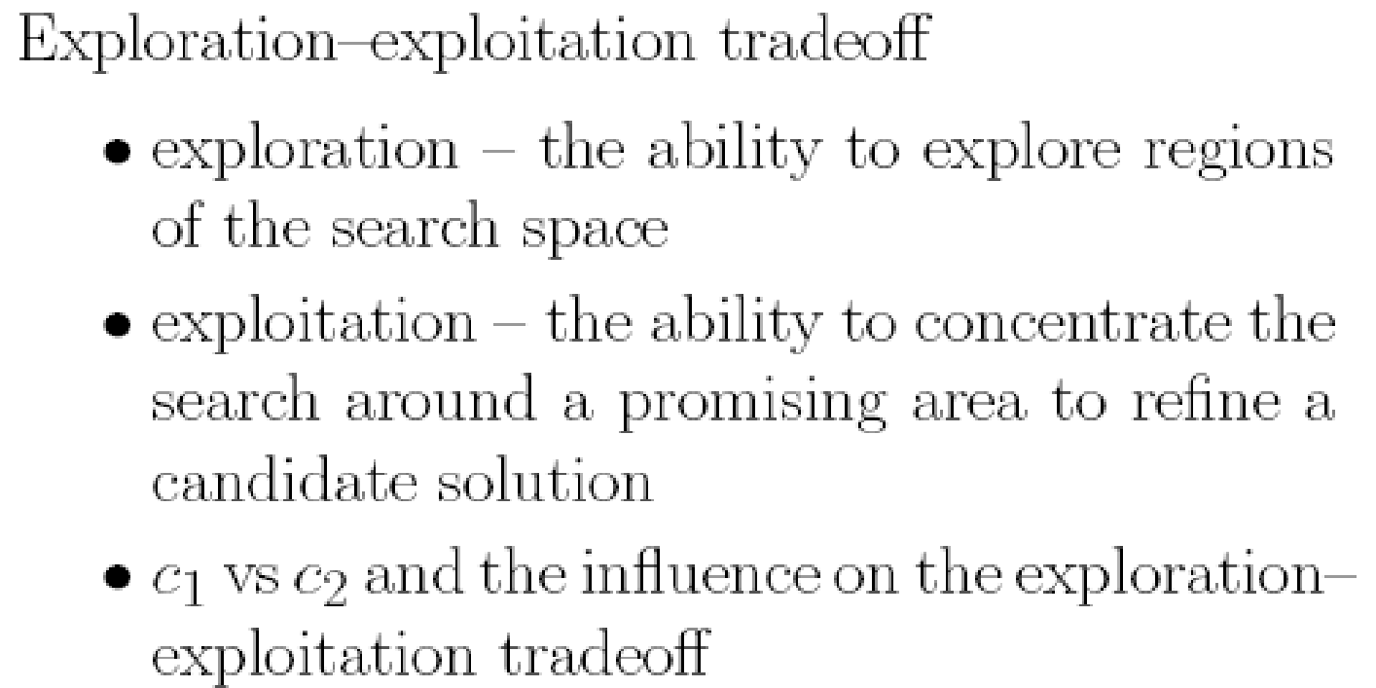

Slide 29
