Slide 1

A Two Stream Fusion Network For Human Fall Detection in Video Surveillance
Presented By:
Md. Nazmul Haque
Roll: 1707101
Supervised By:
Dr. Sk. Md. Masudul Ahsan
Professor Dept. of Computer Science and Engineering Khulna University of Engineering & Technology

Slide 2
Outline
Introduction & Motivation
Related Works
Objectives
Methodology
Experimental Results
Limitations
Future Work
Conclusions
References

Slide 3
Introduction & Motivation
Falls represent a significant threat to the health and independence of elderly people.
According to WHO 37 million [1] falls occur each year that makes it second leading cause of deaths.
Timely and accurate fall detection can reduce injuries and avoid loss of life.
A video surveillance system!!
- can be solved with the use of cameras that detect and report falls.

Slide 4
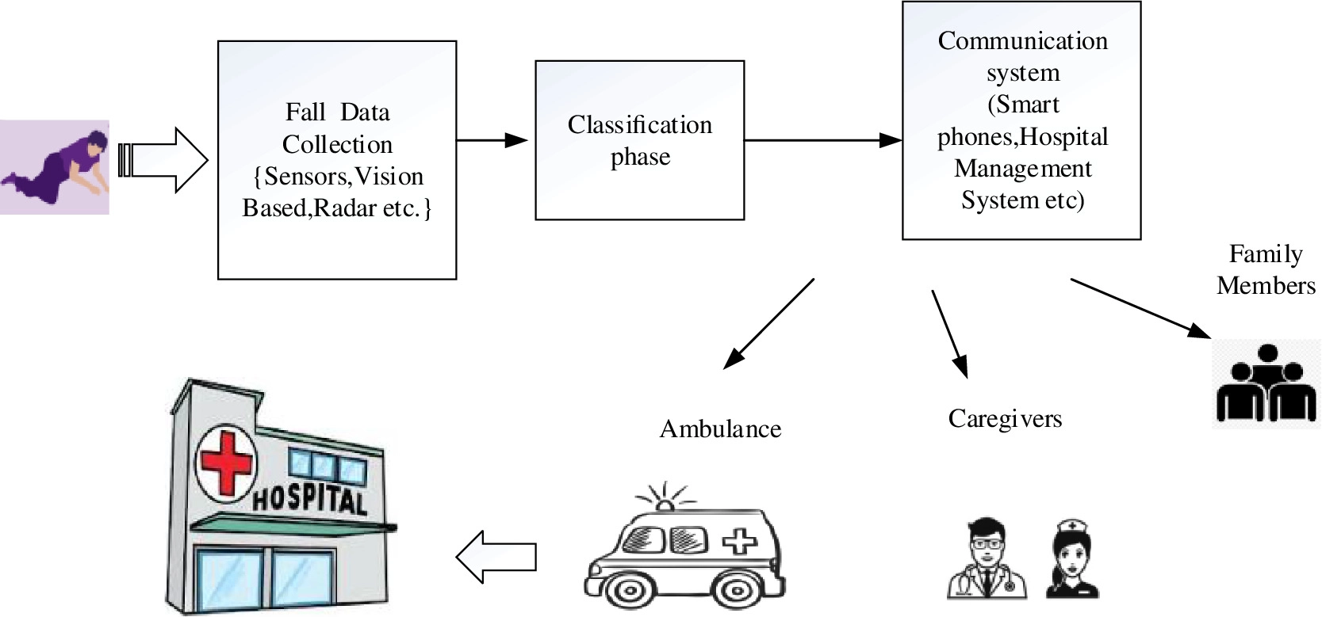
Introduction & Motivation (cont..)
Figure 1: Generalized working principle of fall detection system [16].

Slide 5
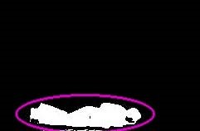
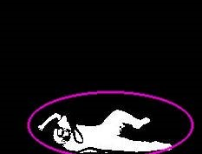
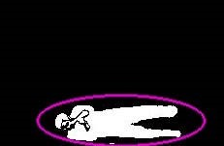
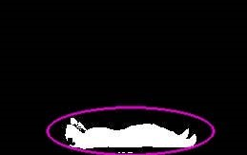
Related Works
Homa Foroughi et al. [2] proposed a Decision-Based approach that extract best-fit approximated ellipse around the human body and projection histogram features.
However the method rely too much on predefined thresholds and cannot generalize well to unseen data.
Forward Fall Backward Fall Sideway Fall Lie down
Figure 3: Homa Foroughi et al’s proposed work.

Slide 6
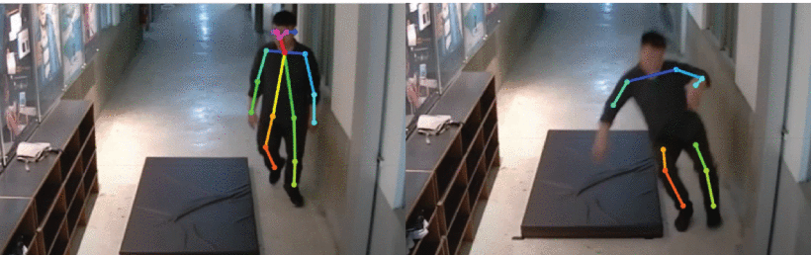
Related Works (cont..)
Wan et al. [3] proposed a pose estimation-based fall detection methodology which is based on a human body posture recognition technique.
Figure 4: Wan et al’s proposed method.
Produces blurred areas when moving fast, resulting in the loss of some joint points.

Slide 7
Related Works (cont..)
Table 1: Summary of the Previous Works.
Paper | Dataset | Methodology
Lei et al. [3] | Own Dataset (50 Fall and 50 ADL videos) | CNN, RNN, LSTM
Zhou et al. [4] | HQFD, Le2i Fall Dataset | Autoencoder
Kasturi et al. [5] | URFD (30 Fall and 40 ADL videos) | 3D CNN
Perejon et al. [6] | Sisfall (sensor data) | Gated RNN and LSTM
Thamer et al. [7] | Le2i (192 Fall and 57 ADL videos) | Multistream CNN

Slide 8
Objectives
To use video perception structure that requires no body worn devices and provide rapid response.
Introducing a novel approach for detecting falls in video.
Ensure the safety of the elderly people.
Detecting falls accurately in real-time, with a low false positive rate.

Slide 9
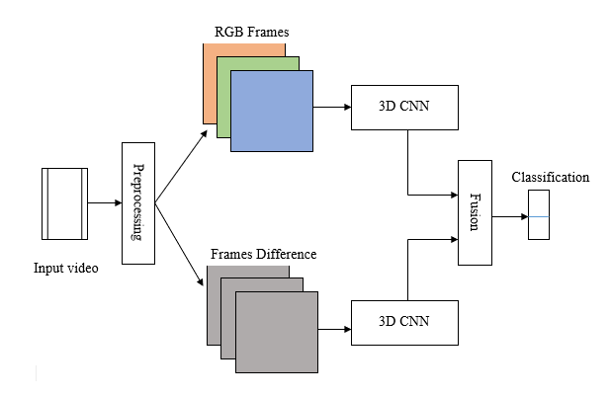
Methodology
Figure 5: Overall Workflow of our proposed method.

Slide 10
Methodology(cont..)
Input
Residual Block 1
Dense(512)
Convolution(2+1)D
Residual Block 2
Dropout
Batch Normalization
Residual Block 3
Dense(256)
ReLu
Residual Block 4
Dropout
Convolution(2+1)D
Residual Block 5
Flatten
Batch Normalization
Dense(2)
ReLu
GlobalAveragePooling3D
Figure 6: 3D CNN Model Architecture.

Slide 11
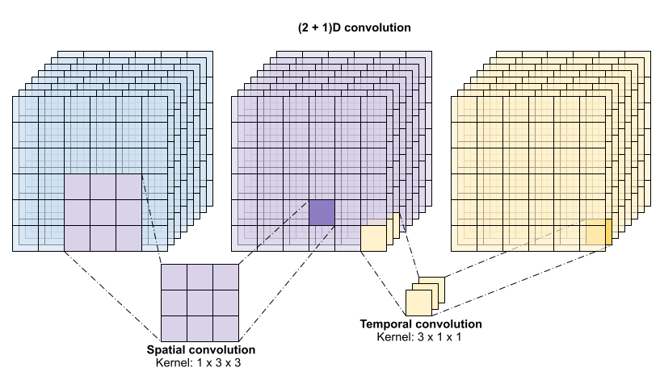
Methodology(cont..)
Figure 7: Feature Extraction Process of 3D CNN [15].

Slide 12
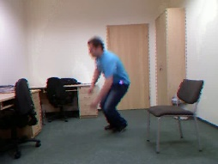
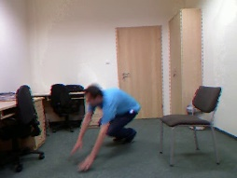
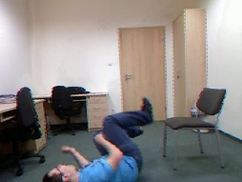
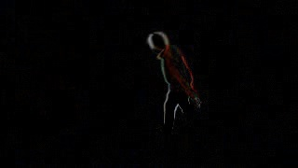
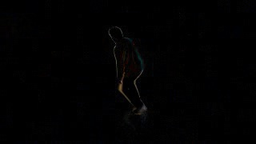
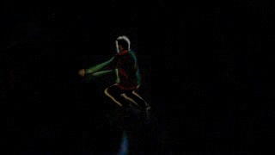
Methodology(cont..)
Stacked Module
3D CNN
RGB Frames
Fall
Or
No Fall
Spatio-Temporal Features
concatenate
Dropout
Dense
Dense
3D CNN
Two stream’s Feature Fusion
Frame Difference
Figure 8: Stacking Two Models.

Slide 13
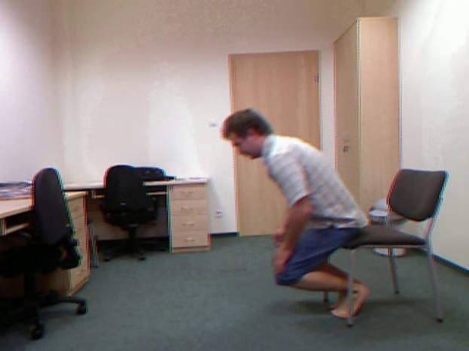

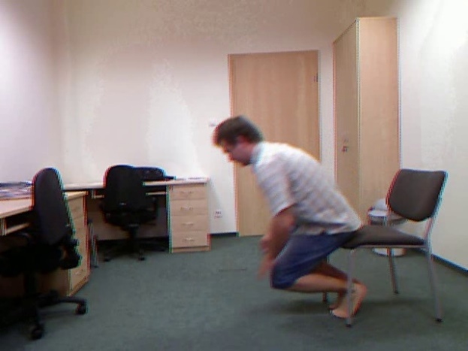
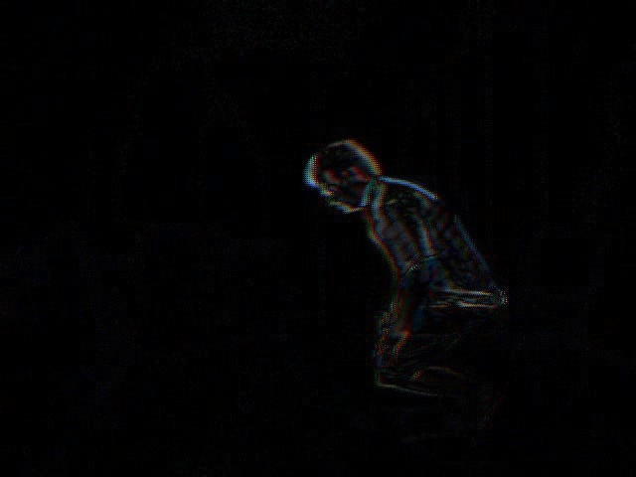
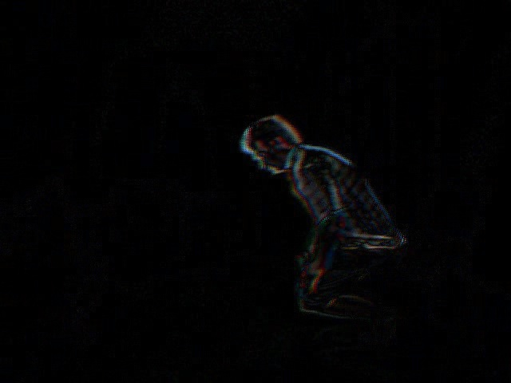
Methodology(cont..)
fd(i) = frame(i+1) - frame(i)
Figure 9: Calculating Frame Difference.

Slide 14
Methodology(cont..)
Input video
Frame Conversion
Fused Feature Map
Resize, Padding
Classifier
Preprocessing
Fall?
Stream One
Stream two
Spatio-Temporal Feature Extraction
Figure 10: Flow Diagram.

Slide 15
Dataset Description
Two Publicly available dataset used for this study.
In Le2i [3] dataset, videos captured in four different environments (Home, Coffee room, Office, Lecture Room). Activities performed in varying the various factors like light, clothes, shadows, reflections, camera view, etc.
Table 4: Description of the two datasets
Dataset | Resolution | Length(sec) | # Falls | #No- Falls | FPS
Le2i | 320 x 320 | 3-12 | 130 | 126 | 25
URFD | 224 x 224 | 3-7 | 30 | 40 | 16

Slide 16
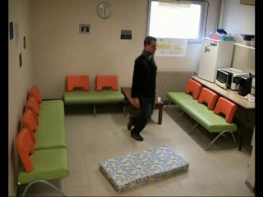
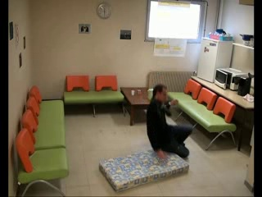
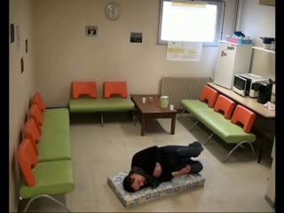
Dataset Description(cont..)
URFD dataset [4] was presented by Kwolek and Kepski. This dataset contains 40 ADL sequences and 30 fall sequences.
Figure 11: Samples from Le2i and UR Fall Dataset

Slide 17
Dataset Preparation
Dataset Collection
Dataset Labelling
Sampling
Train Set
Validation Set
Test Set
Model Training
Model Evaluation
Figure 12: Dataset Preparation.

Slide 18
Experimental Results
A standard split was performed on the dataset. 60% for training, 20% for validation and 20% videos were used for testing.
Table 2: Evaluation Results of the two datasets.
Dataset | Accuracy | FPR | Sensitivity | Specificity
URFD | 0.9286 | 0.00 | 0.8571 | 1.00
Le2i | 0.9388 | 0.0 | 0.8929 | 1.00

Slide 19
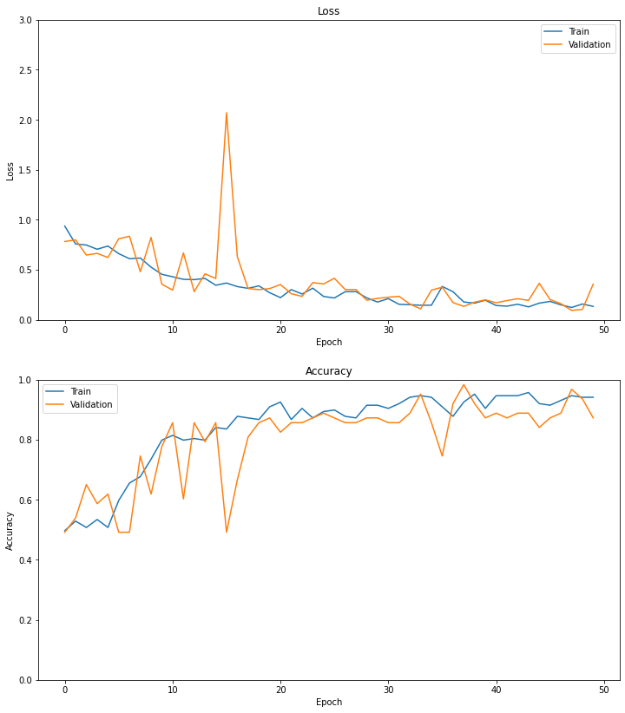
Experimental Results(cont..)
Loss function – Sparse Categorical Crossentropy
Optimizer – Adam
Learning Rate – 0.0001
Metrics - Accuracy
Figure 13: Training and Validation Graph of Accuracy and Loss for Le2i Dataset.

Slide 20
Comparative Analysis
Comparison with Previous Work.
Table 3: Comparison with previous works on same dataset.
Authors | Accuracy | Sensitivity | Specificity | Precision
Saleh et al. [5] | 79.30% | 84.30% | 73.07% | 79.40%
Abdo et al. [6] | 97.00% | 99.00% | 97.00% | -
Alanazi et al. [7] | 90.90% | 94.56% | 81.08% | 90.84%
Li et al. [8] | 86.21% | 93.18% | 64.29% | 91.11%
Ullah et al. [9] | 78.50% | 93.00% | - | 81.50%
Proposed | 93.88% | 89.29% | 100.00% | 100.0%

Slide 21
Limitations
The use of cameras for video surveillance raises privacy concerns.
Computational cost.
Lighting conditions may affect the accuracy.
Dependence on camera placement.
Lack of adequate datasets.

Slide 22
Future Work
Improving lighting robustness.
Integrating audio and video data.
Using more robust features (Optical flow, Heatmap, Gradient e.tc).
The system can be further developed to provide real-time response, such as triggering alarms or automatically calling for help.

Slide 23
Conclusions
We propose novel two-stream 3D CNN architecture for video-based Fall detection for elderly patients.
The system was evaluated against other previously proposed methods and demonstrated good results.
Our method can be used in healthcare centers, to provide assistance to caregivers.
We hope to improve upon our existing work in the future.

Slide 24
References
Centers for Disease Alert and Prevention (CDC)-Preventing Older Adult Falls. https://www.cdc.gov/injury/features/older-adult-falls/index.html. World Health Organization (WHO) global report on falls prevention in older age. 2008. url: http://apps.who.int/iris/handle/10665/43811 with Fusion”. Diagnostics 2022, 12, 3060.
H. Foroughi, B. S. Aski and H. Pourreza, "Intelligent video surveillance for monitoring fall detection of elderly in home environments," 2008 11th International Conference on Computer and Information Technology, Khulna, Bangladesh.
W. -J. Chang, C. -H. Hsu and L. -B. Chen, "A Pose Estimation-Based Fall Detection Methodology Using Artificial Intelligence Edge Computing," in IEEE Access.
Le2i Dataset: https://imvia.u-bourgogne.fr/en/database/fall-detection-dataset-2.html
URFD Dataset: http://fenix.univ.rzeszow.pl/mkepski/ds/uf.html
M. Saleh and R. L. B. Jeannès, "Elderly Fall Detection Using Wearable Sensors: A Low Cost Highly Accurate Algorithm," in IEEE Sensors Journal, vol. 19, no. 8, pp.
Chen, W.; Jiang, Z.; Guo, H.; Ni, X. “Fall Detection Based on Key Points of Human-Skeleton Using Open Pose.” Symmetry 2020,12,744.
Alanazi, T.; Muhammad, G. “Human Fall Detection Using 3D Multi-Stream Convolutional Neural Networks.
X. Li, T. Pang, W. Liu and T. Wang, "Fall detection for elderly person care using convolutional neural networks," 2017 10th International Congress on Image and Signal Processing, BioMedical Engineering and Informatics (CISP-BMEI), Shanghai, China 2019

Slide 25
References
Nooruddin, S., Islam, M.M., Sharna, F.A. et al. “Sensor-based fall detection systems: a review”. J Ambient Intelligent Human Computer 13, 2735–2751 (2022).
H. Abdo, K. M. Amin and A. M. Hamad, “Fall Detection Based on RetinaNet and MobileNet Convolutional Neural Networks,” 2020 15th International Conference on Computer Engineering and Systems (ICCES), Cairo, Egypt, 2020.
Chuankun Li, Pichao Wang, Shuang Wang, Yonghong Hou and Wanqing Li, "Skeleton-based action recognition using LSTM and CNN," 2017 IEEE International Conference on Multimedia & Expo Workshops (ICMEW), Hong Kong, 2017.
Rougier, C., St-Arnaud, A., Rousseau, J., Meunier, J., VideoSurveillance for Fall Detection. Department of Computer Scienceand Operations Research, University of Montreal, Canada.
Spehr, J., Gövercin, M., Winkelbach, S., Steinhagen-Thiessen, E.,Wahl, F.M. Visual Fall Detection in Home Environments.
T. Lee and A. Mihailidis. An intelligent emergency responsesystem: preliminary development and testing of automatedfall detection. Journal of telemedicine and telecare

Slide 26
Thank You

