Slide 1

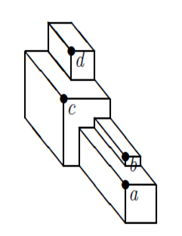
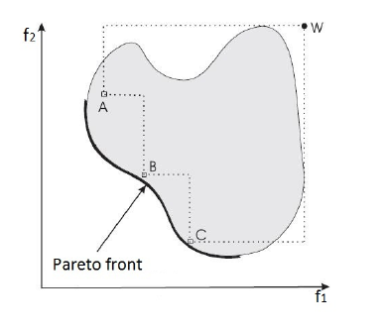
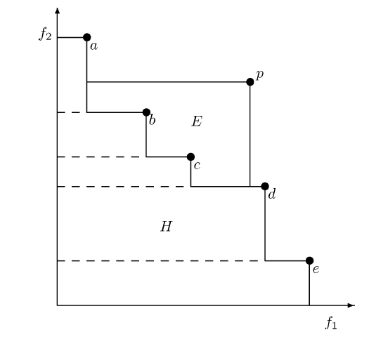
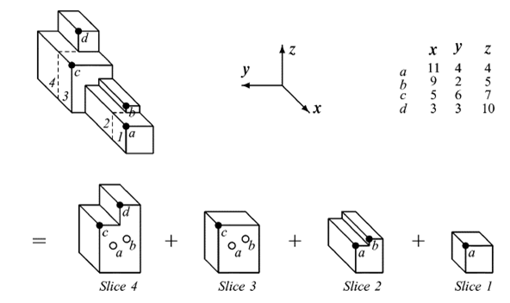
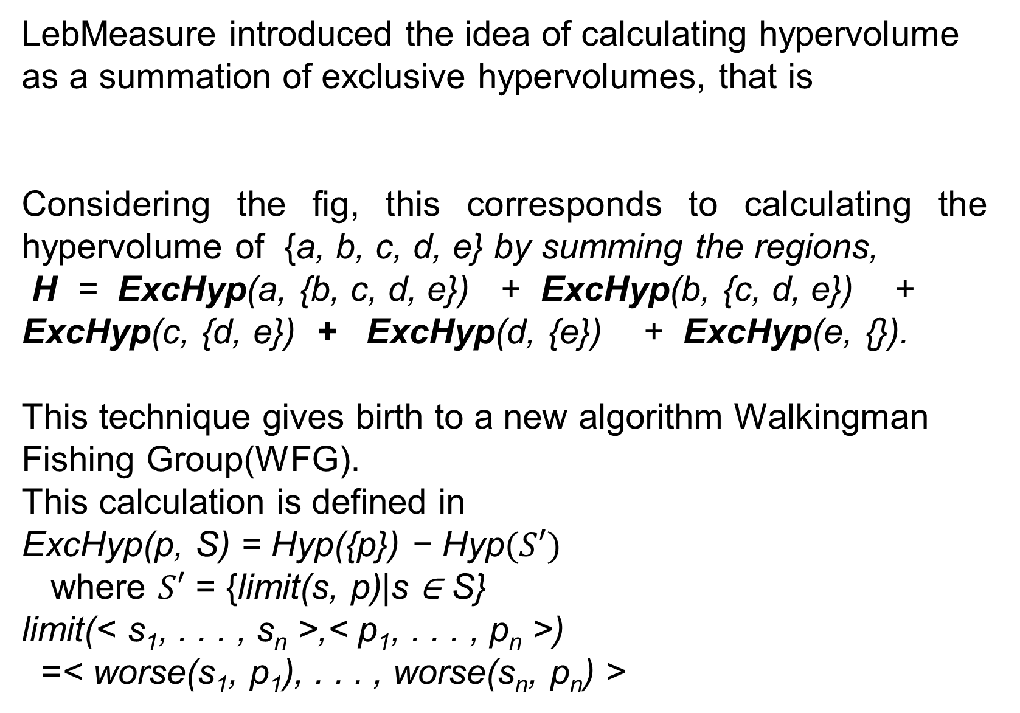
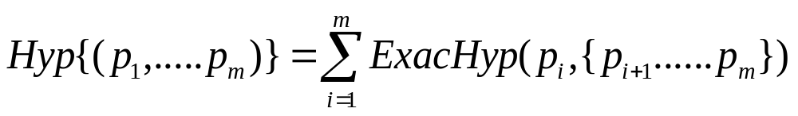
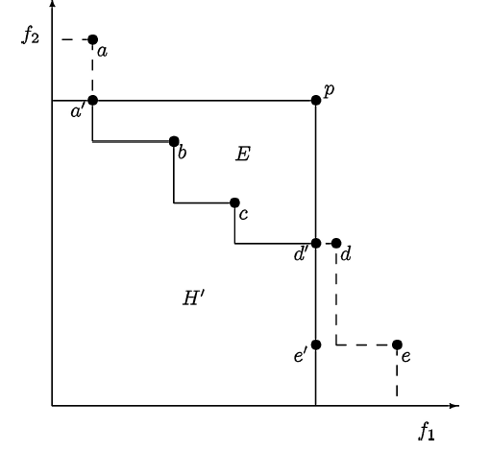
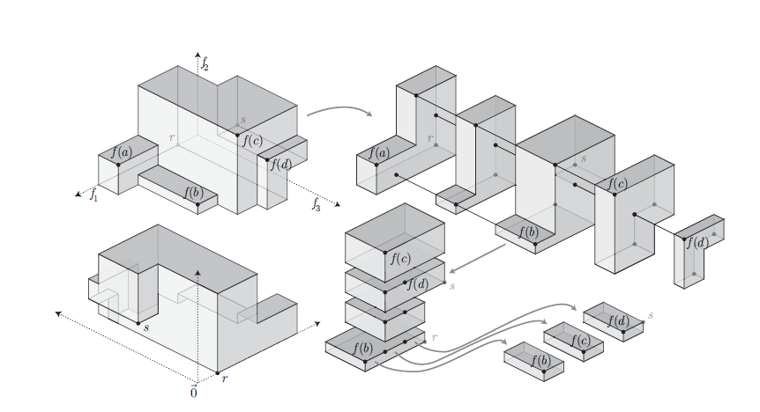
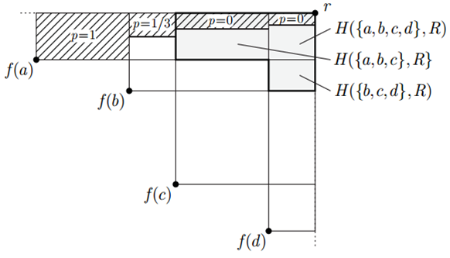
A Study on Recent Fast Ways of Hypervolume Calculation for MOEAs
Mainul Kabir (0905014) and Nasik Muhammad Nafi (0905021)
IV. Circuit Construction
I. Introduction
III. Background
To find diversified solutions converging to true Pareto fronts, hypervolume indicator-based Algorithms have been established as effective approaches in multiobjective evolutionary algorithms (MOEAs). However, the bottleneck of hypervolume indicator-based MOEAs is the high time complexity for measuring the exact hypervolume contributions of different solutions while dealing with many objectives.
III. Background
.
Classical definitions of the hypervolume indicator, also known as Lebesgue measure or S-metric are based on volumes of polytopes or hypercubes.
Without loss of generality, we assume that k objective functions f =(f₁, ..., f_{k}) that map solutions x ∈ X from
the decision space X to an objective vector
f(x) = (f₁(x),...,f_{k}(x)) ⊆ R_{k} have to be maximized.
The hypervolume indicator I_{H} (A) of a solution set A ⊆ X can be defined as the hypervolume of the space that is dominated by the set A and is bounded by a reference point r = (r₁ ,...,r_{k}) ∈ R_{k} :
I_{H}(A) = λ( Ua∈A [f₁(a),r₁] × [f₂(a),r₂] × ···× [f_{k}(a),r_{k}])
where λ(S) is the Lebesgue measure of a set S and
[f₁(a),r₁] × [f₂(a),r₂] × ···× [f_{k}(a),r_{k}] is the k-dimensional hypercuboid consisting of all points that are weakly dominated by the point a but not weakly dominated by the reference point.
II. Motivation
It is evident from experiment that for a higher number of objectives hypervolume- based algorith outperform standard MOEAs. In hypervolume indicator-based algorithms hyper volume is used as objective function for fitness assignment. The hypervolume of a set of solutions measures the size of the portion of objective space that is dominated by those solutions collectively. Hypervolume captures in one scalar both the closeness of the solutions to the optimal set and their spread across objective space which are the main two target of the MOEAs. Moreover, the only known indicator that is compliant with the concept of Pareto-dominance. Most hypervolume-based algorithms first perform a nondominated sorting and then rank solutions within a particular front according to the hypervolume contribution of the solutions.
IV. Variations of Hypervolume
Inclusive Hypervolume:
Where HV is the union of v_{i} which is defined by a non-dominated point in S and a reference point in R.
Inclusive hypervolume of a point p is the size of the part of objective space dominated by p alone,IncHyp(p) = Hyp({p}).
Exclusive Hypervolume:
The exclusive hypervolume of a point p relative to an underlying set S is the size of the part of
objective space that is dominated by p
but is not dominated by any member of S.
Exclusive hypervolume can be defined as
ExcHyp(p, S) = Hyp(S ∪ {p}) − Hyp(S).
VI. Hypervolume by Slicing Object
Given m mutually nondominating points in objectives, the HSO algorithm is based on the idea of processing the points one objective at a time. Initially, the points are sorted by their values in the first objective.
These values are then used to cut cross-sectional “slices” through the hypervolume; each slice will itself be an n–1 objective hypervolume in the remaining objectives.
Each slice is calculated and is
multiplied by the depth of the
slice in the first objective, then
these –objective values are
summed to obtain the total
hypervolume..
.
V. Calculating HV Point wise
.
VII. HypE- An Improvement Over HSO
A population with four solutions as in Fig.; when two solutions need to be removed (k = 2), then the subspaces H({a, b, c}, P,R), H({b, c, d}, P,R), and H({a, b, c, d}, P,R) remain weakly dominated independently of which solutions are deleted.
This led to the idea of considering the expected loss in hypervolume that can be attributed to a particular solution when exactly k solutions are removed.
.
VIII. Future Objective
Finding an algorithm for MOs by which the accuracy of the hypervolume estimation and the time-cost plus available computing resources can be traded off.
.
Department of Computer Science and Engineering (CSE), BUET

