Slide 1


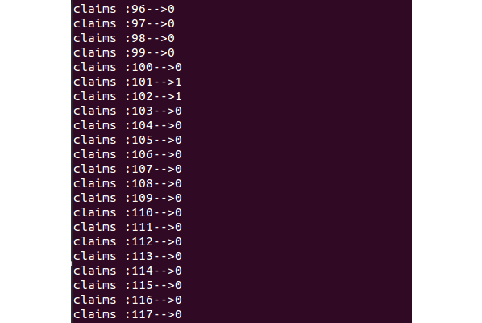
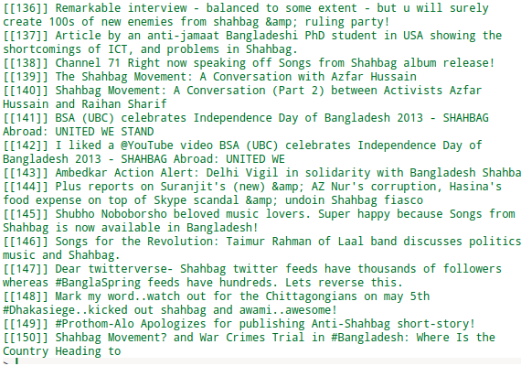
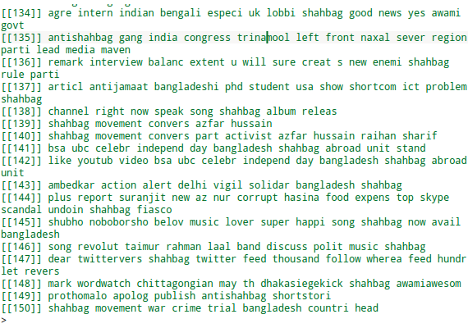
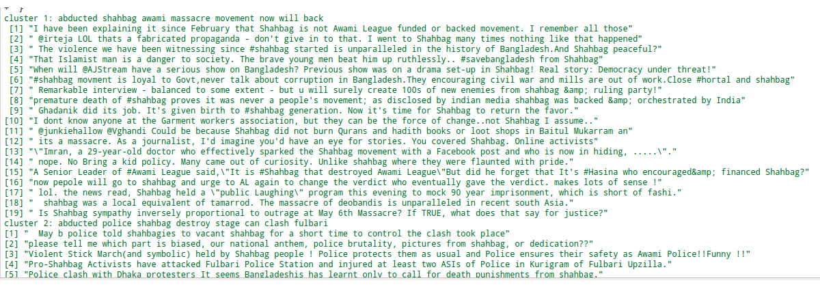
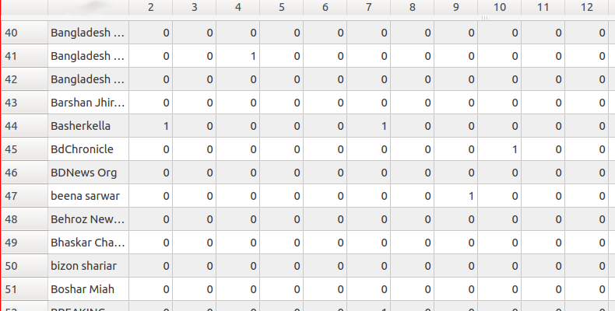
The Study of Reliable Social Sensing
Sk. Kamruzzaman, Md. Nawajish Islam
Motivation
Social Sensing
Humans perform sensory data collection using social platforms
From collected data event is detected
Challenges
Source node or Human input are less reliable
Possibility of noisy data.
Large volume of data
Problem Domain
Data collected from social sensing applications are too noisy to use in any mathematical calculation
To find the reliable data source node formal structure is used which is called Observation Matrix.
A group of M participants, S1, ..., SM , make individual observations about a set of N measured variables C1, ..., CN in their environment.
Participants are Sources or Network Nodes and measured variables are Claims or Events.
Sources and Claims together creates a M*N Observation Matrix. or SC Matrix
Background Study
[1] Wang et al. On Bayesian interpretation of fact-finding in information networks, 2011
[2] Pasternack et al.. Knowing what to believe (when you already know something),2010
[3] Yin et al. Truth discovery with multiple conflicting information providers on the web, 2008
[4] Aggarwal et al. Data Clustering Algorithms and Applications, 2014
[5] Wang et al. On Truth Discovery in Social Sensing: A Maximum Likelihood Estimation (EM) Approach, 2012
Users
Tweets
Sources
Traffic jam on X street
Claims
 | 1 | 2 | 3
1 | 1 | 1 | 0
2 | 0 | 1 | 0
3 | 0 | 0 | 1
SC Matrix Computation
Carnival has ended
Flow Chart
Collecting
data from
Social sensing
application
It is raining
Transform to
Data frame
Calculate
unique
sources
Performance Measurement Framework
Filter data
System
Experiment
Cluster with K
K=numbers of
clusters
Create
SC matrix
Input SC matrix
Language : C++ [en.wikipedia.org/wiki/C%2B%2B]
Input data : Generated SC matrix
Input algorithm : Expectation Maximization[2]
Is
clustering
good ?
Input Algorithm
Result (credibility of claim)
no
yes
Testbed Description
Run the algorithm On SC matrix
Data Mining Language: R [www.r-project.org/]
Input Dataset : Twitters during
'Shahbagh Uprising' in Bangladesh
Clustering : K-means, K -Medoids
Output Algorithm's performance
Sample Output
Input
Filtered data
Cluster output
SC Matrix
Department of Computer Science and Engineering (CSE), BUET

