Slide 1


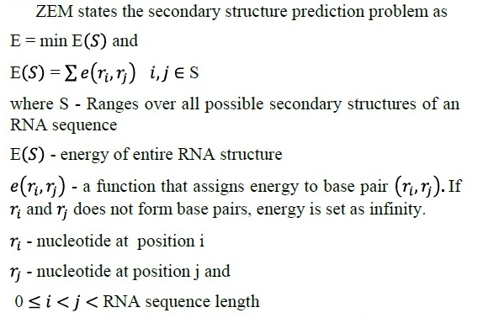
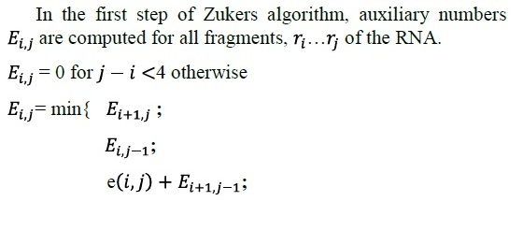

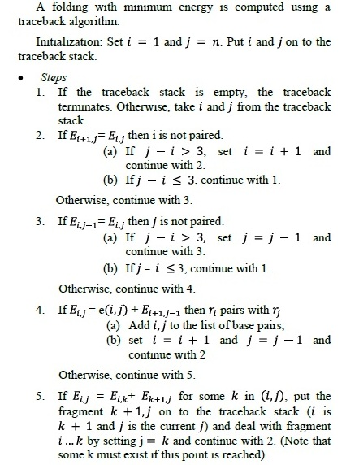
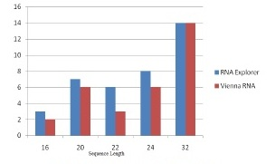
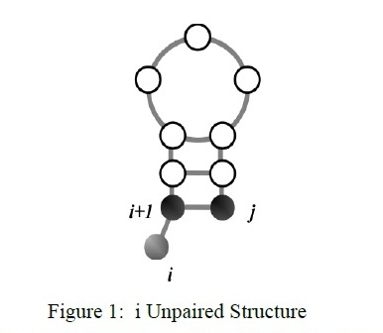
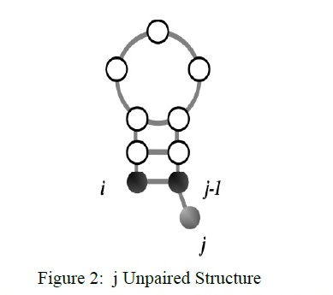
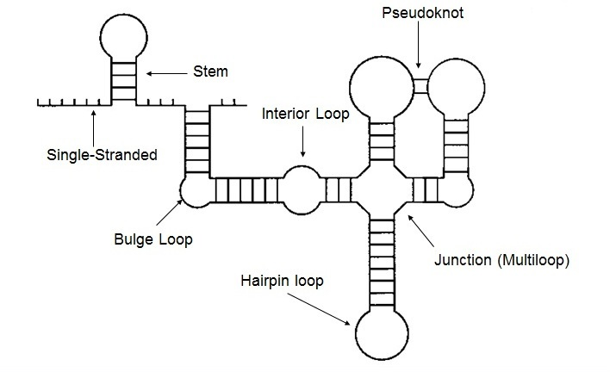
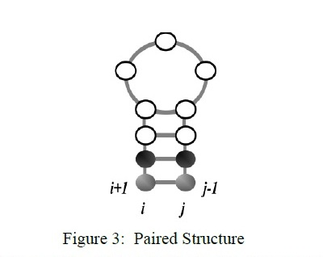
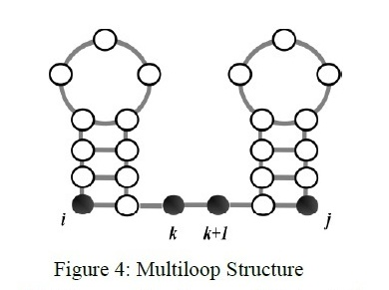
Optimization of ZEM Algorithm in Prediction of RNA Secondary Structure
Author: Tanzim Ahmed (0805094)
Genetic information of an organism is transferred from Deoxyribonucleic Acid (DNA) to Ribonucleic Acid (RNA) and then to Proteins.
The biological role of many RNA crucially depends on their structure.
Predicting secondary structure of RNA is the most important factor in determining its 3D structure and functions.
Introduction
ZEM (Zuker’s Energy Minimization) Algorithm finds the biologically correct structure of each RNA sequence and its corresponding free energy value.
It works on dynamic programming approach.
ZEM Algorithm
Understanding the function of RNA molecules is a key to unlocking the pathways of disease and biology.
Knowledge about this native
structure can have an enormous
impact on the field of pharmacology,
medical science and drug discovery.
Applications
Energy Calculation
Finding Auxiliary Numbers
Calculation of Base Pairs
Trace Back Algorithm
Two tools RNA Explorer and Vienna RNA Package are used to calculate the base pairs of RNA. The more is the number of base pairs, the more stable the structure is.
Comparison between two tools:
RNA has single stranded spiral shape.
Optimization of ZEM
Immediate time complexity of ZEM algorithm is: O(n⁴) and space complexity: O(n²).
There are O(n²) matrix entries and O(n²) interior loops.
We aim at reducing complexity of limiting case i.e. interior loops by bounding maximal interior loop size (e.g. 30).
Then the time complexity of ZEM reduces to O(n³).
References
[1] Cinita Mary Mathew and G.H. Meera Krishna, Prediction of RNA Secondary Structure from Random Sequences Using ZEM, Bonfring International Journal of Data Mining, Vol. 2, No. 1, March 2012.
[2]http://math.mit.edu/classes/18.417/Slides/rna-prediction-zuker.pdf
RNA carries different loop structures.
Department of Computer Science and Engineering (CSE), BUET

