Slide 1

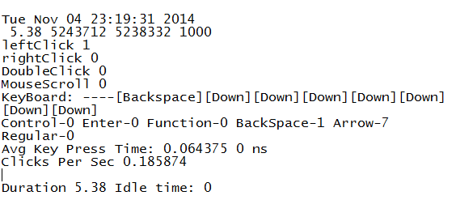
eWatchdog: An Electronic Watchdog for Unobtrusive Emotion Detection based on Usage Analysis
Rayhan Shikder
Email: 0905060.rs@ugrad.cse.buet.ac.bd
Background
Emotion is, perhaps, the most critical attribute of living beings that is critical to detect and generate artificially. Its detection always remains a classical well-explored problem.
There exist many approaches for determining human emotions based on facial expression analysis [1], thermal imaging of faces [2], gesture and pose tracking [3], voice intonation [4], etc.
Building Blocks of Our Study
Emotion Classes: The target emotion classes in our study are happiness, sadness, fear, anger, disgust, and surprise.
Emotion Induction System: A survey system comprising videos, audios, images, and news texts that are used to induce different classes of emotion onto a participant of the system. The survey contents will be presented to the participant and the participant will be prompted to have feedback on the contents. The task of having feedback through a device eventually provides usage data.
Usage Data: Comprises different data pertinent for keyboard and mouse usage such as typing speed, dwelling time, clicking speed, etc.
Feature Extraction: A module that runs in the background and captures users significant usage data, also known as features, and logs them in every 5 seconds.
Feature-Emotion Mapping: A module that clusters features based on corresponding emotions
Motivation and Contribution
Motivation: Existing emotion detection approaches -
Demand additional infrastructure such as webcam, body mounted hardware [5], etc., which are often intrusive.
Require specialized information such as voice, gestures, facial expression, etc., which are not always available
Our contribution: We propose a novel emotion detection system that detects emotion from widely-used electronic devices
Demanding no additional infrastructure, and
Exploiting conventionally available usage data.
Working Procedure of Our Study
Emotion Learning System
Emotion Induction System
User
Feature Extraction
Feature-Emotion Mapping
Emotion Classification
Survey Inputs
Usage Data
Features
Figure 1: Our proposed approach for emotion detection
Current Progress of Our Study
We are developing the survey system for our study.
We have collected related videos, audios, images, and news texts for the survey system.
We have developed the Feature Extraction module.
Scope and Applications of Our Study
Our study can facilitate making electronic devices more human like, which will lead towards
Making personal computers and cellphones as emotional counterparts,
Devising virtual psychologist to aid psychic patients using electronic devices.
Conclusion and Future Work
Detecting emotion is always of utmost interest, even though performing this task from widely available usage data is yet to be focused in the literature.
We perform a study to detect emotion from widely-available usage data of electronic devices.
We plan to develop the feature-emotion mapping module and conduct real survey using our developed system.
In future, we plan to create emotion in personal computers based on the findings of our study.
Figure 2: Data logged after feature extraction
References
[1] S. Ioannou, A. Raouzaiou, V. Tzouvaras, T. Mailis, K. Karpouzis and S. Kollias: "Emotion Recognition through Facial Expression Analysis Based on a Neurofuzzy Method," Neural
Networks, vol. 18, pp. 423-435, 2005.
[2] S.G. Kong, J. Heo, B. Abidi, J. Paik and M. Abidi: "Recent advances in visual and infrared face recognition—a review" Computer Vision and Image Understanding, vol. 97, no. 1,
pp. 103-135, Jan. 2005.
[3] H. Gunes and M. Pantic, & ldquo, “Dimensional Emotion Prediction from Spontaneous Head Gestures for Interaction with Sensitive Artificial Listeners”, Proc. Int',l Conf. Intelligent
Virtual Agents, pp. 371-377, 2010.
[4] O. W. Kwon, K. Chan, J. Hao, and T. W. Lee: “Emotion recognition by speech signals,” In Proc. EUROSPEECH, 2003.
[5] U Dimberg: “Facial electromyography and emotional reactions”, Psychophysiology (Impact Factor: 3.18),1990.
[6] R.W. Picard: “What does it mean for a computer to 'have' emotions?”, MIT Media Laboratory, 2002.
[7] A.F.M. Nazmul Haque Nahin, Jawad Mohammad Alam, Hasan Mahmud and Kamrul Hasan: “Identifying emotion by keystroke dynamics and text pattern analysis”, Taylor &
Francis online, March, 2014.
Department of Computer Science and Engineering (CSE), BUET

