Slide 1

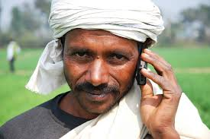

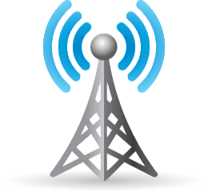
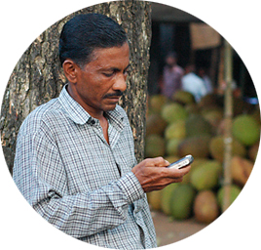
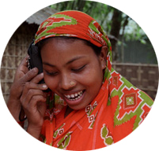
m-Government : Ensuring Hassle Free Citizen Services Through Mobile Phone
Khalid Akbar(0905016), Rafsan Siddiqui(0905017), Almash Alam (0905061)
Introduction:
m-Government refers to collection of services as the strategic use of government services and applications which are only possible using cellular/mobile telephones, laptop computers, personal digital assistants (PDAs) and wireless internet infrastructure.
After introducing the challenges and failures of ﬁrst generation e-government due to infrastructure, strategy and access and the rhetoric of the next generation of e-government efforts, m-Government is more potential and interactive.
Motivation:
Although Mobile Phone Subscribers are in high percentage, no significant steps have been taken for providing citizen centered services through mobile phone. It is the media through which the government can reach the citizens and citizens can take benefit of government services.
Problem Definition:
We are trying to propose a m-Government service where citizens can communicate with the local government corresponding to only his area so that he doesn’t have to go through tedious processes to submit even the trivial request.
Architecture
CSTMP
WARD Councilor / UP Member
Mayor / UP Chairman
Local Member of Parliament
Typical Citizen Complaints :
Electricity, Water & Gas Supply
Sanitation, Drainage Issues, Dustbin placement
Hooliganism, Drug Addiction, Eve-Teasing
Water, Air, Land and Sound pollution
Transport and Road problems
Necessary Tools :
PHP/ Python Server
MySQL Database
Android, iOS
HTML5, CSS, Angular JS
CSTMP Features:
Authenticity of each user will be ensured.
Each complaint will have a complaint ID, so a user can complain again using his previous complaint ID in case of problem not resolved.
A central database has to be maintained for receiving complaint, but each user can only submit his complaint to local government representatives.
In case of false complaint a user will be banned for 3 to 6 months and won’t be able to submit a complaint.
Spot under privileged and problematic areas
Technological Challenges :
Identifying a user by his National Identity Card Number
Keeping Track of user complaint request
Processing huge amount of user requests simultaneously
Ensuring user authenticity and prevent spamming
Keeping user privacy
Analyzing and Processing user data to identifying most affected areas of the country and generating a report based on that
REFERENCES
Bangladesh Telecommunication Regulatory Commission www.btrc.gov.bd
Bangladesh Bureau of Statistics www.bbs.gov.bd/
Department of Computer Science and Engineering (CSE), BUET

