Slide 1

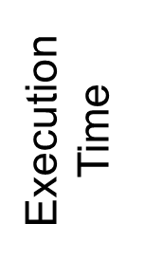
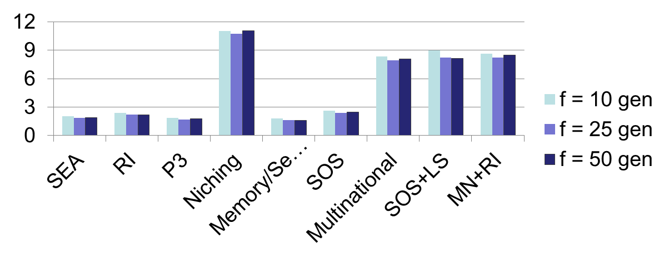

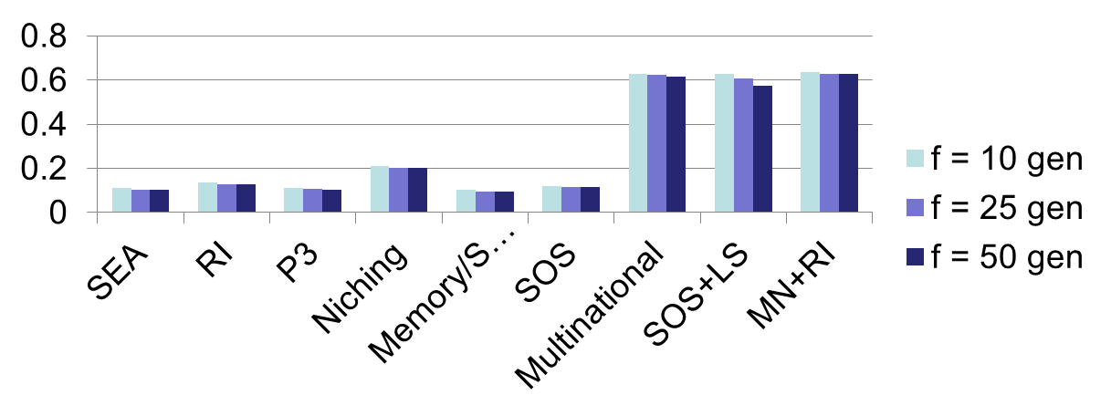
Improving Random Immigrants Injections for Dynamic Multi-objective Optimization Problems.
Md Nurullah Patwary Fahim (0905019)
1. Introduction
4. Background
The real world multi-objective optimization problems [1] are mostly dynamic in nature, where the objective functions, constraints and many other parameters could change with time. Obtaining the desired solution within the time before the next change occurs becomes an important issue.
The random immigrant approach is incorporated with static multi-objective optimization algorithms. When change in the environment is detected, a portion of the current population is replaced by randomly generated individuals. The goal is to maintain the diversity. This approach consumes little time, as the only overhead is to generate the random individuals. The comparison [3] of different approaches against execution time and fitness for different frequency of change is given below.
2. Problem Definition
Dynamic Multi-objective optimization algorithms [2] incorporate some approaches to handle the change in environment. Some of these approaches give better solutions but takes time to find the optimal front. If enough time not given, no good solution can be found by these approaches.
3. Objective
Random Immigrants approach [3][4] does not have very good performance but takes less time to converge towards optima. The goal is to improve the convergence of this method and analyze the with respect to other well known approaches.
Fig: Time and Fitness of different algorithms for dynamic MOEA for different frequency of change.
5. Proposed Methodology
i. When the change happens, the population tends to move towards the new optima. Whole population re-evaluated.
ii. Then a binary tournament is held. A portion of the individuals are randomly selected as first participant in the tournament.
iii. Then a neighbor individual around each randomly selected individuals are selected at a minimum distance δ as second participants.
X2
X2
X2
δ
X1
X1
X1
iv. The binary tournament is held. A vector dV_{k} from the worse to better individual is recorded with each winner.
v. For each winning individual, a new individual is generated at distance dV_{k} from winner in the same direction replacing the worse one.
vi. With these new individual, the optimization process is continued.
X2
X2
X2
Δv_{k}
Δv_{k}
X1
X1
X1
6. Future Work
7. References
This approach could be further improved by making it adaptive with the change in environment.
Other heuristic approaches could be formulated from this to get a good performance within short time span.
Eckart Zitzler (1999), Evolutionary Algorithms for Multiobjective Optimization: Methods and Applications, A dissertation submitted to the Swiss Federal Institute of Technology Zurich for the degree of Doctor of Technical Sciences.
Karsten Weicker (2003), Evolutionary Algorithms and Dynamic Optimization Problems.
Demet Ayvaz, Haluk Rahmi Topcuoglu, Fikret Gurgen (2011), Springer Science+Business Media.
Lam T. Bui, Jurgen Branke, Hussein A. Abbass,Multiobjective optimization for dynamic environments.
Department of Computer Science and Engineering (CSE), BUET

