Slide 1

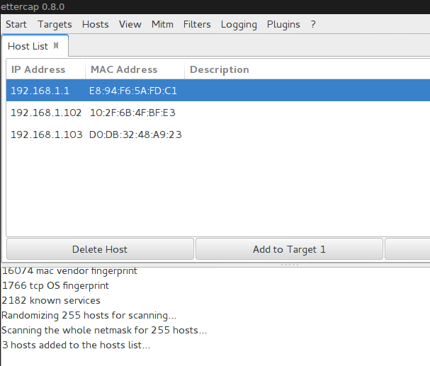
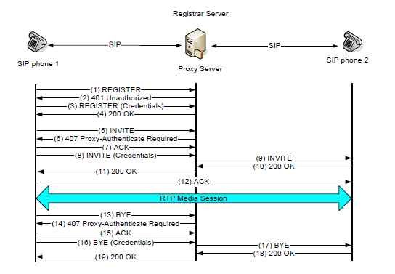
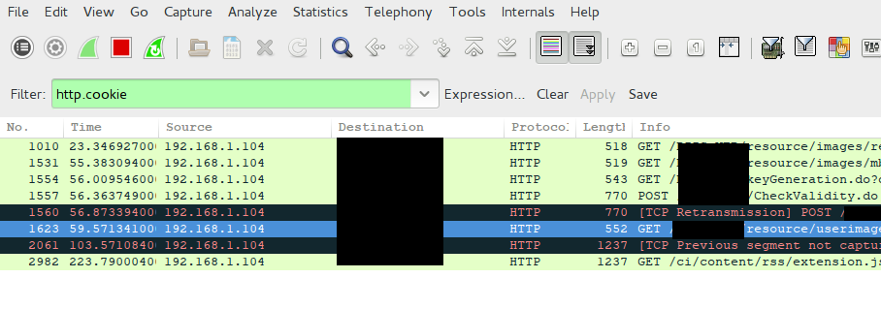
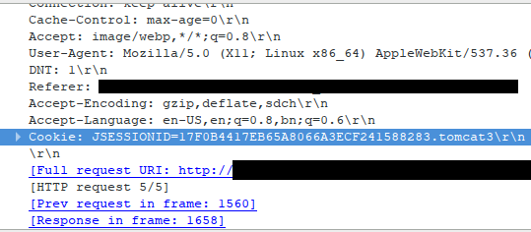
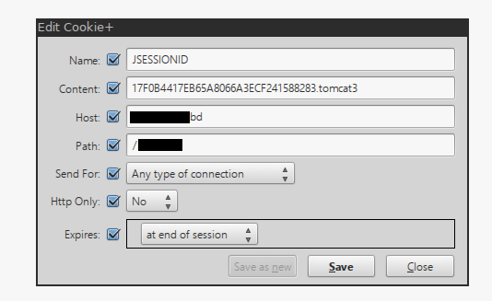
Demonstrating HTTP Session Hijacking through ARP Cache Poisoning and Man-in-the-Middle Attack and exploring HTTPS and VOIP session vulnerabilities
Mainuddin Ahmad Jonas and Risul Islam
Email: jonas.maj@gmail.com and risulcse09@gmail.com
What is Session Hijacking?
HTTPS Protocol and its Vulnerabilities
A session is a lasting connection between a user (a browser) and a server involving the exchange of many requests
Session ID is a unique identifier used by the client to gain access to session data stored on the server
Session Hijacking is the exploitation of a valid computer session where an attacker takes over a session between two computers.
It is done by stealing the Session ID.
Due to the inherent vulnerabilities of HTTP protocol demonstrated, HTTPS connection is recommended
However, even HTTPS is not secure from all MITM attacks
Vulnerability in SSL Handshaking and oversight by end users can be exploited
SSL handshaking protocol is done over plaintext – allowing spoofing of certificates through MITM attacks. Attacks of these kinds are known as SSL Sniffing attacks.
In SSL Stripping, the man-in-the-middle-attacker strips off the SSL protocol from the server’s response, and sends the client a normal HTTP response, while at the same time maintaining an SSL connection with the server.
HProxy, HSTS, SSLock, HTTPSLock, ISAN Enforcer are proposed solutions to SSL Stripping
We are currently in the process of developing a better method of preventing SSL Stripping attacks.
How an HTTP session can be Hijacked
Any unencrypted HTTP session can be hijacked by launching a Man-in-the-Middle attack
Three steps involved:
  Poisoning the ARP cache
  Sniffing the Session ID
  Hijacking the Session using the stolen Session ID
Poisoning the ARP Cache
VoIP(Voice over Internet protocol)
Ettercap is used to poison the ARP Cache
Client IP Address 192.168.1.102, the default gateway 192.168.1.1 and the attacker machine 192.168.1.103
After the attack, all traffic between client and default gateway passes through the attacker’s machine
A protocol which is now widely used in the telephony system.
Number of Residential VoIP subscribers in US is 44 million (IDC report 2010)
Most people consider VoIP safe but increasingly it is becoming more vulnerable.
The figure shows the communication process.
Fig. 1: Poisoning the ARP cache using Ettercap
Fig. 5. Communication in VoIP
Sniffing the Session ID
After establishing the MITM attack, the Session ID can be stolen using any packet sniffer.
In Fig . 2, we have shown the use of Wireshark filters to capture the relevant HTTP traffic from our victim machine
In Fig. 3, the captured traffic is inspected to find out the secret Session ID of the current session.
Attacks on VoIP and Prevention
Man In The Middle(MITM) attack
  A Remote Attacker (RA) acts as SIP Proxy Server(PS) to a SIP Phone and vice versa
DOS attack
DOS is nothing but making the service of VoIP stop or hamper. 2 types:
  SIP Parser attack occurs in malforming INVITE message
  Flooding attack means overflowing the PS with INVITE message
SQL injection is injecting SQL statement in INVITE message header
Prevention of VoIP attacks:
Fig. 2: Using Wireshark filters to capture HTTP cookies sent from our victim machine
Fig. 3: Inspecting the Session ID from the captured packets. Here we can see the Session ID is 17F0B4417EB65A8066A3ECF241588283.tomcat3
Serial No |  | Attack Name | Defense Mechanism | Properties | Further attacks
1 |  | MITM | Using dynamic ID value and a wide ranged port number in DNS query . | No brut force search by RA. | Possible by Brut force search and sniffing
 |  |  |  | Burdensome, takes time.
2 | A | SIP Parser(DOS) | Message header checking strongly . | No harmful header | Not possible .
 |  |  |  | No multiple connection
 | B | Flooding (DOS) | Allowing the PS a max number of hit per second from a SIP Phone | Flooded limited from single phone | Still possible by DDOS .
 |  |  |  | Poor service
3 |  | SQL Injection | Message header checking strongly | No harmful header | Still possible but limited .
 |  |  |  | Computationally burden
Hijacking the Session with the stolen Session ID
Using the stolen Session ID, it is easy to gain access to a valid logged in session.
Figure shows, a Firefox add-on (Cookies Manager+) is used to hijack the session
We are building an automated tool to carry out all 3 steps
Fig. 4: Using Cookies Manager+ to hijack the session . Here we insert the Session ID we sniffed in the previous step
Department of Computer Science and Engineering (CSE), BUET

