Slide 1

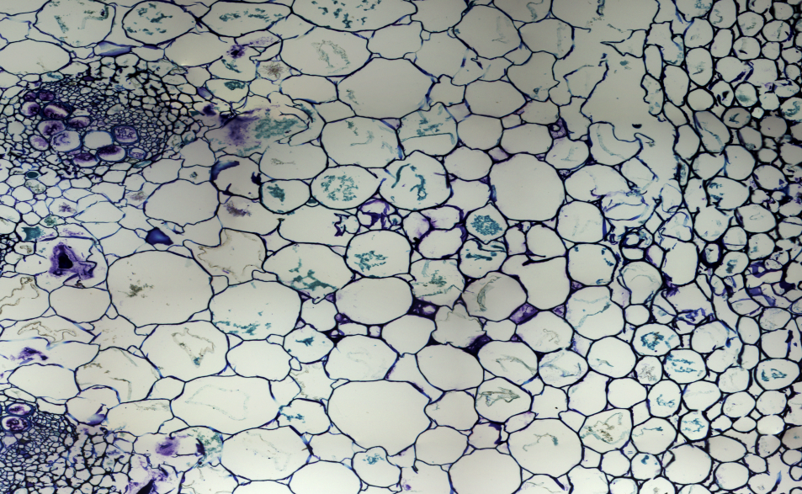
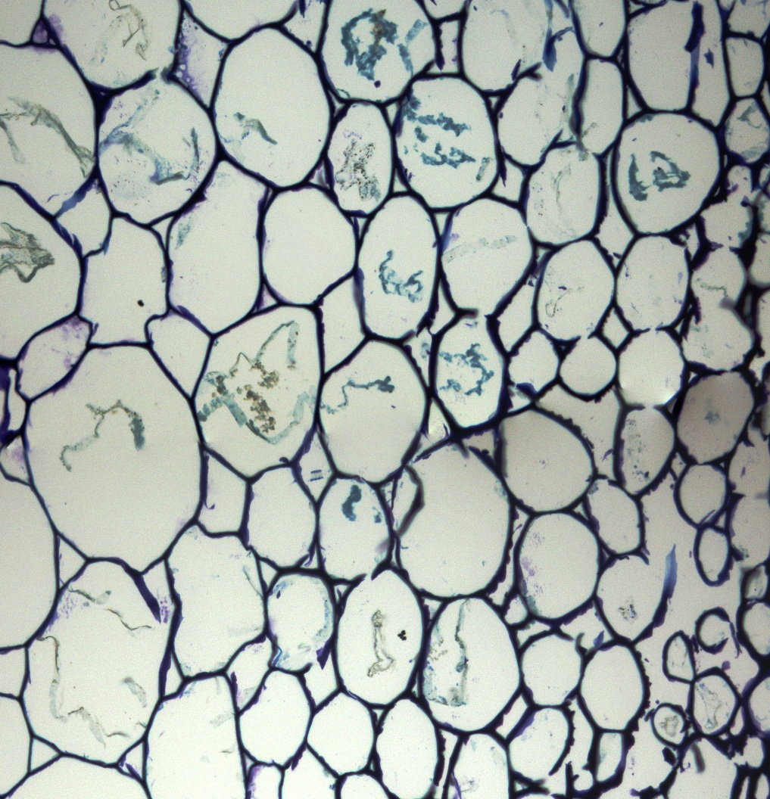
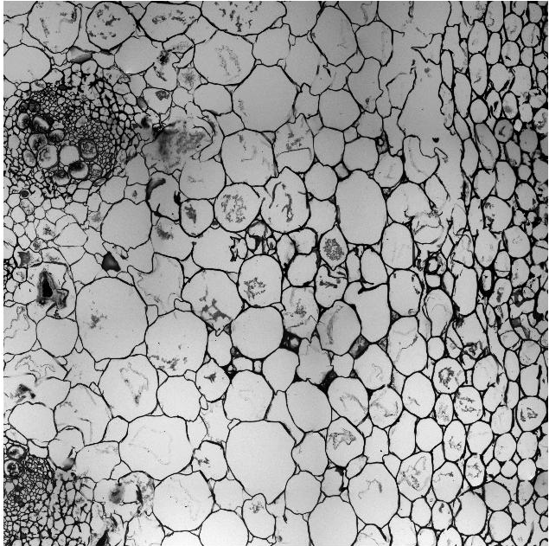
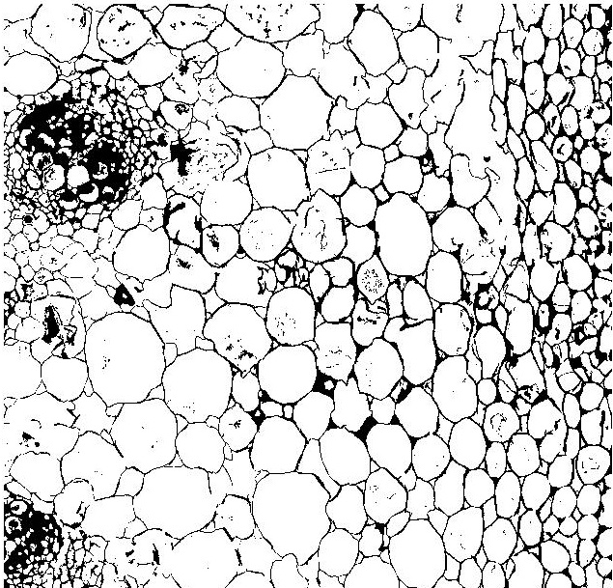
Noise Reduction from Cellular Biological Images Using
Adaptive Fuzzy Filter
Majbah Uddin(0805098)
Motivation
Problem Domain
Biological cellular imaging technology has enormously increasing its importance in the cellular architecture and interaction that underlie essential functions with in cells and tissues.
The advances in different computational techniques have also increased the relevance of image processing algorithms for computer aided biological laboratories and for analysis of other biological data.
However, the different modalities of biological cellular images still presents some disadvantages ,such as noise ,distortion of actual images which may reduce reliability and make it difficult computer aided research works and biological data analysis.
In order to decrease these disadvantage we want to develop a framework using adaptive fuzzy filter
In the Digital Image Processing field several noises Gaussian noise (White noise) Salt & Pepper noise and Speckle noise found in images. Noise when get added to image destroy the details of it. Several filtering methods had used to remove several types of noise removal from different types of images.
Biological cellular images are very complex and sophisticated images ,every possible details is important for research works. So removing noise and keeping image detail intact in cellular images is hard to maintain.
Our Experimental images:
Related Work or Background Study
Our Proposed Method
In 2005 Rami J.Oweis, Muna J.Sunna’T introduces A combined Neuro–Fuzzy approach for classifying
image pixels in Medical Applications.
In 2011 Aneesh Agrawal , Abha Choubey , Kapil Kumar Nagwanshi introduces Development of adaptive fuzzy based Image Filtering techniques for efficient Noise Reduction in Medical Images. They uses ultrasound images and only color images.
Area weighted tessellation : a new solution for an old problem by N.Wang,Ke Ma ,J.Huang, W.Liu. By the help of technique describe in this paper we developed a algorithm using adaptive median filter for noise removal but it was not well enough . Some experiment result has given below.
Some previous results:
a)Original input gray image b) Output gray image after using
adaptive median filter
We want to develop a new fuzzy filter for keeping detail and noise reduction for biological cellular images.
Flow chart :
Start
Convert input image to binary image
Use Fuzzy Clustering algorithm and check each pixel P(x ,y)
YES
P(x ,y) noisy?
NO
Noise Free Pixels
are left unchanged
Noisy Pixels are detected and compute Median pixel
Compute value of neighboring pixels
Compute the fuzzy membership value and restoration term
Replace noisy pixels by restoration term
Stop
Possible Experiment Plan and Test Bed
Experiment Plan:
We will design our filter and implement it using Matlab.
We will use other existing filters and analyze their data and our data
Compare our result with other existing filter and methods
Test bed:
Check to remove almost all possible noise may occur to cellular images
Performance measuring of filter.
Department of Computer Science and Engineering (CSE), BUET

