Slide 1


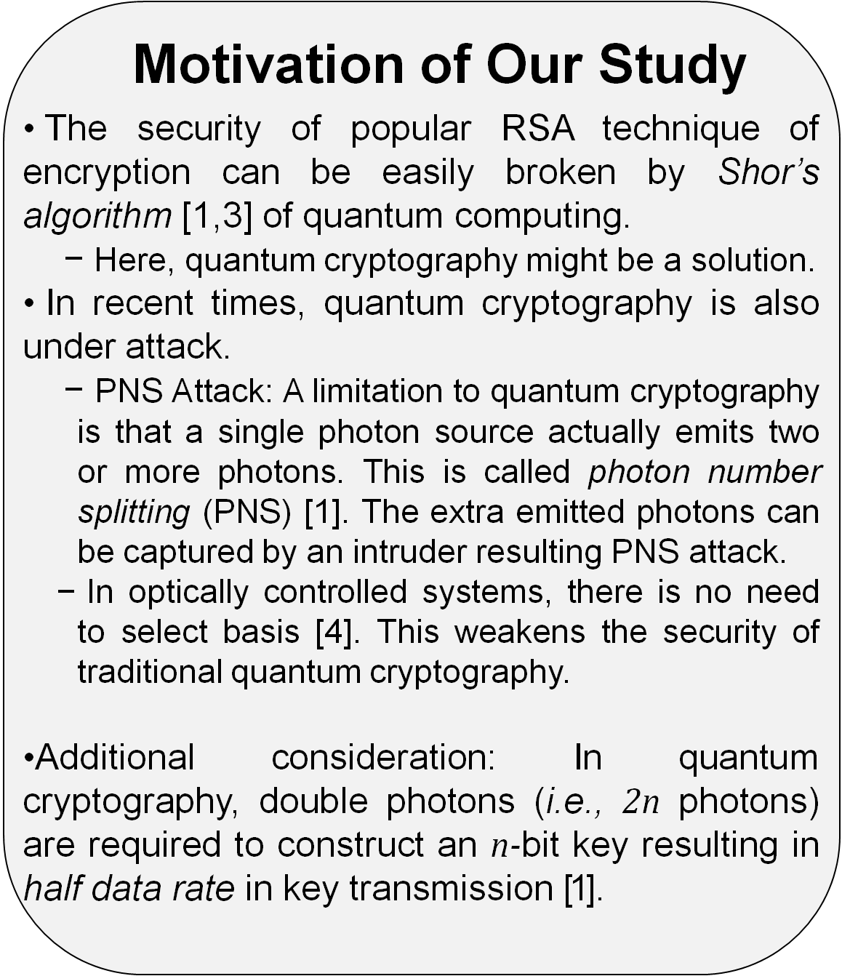
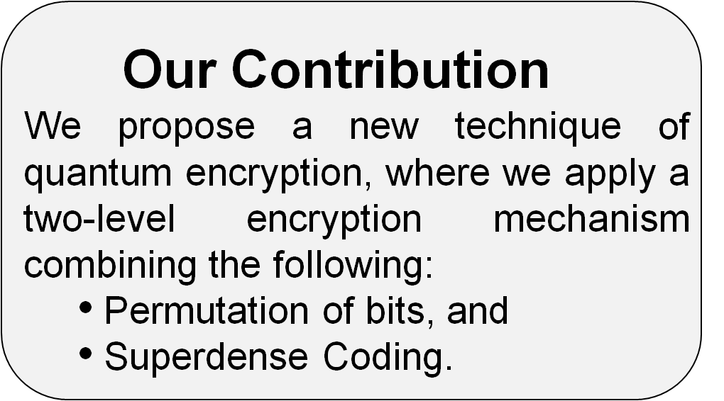

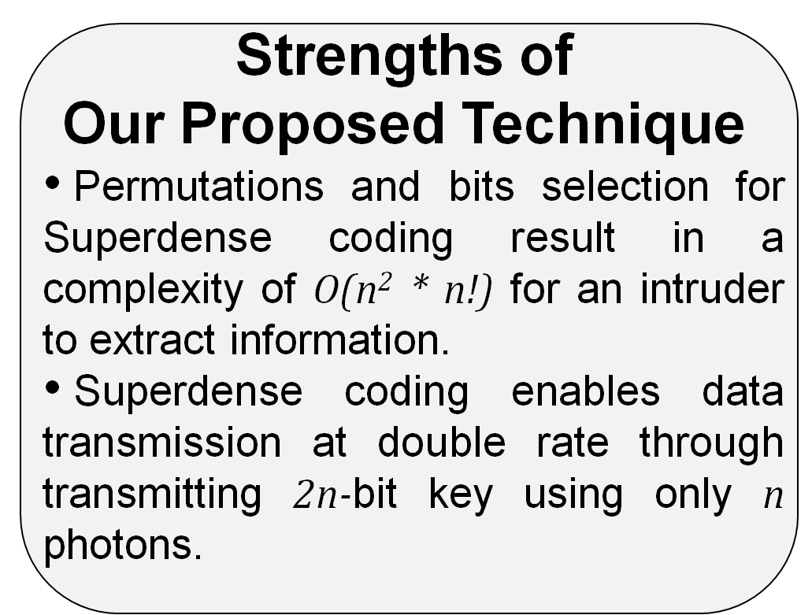




















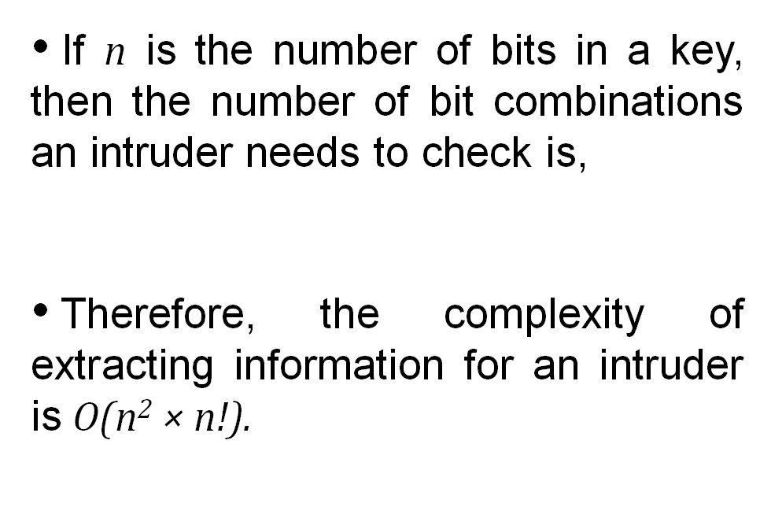
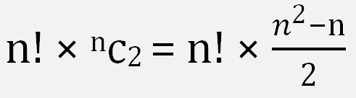
SuperCrypt: A Novel Technique of Quantum Cryptography Simultaneously Improving Both Security Level and Data Rate
Kazi Sinthia Kabir, and Tusher Chakraborty
Email: sinthia.096@gmail.com, tusherchakraborty@matholympiad.org.bd
Qubit (quantum bit): The basic unit in quantum computation, which is a linear superposition of 0 and 1 [1]. A qubit is generally represented as follows,
where α and β determine the corresponding extents of superposition.
Quantum entanglement: A quantum mechanical phenomenon that describes quantum states of two objects with reference to each other, even though the individual objects may be spatially separated [1].
Superdense Coding: A Method of quantum communication to increase the rate of transferred data [2].
Quantum Cryptography: Use of quantum computation to perform cryptographic tasks [1].
  Security in traditional quantum cryptography is based on selection of a basis for measurement of photons, which carry the values of qubits.
  If an intruder fails to select the basis correctly, he cannot extract the data.
Steps at the Sender Side
Encode the message with key using XOR operation.
Permute the bit positions of the key according to predefined rules known both by sender and receiver.
Perform Superdense Coding of the modified key string.
Send the Superdense coded photons for transmitting the key.
System Model of
Our Proposed Technique
Steps at the Receiver Side
Receive the Superdense coded photons.
Decode from the Superdense coded form.
Permute the bit positions of the key in a reverse manner according to predefined rules to extract the original key.
Decode the message using XOR operation with the key.
Sender Receiver
0 1 0 0 1 1 1 0
Key
Message
Message
Key : 1 0 1 1 0 0 1 0
Permutated key : 0 1 0 0 1 1 1 0
XOR
XOR
Ψ
Ψ
Ψ
Ψ
Encoded message
Encoded message
transmission
Encoded message
Key
Photon position | Key bit positions
1 | 1 | 5
2 | 4 | 8
3 | 2 | 7
4 | 3 | 6
Permutation
Reverse
Permutation
0 1 0 0 1 1 1 0
Modified key
Modified key
Superdense
Coding
Key
transmission
Superdense
Decoding
Table: Bit selection for Superdense Decoding
Ψ
Ψ
Ψ
Ψ
Superdense coded key
Superdense coded key
Key bit positions |  | Photon position
1 | 5 | 1
4 | 8 | 2
2 | 7 | 3
3 | 6 | 4
Figure: Block diagram of proposed encryption technique.
Received key : 0 1 0 0 1 1 1 0
Reverse Permutated Key: 1 0 1 1 0 0 1 0
Table: Bit selection for Superdense Coding
Recycling Qubits
Conclusion and Future Work
References
Our system largely depends on entanglement of qubits. However, if a qubit is measured, its entanglement is destroyed.
Therefore, we propose to utilize either of the following methods:
  Recycling qubits [3], and
  Re-establishing entanglement [5].
As even quantum encryption comes under security threats in recent times, we propose a highly-secure technique of quantum encryption with higher information transfer rate.
The computational power of practical quantum computers is increasing day-by-day, which might cause threat even to our proposed technique in future. Therefore, we plan to incorporate a third level of encryption by changing the basis of photon to make the system more secured.
We plan to explore synchronization between the information transmitted through the quantum channel and the classical channel.
We also plan to perform simulation of our proposed system.
[1] A. V. Sergienko, “Quantum communications and cryptography”, Taylor and Francis, 2006.
[2] C. G. Yale, B. B. Buckley, D. J. Christle,L. C. Bassett, and D. D. Awschalom, “All-optical control of a solid-state spin using coherent dark states,” National Academy of Sciences, vol. 110, no. 19, pp. 7595–7600, 2013.
[3] University of Bristol. "Quantum computing with recycled particles." ScienceDaily. 23 October 2012. www.sciencedaily.com/releases/2012/10/121023112515.htm Last accessed: 22 March, 2015.
[4] C. H. Bennett and S. J.Wiesner, “Communication via one-and twoparticle operators on einstein-podolsky-rosen states” Physical review letters, vol. 69, p. 2881, 1992.
[5] Abdi, Mehdi, Paolo Tombesi, and David Vitali. "Entangling two distant non‐interacting microwave modes." Annalen der Physik 527.1-2, 2015.
Complexity Analysis
Department of Computer Science and Engineering (CSE), BUET

