Slide 1

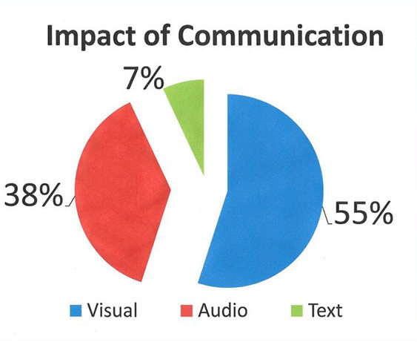
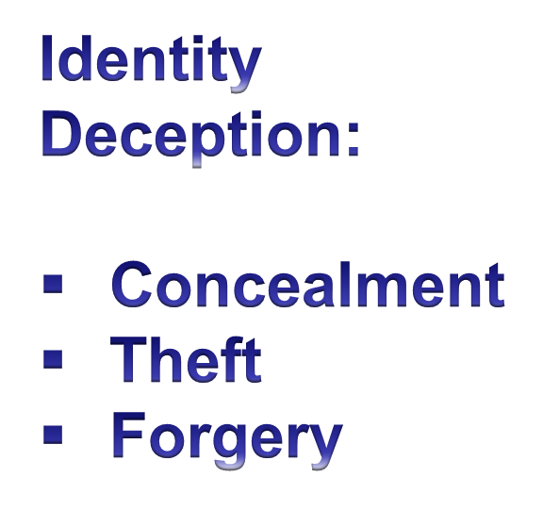
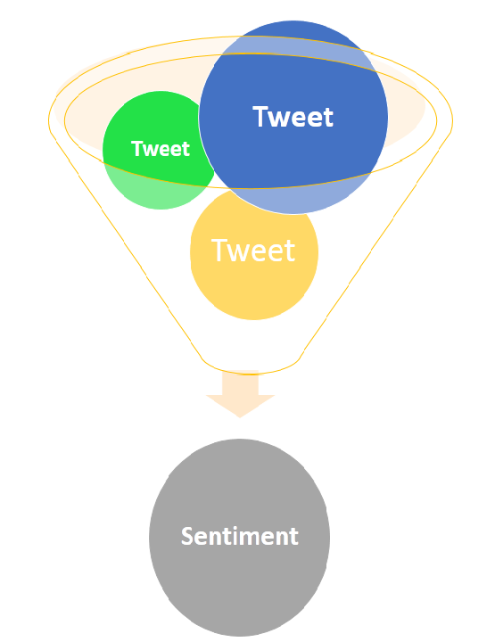
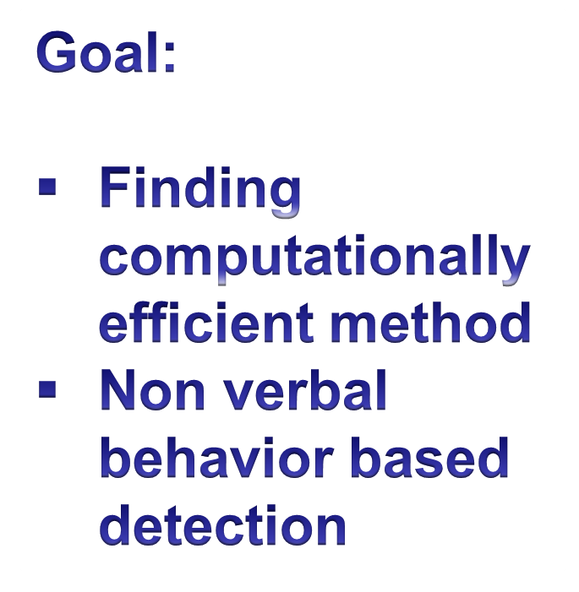
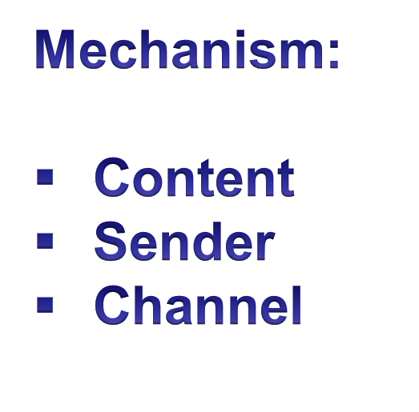
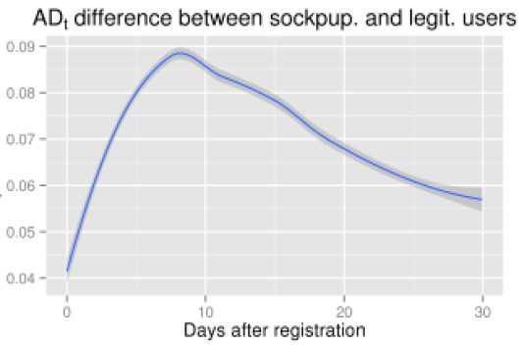
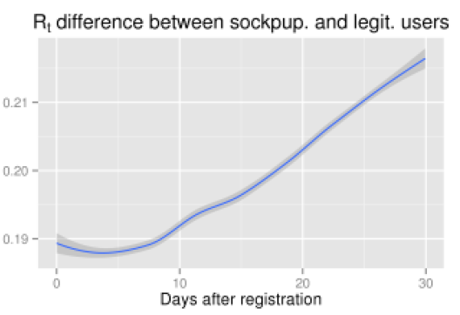


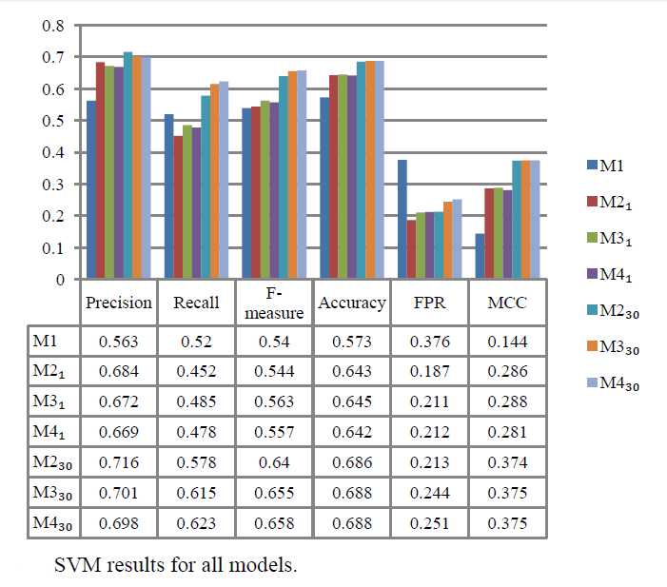
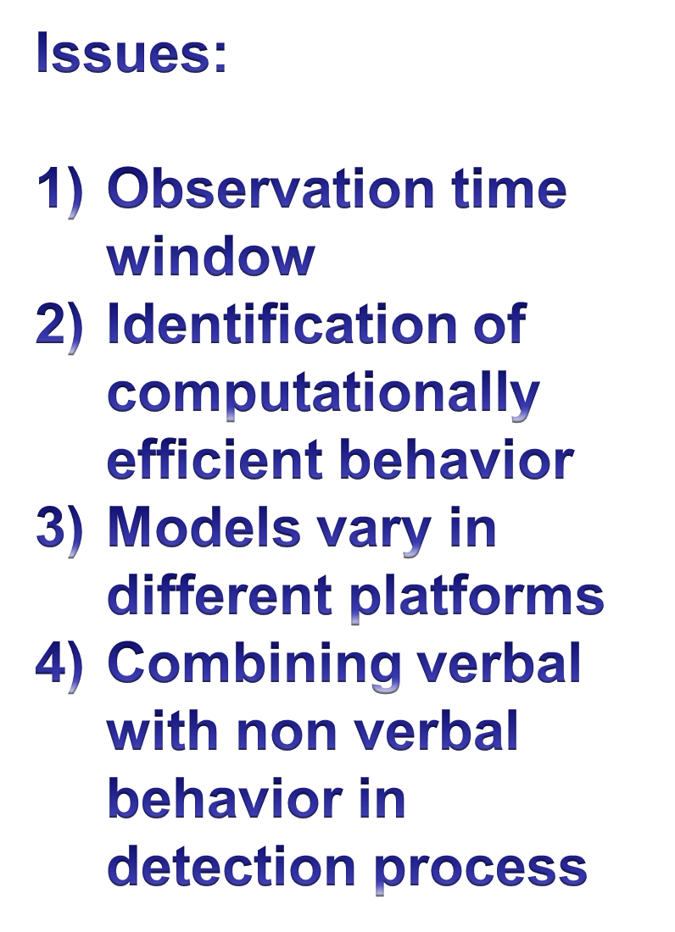
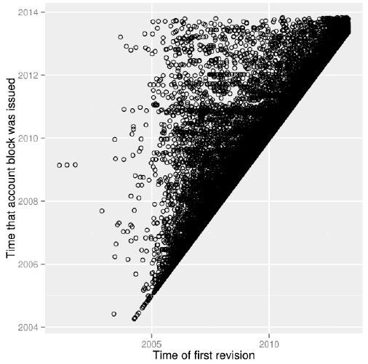

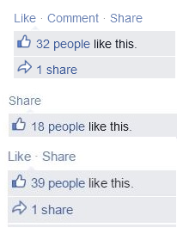

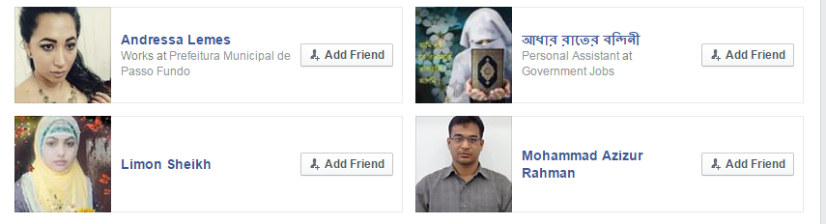
Identity Deception Detection in
Facebook Using Nonverbal Behavior
Md. Asiful Haque
Introduction
State of the Art
Wikipedia User Data
K fold cross validation algorithm
Support Vector Machine
Fig: Precision, recall F-measure and other parameter values
Fig: First revision vs. account block time (sock puppet cases)
Proposed Idea
Spamming
Challenges:
Finding appropriate attributes
Mathematically model them
Getting data
Friend list full of opposite gender ID
Many likes,
Few Comments
Department of Computer Science and Engineering (CSE), BUET

