Slide 1


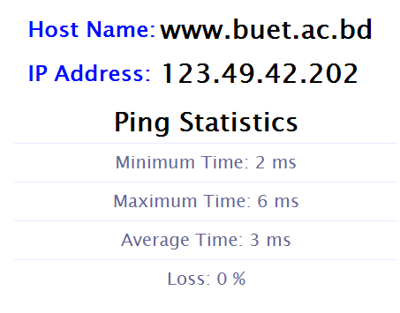
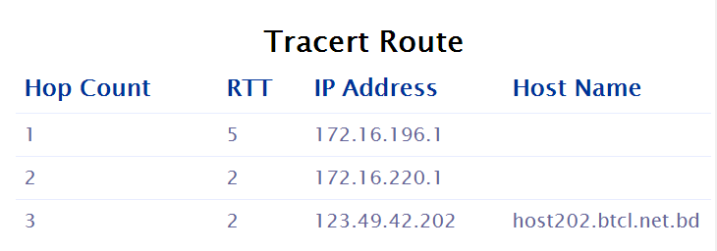
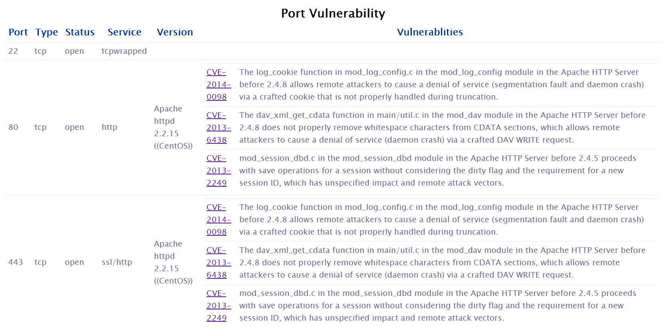
SmartAttacker: Towards Developing an Attacker Exploiting Artificial Intelligence
Raju Ahmed Shetu
Email: 0905011.ras@ugrad.cse.buet.ac.bd
Background & Motivation
The most prominent web attacks are generally of the following five types:
    Remote Code Execution
    SQL Injection
    Cross-Site Scripting
    Format String Vulnerabilities
    Username Enumeration
All of these attacks mostly focus on only one aspect of the system, and thus, limits their success rate.
  Human intervention is needed to enhance the success attack rate combining the attacks.
Augmenting an automated attacker with artificial intelligence can lead towards the next step of enhancing the success attack rate.
Related Work
Traditional web attacks are mostly done by botnets, which can initiate various kinds of attacks such as DDoS attack, ClickFraud, Spyware, E-mail Spamming, Adware, Fast Flux, etc. [1]
Botnets are controlled by Botnet originator known as “Bot Herder” or “Bot Master”, which can control a group of botnets through Internet relay chat channel via Command & Control (C&C) server [3].
Experienced Bot Operator programs the command protocol from scratch that includes server program, client for operation, and the program that embeds the client to victim’s computer [2].
To the best of our knowledge, no bot is intelligent enough to determine an attack plan on its own.
Approach to Our Study
Work Done So Far
SmartAttacker is divided into two modules -
  Information Gathering Module, and
  Intelligent Attacker Module.
Information Gathering Module is completed so far. It captures aliveness, route information, and port vulnerabilities.
  Aliveness is assessed through Ping statistics.
  Route information is gathered through Tracert.
  Port vulnerabilities are scanned through NMAP.
Target system
Get data
Penetration
testing
Attack target with new scenario
Identify individual vulnerabilities
Success attack probability > Desired value
Yes
Generate new attack scenario
No
Fig. 2: Aliveness scanning through SmartAttacker
Fig.1 : Flowchart of SmartAttacker
Conclusion & Future Work
We propose to develop an smart attack tool exploiting artificial intelligence, which is yet to be focused in the literature.
We have developed an Information Gathering Module and currently developing an Intelligent Attacker Module.
In future, we plan to explore how to combat with such intelligent attacker module.
Fig. 3: Route scanning through SmartAttacker
References
[1] P. Ramneek. “Bots & Botnet: An Overview”, SANS Institute. Retrieved 12 November 2013.
[2] C.Y. Cho, D. Babic, R. Shin and D. Song. “Inference and Analysis of Formal Models of Botnet Command and Control Protocols”, ACM Conference on Computer and Communications Security, 2010.
[3] P. Wang. “Peer-to-Peer botnets”. In Stamp, Mark & Stavroulakis Peter. “Handbook of Information and Communication Security”. Springer, 2010.
Fig. 4: Port Vulnerability scanning through SmartAttacker
Department of Computer Science and Engineering (CSE), BUET

