Slide 1



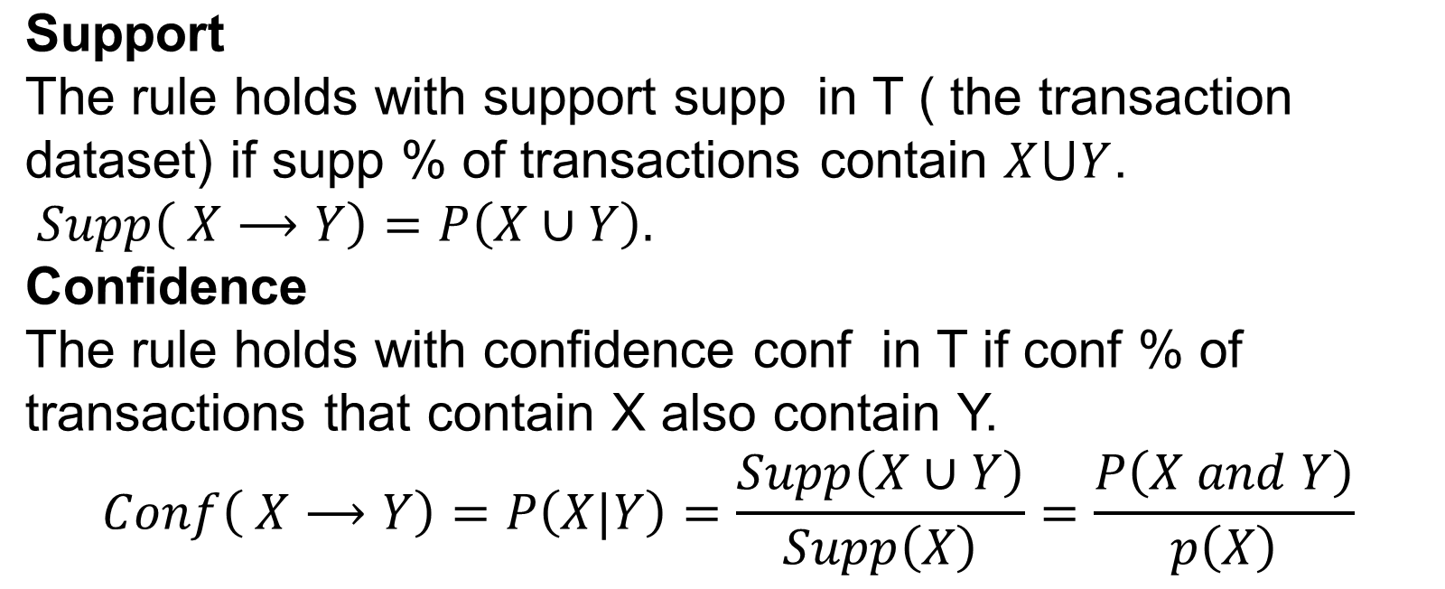



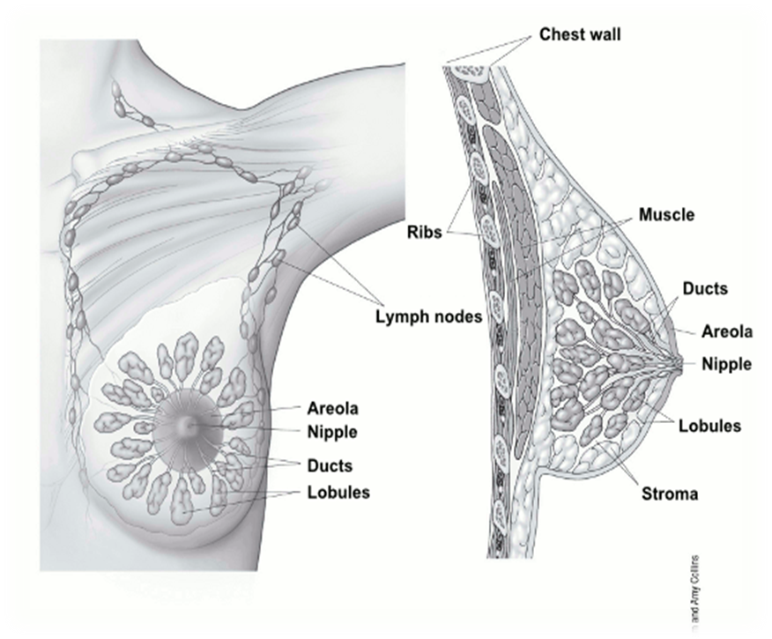

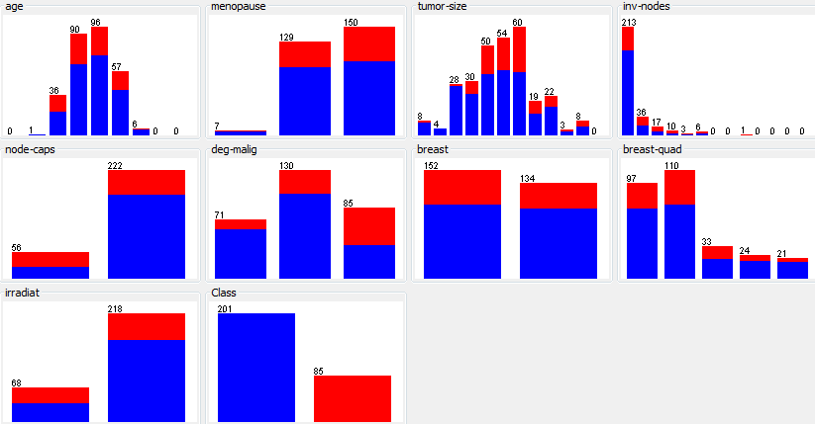

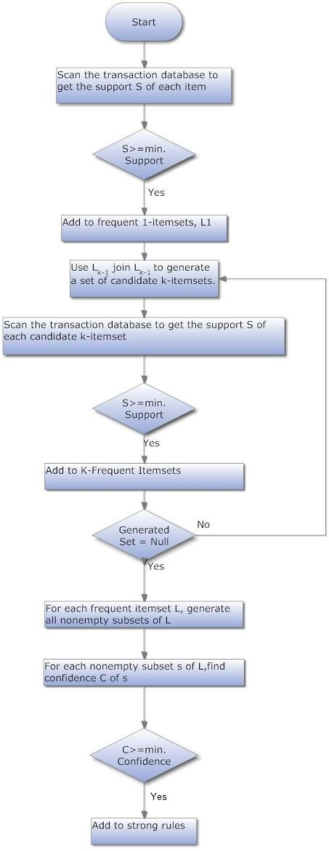



Recurrent Breast Cancer Detection Based on Association Rules Using Frequent Itemset Mining
Md. Samiul Saeef, Md. Siddiqur Rahman
Introduction
Interestingness Criteria
Breast cancer is one of the leading cancers for women when compared to all other cancers. It is the second most common cause of cancer death in women. It often recurs anywhere from 2 to 15 years following initial treatment. Data mining methods can help to successfully detect breast cancer recurrence.
Objective
Our research aims at helping medical experts in recurrent breast cancer detection by providing strong rules extracted from cancer patient database. We use Apriori algorithm for frequent itemset mining in order to discover these strong association rules.
Experimental Setup
Dataset:
The dataset for this work is collected from UCI Machine Learning Repository. There are total 10 variables, and 286 records of patients were created for the analysis.
Tool:
WEKA 3.6.10 has been used to explore the behavior of the Apriori algorithm for finding the association rules. The .csv file are converted into .arff file, which is the acceptable format for WEKA tool. Minimum support defined by the tool for the generated rule is 0.1.
About Breast Cancer
Inside a woman's breast are 15 to 20 sections, or lobes. Each lobe is made of many smaller sections called lobules. Fibrous tissue and fat fill the spaces between the lobules and ducts (thin tubes that connect the lobes and nipples [Fig. 1]). Breast cancer occurs when cells in the breast grow out of control and form a growth or tumor. Tumors may be cancerous (malignant) or benign.
Experimental Result
Some association rules for detecting recurrent breast cancer of the breast cancer patients are mentioned below, and visual form of breast cancer using all attributes is presented in the graphical form in Fig. 3
Fig. 1: Normal Breast tissue
Recurrent breast cancer is breast cancer that comes back after initial treatment. Although the initial treatment is aimed at eliminating all cancer cells, a few may have evaded treatment and survived. These undetected cancer cells multiply, becoming recurrent breast cancer.
Fig. 3: Visual form of breast cancer using all attributes.
Association Rule Mining
Rule-1:
menopause=ge40 inv-nodes=0-2 deg-malig=1 irradiat=no 30 ==>
Class=no-recurrence-events 29 conf:(0.97)
Rule-2:
menopause=ge40 deg-malig=1 irradiat=no 30 ==> inv-nodes=0-2
Class=no-recurrence-events 29 conf:(0.97)
Rule-3:
node-caps=yes 56 ==> Class=recurrence-events 31 conf:(0.55)
Rule-4:
deg-malig=3 85 ==> Class=recurrence-events 45 conf:(0.53)
Association rules are useful for analyzing and predicting the future event.
Apriori Algorithm:
The Apriori is a classic algorithm for frequent item set mining and association rule learning over the transactional databases . Association rules mining using Apriori algorithm uses a “bottom-up” approach, breadth-first search, and a hash tree structure to count the candidate item sets efficiently. A two-step Apriori algorithm is explained with the help of flowchart as shown in Fig. 2, and the algorithm is mentioned below:
Step 1: Initially scan DB once to get frequent 1-itemset
Step 2: Gene rate length (k + 1) candidate itemsets from length k frequent itemsets
Step 3: Test the candidates against DB
Step 4: Terminate when no frequent or candidate set can be generated
Future Work
Applying data mining methods in large datasets with numerous patient attributes so that a good number of significant rules can be extracted predicting recurrence in breast cancer more accurately.
Conclusion
In our research we developed a prediction model for recurrent breast cancer. Specifically, we used a popular data mining method: frequent itemset mining.
References
Chaurasia, Vikas, and Saurabh Pal. "Data Mining Techniques: To Predict and Resolve Breast Cancer Survivability." (IJCSMC) International Journal of Computer Science and Mobile Computing 3.1 (2014): 10-22.
Sharma, Neha, and Hari Om. "Significant Patterns Extraction to Find Most Effective Treatment for Oral Cancer Using Data Mining." Systems Thinking Approach for Social Problems. Springer India, 2015. 385-396.
Fig. 2: Flowchart of Apriori Algorithm
Department of Computer Science and Engineering (CSE), BUET

