Slide 1






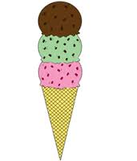
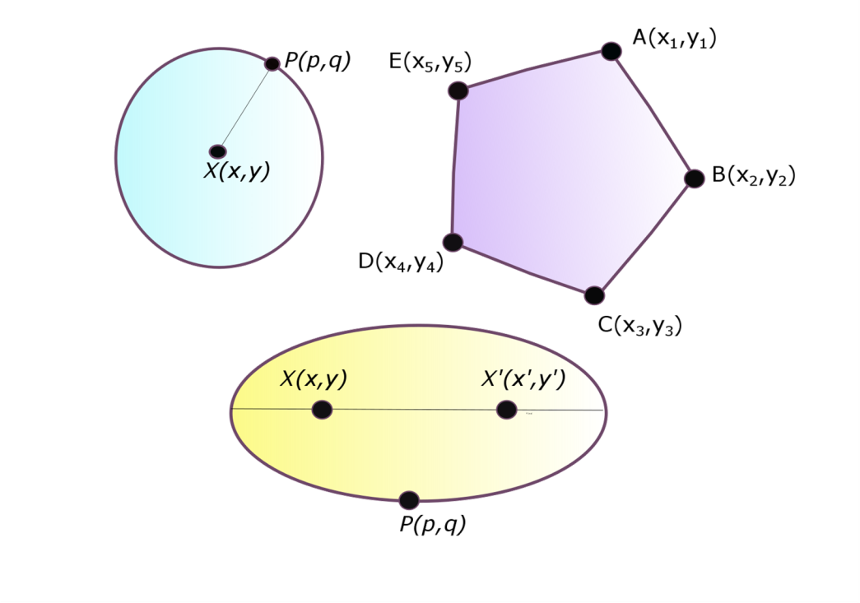
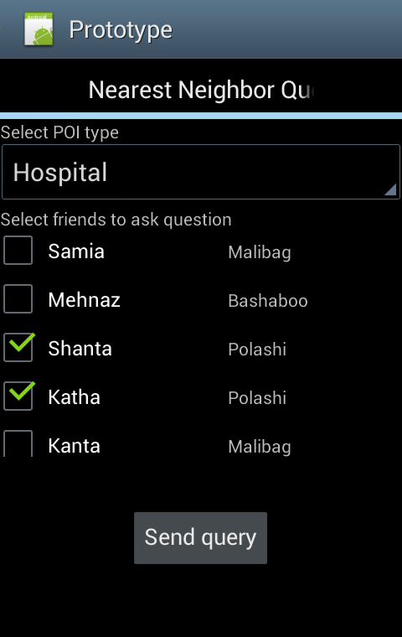
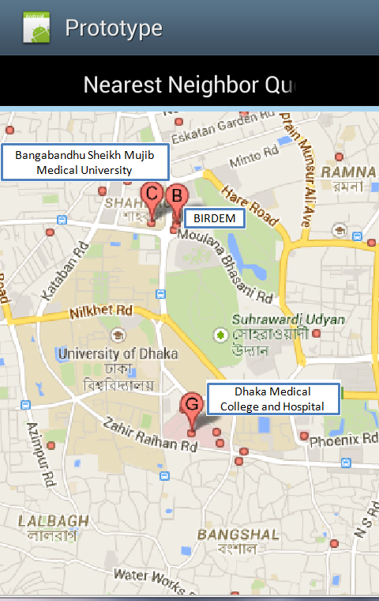
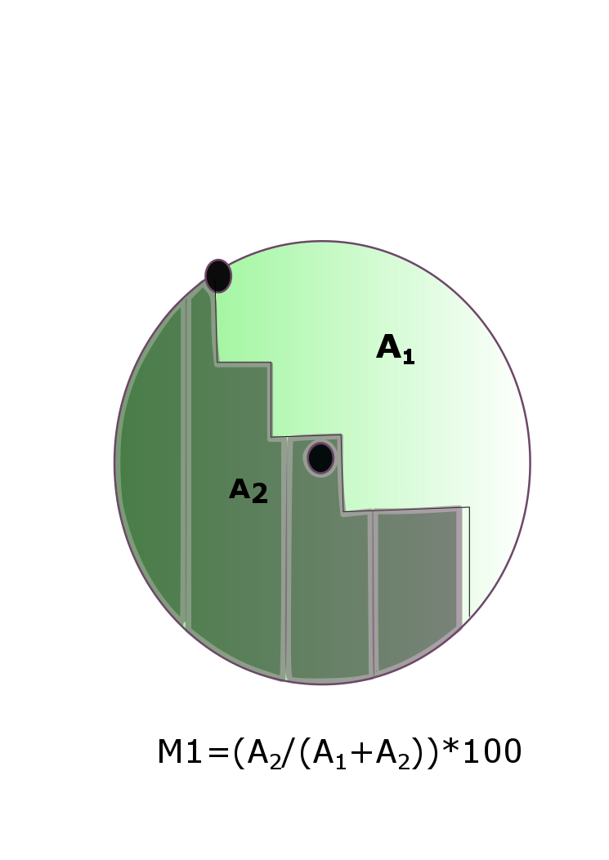
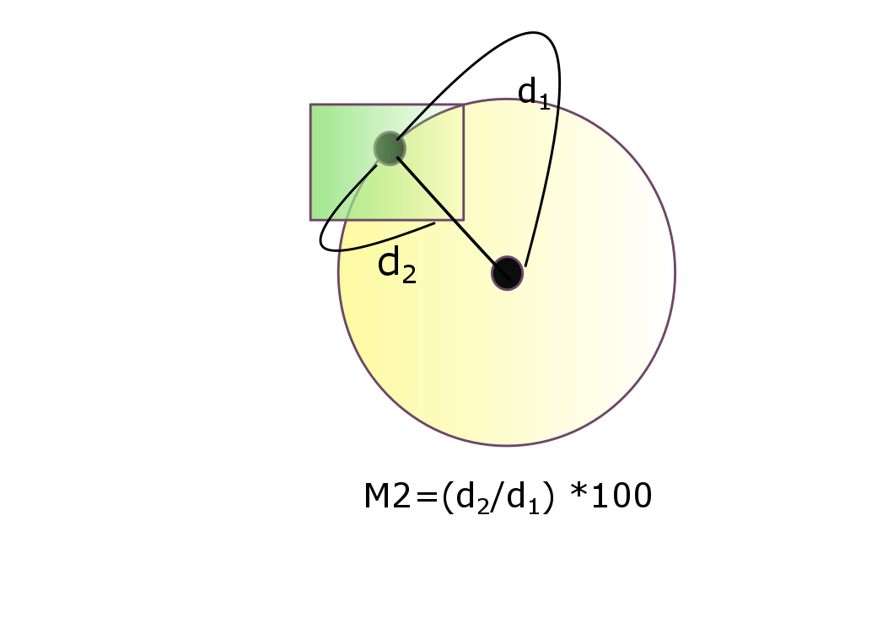

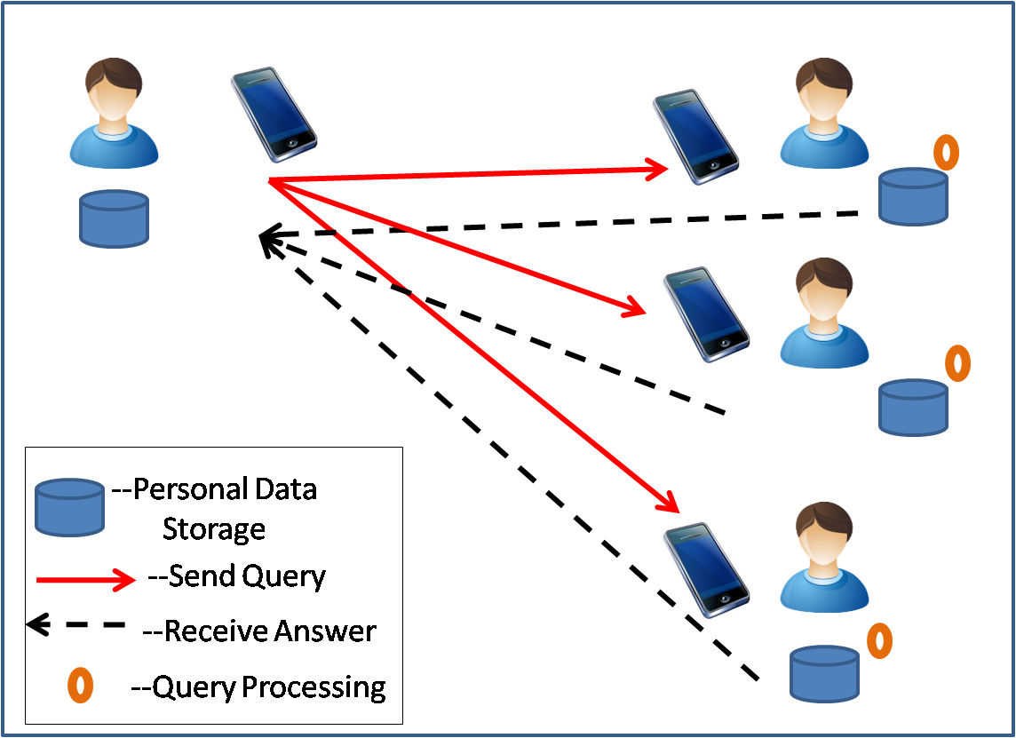

A Crowd-Enabled Approach for Efficient Processing of Nearest Neighbor Queries in Incomplete Databases
Samia Kabir, Mehnaz Tabassum Mahin
Nearest Neighbor Queries
Data Collection and Storage
I feel like having Ice Cream
Let’s ask my friends which is the nearest Ice-Cream parlor from here!
POI Information
Indexing
Users’ input about POIs
Shared information from a group of people
POI Tree : | R-Tree
Space Tree : | Quad-Tree
Space Information
Additional derived space information
Mapping into geometric properties
3 types of possible mapped region
--Known Region
--Unknown Region
--------------------------
Unit of Division
Objective
We present a crowd-enabled approach to eliminate the role of Location-based Service Provider (LSP) and evaluate Nearest Neighbor (NN) queries in real time with guaranteed confidence level where both data and computation are crowd-sourced.
Figure 2: Geometrical Mapping of user information
Figure 3: Quad Tree
Indexing
Query Processing
Uniqueness
Single User Processing
Aggregation
Limitations of traditional LSP
Our approach
A Nearest Neighbour query in two steps on POI- tree and Space-tree
Aggregation of query results from multiple users
Evaluation in own space tree
Determination of two types of measure
Reveals users’ personal information
Biased nature of LSP about nearest POIs
No awareness of a user’s choice and preference
Step 1: Query Processing on POI-Tree
Step 2: Query Processing on Space tree
BFS on the R-Tree
A priority Queue sorted by minimum distance of Minimum Bounded Rectangle (MBR) w.r.t. query point
Returns the nearest POI to Step 2
Finds a circle with center Q and radius |Q-P|
Q = query point
P = POI from Step1
Finds units of known space w.r.t. set of MBR,S
Returns {P,S}
Elimination of the role of LSP
A different indexing method to store POIs and space information for efficient NN queries evaluation
Two different measures for quality of answers
A result set, A = {P, M₁, M₂}
Research Challenges
System Prototype
Confidence Level
Existing approaches^{[1,2]} are based on the assumption that LSPs have complete space knowledge. But in crowd-enabled approaches, users have incomplete knowledge.
Lower bound of accuracy for query-answer
Figure 6: Calculating Confidence Level
How to evaluate NN queries with incomplete and distributed databases
Multiple queries like Group Nearest Neighbour or Range queries
Imprecise location information
Future Challenges
System Architecture
Conclusion
Figure 1:
System
Overview
And User
Interaction
Figure 4: Send query
Figure 5: Receive answer
We present the first crowd-enabled approach to process NN queries in incomplete databases. We introduce an indexing technique for POI and space information and provide the quality guarantee of query-answers.
Single user processing
Communication frequency = 2(n-1)
Evaluation
R-tree | O(Mlog_{M}n₁)
Quad-tree | O(n₂+h)
POI(point of interest) and space knowledge of user stored in personal devices
Every user processes NN queries on her local data storage.
The final result is evaluated from the aggregated knowledge.
n₁ = number of nodes in R-tree, n₂ = number of nodes in Quad-tree, h = height bound of quad-tree, M= the maximum number of entries of a node
References
Aggregation = O(N), where, N = ∑_{0<i<n} p_{i}, n = group size, p_{i} = number of POIs from user i
N. Roussopoulos, S. Kelley, and F. Vincent. Nearest
neighbor queries. In ACM SIGMOD International Conference,1995.
T. Hashem, M. E. Ali, L. Kulik, E. Tanin, and A. Quattrone. Protecting privacy for group nearest neighbor queries with crowdsourced data and computing. UbiComp, 2013.
Department of Computer Science and Engineering (CSE), BUET

