Slide 1

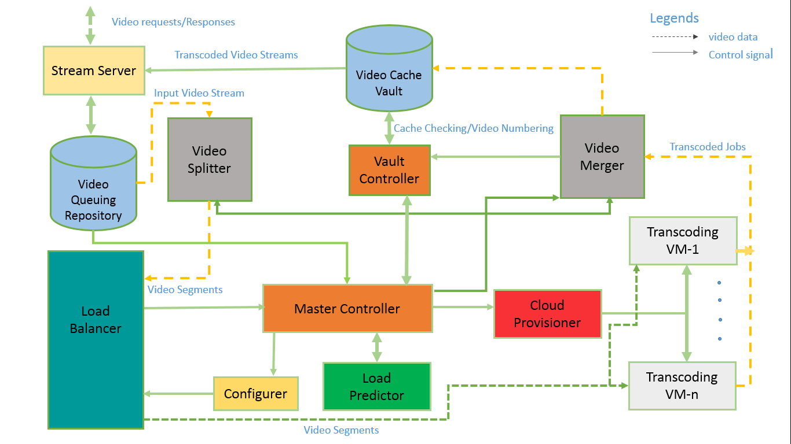

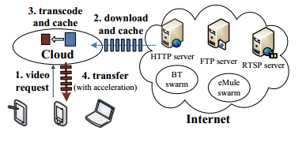
Dynamic Resource Provisioning for Video Transcoding in IaaS Cloud
Ashikee Ghosh, Md. Saiful Islam Bappi
Video transcoding is a computationally intensive operation. The approach is to provide a dynamic resource provisioning algorithm to scale video transcoding service on a given IaaS cloud.
Figure 1: Working principle of cloud transcoder
Fig: Working principle of cloud transcoding
Video transcoding for an on-demand video streaming service needs to be done on-the-fly in real-time. To use cloud resources efficiently during transcoding in IaaS cloud resources need to be allotted effectively to create some balance between transcoding latency & cost-efficiency. Our objective is to:
Provide a provisioning algorithm to allocate and deallocate VMs to a dynamically scalable cluster of video transcoding servers.
Simulate the provisioning algorithm for different scenarios and compare cost vs. performance ratios.
Fig2: System Architecture
Algorithm 2:
sum := 0
        for i := 1 to S_{Z}(R)
        sum := sum + L_{Q}(Qi)
        end for
        N_{v} := sum / n
It passes that number to Master controller.
VM Provisioning :
Redundant VMS get alert after every load check. HT_{VM}(vi) increases. After reaching certain number of alerts Master controller turns the VM off. Each time video repository reaches an upper limit new VMs are switched on.
Priority Check:
Priority value Pv(v_{i}) is assigned to each video stream v depended on requestor priority P_{R}(r_{i} ), waiting time W_{V}(v_{i}) . Video with higher priority M_{P} are assigned for transcoding.
Algorithm 1:
        for i := 1 to S_{Z}(R)
        P_{v}(v_{i}) := getPR(P_{R}(r_{i}), W_{V}(v_{i}) )
        end for
        Mp := max(Pv(v))
Cache Check:
Vault controller checks each video stream v_{i} is with unique id H(v_{i}) for cache availability of the stream. If video is found on cache, it is directly transferred to output stream. Cache value of the video C_{V}(H(V_{i}) is increased. Otherwise transferred for Load Balancer for assigning to VM.
Load prediction:
Load predictor predicts a probable number of VMs N_{v} need to be activated using values of recent repository queue lengths.
We’ll be using Cloudsim for creating and simulating virtual cloud. We have tested this framework for some sample environment. And it showed some promising result and it would be a perfect framework for our proposed algorithm.
Jokhio, F.; Ashraf, A.; Lafond, S.; Porres, I.; Lilius, J., "Prediction-Based Dynamic Resource Allocation for Video Transcoding in Cloud Computing," Parallel, Distributed and Network-Based Processing (PDP), 2013 21st Euromicro International Conference on , vol., no., pp.254,261, Feb. 27 2013-March 1 2013
2. Rui Cheng; Wenjun Wu; Yihua Lou; Yongquan Chen, "A Cloud-Based Transcoding Framework for Real-Time Mobile Video Conferencing System," Mobile Cloud Computing, Services, and Engineering (MobileCloud), 2014 2nd IEEE International Conference on , vol., no., pp.236,245, 8-11 April 2014
Department of Computer Science and Engineering (CSE), BUET

