Slide 1

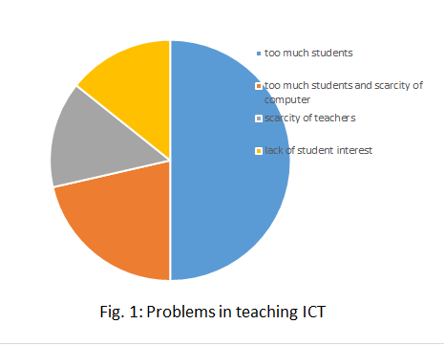
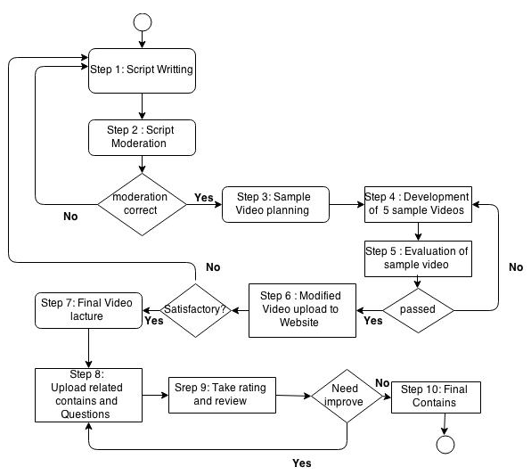
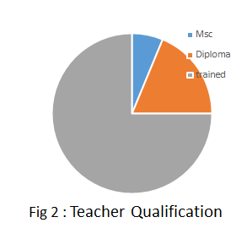
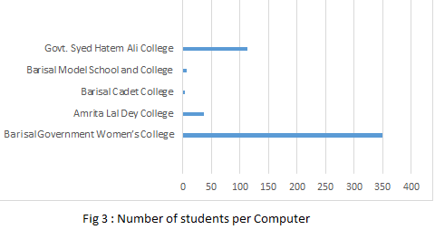
E-Learning of ICT Course in Higher Secondary Level
Dipu Sarkar, Shourav Nath
Problem Definition
Methodology(Contd.)
According to the National Curriculum coordination Committee of the Ministry of Education, from 2013-14 Information and Communication Technology(ICT) subject has been incorporated in the curriculum which is mandatory for students in all of the six branches.
As this subject has been introduced too recently, it is a huge challenge for the government to make all of the college teachers well trained all over Bangladesh.
To the students, it is a very new phenomenon. In the rural areas of Bangladesh the things are more complicated. The students have no idea of modern technologies. So in this case it will be more difficult to teach them.
The videos those will be uploaded to a interactive user-friendly website and the teachers can upload exam questions and the students can download the materials.
The website will include a discussion board of the teachers and the students where the students can ask any question about the topic.
The video lectures will be given rating and ranking based on this rating. The teachers will be able to make good video watching most popular videos.
Implementation
Analyzed the course topics and chose some sample topics to cover
Made script for video lectures on sample topics
Moderated the script
Made several videos on same topic in several ways
Analyze the ways to make more interactive and easy-to-grab e-learning videos
Objective
To develop effective e-learning content based ICT course of Hsc level to train the teachers and introduce them with ICT subject easily, and
Let the students of Higher Secondary level earn in depth knowledge about ICT and importance of this subject in this modern era interactively, reach the greater number of population efficiently through e-Learning.
Result and Discussion
We visualized some selected problems based on data collected from several colleges. In fig 1 there are the problems of teaching ICT education identified by the teachers.
In fig 2 it is the picture of the qualification of the ICT teachers. In fig 3 it is the picture of the ratio of the students and computer in several colleges.
Methodology
Conclusion
• In this thesis, we have analyzed the ICT course in details as per curriculum.
• The problems of the existing situation regarding students, teachers and infrastructure have been studied and evaluated as shown in result and discussion.
• Sample lectures, videos has been developed and evaluated
• Based on the sample, we shall develop the full e-learning content.
Department of Computer Science and Engineering (CSE), BUET

