Slide 1

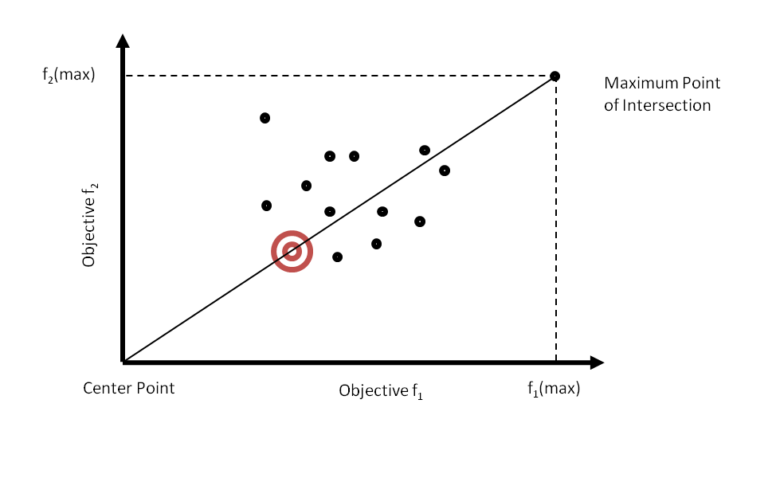
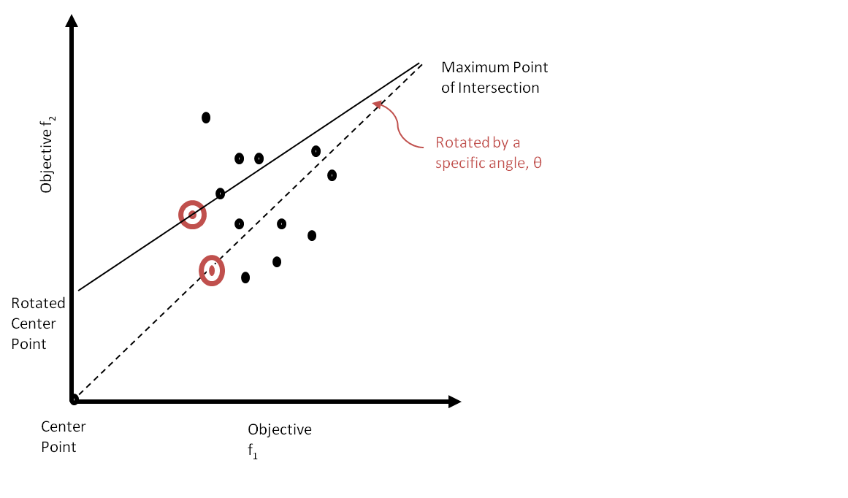
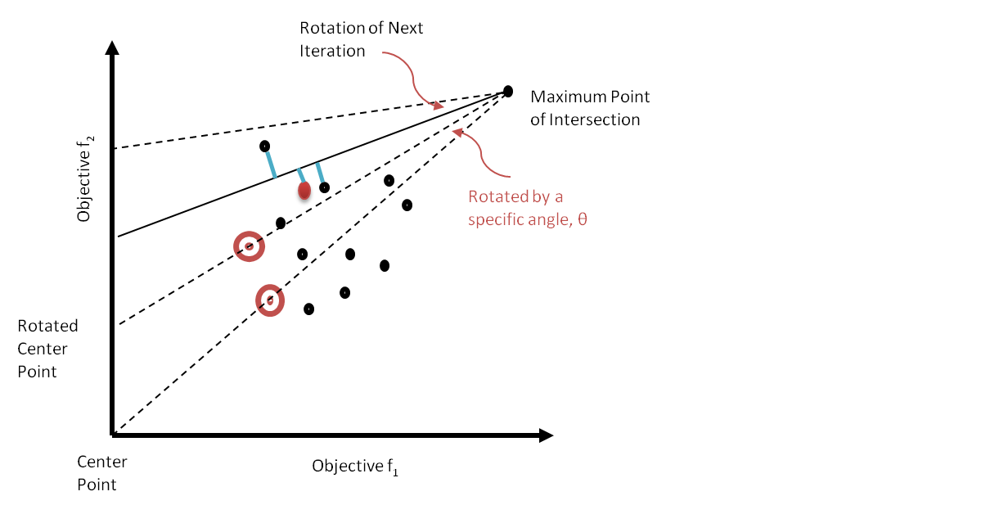
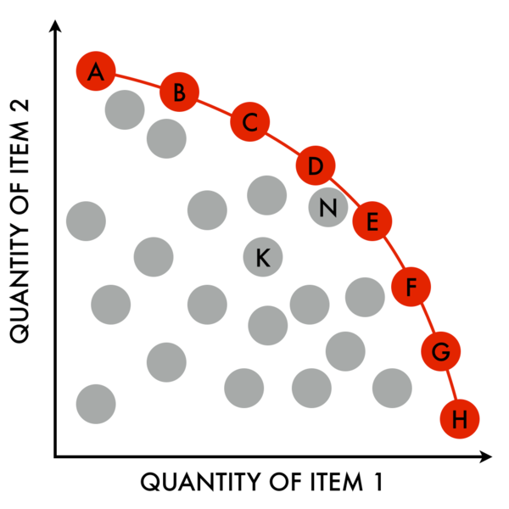
A New Algorithm for Solving Many-objective Optimization Problem
Md. Shihabul Islam (0905115) and Bashiul Alam Sabab (0905117)
Problem Definition
Most current state-of-the-art Evolutionary Multi-objective Optimization (EMO) algorithms, such as NSGA II, SPEA2 and MOEA/D perform well on problems with two or three objectives. But they encounter difficulties in their scalability to Many-objective Optimization Problems (problems with more than three objectives).
Fig. 2: Initial iteration; taking the solution which lies on the straight line between the maximum point of intersection and the center point
Objective
Propose a new algorithm for solving Many-objective Optimization Problems that will ensure fast convergence and high degree of diversity of non-dominated solutions.
Evolutionary Multi-objective Optimization
Evolutionary Multi-objective Optimization (EMO): Involves a number of objective functions which are to be either minimized or maximized. General form: Maximize/Minimize: f_{m}(x), m = 1, 2, …, M; Subject to: g_{j}(x) ≥ 0, j = 1, 2, …, J; h_{k}(x) = 0, k = 1, 2, …, K; x^{(L)}_{i} ≤ x_{i} ≤ x^{(U)}_{i}, i = 1, 2, …, n; Where, ‘x’ is a vector of decision variables: x = (x₁, x₂, …, x_{n})^{T} and each decision variable, x_{i} ∈ R is bounded by the lower bound x^{(L)}_{i} and upper bound x^{(U)}_{i} which constitute the decision variable space, ‘m’ is the number of objectives. Solutions satisfying inequality J and equality K constraints are feasible and belong to the feasible part of the decision space Many-objective Optimization: When, the number of objectives, m ≥ 3, the problem is called a Many-objective Optimization Problem (MaOP). Domination: A solution x⁽¹⁾ is said to dominate another solution x⁽²⁾ , if both the following conditions are true: i) x⁽¹⁾ is no worse than x⁽²⁾ in all objectives. ii) x⁽¹⁾ is strictly better than x⁽²⁾ in at least one objective. Pareto-optimality: Pareto-optimal set is the non-dominated set of the entire feasible search space. The image of the set of Pareto efficient solutions is called Pareto-front.
Fig. 3: New position of the center point after rotation of the straight line by an angle, θ
Fig. 4: Iteration for the situation where no solution lies on the straight line
Flow-chart of the Algorithm
Generate Initial Population (P_{t}) of Size N
Generate Report
Fig. 1: The connected line of red points represents the Pareto-front
Yes
Selection Recombination Mutation
Reached Targeted Iteration Number?
Failure of EMO Algorithms for Solving MaOP
Almost all solutions in current population become non-dominated in early generations. Hence, Pareto dominance-based fitness evaluation cannot generate a strong selection pressure which is necessary to drive the population to the Pareto front. Convergence improvement often causes a decrease in the diversity of the non-dominated solutions. As a result, the search ability of Pareto dominance-based EMO algorithms is severely deteriorated.
Generate Offspring (Q_{t}) of Size N
No
Total Population:
R_{t} = P_{t} + Q_{t,} of Size 2N
Apply Our Mechanism to Select |N- P_{t+1}| Solutions from the Front and Add it to P_{t+1} (size N)
Sort R_{t} According to Non-domination Fronts (F₁,F₂ and so on… )
Our Method
Step 1: In each generation, calculate the maximum point of intersection by taking the maximum value of each of the objectives (Fig. 2). Step 2: Connect the maximum point of intersection and the center point provided by the decision maker to get a straight line (Fig. 2). Step 3: Find out the solution which lies on the straight line. If there are multiple solutions, then take the one nearest to the center point (Fig. 2). Step 4: Now, rotate the straight line with respect to the maximum point of intersection by a predefined angle, θ provided by the decision maker. The rotation process has to be executed on both clock-wise and anti-clock-wise direction. The maximum rotation limit will be the boundary specified by the maximum points of the objectives (Fig. 3). Step 5: If no solutions lie on the straight line of i^{th} iteration, at first draw the rotation of (i+1)^{th} iteration. As a result, a triangle will be formed using the lines of (i-1)^{th} and (i+1)^{th} iteration. Now, calculate the straight line distance between the solutions lying in the triangle region to the straight line of i^{th} iteration. The solution with the minimum straight line distance will be the desired solution of this step. In case the (i+1)^{th} iteration crosses the boundary line, the boundary line has to be counted instead (Fig 4).
No
Add Front to Next Generation of Population, P_{t+1}
Yes
If |N- P_{t+1}| > 0 and |N- P_{t+1}| > F_{Next}
Conclusion
Our proposed algorithm can work well ensuring fast convergence and high degree of diversity of non-dominated solutions. Our future challenge will be to test the algorithm in cases of high dimensionalities & compare its performance with the existing state-of-the-art MaOP algorithms.
References
[1] K. Deb, “Multi-Objective Optimization Using Evolutionary Algorithms: An Introduction”, Multi-objective Evolutionary Optimisation for Product Design and Manufacturing, pp. 3-34, 2011. [2] K. Deb, H. Jain, “An Evolutionary Many-Objective Optimization Algorithm Using Reference-Point-Based Non-dominated Sorting Approach, Part I: Solving Problems With Box Constraints”, IEEE Transactions on Evolutionary Computation, vol: 18, issue: 4, pp. 577-601, 2013.
Department of Computer Science and Engineering (CSE), BUET

