Slide 1
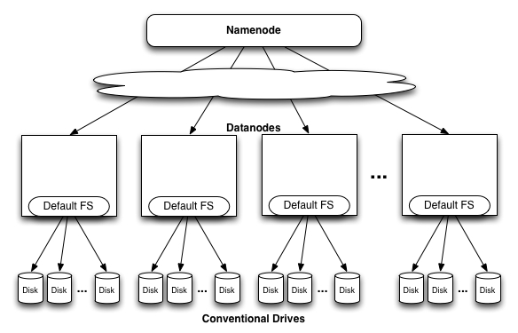
Wireless Sensor Network Integretion
With Cloud Computing
H.M.A Alam, Amit Biswas
Department of Computer Science and Engineering,
Bangladesh University of Engineering and Technology, Dhaka, Bangladesh
I. Introduction
IV. Some DFS Services
Cloud computing is a practice of using a network of remote servers hosted on the Internet to store, manage, and process data, rather than a local server or a personal computer.
Several types of cloud service available
    Software as a service (SaaS)
    Platform as a service (PaaS)
    Infrastructure as a service (SaaS)
A wireless sensor network (WSN) (sometimes called a wireless sensor and actor network (WSAN)) are spatially distributed autonomous sensors to monitor physical or environmental conditions.
Wireless sensor network send huge amount of data. This can not be handled in traditional way.
Nimbits
Nimbits Run on Google App Engine platform. Nimbits server can also be installed on any J2EE server like Apache,Tomcat,Jetty,WebSphere or JBOSS running on Amazon EC2,our servers or even a Raspberry Pi.
Nimbits is an Open Source Java Library that provides an easy way to
develop JAVA, Web and Android solutions that use a Nimbits Server as
a backend platform.
Nimbits Server records and processes geo and time stamped data and
executes rules we define based on that information.
Hadoop
Hadoop is a free, Java-based programming framework that supports the processing of large data sets in a distributed computing environment. The Apache Hadoop project develops open-source software for reliable, scalable, distributed computing.
Hadoop DFS provides high throughput access to application data.
Hadoop Yarn is a framework for job scheduling and cluster management.
Hadoop Map Reduce is Yarn based system for parallel processing of large data set.
II. Objective
  Scalable
  Secure
  Fast
  Possible to interface with computers
VI.HDFS(Hadoop Distributed File System)
III. Background
Data is organized into les and directories.
Files are divided into uniform sized blocks (default 64MB) and distributed across cluster nodes.
Blocks are replicated (default 3) to handle hardware failure.
Replication for performance and fault tolerance (Rack-Aware placement).
HDFS keeps checksums of data for corruption detection and recovery.
  Sensors from wireless sensor network send data in almost every 5 second. If the number of sensor is high, the amount of data received at server will be huge.
  We are not sure about how many space needed for storing sensor data. Cloud service can be a good solution .
  Cloud Computing reduces capital costs. There’s no need to spend big money on hardware, software or licensing fees.
  Processing this amount of data in one machine can be costly. So we use distributed file system. Some distributed file systems support scaling from one pc to thousands.
VI.Goal
V. Challenges of WSN
Main advantage of Hadoop is that, it is open source. So we can study it’s code. We are currently studying about Hadoop open source code, configuration and sensor network simultaneously. As sensor network send data at a high rate, a huge amount of data has to be analyzed. Which is quite impossible to do with normal machine. We have to use
Hadoop. In the next few week we will try to and some ways to improve the performance and also see security of Hadoop closely to look for any error. We can also use Hadoop Map Reduce to do a job with big data.
Ad hoc deployment , requiring that the system identities and copes with the resulting distribution and connectivity of nodes.
Dynamic environmental conditions requiring the system to adapt over time to changing connectivity and system stimuli.
Unattended operation requiring configuration and reconfiguration be automatic (self-configuration).
WSN deal with real world environments. In many cases, sensor data must
be delivered within time constraints so that appropriate observations can
be made or actions taken.
WSN are limited in their energy, computation, and communication capabilities.
Undergraduate Poster Presentation
Match 31, 2015
Department of CSE, BUET, Dhaka, Bangladesh

