Slide 1


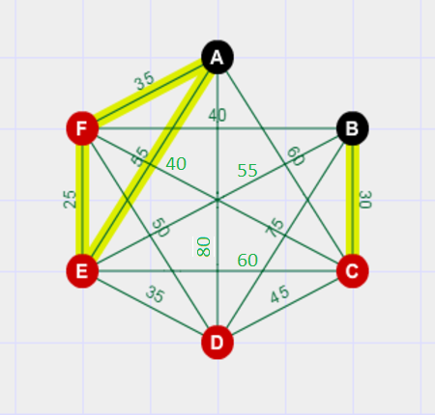
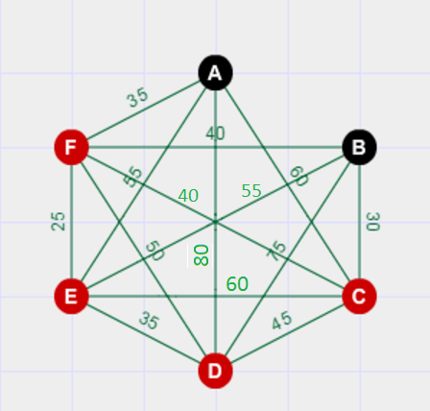
Analyzing Planning Domains For Task Decomposition
AHM Modasser Billah(0905034), Raju Ahmed(0905051)
Motivation:
Planning involves an explicit deliberation process that chooses and organizes actions by anticipating their outcomes. It aims at achieving some pre-stated objectives. Planning, similarly to many other computational problems, suffers from the curse of combinatorial explosion. Decomposition of the problem into simpler, possibly independent sub-problems can be a powerful technique to solve planning problems. We are analyzing various planning domains to discover certain characteristics that enable us to decompose planning problems.
Example Domain:
The Travelling Purchaser Problem (TPP) is a generalization of the Travelling Salesman Problem. It is defined as follows: we have a set of products and a set of markets. Each market can provide a limited amount of each product at a known price. The TPP consists in selecting a subset of markets such that a given demand for each product can be purchased, minimizing the combined traveling and purchasing cost.
Figure-1: A sample problem in TPP Domain
Steps of Analysis:
Finding Tasks, Goal Tasks and Required Objects for Tasks:
1.Task-1: Purchasing required products from markets.
2.Goal Tasks: The goal is to minimize total travelling and purchasing cost to meet the demand of products.
3.Required Objects: Truck, Product, Market.
2. Identifying which required object can be used for decomposition:
Here we have three objects in our sample domain which may be used to decompose the problem namely trucks, products and markets.
We can assign different trucks to purchase and return products from different markets to complete our goal task.
So, the problem can be decomposed into smaller sub-problems using the truck object.
3. Grouping of objects into sub-problems around the selected object for decomposition:
A decomposition for the problem at hand is illustrated below:
Figure-2: A sample decomposition of the problem at hand
The assignments of markets to trucks and amount of products to be bought from each market is shown in the figure.
The assignment was chosen in a way so that we can minimize the travelling and purchasing cost while purchasing the required amounts of all the products.
Conclusion:
In this thesis, the performance improvement of the proposed decomposition approach is being studied for various benchmark planning problem domains. Decomposition is generally beneficial, but aggressive decomposition can lead to poor quality solution.
 | Q* | B**
P1 | 40 | 30
P2 | 35 | 35
P3 | 45 | 45
C
200
235
75
T1
Required Quantity
T2
Product | Quantity
P1 | 110
P2 | 80
P3 | 90
 | Q | B
P1 | 30 | 30
P2 | 40 | 15
P3 | 30 | 30
C
180
250
60
 | Q | B
P1 | 50 | 50
P2 | 30 | 30
P3 | 50 | 15
C
150
220
90
 | Q* | C**
P1 | 40 | 200
P2 | 35 | 235
P3 | 45 | 75
T1
Required Quantity
 | Q | B
P1 | 50 | 0
P2 | 40 | 0
P3 | 45 | 0
C
220
300
105
T2
Product | Quantity
P1 | 110
P2 | 80
P3 | 90
Market
Depot
*Quantity
** Bought Amount
 | Q | C
P1 | 30 | 180
P2 | 40 | 250
P3 | 30 | 60
 | Q | C
P1 | 50 | 150
P2 | 30 | 220
P3 | 50 | 90
 | Q | C
P1 | 50 | 220
P2 | 40 | 300
P3 | 45 | 105
Market
*Quantity
** Cost/Unit
Depot
Department of Computer Science and Engineering (CSE), BUET

