Slide 1

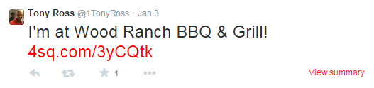

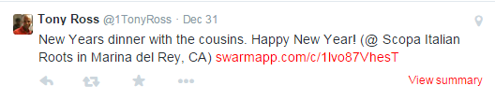
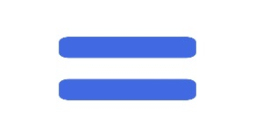

Can We Predict Eat Out Behavior of a Person from Tweets and Check-ins?
Md. Taksir Hasan Majumder (0905002) Md. Mahabur Rahman (0905093)
Problem Definition
Outcome
Social network platforms such as Twitter or Facebook are used by millions of people for expressing their opinions, interests, emotions, etc. At the same time, a location based social network such as Foursquare is becoming a popular tool for users to publish their visited places through check-ins. These tweets and check-ins information reveal different habits and characteristics of a person. In this project, we will investigate whether we can predict a person's eat out behavior from his tweets and check-ins.
The following chart shows some sample data of Twitter users showing their frequency of availing themselves to Cheap, Moderate, Expensive and Very Expensive types of places based on cost.
The following table shows LIWC category having significant correlation with the restaurant categories. ( * signifies p<0.05 and ** signifies p<0.01 )
Restaurant Category | LIWC Category | Std. Coefficient | Sig level | R-square | Adjusted R-square
Cheap | Unique | -1.7 | ** | 0.275 | 0.236
 | Sixltr | -1.4473 | **
 | Posemo | -3.8677 | *
Moderate | Swear | 32.5291 | * | 0.124 | 0.094
 | Work | -5.781 | *
Expensive | Unique | 1.3548 | ** | 0.488 | 0.451
 | We | 31.7238 | **
 | Anger | -17.5301 | *
 | Money | 7.814 | *
Very Expensive | WC | -0.0001 | * | 0.334 | 0.298
 | Unique | 0.3662 | **
 | Sixltr | 0.4858 | **
Objective
Predicting where a person is most likely to eat out based on his/her tweets from Twitter and check-ins from Foursquare.
Our Approach
Find Suitable Twitter Users
Observation
Fetch User Tweets
“Cheap” category :
Positive motivation has strong negative correlation.
Small words also have strong negative correlation.
“Moderate” category :
Less work means more visit to moderate places.
“Swear” type words imply preference to moderate category.
“Expensive” category :
Unique and social words correlate strongly.
Money related tweets correlate strongly too.
“Very Expensive” category :
Strong correlation with unique and bigger words.
More tweets than any other categories.
Parse Check-in Tweets
Store Information
Figure 1: Data collection
Apply LIWC Analysis on Data
Conclusion
Find Correlation of Attributes
We have strong adjusted R-square values for cheap, expensive and very expensive category, which imply we can predict almost accurately if a person is likely to visit such places. Despite moderate category having a poor adjusted R-square value, we can indirectly predict it accurately by observing the values for other three categories. Therefore, our model can accurately judge where a person is most likely to eat out.
Apply Linear Regression Analysis
Check Strength of the Model
Future Work
Figure 2: Data analysis
Can we predict suitability of a new restaurant service based on local twitter users’ tweets ?
Can we predict the financial conditions of a person from his tweets with survey as basis for ground truth ?
Department of Computer Science and Engineering (CSE), BUET

