Slide 1

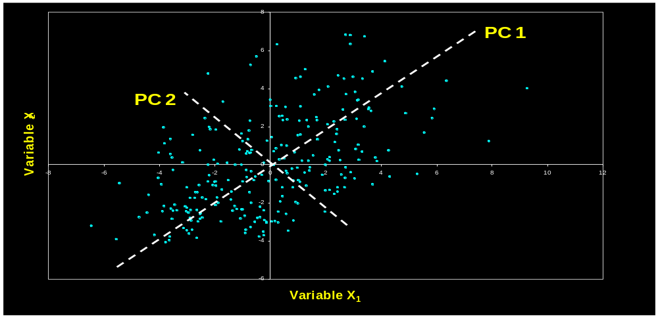
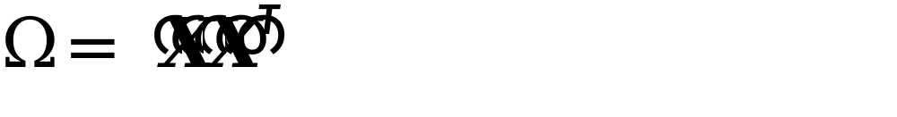



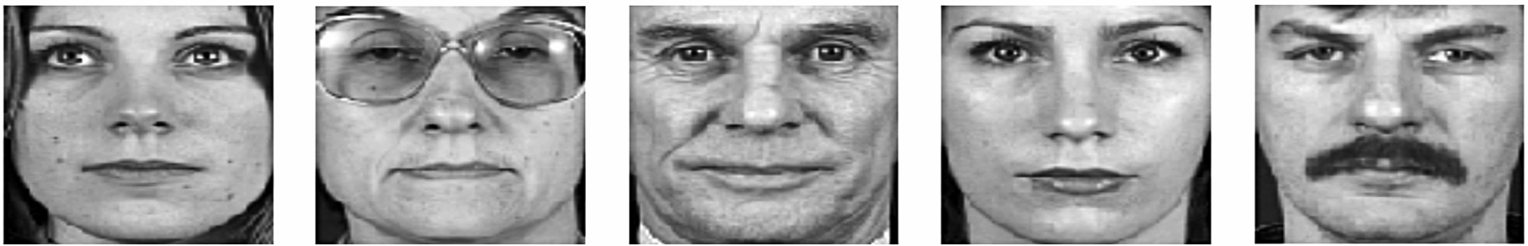
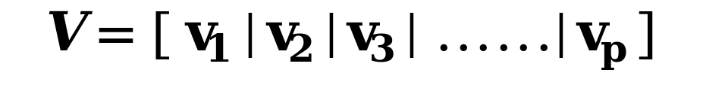


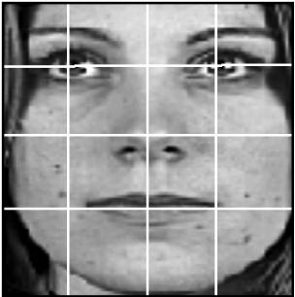
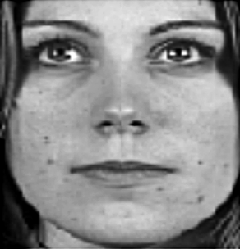
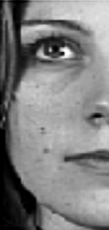
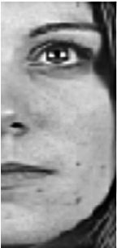
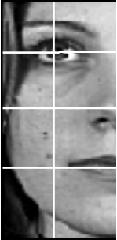







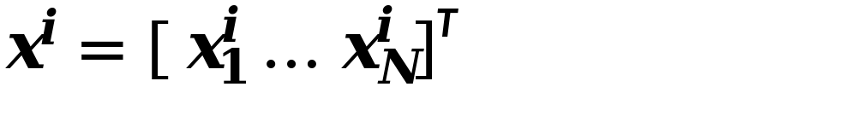


An Approach to Face Recognition System
Using Principal Component Analysis (PCA)
Fattah Muhammad Tahabi, Ratul Antik Das
Motivation
Step-4 : Calculate covariance matrix
The data matrix X is multiplied by its transpose to calculate the covariance matrix.
Step-5 :Compute the eigenvalues and eigenvectors
The eigenvalues and corresponding eigenvectors are computed for the covariance matrix.
here V is the set of eigenvectors associated with the eigenvalues
Step-6 :Order eigenvectors
Order the eigenvectors according to their corresponding eigenvalues from high to low. Keep only the eigenvectors associated with non-zero eigenvalues. This matrix of eigenvectors is the eigenspace V , where each column of V is an eigenvector.
Step-7 : Project training image
Each of the centered training images ( ) is projected into the eigenspace. To project an image into the eigenspace, calculate the dot product of the image with each of the ordered eigenvectors.
Therefore, the dot product of the image and the first eigenvector will be the first value in the new vector. The new vector of the projected image will contain as many values as eigenvectors.
Step-8 : Identify test images
Each test image is first mean centered by subtracting the mean image, and is then projected into the same eigenspace defined by V .
and
The projected test image is compared to every projected training image and the training image that is found to be closest to the test image is used to identify the training image. The images can be compared using any number of similarity measures; the most common is the L₂ norm or euclidean distance.
Face recognition has attracted significant attention in the past decades because of its potential applications in biometrics, information security, and law enforcement. Many methods have been suggested to recognize faces.
PCA has been widely investigated and has become one of the most popular face-recognition approaches.
Objective
Working on principal component analysis approach.
Trying to enhance the capability of PCA for semi frontal face image
Input
Image
Face
Detection
Feature
Extraction
Face Recognition
Identification/ Verification
Limitations of PCA
Can not detect non-frontal image.
Can not detect if sunglasses or any object that prevents getting
face information.
Not applicable to noisy image.
Methodology
Training Database
Step 1 : In general approach of PCA, each image is divided into nxn blocks or pixels. Then all pixel values are taken into a single one dimensional matrix. Showed in figure:1
Figure : 1 Figure : 2
Our proposal here is that if we find half image of actual image, we divide each test image and then convert to single column matrix. Afterwards, general PCA will be applied.
Step-2 : Center data
The images are mean centered by subtracting the mean image from each image vector.
Step-3 : Create data matrix
These vectors are combined, side-by-side, to create a data matrix of size NxP (where P is the number of images).
, where
References
, where
[1] Belhumeur P., Hespanha J., and Kriegman D. (1997), Eigenfaces vs. Fisherfaces: Recognition Using Class Specific Linear Projection, IEEE Trans. PAMI, 19(7):711-720.
[2]Jim Austin, Thomas Heseltine, Nick Pears and Zezhi Chen, “Face recognition: A comparison of appearance-based approaches”, ACA Group, Deptt. of Computer Science, University of York, 2003.
Department of Computer Science and Engineering (CSE), BUET

